Slide 1
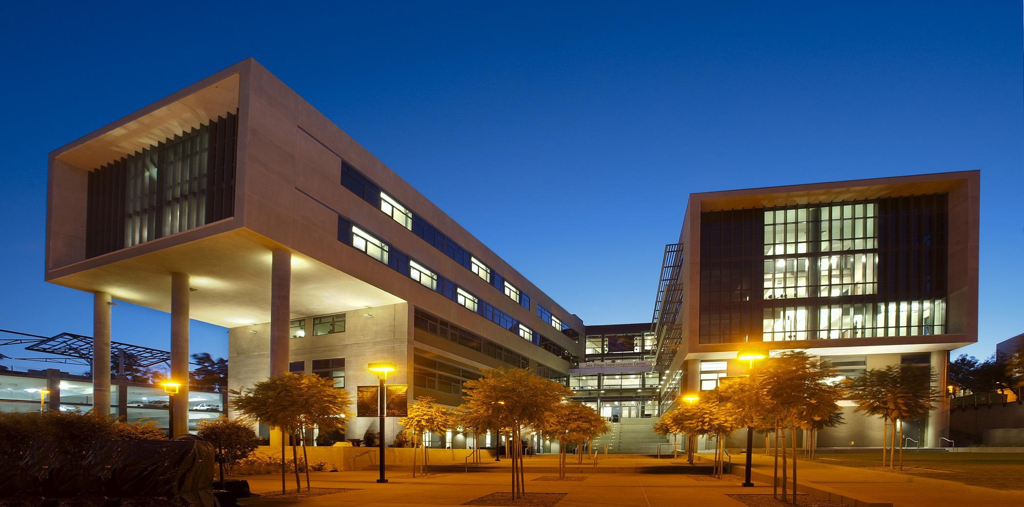
Status of the National Research Platform (NRP)
6NRP Meeting, January 29th , 2025
Frank Wuerthwein
Director
San Diego Supercomputer Center

Slide 2
6NRP has three themes this year
AI Education on NRP
Domain Specific architectures to address scaling beyond Moore’s Law
… and we are trying something new this year:
  Facilitate a domain science to expand into the AI Education curriculum
  => We chose “Fusion Energy” as the domain science for this year

Slide 3
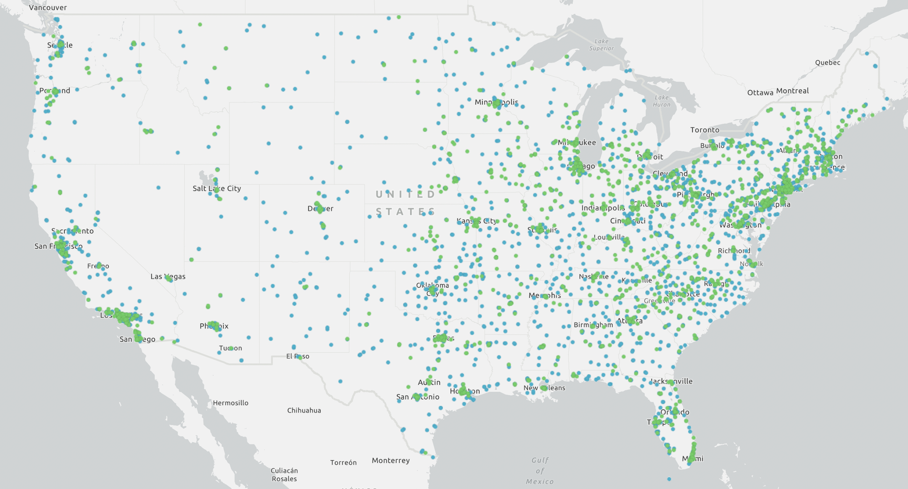
3900 accredited institutions of higher learning
Only 146 of these institutions are classified as R1
=> for most institutions their primary focus is on education
https://nces.ed.gov/ipeds/collegemap/#

Slide 4

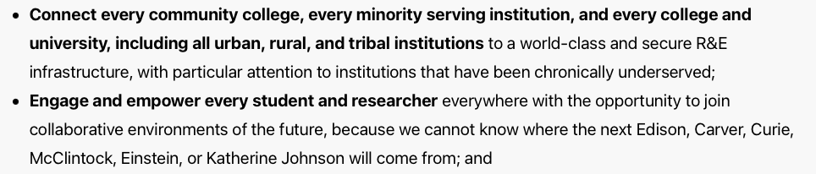
Motivation for our Vision
https://mindsweneed.org

Slide 5
Long Term Vision
Create an Open National Cyberinfrastructure that allows the federation of CI at all ~4,000 accredited, degree granting higher education institutions, non-profit research institutions, and national laboratories.
    Open Science
    Open Data
    Open Source
    Open Infrastructure
Open Compute
Open Storage & CDN
Open devices/instruments/IoT, …?
  Openness for an Open Society

Slide 6
Community vs Funded Projects
Lot’s of funded projects that
contribute to this shared
vision in different ways.
Funded projects
Community with
Shared Vision
PNRP provides core services for the
National Research Platform Community
Open Infrastructure is “owned” and “built”
by the community for the community

Slide 7
National Research Platform
How do we execute on this vision?

Slide 8
The NRP Strategy for growth
Exploit existing social networks to engage colleges
  The Regional Research & Education Networks play a crucial role in that they are already engaged with the colleges in their regions, and with each other via the Quilt
Exploit an ongoing transformation of higher education towards increasing use of data & compute as essential part of classroom education.
  AI is an accelerant of a transformation that preceded ChatGPT
Reduce TCO of compute & data infrastructure for colleges
  We provide scalable remote system administration, user support, and training
  Lean into the CC* program by the NSF to bring AI hardware to places that never had such capabilities before.
As we solve the AI education TCO pain point for colleges, we advance their research capabilities as a desired side-effect

Slide 9
2M students enrolled
~10% of US college students
See next talk for details on
CENIC AIR

Slide 10
Flexible Architecture to build on horizontally & vertically
Depending on effort available and control desired, you can built on NRP both vertically and horizontally at different layers of the stack.
Federate your existing batch and storage cluster via OSG/PATh
OSG/PATh
Federate your existing Kubernetes infrastructure, including commercial cloud
HTCondor
SLURM
Admiralty
Join & build on the existing NRP Kubernetes infrastructure
Kubernetes
IPMI, Firmware, BIOS
Have the NSF funded PNRP project operate your hardware via IPMI
Hardware

Slide 11
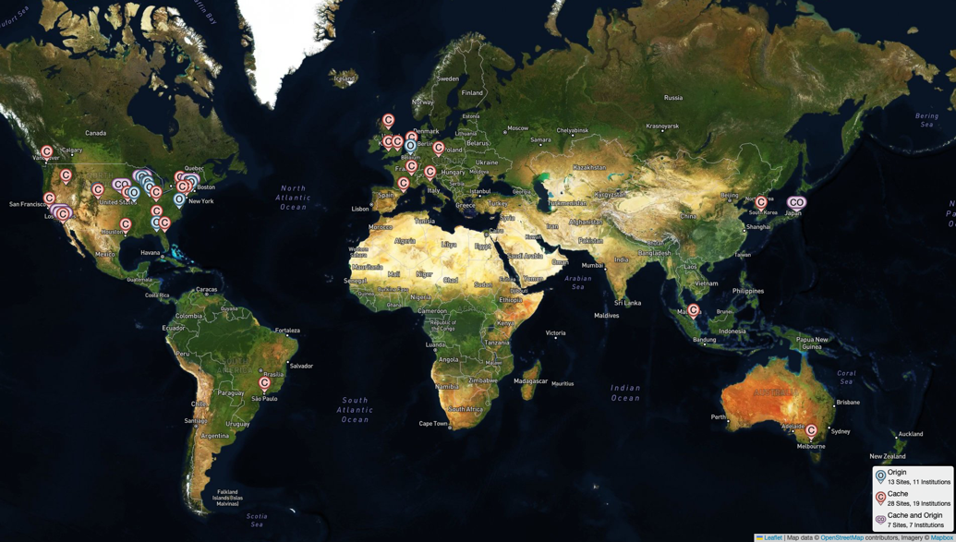
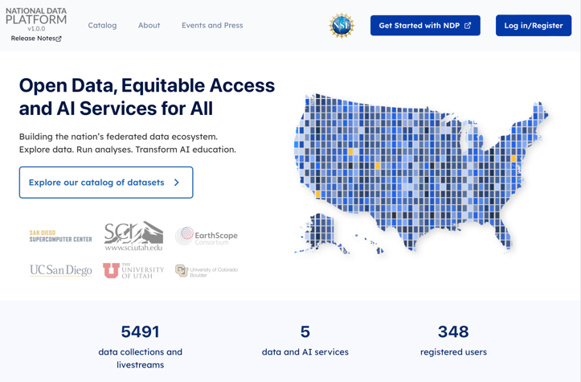
Example Vertical Extensions of NRP
Open Science Data Federation
is a Data Access Network
“Any Data, Anytime, Anywhere”
Federated Metadata Cataloguing on top of OSDF
See more details tomorrow 3:30-4pm
35 caches at 28 institutions across 4 continents
20 data repositories across 18 institutions
More details at 11am today
162PB of data accessed in 2024

Slide 12
Status of NRP in January 2025

Slide 13
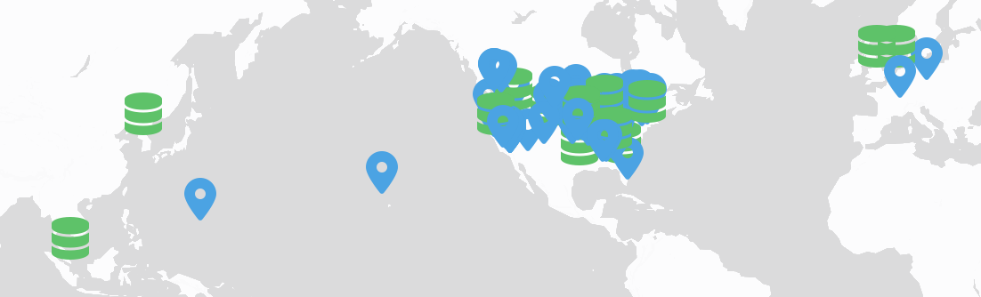
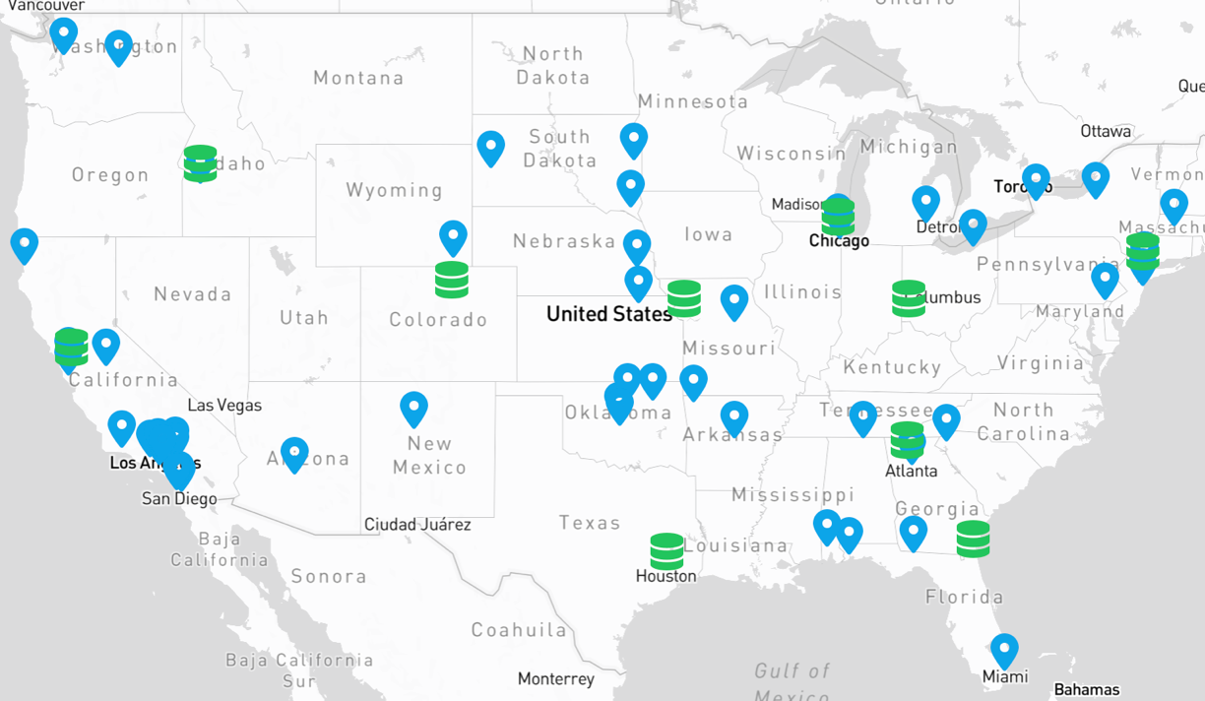
425 Nodes of hardware at
72 organizations
6 international
21 network POPs
45 US colleges

Slide 14
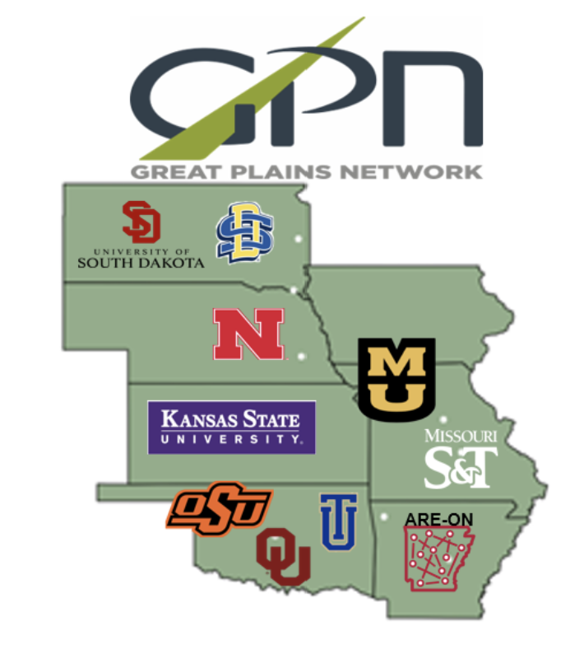
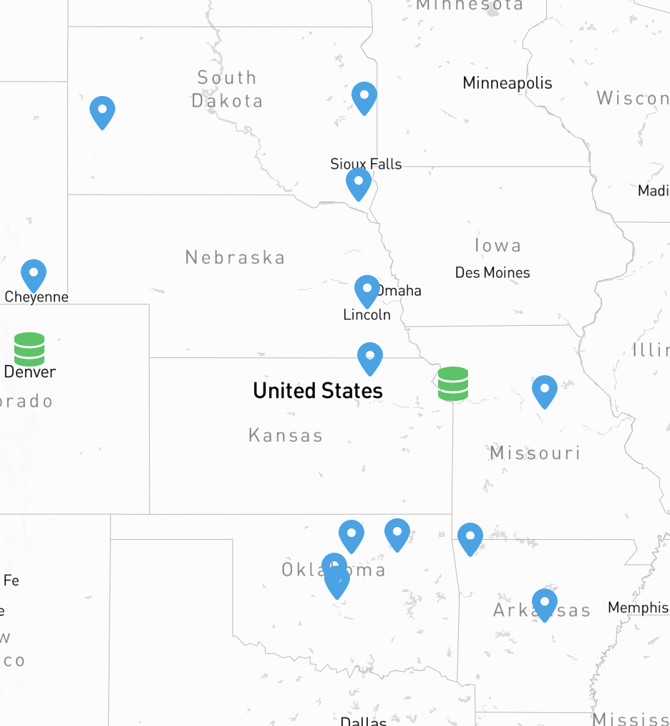
NRP includes hardware at
a dozen colleges in the
Great Plains Network
More details this afternoon

Slide 15
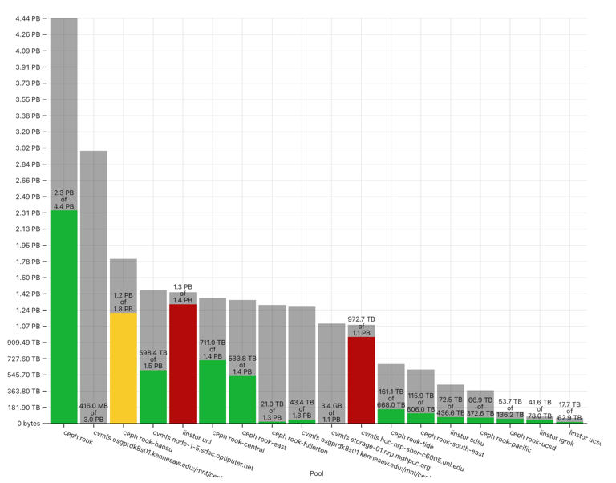
The Resources Available on NRP
Type of Accelerator | # of that type in NRP
A10 | 288
3090 | 258
2080TI | 180
1080TI | 132
A100 | 148
L4 | 96
L40 | 68
A6000 | 49
Type of Accelerator | # of that type in NRP
V100 | 42
A4000 | 32
4090 | 26
Other GPUs | 148
Total GPUs | 1466
Xilinx U55C | 32
Intel Stratix 10MX | 24
Qualcom AI100 | 8
22 PB of storage
In addition, there are 11,057 x86 CPU cores,
in nodes that have no accelerators.

Slide 16
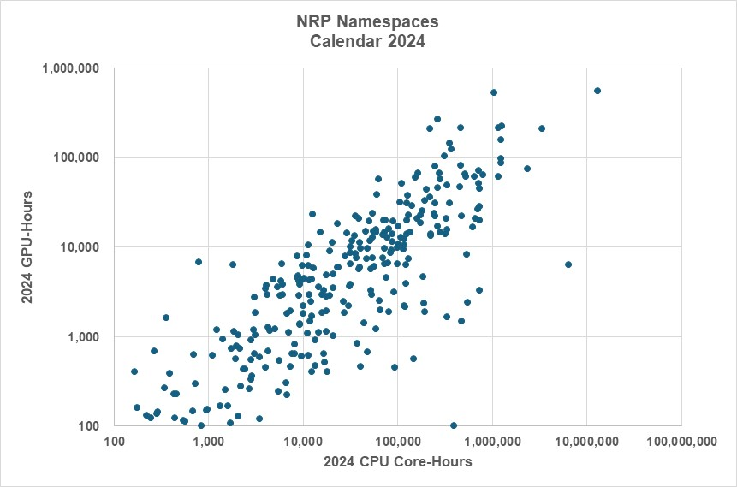
In 2024, 285 NRP Namespaces across 35 colleges
Used More Than 100 GPU-Hours & 100 CPU-core hours [2 GPU-Hrs/Week]
For discussion of science done
See Larry Smarr’s talk on Thursday
AI/ML Researcher
Observatory
Community Software

Slide 17
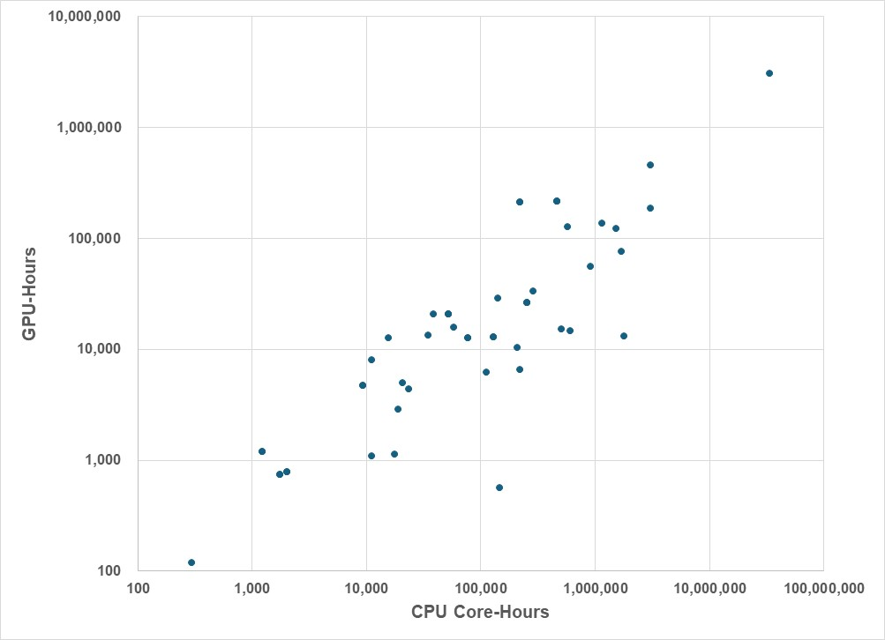
35 Campuses Used Hundreds to Millions of NRP GPU-Hrs & CPU Core-Hrs in Calendar 2024, Including 16 MSIs and 4 in EPSCoR States
UC San Diego
An additional 20 colleges consumed
>100 CPU-core hours && <100 GPU-hours
and a further 8 colleges consumed
< 100 CPU-core hours && <100 GPU-hours
UC Santa Cruz
MSK Cancer Center
Stanford U.
U. Missouri-Columbia
San Diego State U.
UIC
USRA
CSU San Bernardino
AMNH
CSU
CSU Northridge
U. Louisiana at Lafayette
U. Central Florida
Yonsei U., S. Korea
U. Florida
U. North Texas
UC Irvine
U. Nebraska-Omaha
UNL
U. Virginia
UC Riverside
UC Santa Barbara
U. Washington
UC Berkeley
MIT
Drexel U.
UC Los Angeles
SDCCD
CSU Fullerton
In total, 63 campuses had active namespaces
out of which 23 are MSI
and 12 are in EPSCoR states but not MSI
Washington U. St. Louis
Oregon State U.
Kansas State U.
Georgia Institute of Technology
Oklahoma State U.
Purdue U.
U. Penn
MSI
Florida A&M U.

Slide 18
Educational Use of NRP

Slide 19
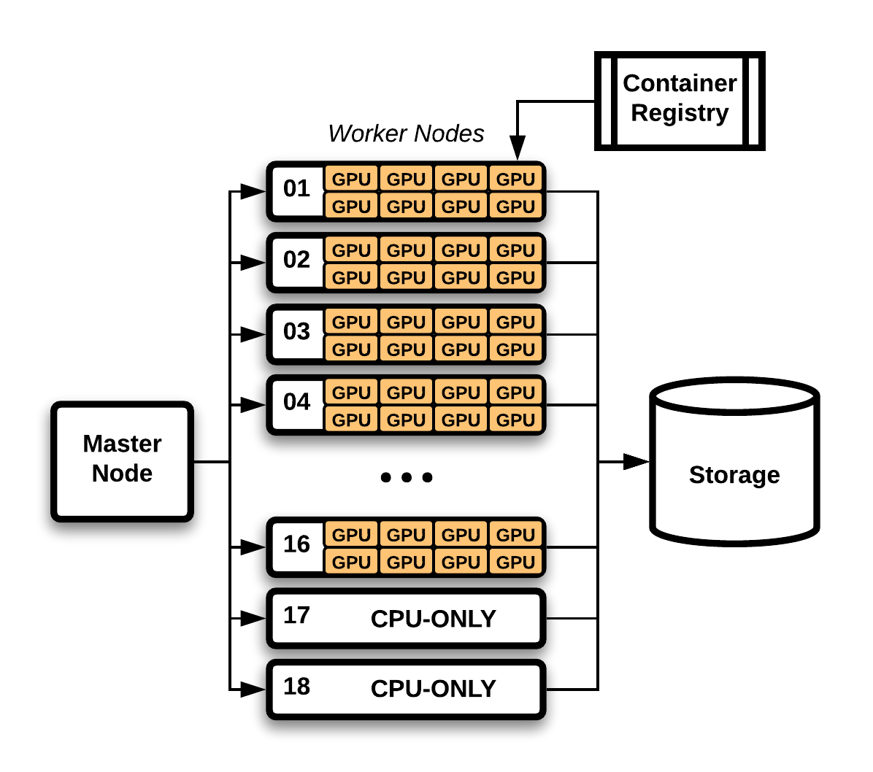
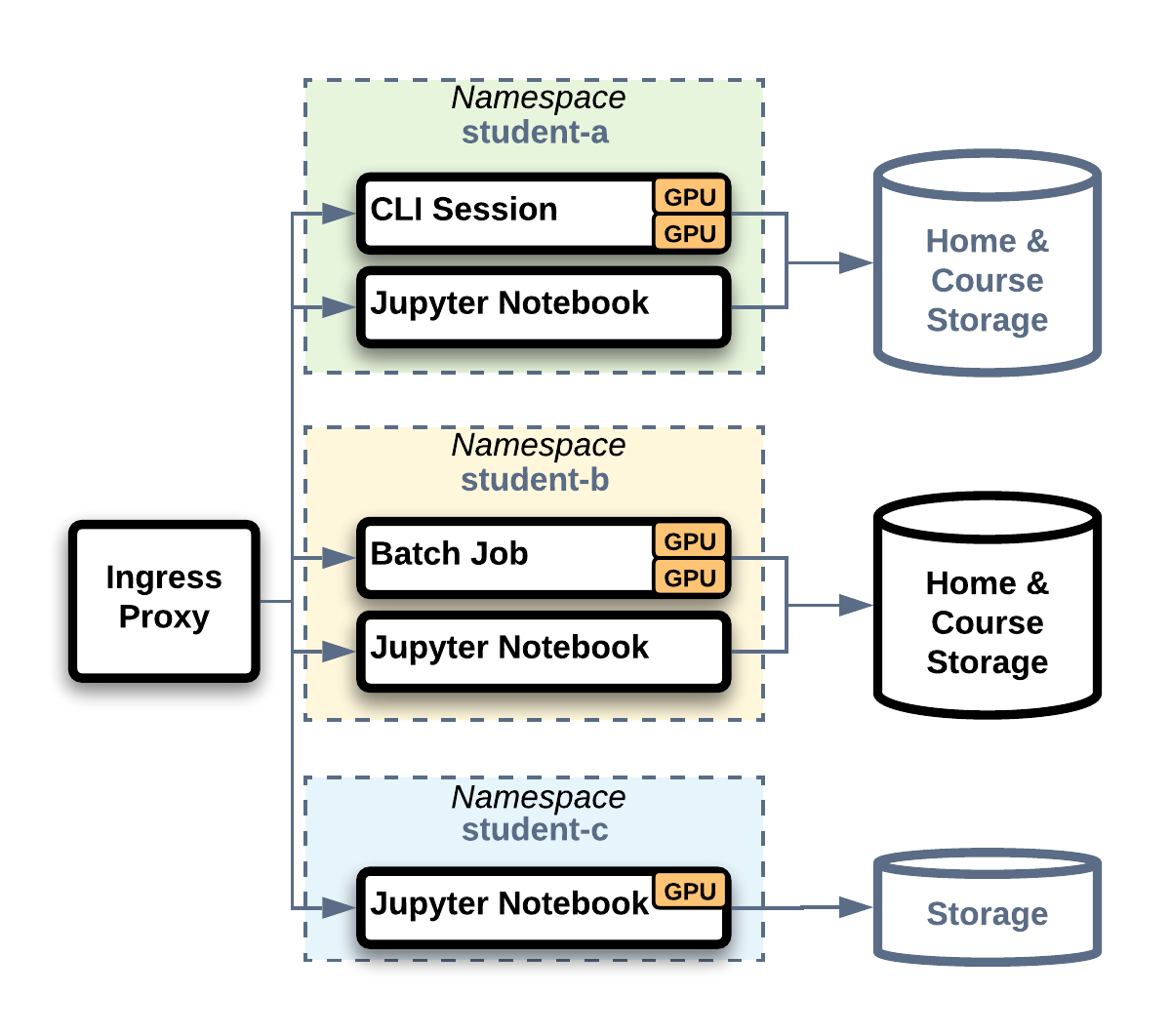
UC San Diego as an Example
Software & OS
Docker + Kubernetes + Helm
z2jh + JupyterHub + Jupyter
Nodes: Debian 12 + Puppet
Custom rostering/course mgmt
On-Premises Hardware
23 nodes, 1024 CPU cores (Intel/AMD)
132 GPU (1080Ti/2080Ti/A30/A5000)
500TB storage via ZFS/NFS

Slide 20


Student Enrollment by Quarter
22% of all UCSD undergraduates
Used this infrastructure in AY24
Total course enrollment in AY24 = 16945
Total in AY24 | 9171
UG Students | 7329
Grad/Prof Students | 1842
Some students take multiple courses/AY
33,792 undergraduates
enrolled in Fall 2023

Slide 21
Let’s play with some numbers …
20M students attend college in the USA
50% of students at San Diego State University want some sort of formal training in AI (see talk by David Goldberg on Thursday)
22% of UC San Diego undergraduates have used data & compute in their classroom in AY24
=> There are 4-10M college students in the USA that need data & compute resources for their classroom education

Slide 22
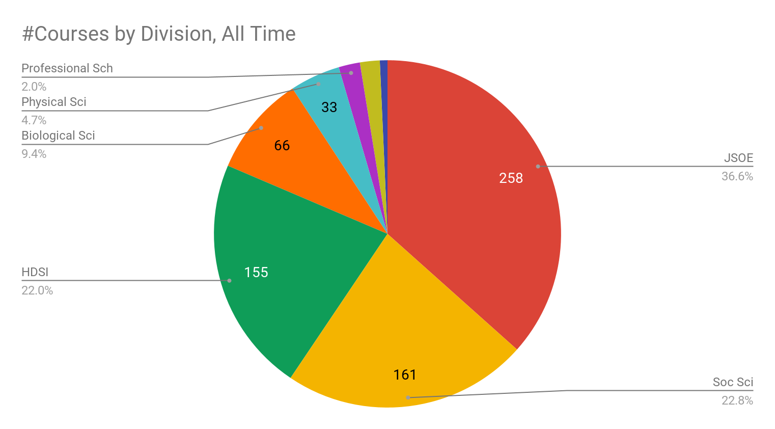
Courses by Division, All Time
School of Engineering
Data Science
School of Social Sciences

Slide 23
Status of Classroom Activities on NRP
Institution | # of courses | # of Students | Comments
San Diego State U. | 37, some multiple times | 1064 over 2 years
CSU San Bernardino | 14, some multiple times | 490
CSU Fullerton | 4 | 150
Drexel | 1 | 300 students per classroom | Failed to scale during peak use in exam
UC Berkeley | 1 | 122 | NAIRR Classroom
U of Oklahoma | 4 (+6 carpentry) | 625
Cal Poly Humboldt | 2 | 56 | 3rd class fell back to Cloud provider
U. of Missouri | 5 | ~100 | 1 class uses NRP directly, 4 use jupyter
NRP has been used by more than 2,500 students across more than 50 courses at 8 colleges

Slide 24
Challenges & Lessons learned
NRP is not as robust as AWS, Azure, or Google
  We need to strive for more redundancy of core services
    One of the reasons why we have a dedicated panel on data today.
  Learned some best practices on data pre-loading for scalability
  There’s a limit of what level of support we can provide …
      … NSF does not pay us to provide 24x7 support because research does not require it.
      We need to define expectations better …
People do best when they have full control over the scale of hardware they need.
  Bring Your Own Hardware works better than Soup Kitchen

Slide 25
NRP brings CS R&D and Domain R&D onto the same platform
NRP blurs the lines between ”testbed” and “production” CI
Create social cohesion to accelerate domain science
adoption of new programming paradigms & architectures

Slide 26
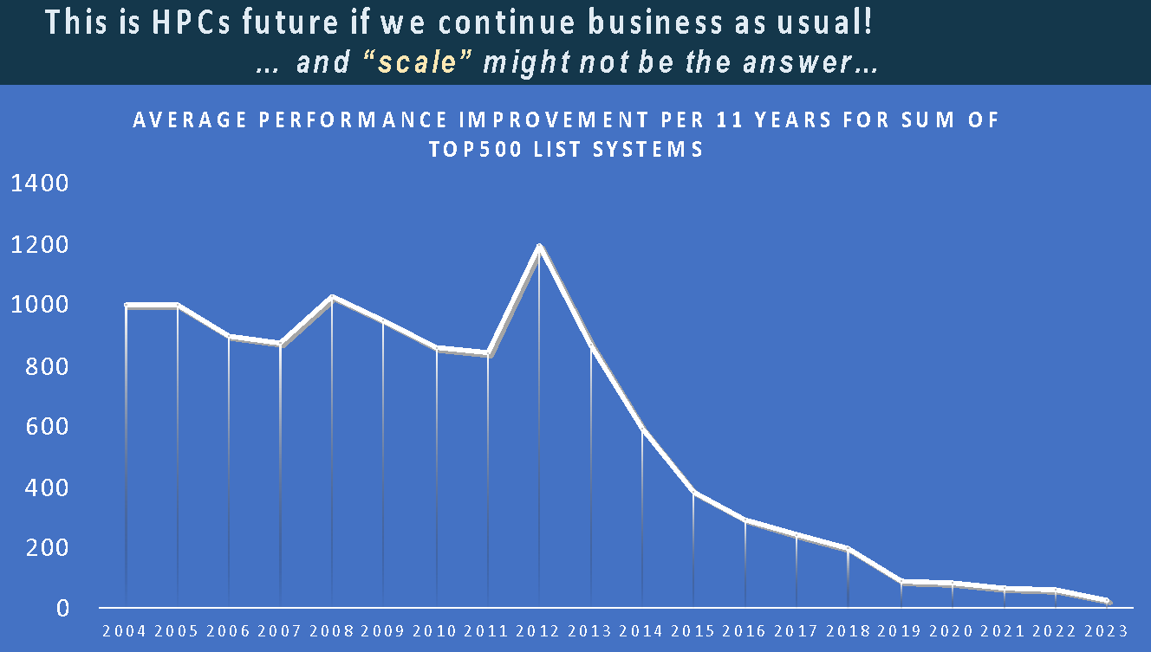
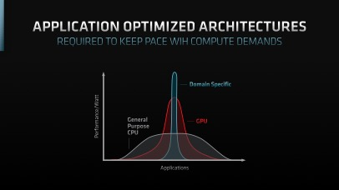
“end of Moore’s law” motivates new architectures
John Shalf @ SC23
Mark Papermaster, CTO of AMD
Performance improvements vs time
slowed down by O(100)
PRISM, a Jump 2.0 project
funded by SRC
is early user of FPGAs@NRP
More details Thursday
1:30-3:30pm
PI, Tajana Rosing
NRP supports FPGAs, P4 switches, NVIDIA DPUs & DGXs
Committed to be a “Playground” of technologies, easily deployed & operated via BYOR and BYOD.

Slide 27
Aside on Cybersecurity

Slide 28
Acceptable Use Policy (AUP) of NRP (I)

Slide 29
Acceptable Use Policy (AUP) of NRP (II)
Violation of this AUP is not a joke !!!
Violators may be reported to law enforcement.

Slide 30
Cybersecurity in Nautilus@NRP
How We’re Securing NRP Nautilus:
  Kubernetes: workload isolation, Falco: runtime threat detection, Prometheus: monitoring and alerts, CILogon: federated identity management, live documentation: up-to-date security policies, and enhanced log collection for detailed auditing.
Call to Action for Admins and PIs:
  Implement onboarding processes to ensure every user understands and adheres to the policies in the AUP and documentation.
  Establish an offboarding process for graduating students or departing group members:
    Remove unused resource reservations.
    Ensure users are properly removed from namespaces, and namespace rosters are up-to-date.
    Revoke access keys, tokens, and configurations, preventing credential sharing.
  Set default permissions for publicly-accessible services to default-deny and add trusted institutions/users to an allow-list.

Slide 31
Cybersecurity in Nautilus@NRP
Security Violations (Over Past Year):
Exposed IPMI Interfaces:
  A PI’s lab machine, used by approximately 2 dozen NRP users, was ransom-wared due to an exposed IPMI interface on the public internet.
  Action Taken: Invalidated NRP user credentials => users required to reauthenticate securely to mitigate risks.
  An NRP node at a different site became vulnerable after an ACL dropped in front of its IPMI interface. The issue was resolved by reinstalling the node and fixing the ACL.
Compromised Pod:
  Exploited PostgreSQL pod (weak password) used for port scanning.
  Action Taken: Pod terminated, namespace banned, PVCs deleted, admin privileges revoked.
Crypto-Mining (Case 1):
  Cryptomining caused by use of compromised Python ML library; credential sharing among users detected.
  Action Taken: Namespace and user accounts banned, stricter credential policies enforced, PI informed.
Crypto-Mining (Case 2):
  Two cases of crypto-mining by bad actors in a publicly-accessibly JupyterHub deployment.
  Action Taken: Namespace temporarily restricted until admins banned the users and their institutions.
Publicly Shared Config File:
  A user accidentally shared their config file (including credentials) in the Nautilus Support chat on Matrix, exposing credentials to thousands of users.
  Action Taken: CILogon contacted to invalidate the user’s refresh token and issue a new one.

Slide 32
Cybersecurity in Nautilus@NRP
Never Expose your IPMI interface to the public internet !!!
Security Violations (Over Past Year):
Exposed IPMI Interfaces:
  A PI’s lab machine, used by approximately 2 dozen NRP users, was ransom-wared due to an exposed IPMI interface on the public internet.
  Action Taken: Invalidated NRP user credentials => users required to reauthenticate securely to mitigate risks.
  An NRP node at a different site became vulnerable after an ACL dropped in front of its IPMI interface. The issue was resolved by reinstalling the node and fixing the ACL.
Compromised Pod:
  Exploited PostgreSQL pod (weak password) used for port scanning.
  Action Taken: Pod terminated, namespace banned, PVCs deleted, admin privileges revoked.
Crypto-Mining (Case 1):
  Cryptomining caused by use of compromised Python ML library; credential sharing among users detected.
  Action Taken: Namespace and user accounts banned, stricter credential policies enforced, PI informed.
Crypto-Mining (Case 2):
  Two cases of crypto-mining by bad actors in a publicly-accessibly JupyterHub deployment.
  Action Taken: Namespace temporarily restricted until admins banned the users and their institutions.
Publicly Shared Config File:
  A user accidentally shared their config file (including credentials) in the Nautilus Support chat on Matrix, exposing credentials to thousands of users.
  Action Taken: CILogon contacted to invalidate the user’s refresh token and issue a new one.

Slide 33
Cybersecurity in Nautilus@NRP
Never Expose your IPMI interface to the public internet !!!
Security Violations (Over Past Year):
Exposed IPMI Interfaces:
  A PI’s lab machine, used by approximately 2 dozen NRP users, was ransom-wared due to an exposed IPMI interface on the public internet.
  Action Taken: Invalidated NRP user credentials => users required to reauthenticate securely to mitigate risks.
  An NRP node at a different site became vulnerable after an ACL dropped in front of its IPMI interface. The issue was resolved by reinstalling the node and fixing the ACL.
Compromised Pod:
  Exploited PostgreSQL pod (weak password) used for port scanning.
  Action Taken: Pod terminated, namespace banned, PVCs deleted, admin privileges revoked.
Crypto-Mining (Case 1):
  Cryptomining caused by use of compromised Python ML library; credential sharing among users detected.
  Action Taken: Namespace and user accounts banned, stricter credential policies enforced, PI informed.
Crypto-Mining (Case 2):
  Two cases of crypto-mining by bad actors in a publicly-accessibly JupyterHub deployment.
  Action Taken: Namespace temporarily restricted until admins banned the users and their institutions.
Publicly Shared Config File:
  A user accidentally shared their config file (including credentials) in the Nautilus Support chat on Matrix, exposing credentials to thousands of users.
  Action Taken: CILogon contacted to invalidate the user’s refresh token and issue a new one.
Always use strong passwords

Slide 34
Cybersecurity in Nautilus@NRP
Never Expose your IPMI interface to the public internet !!!
Security Violations (Over Past Year):
Exposed IPMI Interfaces:
  A PI’s lab machine, used by approximately 2 dozen NRP users, was ransom-wared due to an exposed IPMI interface on the public internet.
  Action Taken: Invalidated NRP user credentials => users required to reauthenticate securely to mitigate risks.
  An NRP node at a different site became vulnerable after an ACL dropped in front of its IPMI interface. The issue was resolved by reinstalling the node and fixing the ACL.
Compromised Pod:
  Exploited PostgreSQL pod (weak password) used for port scanning.
  Action Taken: Pod terminated, namespace banned, PVCs deleted, admin privileges revoked.
Crypto-Mining (Case 1):
  Cryptomining caused by use of compromised Python ML library; credential sharing among users detected.
  Action Taken: Namespace and user accounts banned, stricter credential policies enforced, PI informed.
Crypto-Mining (Case 2):
  Two cases of crypto-mining by bad actors in a publicly-accessibly JupyterHub deployment.
  Action Taken: Namespace temporarily restricted until admins banned the users and their institutions.
Publicly Shared Config File:
  A user accidentally shared their config file (including credentials) in the Nautilus Support chat on Matrix, exposing credentials to thousands of users.
  Action Taken: CILogon contacted to invalidate the user’s refresh token and issue a new one.
Always use strong passwords
We have automated crypto-mining detection and anybody we catch will be barred for life from NRP.

Slide 35
Cybersecurity in Nautilus@NRP
Never Expose your IPMI interface to the public internet !!!
Security Violations (Over Past Year):
Exposed IPMI Interfaces:
  A PI’s lab machine, used by approximately 2 dozen NRP users, was ransom-wared due to an exposed IPMI interface on the public internet.
  Action Taken: Invalidated NRP user credentials => users required to reauthenticate securely to mitigate risks.
  An NRP node at a different site became vulnerable after an ACL dropped in front of its IPMI interface. The issue was resolved by reinstalling the node and fixing the ACL.
Compromised Pod:
  Exploited PostgreSQL pod (weak password) used for port scanning.
  Action Taken: Pod terminated, namespace banned, PVCs deleted, admin privileges revoked.
Crypto-Mining (Case 1):
  Cryptomining caused by use of compromised Python ML library; credential sharing among users detected.
  Action Taken: Namespace and user accounts banned, stricter credential policies enforced, PI informed.
Crypto-Mining (Case 2):
  Two cases of crypto-mining by bad actors in a publicly-accessibly JupyterHub deployment.
  Action Taken: Namespace temporarily restricted until admins banned the users and their institutions.
Publicly Shared Config File:
  A user accidentally shared their config file (including credentials) in the Nautilus Support chat on Matrix, exposing credentials to thousands of users.
  Action Taken: CILogon contacted to invalidate the user’s refresh token and issue a new one.
Always use strong passwords
We have automated crypto-mining detection and anybody we catch will be barred for life from NRP.
Don’t ever share your credentials with anybody.
Don’t ever use somebody else’s credentials.
If we catch you use somebody else’s credentials you will be barred for life from NRP.

Slide 36



Thank You to our Sponsors

Slide 37


NSF-funded study on AI use
UCSD/SDSC’s AI Blueprint Factory is seeking interview subjects who are:
Graduate student, postdoc, faculty, or staff in any field
Engaged in research or teaching that utilizes AI methods
Creating or using tools, software, datasets, or cyberinfrastructure
We want to talk with you! Contact Jeanette Sperhac:
AI Blueprint Factory, a project of SGX3 at SDSC
help@sciencegateways.org

Slide 38
Why Fusion Energy?
From SIA & SRC publication in 2015:
Rebooting the IT Revolution
A Call To Action
They predict that at the rate at which computing
grows vs time, it would consume the world’s energy
supply sometime in the 2040’s.
… unless something dramatic happens
on either the supply or the demand side of the equation.

Slide 39
Summary & Conclusions
NRP addresses Two Core Challenges:
  Opportunity is a requirement for Social Mobility
    Education is the most effective guarantor of social mobility
    Data & Compute is increasingly required for Education
  We provide a Data & Compute Platform for Higher Ed that is cost-effective
  and aspire to make it available to all colleges in the USA
  The “end of Moore’s law” is leading to a proliferation of “architectures” … domain science adoption is at risk …
  We provide a “garden of architectures” for both domain, CS, and ECE research

Slide 40
Acknowledgements
The NRP is supported by NSF grants OAC-1541349, OAC-1826967, OAC-2030508, OAC-1841530, OAC-2005369, OAC-21121167, CISE-1713149, CISE-2100237, CISE-2120019, & OAC-2112167
And by CENIC, Pacific Wave, MREN, GPN, NYSERNet, FLR, NEREN, SunCorridor, OARnet, SCLR, the Albuquerque GigaPoP, and Internet2
As well as a long list of Universities and colleges that host hardware, and share their hardware with the community.

Slide 41
Q&A

