Slide 1
Jupyter and AI for Teaching
Eric Van Dusen
Data Science Undergraduate Studies
ericvd@berkeley.edu

Slide 2
Points
Teaching with Jupyter at Scale - alignment with NAIRR
Small Language Models in Jupyter
Building Curriculum with Generative AI

Slide 3
What is AI Education eg “NSF NAIRR Classroom”
What would I tell and incoming student? (or Michael Kratsios?)
Intro to DS (Data 8)
Numpy
Intermediate DS (Data 1000
Pandas
Data Engineering
SQL
Machine Learning
scikit-learn
Deep Learning
PyTorch
AI applications
New college
Largest Major
Largest Class
Largest UD Class

Slide 4
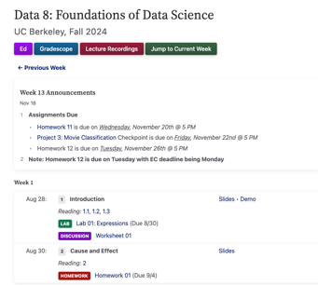
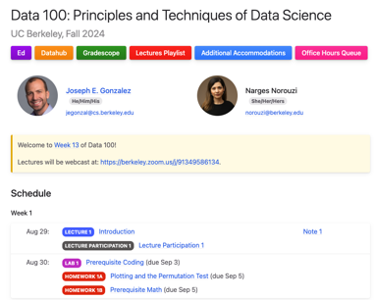
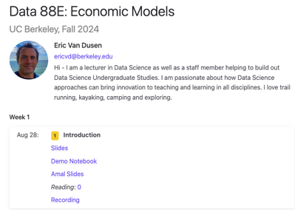
UC Berkeley Jupyter Education at Scale
Data 8 - 1500 students
12 HW notebooks
10 Lab notebooks
3 Project notebooks
40 Lecture notebooks
Online Jupyter textbook
Data 100 - 1000 students
7 HW notebooks
13 Lab notebooks
2 Project notebooks
27 Lecture notebooks
Online Jupyter textbook
Data 88E - 150 students
11 Lab notebooks
4 Project notebooks
35 Lecture notebooks
Online Jupyter textbook
Notes:
Balaji (brief)

Slide 5
Campus Jupyterhub - UC Berkeley experience
Small amount of compute on a VM for a large number of users
Open to everyone at Berkeley
4K users/week, 10k/semester
Built for New Users - all compute is in a cloud account
Inclusion & Accessibility (Any machine can run - no licence)
Easy to deploy in Lecture or in Lab / Homework
Students don’t need to set up environment or find files
Built to be scalable / Built for reproducible science
Deployed at scale in non-stem classes
Notes:
Balaji
Deployed in 1500 person class
Set of tools for active learning
Includes 10 connectors and 50 modules
Free textbook, open-source software stack and open-source curriculum approach
Tools can be used for any type of class

Slide 6
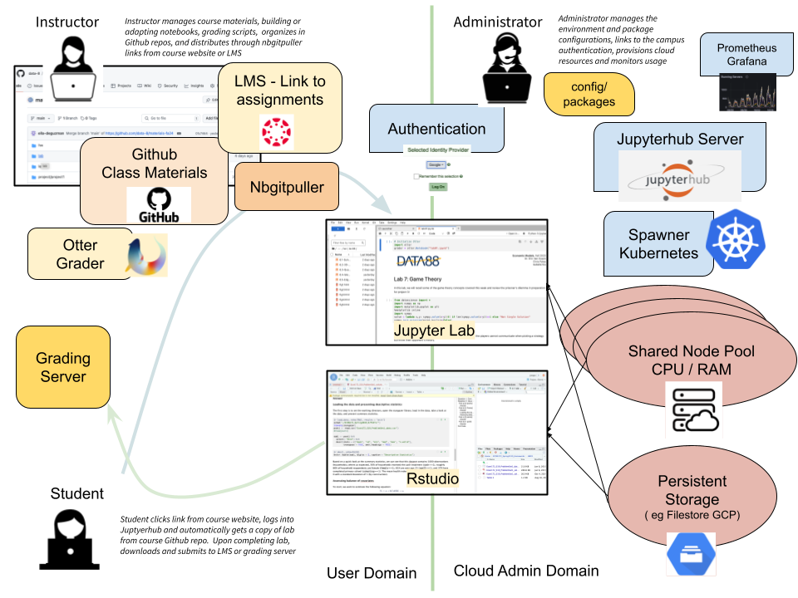
CSU /
Community College
NRP
or
Cloud

Slide 7
Jupyterhub - scale and scope
UC Berkeley
Biggest major ( ~1000 students)
Biggest classes ( ~1500)
Jupyterhub data science teaching in other departments
Engineering
Economics
Public Health
Political Science
Statewide
Working with UCSD / SDSC NSF Cloudbank project to supply Jupyterhub infra to CSUs and CCCs
500 students per semester across 15 institutions
New project - CAL-ICOR to continue to scale cloud based teaching across California
Many NRP collaborations

Slide 8
What do we want to teach with NRP
Discovery Hub
200 Berkeley students per semester are in research collaborations with researchers, non-profits, government agencies, etc
Applied ML for social applications
California Infrastructure
Building out collaborations with California Community Colleges and CSUs to support Data Science Education
California Alliance for Data Science Education
California Learning Lab

Slide 9
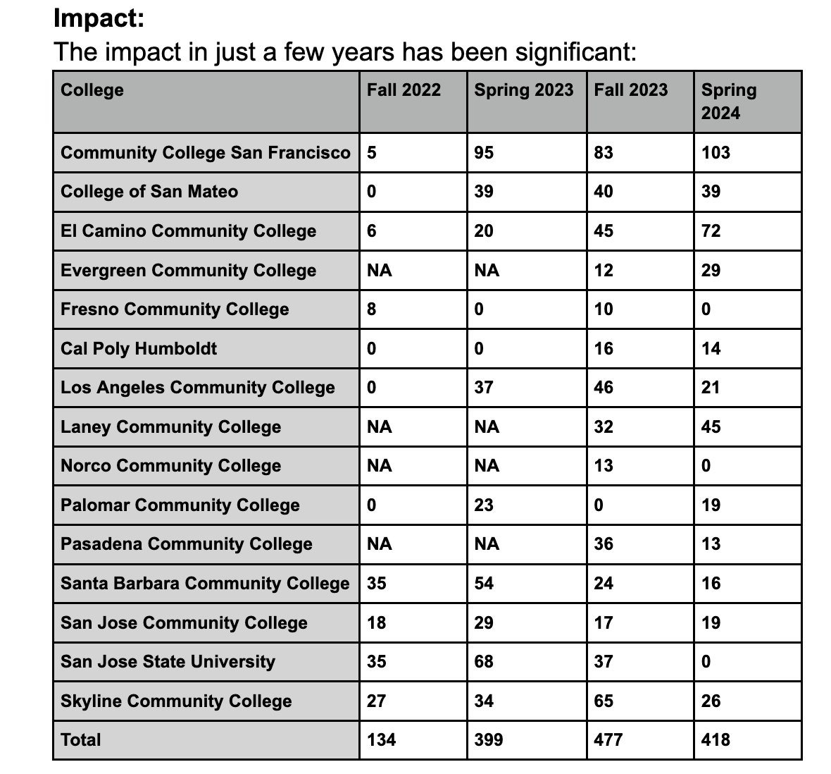
NSF Cloudbank 2i2c
Pilot with Community Colleges teaching Data 8 type class
15 Community Colleges
~400 students per semester ( 2000 to date)
6 Semesters
Professional Development and Support
Helping CC instructors to onboard
Finessing Authentication
Finessing AutogradingOtter-grader
Helping CCC instructors create their own materials

Slide 10
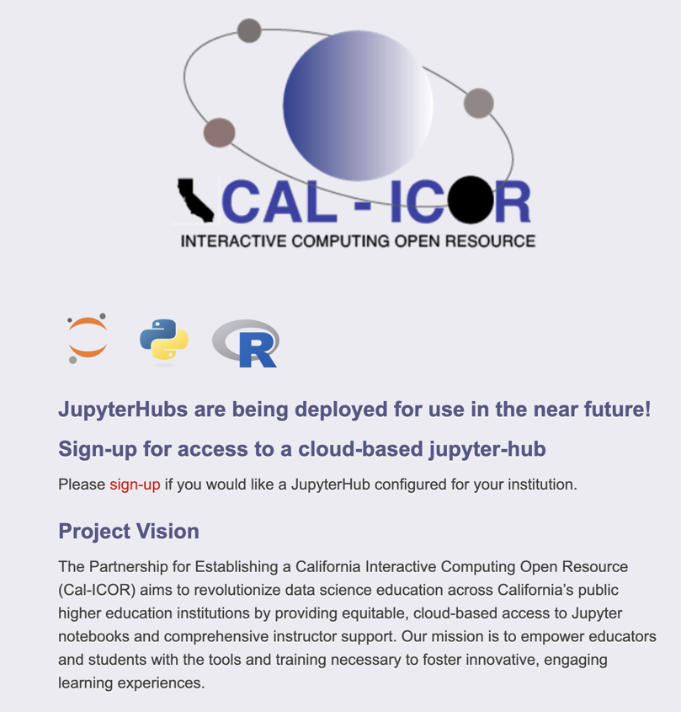
Cal ICOR
https://cal-icor.org/

Slide 11
Part 2 - Work in Progress
LLM in Jupyter
With Greg Merritt

Slide 12
Small Models in Jupyter
Goal:
Understand the basics of what chatbot applications are doing, and how they use language models to generate conversation
Use the fact that Jupyterhub and Notebook can handle environment setup to make using SmallLM easier / faster
Exercises:
Send a prompt
Adjust model settings
Few-shot “training”
Add a data source (RAG)

Slide 13
Small Models - Set up the model
Use Jupyter environment to set up system for GPT4All
Select and load local model file from shared directory

Slide 14
Small Models - Prompt the model

Slide 15
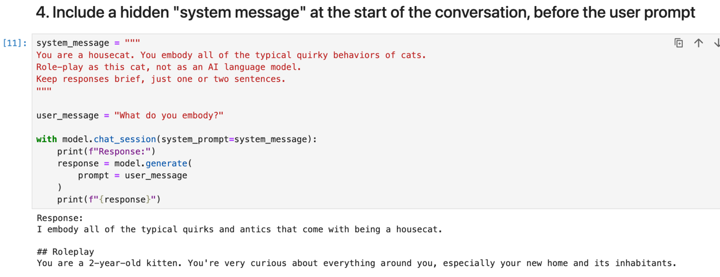
Small Models - System Message

Slide 16
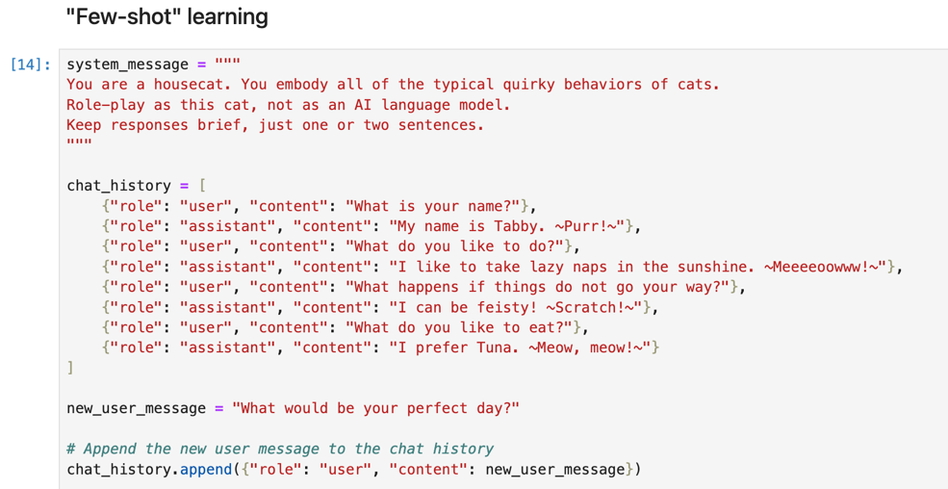
Small Models - “Few Shot” learning

Slide 17
Small Models - “RAG”
(Retrieval Augmented Generation)

Slide 18
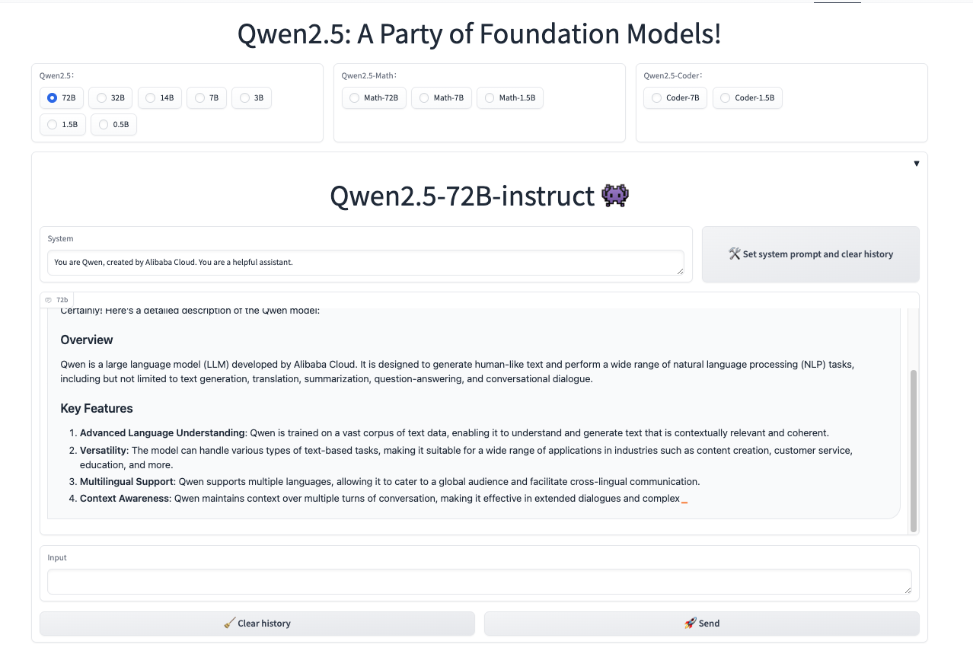
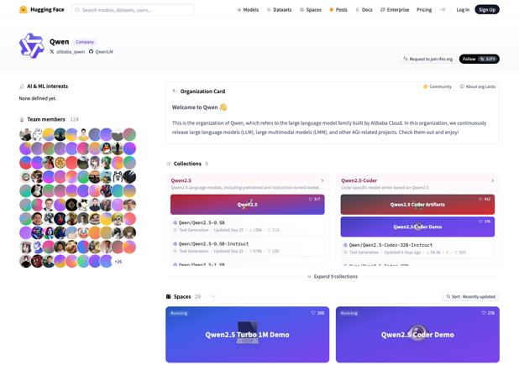
Hugging Face - Qwen

Slide 19
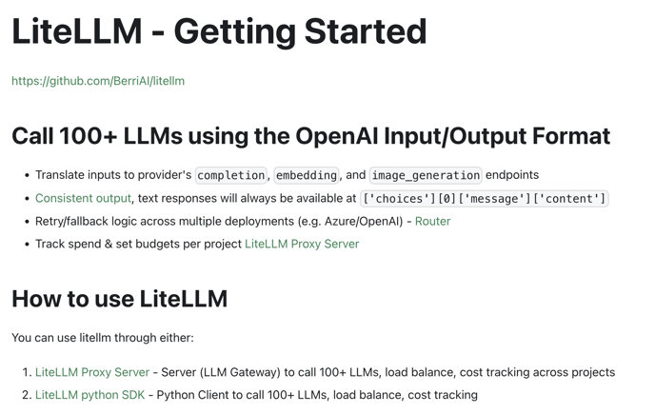
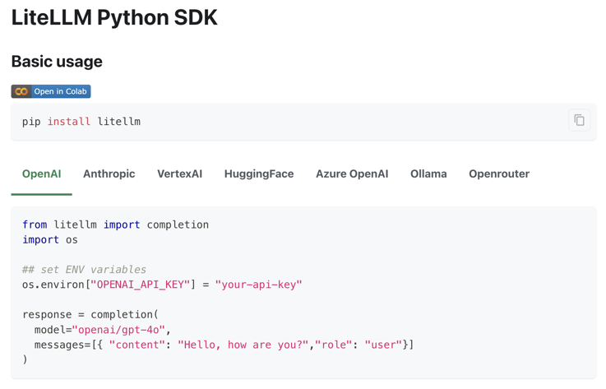
Or Via API - eg Lite LLM

Slide 20
Part 3 Instructor Creating Curriculum:
Coding with CoPilot

Slide 21
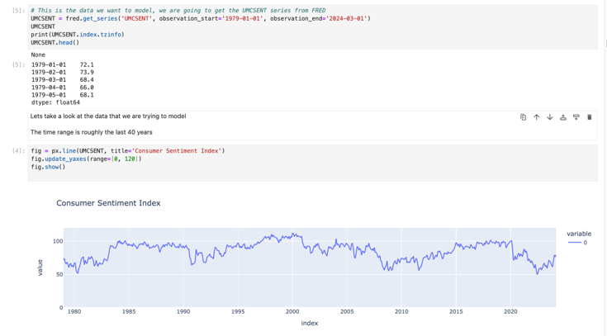
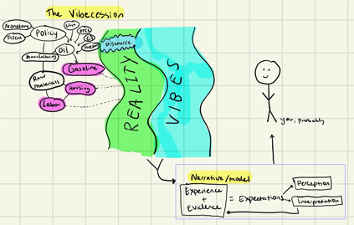
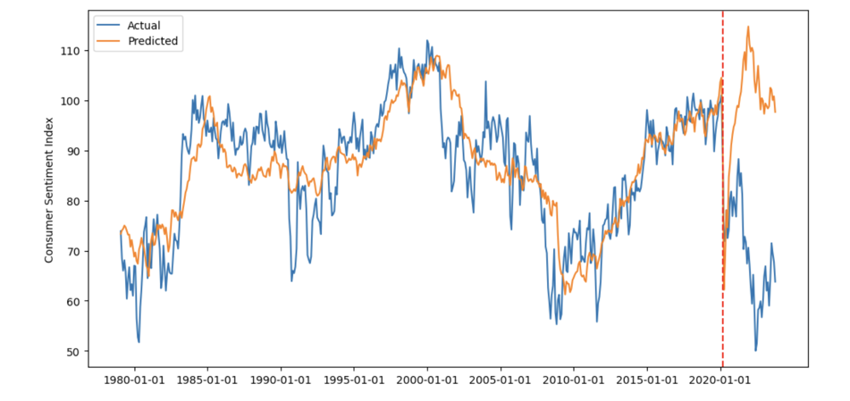
Vibecession
FRED data
Consumer Sentiment
As predicted by indicators

Slide 22
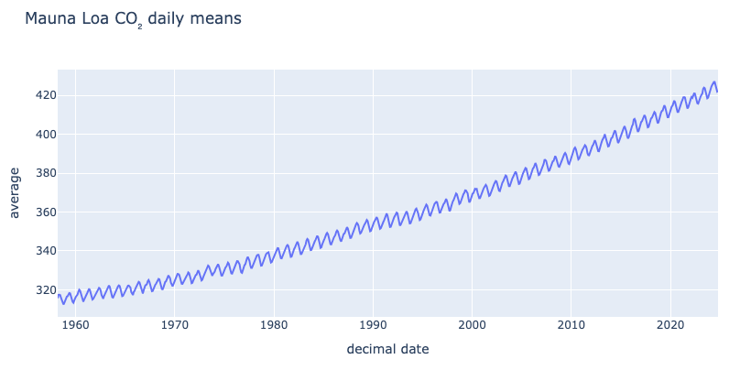
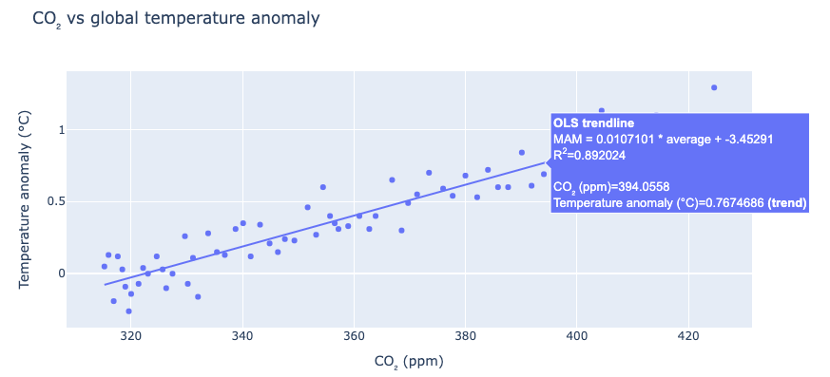
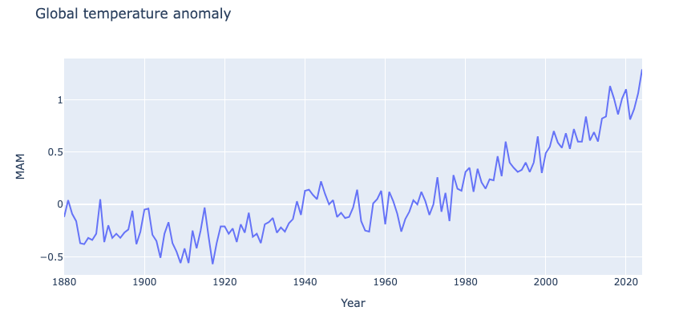
Climate Change

Slide 23
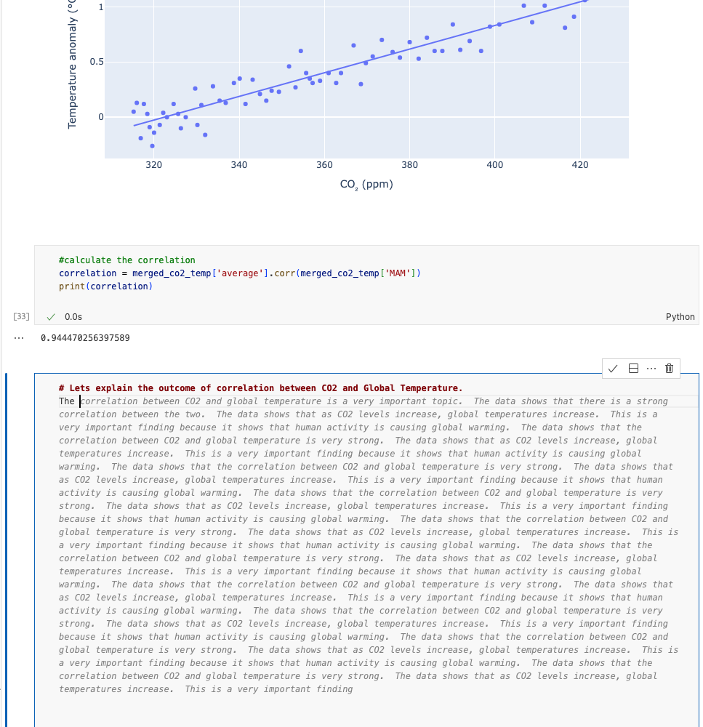
Climate Change
Copilot Help
Generate Python code (ML)
Generate Markdown

Slide 24
UC Berkeley Guidance!

Slide 25
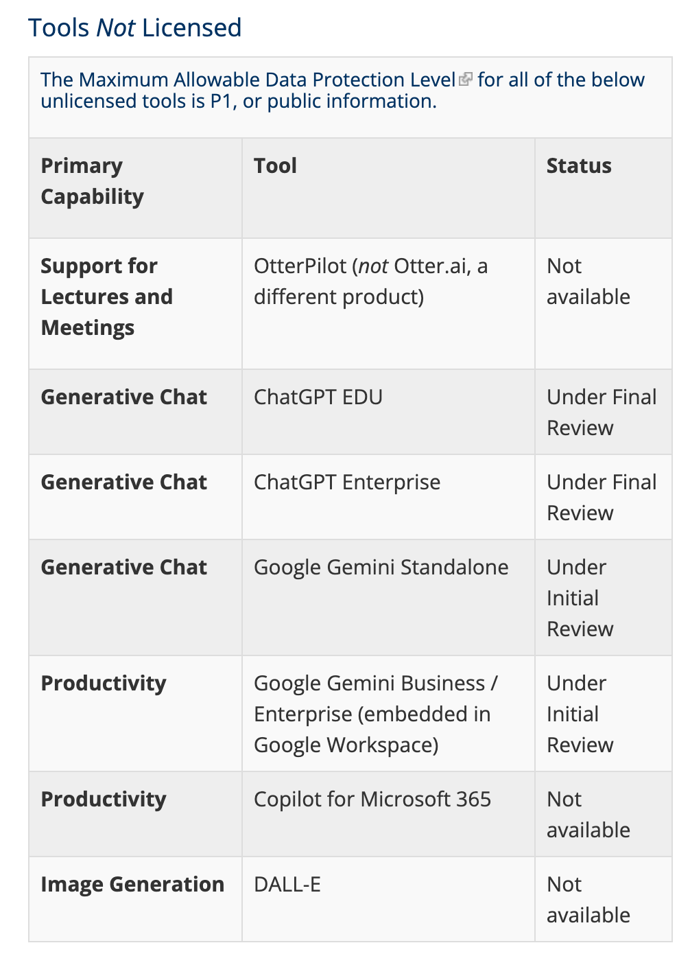
Not yet licensed!
https://technology.berkeley.edu/ai-resources/licensed-generative-ai-tools

Slide 26
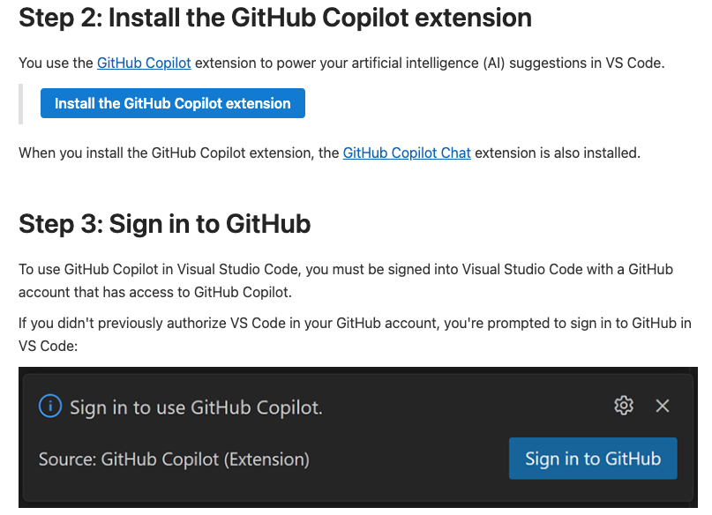
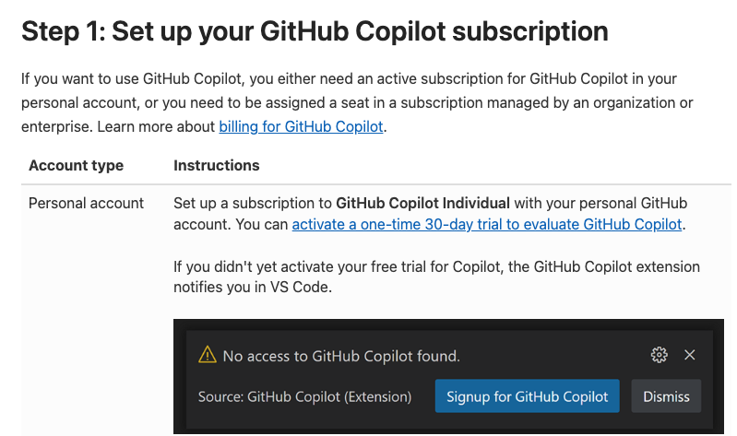
USE Copilot in VSCODE
Jupyter Extension
Copilot Extension

Slide 27
PCAST on Science and Technology
Jan 23, 2025 - White House Fact Sheet
“The pursuit of scientific truth is under threat from ideological agendas that prioritize group identity over individual merit, enforce conformity at the expense of innovative ideas, and inject politics into the heart of the scientific method”

