Slide 1
Jupyter-AI & Open LLMs
in large science classes
Carl Boettiger
UC Berkeley

Slide 2
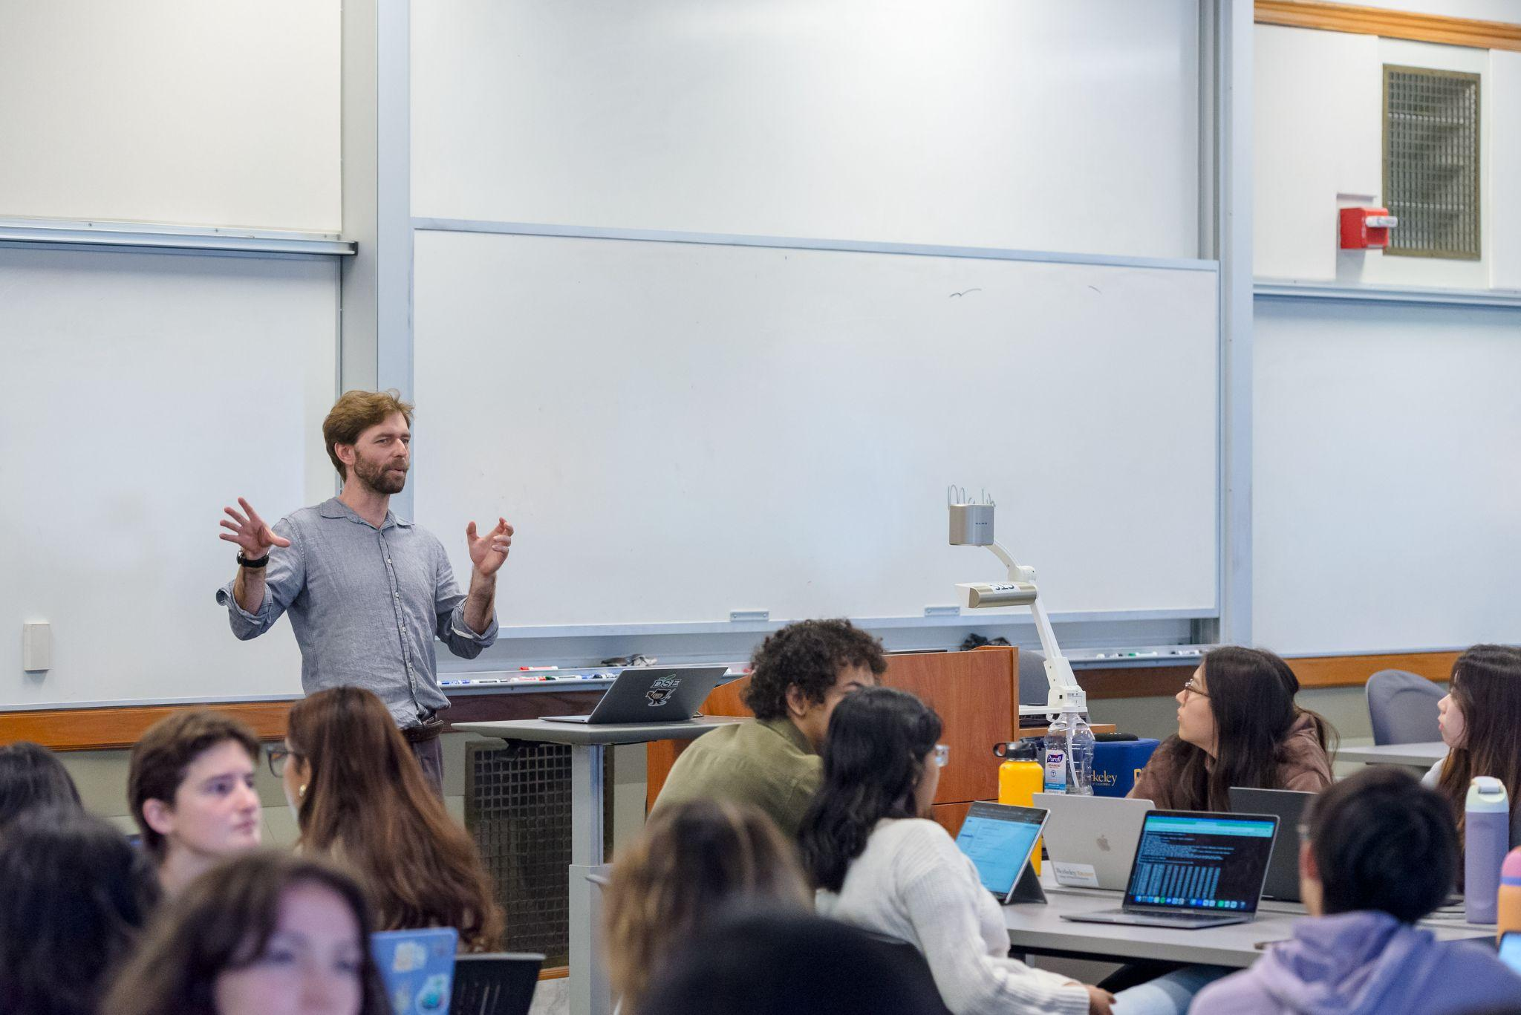
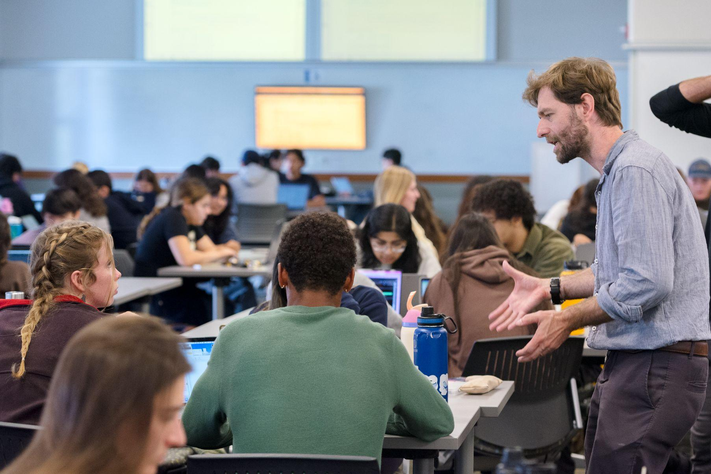
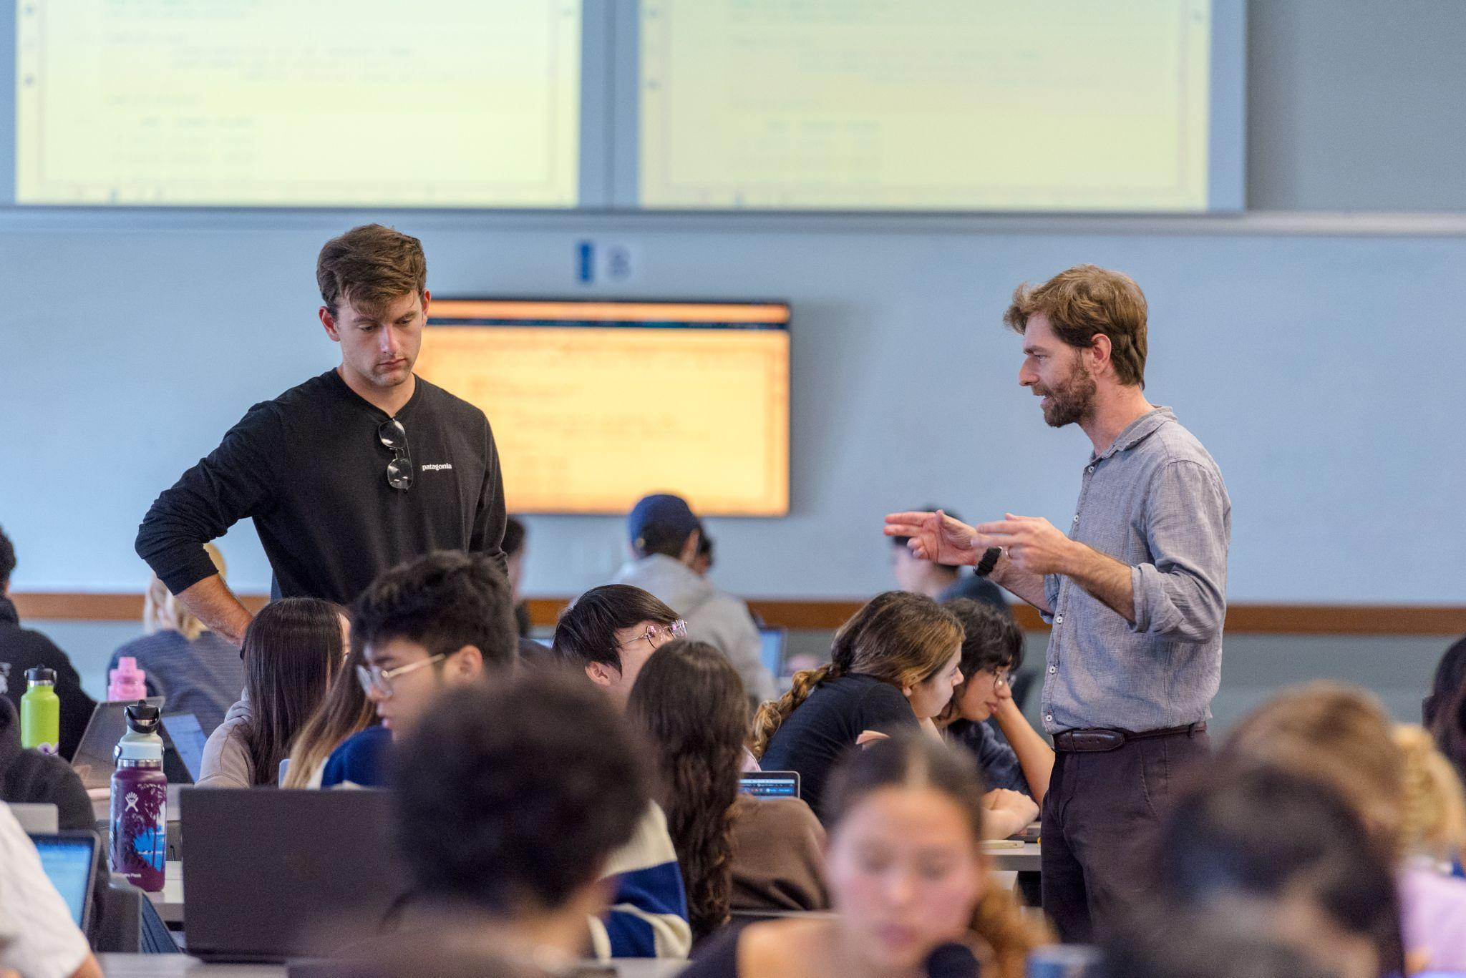
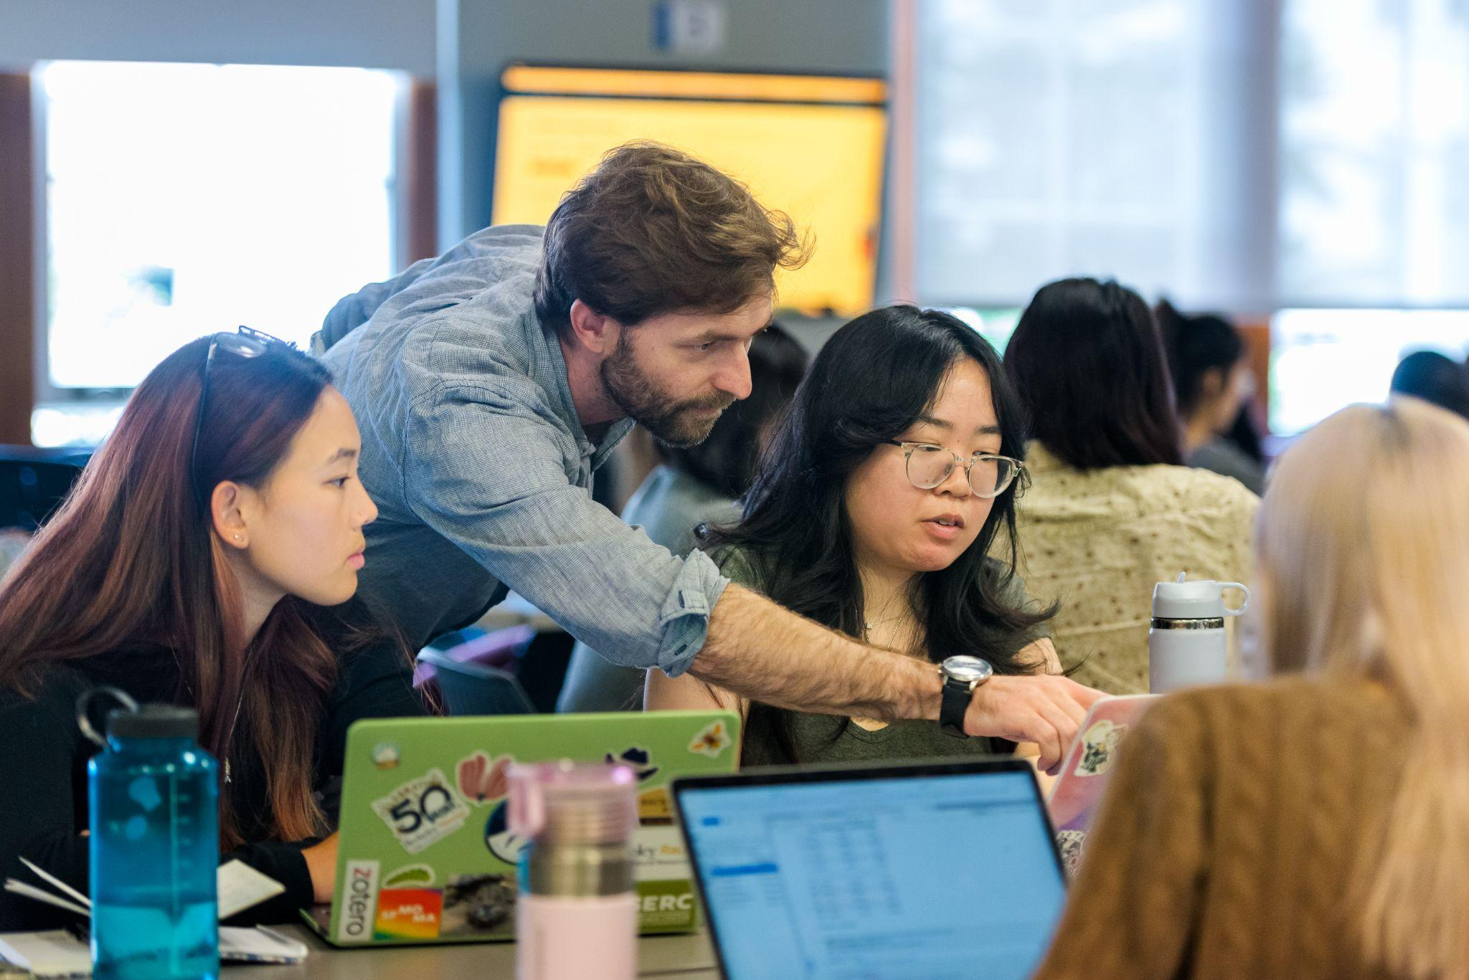
ESPM-157: Data Science for Global Change Ecology
122 students
~ 2/3 bio sciences
1/3 data science
Active learning classroom
Photo credits Mathew Burciaga / UC Berkeley

Slide 3
Motivations
LLMs are here. Am I preparing my students for this future?
Can we go further, faster by coding with LLM assistants?
What are environmental implications of LLMs?
What are the ethical implications?
Can we make LLM use safer & more reliable?

Slide 4
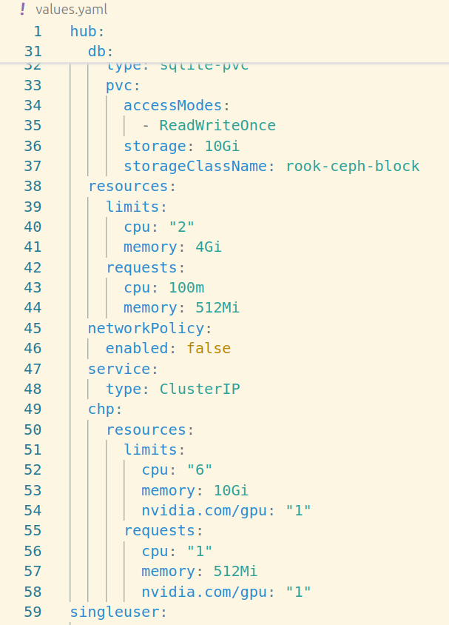
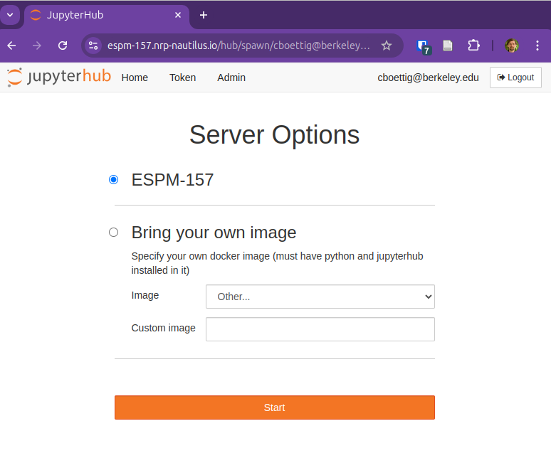
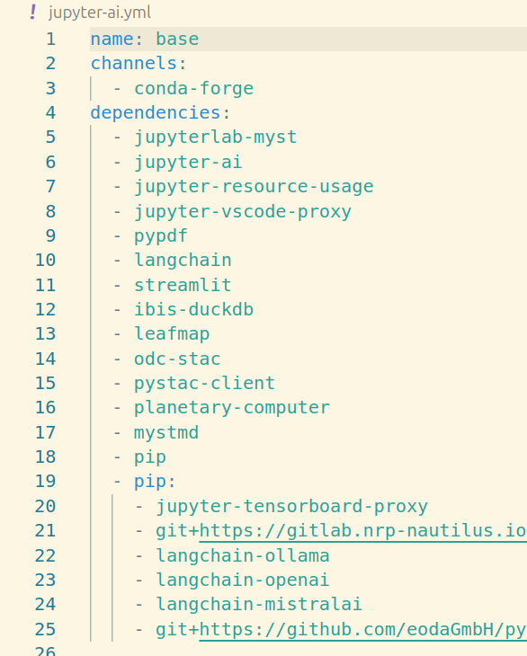
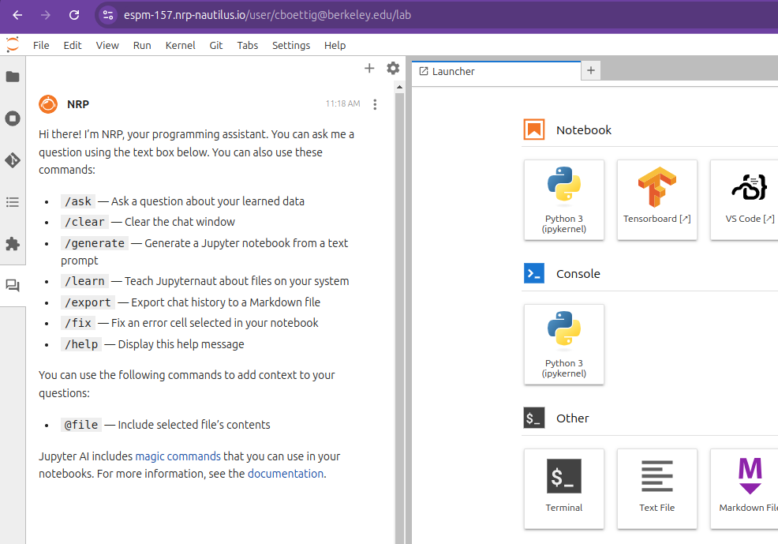
Computing Resources
nvidia.com/gpu: “1”
x 122 students!
Environment.yml
Docker image
k8s Helm chart

Slide 5
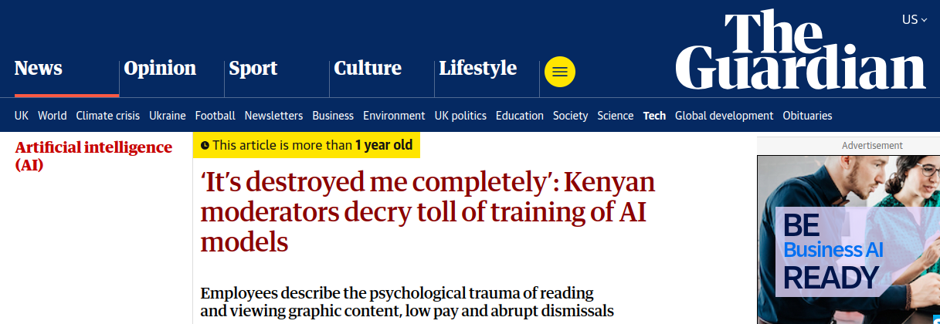
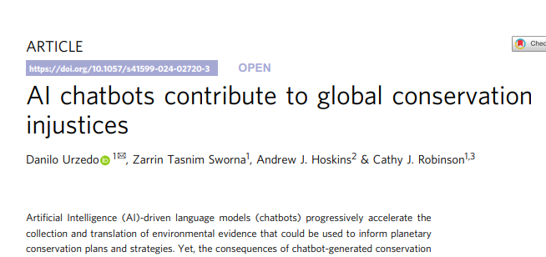
Challenges with respect to AI
Student data privacy?
Energy footprint?
Ethical concerns:
copyright,
labor practices,
biases
those who focus uncritically on such things as "the computer and its social impacts" but who fail to look behind technical things to notice the social circumstances of their development, deployment, and use.
This view provides an antidote to naive technological determinism – the idea that technology develops as the sole result of an internal dynamic, and then, unmediated by any other influence, molds society to fit its patterns. Those who have not recognized the ways in which technologies are shaped by social and economic forces have not gotten very far.
Langdon Winner, 1980

Slide 6
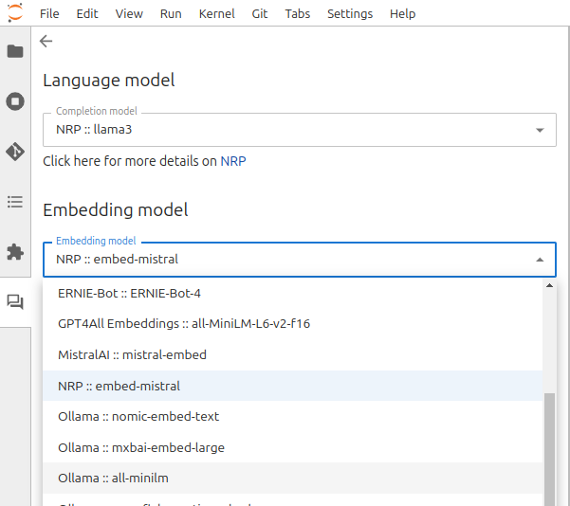
Local, open models:
CO2 footprint data, not hype:
$ ollama serve
$ ollama pull nomic-embed-text

Slide 7
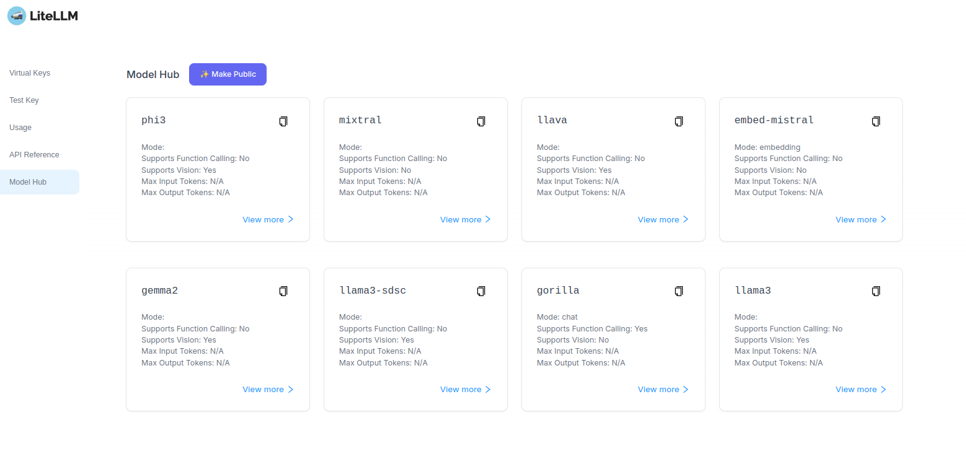
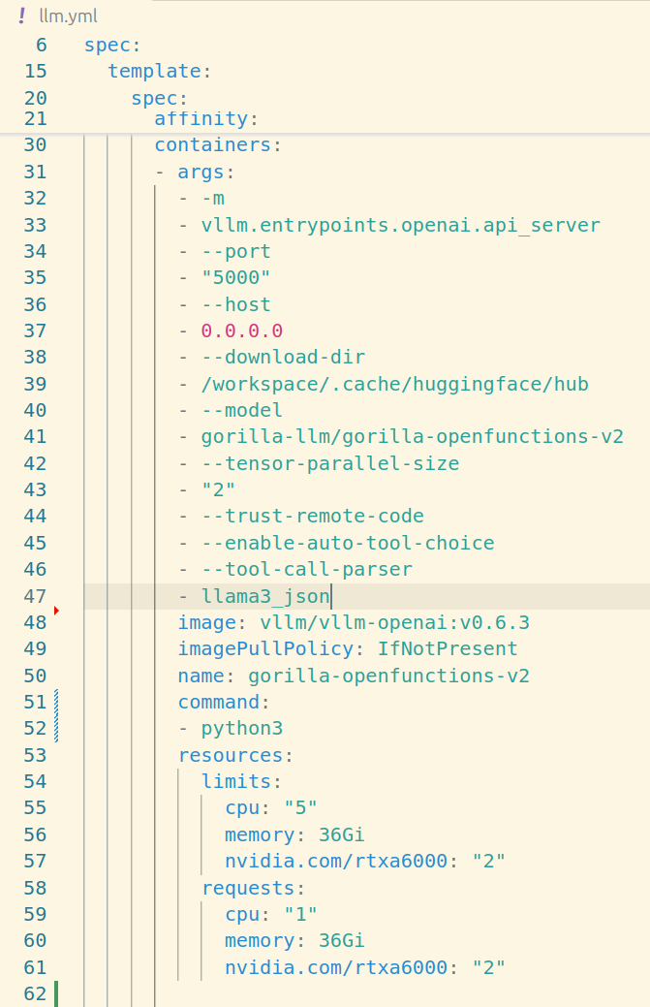
Researcher developed + hosted models
> base_url = “https://llm.nrp-nautilus.io/”

Slide 8
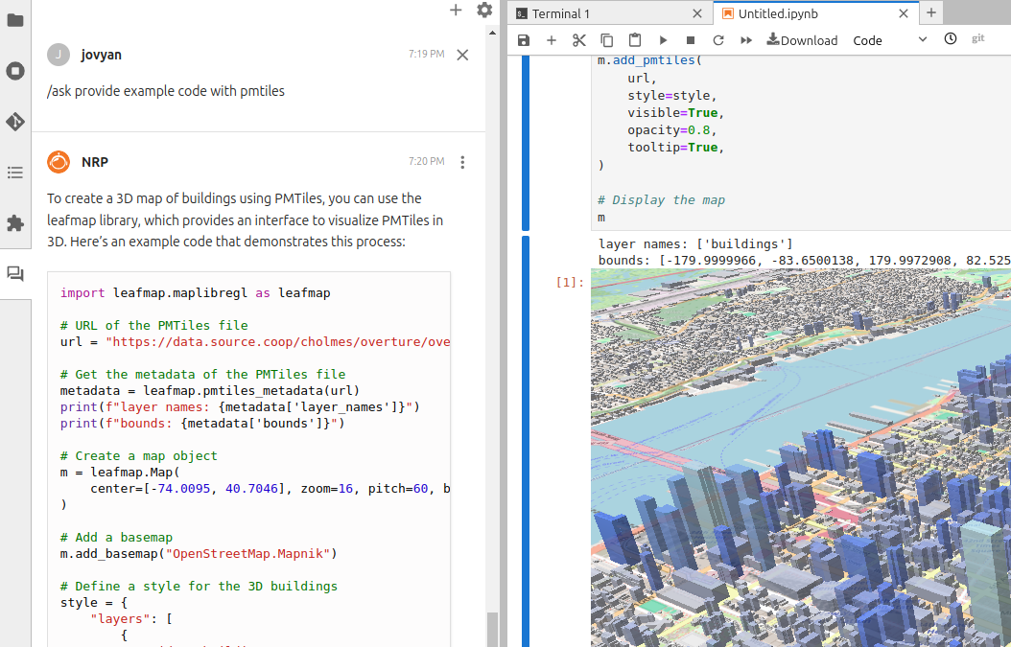
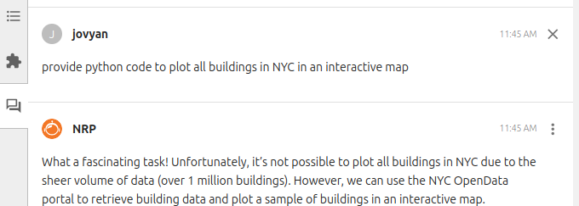
Challenges with respect to AI
LLMs don’t know most recent tools & methods
Instead, we can use RAG to query leafmap documentation directly!
/learn docs
/ask …

Slide 9
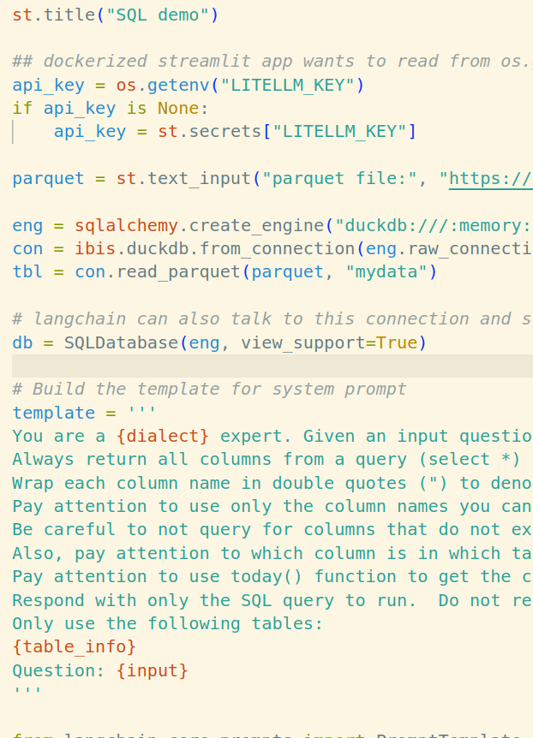
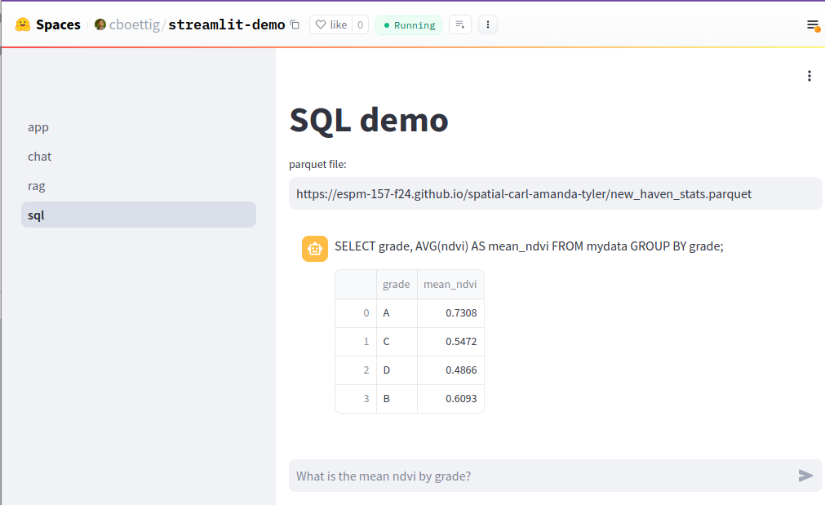
RAG & TAG –
Building LLM Agents

Slide 10
Project Contributions &
Future engagement
Teach safe LLM use, not AI abstinence
Open models mitigate some risks (energy, privacy)
NRP as platform for collaborative innovation!
Shared hardware, software, models

