Slide 1
Data on NRP
Su Lab
01/28/2025

Slide 2
Computer vision research
Storage
CephFS and S3
IO: both reading and writing datasets required for model training
Reads
No simultaneous read from the same files from multiple containers
Writes
No writing to the same files from multiple containers
Write to local disk, then transfer to CephFS/S3
Scale
Simultaneous reading or writing to the same storage using up to 200 containers
Usual dataset size: ~10-100TB, image data

Slide 3
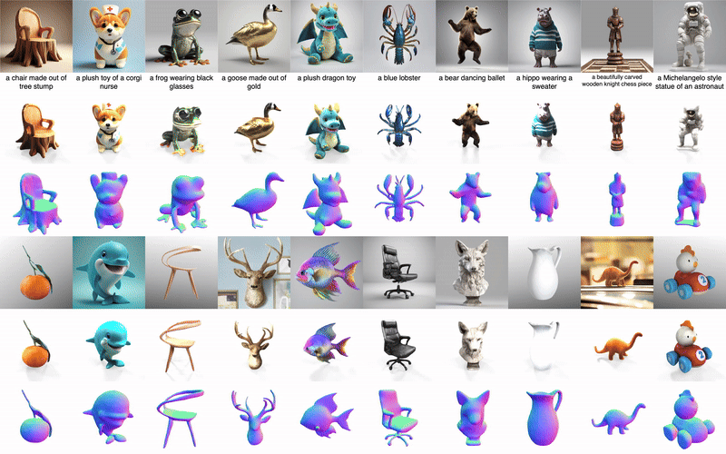
Open-world 3D Generation
This line of research has been published on NeuIPS 2023 and CVPR 2024.
Notes:
3D generation is a technique that takes an image as input and outputs a 3D textured object. Open-world means the image can be any object regardless of its category. Thus it requires a very huge amount of training data. Thanks to NRP we can have the computation resources and large disks to generate and store the data. The series works have been published on …

Slide 4
Robotics research
Storage options
CephFS and S3
IO: More reading than writing; reading is for loading data for supervised learning
Reads
There could be multiple containers access the same files, though we try to minimize
High speed reading preferable to prevent IO bottleneck, e.g., 10 GB/s
Writes
No writing into same files from multiple containers; but we could write to the same storage
Likely for collecting robotics data in simulation
Write to local disk/CephFS, then transfer to S3
Writing speed is not a major bottleneck
Scale
Simeultanueous reading from the same storage in up to 100 containers
Usual dataset size: ~1-10TB, mixture of images and arrays

