Slide 1
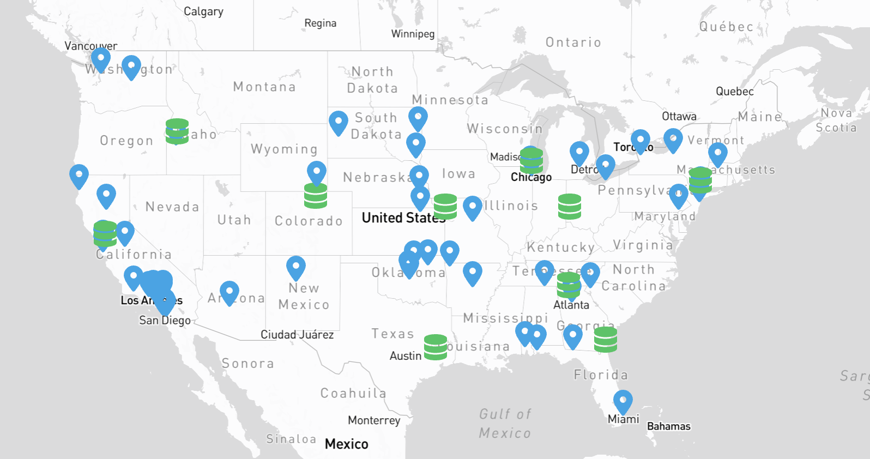
Storage options on the NRP
Derek Weitzel
University of Nebraska-Lincoln

Slide 2
Range of storage options
CEPHFS Storage for pods
CEPH block storage for pods
S3 Compatible
Open Science Data Federation (OSDF)

Slide 3
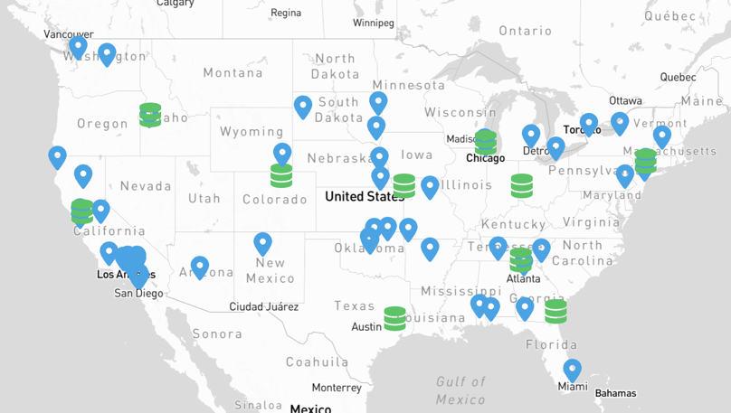
Importance of picking the right storage option for you
Picking the right storage option for your workflow can dramatically affect the efficiency of your job.
Both the storage type and region can affect the efficiency
But, as with everything, choosing a storage option is a tradeoff

Slide 4
Spectrum of NRP Storage Resources
Easier to Use
OSDF
S3
CEPH RBD
CEPHFS
(All based on my very un-scientific opinion)

Slide 5
Spectrum of NRP Storage Resources
Scalability
OSDF
S3
CEPH RBD
CEPHFS
(All based on my very un-scientific opinion)

Slide 6
Importance of picking the right storage option for you
Further, even choosing the right storage region is important!
Installing PyTorch | Western Region | Central Region
CEPHFS | 333s | 1553s
CEPH RBD | 25s | 33s
Lower is better

Slide 7
CEPHFS
Advantages
Easy to use and partition
Can share a data namespace between multiple pods
Appears like a global file system for the users
Disadvantages
Complexity in implementation means many more points of failure
For example: the outage last year that only affected CEPHFS users
Conflicting pods can cause file locking and other issues.
Have to stage data to the cluster through some method.
Slower performance with lots of files

Slide 8
CEPH Block Device
Advantages
Easy to use and partition
Simple implementation leads to less failure points.
Better performance for lots of files (conda / python environments)
Can create “copy” of PVC, allowing an instructor to copy a templated PVC for each student
Disadvantages
Can only be mounted on a single pod at a time, no sharing
Have to stage data to the storage through some method.

Slide 9
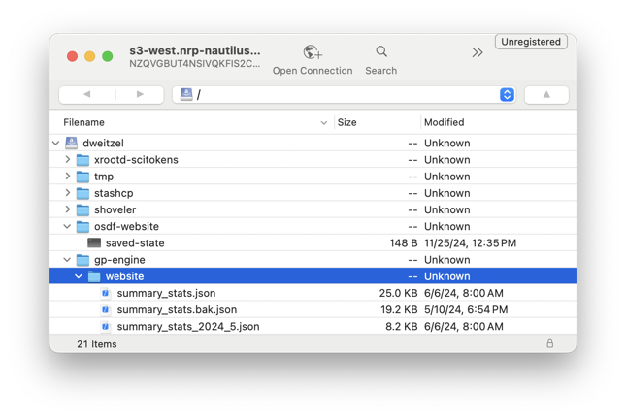
S3 Storage Access
Advantages
Available from all pods
Available from your laptop (with the right tool)
Simple implementation leads to less failure points.
Disadvantages
No mounting on the filesystem. Have to use tools to get / put data.
Either make the data public, or deal with credentials inside the container

Slide 10
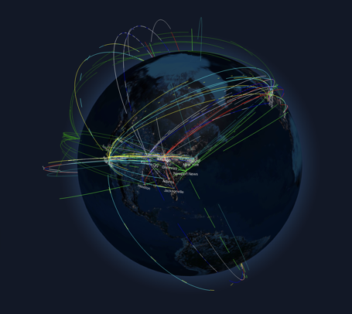
OSDF
Advantages
Available from all pods
Available from your laptop (with the right tool)
Distributed caches throughout the world provide consistent performance
Frequent or repeated access can see speedups over S3 access
Disadvantages
No mounting on the filesystem. Have to use tools to get / put data.
Either make the data public, or deal with credentials inside the container

Slide 11
Ephemeral
Advantages
Very fast access
On many nodes, will be on NVMe
Disadvantages
Only available for the lifetime of the pod
Increasing the size can decrease the nodes capable of handling the storage
Have to pull down the data from another storage resource
Have to put ephemeral storage usage in the pod resource “requests”

Slide 12
Importance of picking the right storage option for you
Let's say you are trying to install PyTorch in your PVC, what should you use?
If your PVC is in the western region:
Installing PyTorch | Western Region | Central Region
CEPHFS | 5.5 minutes | 25 minutes
CEPH RBD | 25 seconds | 33 seconds
Lower is better

Slide 13
Importance of picking the right storage option for you
CEPHFS requires metadata operations to a small number of servers
Each file creation / access requires communication
RBD file access is not per file
Installing PyTorch | Western Region | Central Region
CEPHFS | 5.5 minutes | 25 minutes
CEPH RBD | 25 seconds | 33 seconds
Lower is better

Slide 14
Importance of picking the right region option for you
Reading and writing of even single files gets longer for regions!
To read a 50GB files from a Western RDB PVC, normalized to western region
(CEPH has some write cache, making writes appear faster)
Normalized to western region
Installing PyTorch | Western Region | Central Region | Eastern Region
Write 50GB | 1 | 1.3x | 2.2x
Read 50GB | 1 | 5.6x | 9x
Lower is better

Slide 15
Importance of picking the right region option for you
There is a tradeoff to region locking:
Locking your compute to the same region as your storage severely limits the availability of compute power
But, running in a region without your storage nearby can severely decrease efficiency
Installing PyTorch | Western Region | Central Region | Eastern Region
Write 50GB | 1 | 1.3x | 2.2x
Read 50GB | 1 | 5.6x | 9x
Lower is better

Slide 16
Closing Thoughts
Choosing the ideal storage option for your workflow requires knowledge of your IO patterns
A great rule of thumb is that if you don’t know which to use, a CEPH RBD volume is an acceptable choice, if non-optimal
Keep in mind the tradeoff between storage region and compute region.
The OSDF option is evolving, and will continue to evolve over the next year to become easier to use

