Slide 1
NRP Use Case for Training, Testing & Using Large Satellite Foundation Models
Dr. David Bell
Director of the USRA Research Institute for Advanced Computer Science
Co-Founder of the GenAI Lab for Science & Engineering (2024-Present)
Co-Founder of the Quantum AI Lab (2012-Present)
NRP/PRP Partner since 2021
January 2025

Slide 2
Partnership with NASA to advance AI, Supercomputing & HCI with Academia
USRA-RIACS - Founded in 1983 in collaboration with NASA in Silicon Valley
Industry is making rapid advances in supercomputer technology, human computer interfaces, and artificial intelligence.
…
A major commitment is the establishment of an independent Research Institute for Advanced Computer Science (RIACS), to be operated at Ames Research Center by the Universities Space Research Association”
Transmitted from President Reagan to the U.S. Congress in 1983

Slide 3
40+ Years of AI R&D with NASA, Academia & Industry

Slide 4
Generative AI Lab for Science & Engineering - Started in 2024
AI R&D Collaboration
AI Solutions
Academia
Partnerships
Developing, Testing & Evaluating GenAI Solutions for Scientific & Engineering Applications
At Scale
Government
Industry

Slide 5
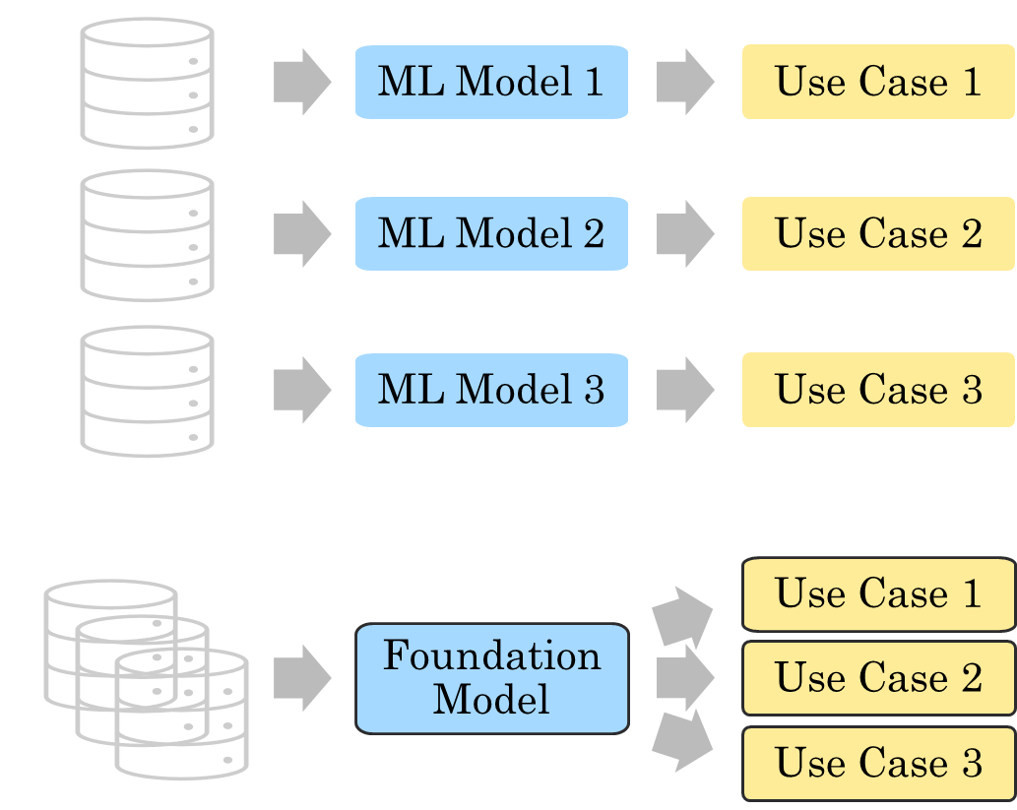
Training a Foundation Model in NRP for Multiple Downstream Use Cases
From
Task Specific Models
Multiple models trained, one for each use case
To
One Foundation Model (FM)
One global model for multiple use cases
Large Language Models (LLMs) are one type of FM
Extreme Rain
Tropical Cyclones
Atmospheric Rivers

Slide 6
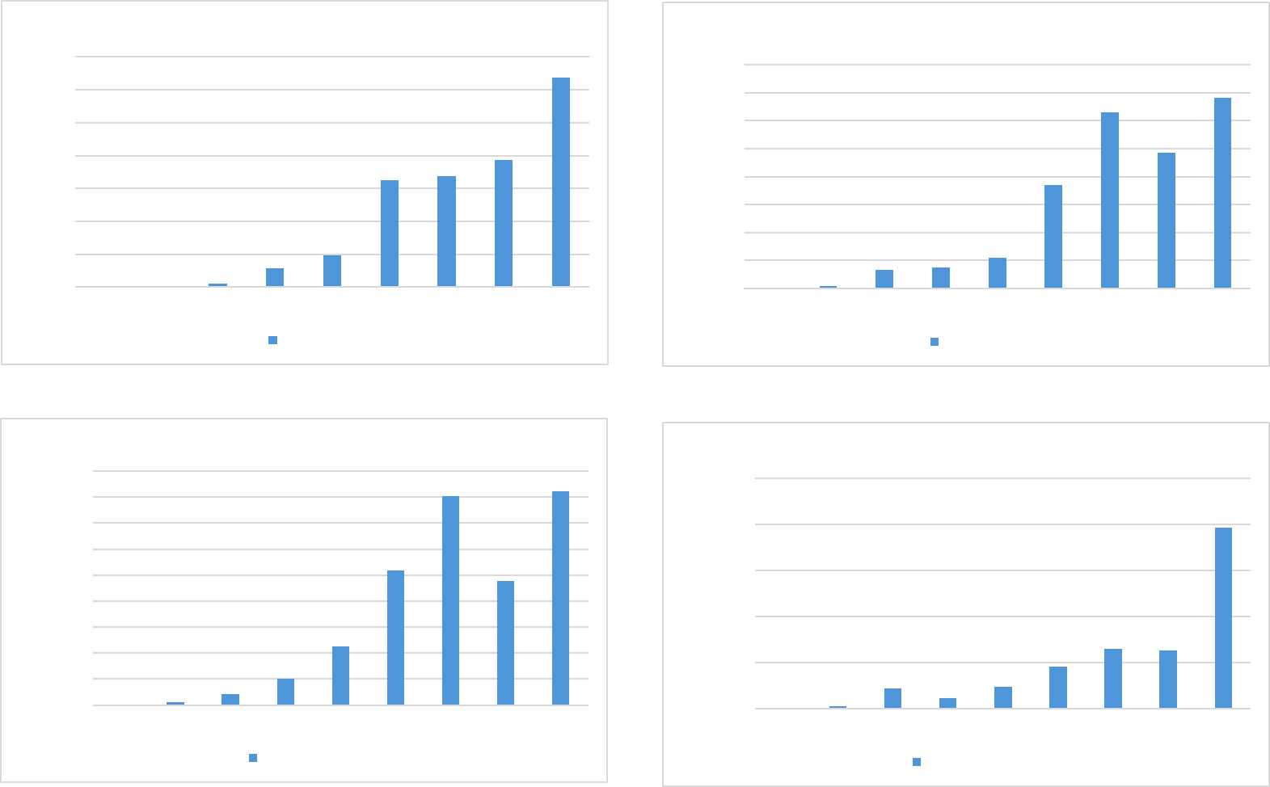
Training Foundation Models with the National Research Platform
Distributed Computing
Distributed Data
Compute
32-48 A10 GPUs for distributed compute (4-6 nodes w/8 GPUs each in Central)
~15 days to train the FM w/10 nodes
Data Reads
~77TB of raw data in CephFS East (NetCDF)
~15TB of ML ready data in S3 East (Zarr)
~4TB cache distributed across each node in NVMe (10X speedup vs S3)
~83M reads for 100K training steps
Data Writes
Checkpoints & logs to CephFS East (~1GB/3 hour)
Desired Capabilities
Higher GPU memory to reduce cache reads 83X
High data transfer speed between all nodes
Monthly stats on data use (read/write)

Slide 7
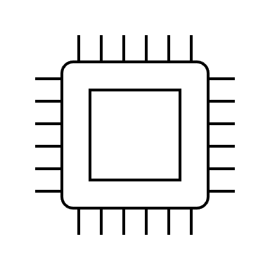
Data Architecture
STORAGE
NODES
SSD
RAM
GPUs
SSD
RAM
GPUs
SSD
RAM
GPUs
SSD
RAM
GPUs
CephFS
~77TB
NVMe (1TB)
24GB
A10
NVMe (1TB)
24GB
A10
NVMe (1TB)
24GB
A10
NVMe (1TB)
24GB
A10
24GB
A10
24GB
A10
24GB
A10
24GB
A10
24GB
A10
24GB
A10
24GB
A10
24GB
A10
24GB
A10
24GB
A10
24GB
A10
24GB
A10
S3
~15 TB
24GB
A10
24GB
A10
24GB
A10
24GB
A10
24GB
A10
24GB
A10
24GB
A10
24GB
A10
24GB
A10
24GB
A10
24GB
A10
24GB
A10
24GB
A10
24GB
A10
24GB
A10
24GB
A10
EAST
CENTRAL

