Slide 1
Strategies and Highlights
of the First Year of CENIC AIR
6NRP Presentation| January 29, 2025
Tony Naughtin, Sr. Advisor to CENIC & CENIC AIR

Slide 2
CENIC is a 501(c)(3) public benefit corporation with the mission to advance education and research statewide by providing a world-class network essential for innovation, collaboration, and economic growth.
California K-12 System
California State University System
Charter Associates:
California K-12 System
California Community Colleges
California State University System
Stanford, Caltech, USC
University of California System
California Public Libraries
Naval Postgraduate School
Other Members Include:
Scientific and Cultural Institutions
Private Colleges and Universities
Hospitals and Specialized Medical Institutions
Biomedical, Science, Space, & Environmental Research Organizations
Tribal Nations
Stanford, Caltech, USC
University of California System
University of Southern California System
California Community Colleges
California Institute of Technology
California Public Libraries
Naval Postgraduate School

Slide 3
What is CENIC AIR?: Program, Goals, Evolution

Slide 4
CENIC’s CalREN Serves 20 million+ Californians
Connects over 12,000 sites across all 58 counties
Owns or operates over 8,000 miles of optical fiber
Collaborates with over 800 private-sector partners
University of California
541,573
Students, Faculty & Staff connected to CENIC’s CalREN (spring 2024)
Independent Universities
128,472
Students, Faculty, & Staff connected to CENIC’s CalREN (spring 2024)
California State Univ.
517,997
Students, Faculty & Staff connected to CENIC’s CalREN (fall 2023)
Has spent 28 years connecting California
California Community Colleges
1.9 Million
on 116 campuses (fall 2023)
One of five CC students in US attends a CCC connected to CENIC’s CalREN
California K-12 Schools
5.8 Million
Students, Faculty, & Staff 58 counties, 1,018 districts 10,010 schools (2022/2023)
California Public Libraries
74.1 Million
Visitors (in 2022/2023)
Over 85% of libraries in participating jurisdictions are connecting at 1 Gbps or higher.
Hospitals & Health Care
9 hospitals
Over 10 million outpatient visits and 2 million inpatient days
Over 50,000 employees served
Tribal Nation Partners
12 Tribal Nations
17 Reservations 13 Libraries
~550 homes
105 Tribal municipalities
10/25/24
Notes:
Backbone -- and several network “layers” -- plus metro fiber, and thousands of last mile circuits that we purchase from nearly every ISP in California. Fiber to research universities, CSU, and larger organizations (e.g., LAUSD). Most members are connected at a minimum of 1Gbps symmetrical services; many at multiple 10Gbps; and an increasing number with one or more 100Gbps connections -- soon to be 400Gbps at our leading research universities.

Slide 5
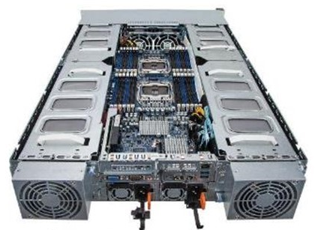
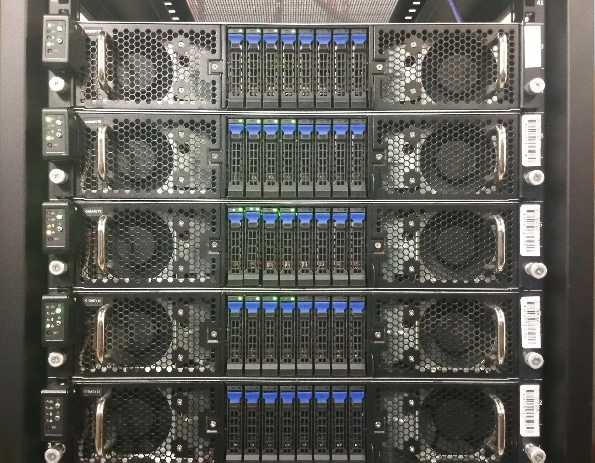
Data Transfer Nodes (DTNs) Terminate CENIC’s Fiber Optics on Campuses: Flash I/O Network Appliances (FIONAs)
GPU-based Nautilus Nodes Solved the Disk-to-Disk Data Transfer Problem at Near Full Speed on Best-Effort 10G, 40G and 100G
Add Up to 8 Nvidia GPUs Per 2U FIONA
To Add Machine Learning Capability
Up to 240TB Storage
Nautilus Nodes Are Rack Mounted
FIONAs Designed by UCSD’s Phil Papadopoulos, John Graham, Joe Keefe, and Tom DeFanti
Notes:
In the last 10 years there have been a series of developments important to AI and the advancement of AI resources and capabilities in R+E, and the opportunity to leverage in California the large and prominent R+E community and institutions with the CENIC’s high performance network that virtually all of the state’s K-20 institutions connect to. This, along with the membership of these institutions in CENIC, coalesces together the technology, common interests, and common objectives of these CENIC members (regardless of their level within the K-20 sector) for purpose of advancing AI infrastructure, AI research capabilities, and an AI trained workforce in the state and eventually at a very large scale.

Slide 6
What is CENIC AIR?: Program, Goals, Evolution cont.
…California-based, on-campus resources dedicated primarily to AI research
2015-2023: NRP / PRP / CENIC AIR: CENIC was a first mover among R+E network to support NRP/PRP sites
Why “CENIC AIR” and why CENIC?
CENIC engineering: increasingly involved in PRP/CENIC AIR installations since 2016
Logical to promote the program via CENIC as the well-established R+E network in the state with a large, active member base across all segments of California R+E
Program formally renamed CENIC AIR in 2023
Notes:
UCSD’s creation of the Nautilus standard for NSF-funded NRP/PRP hyperclusters on college campuses regionally and around the US
2015- present: UCSD and SDSC technical support (mainly OSI Layers 6-7) of NRP/PRP hypercluster nodes; CENIC support in California (Layers 2-5)
2015-present: PRP was initiated as part of this national effort in California, with CENIC providing pre-installation assessment of network connectivity and public IP access for campuses bringing on PRP Science DMZs (i.e. sufficiency of current campus network availability, BGP configuration assistance if needed, enablement and support of a parallel HPC/public IP connection to a campus if needed or recommended, other)
By 2023, with a growing number of CENIC-member institutions in California installing or committing to install PRP Science DMZs for AI R+D purposes, the PRP was renamed the CENIC AI Resource (“CENIC AIR”).
CENIC Engineering became increasingly involved in providing installation and on-going support (through the network layers of the stack) as the number of CENIC AIR colocations has increased onto more and more higher ed campuses throughout California
It became recognized that CENIC, as a well-established provider of high-performance networking serving all of K-20 in California, and with a very large, very active, and very horizontal membership base, is a logical partner to promote, install and support CENIC AIR Science DMZs as an essential AI resource for California

Slide 7
CENIC AIR: Why is It Important and Strategic?

Slide 8
CENIC AIR: Why is It Important and Strategic?
Not news: a broad AI revolution is already here, and already advancing a fundamental shift in society and economies
2 challenges exemplified:
Forrester: by 2030 AI will eliminate 2.4M jobs, many of those held by people of color, and many of those in California
McKinsey: by that time AI produces a net gain from present of about 3M jobs for those with AI skills
California’s AI future presents enormous promise, but only if we meet AI’s challenges to our workforce of tomorrow
At the same time, Democratize and promote equity in the development and application of AI
Notes:
I simply cannot state these points in a manner that is as impactful and inspiring as when Larry Smarr or Tom DeFanti speak them, but…
“Challenges Exemplified” are from a UCLA summary article: https://newsroom.ucla.edu/magazine/ai-revolution-waymo-one-jobs-environment-health-justice

Slide 9
CENIC AIR: Why is It Important and Strategic? cont.
To Democratize AI, among other things, means we won’t merely stand by as hyperscalers and let large tech companies define our AI future with little regard for the social and economic impact AI has on our state and our nation
R+E, and particularly R+E in California, has a significant opportunity to play a leading role the state, and the nation, in this AI transformation
CENIC AIR can evolve into being a long term, strategic resource providing a foundation on which California not only adapts to the AI revolution, but creates new social and economic value from it
Notes:
I simply cannot state these points in a manner that is as impactful and inspiring as when Larry Smarr speaks them, but…I add more talking points as narrative underneath these bullets

Slide 10
CENIC AIR: Why is It Important and Strategic? cont.
CENIC AIR will be largely unaffected by any broad potential cuts to federal funding of AI R+D work in education - though related programs such as NAIRR are threatened
CENIC AIR and California will carry on with the important work of conducting AI research and development, and training AI professionals, with or without federal funding
Notes:
I simply cannot state these points in a manner that is as impactful and inspiring as when Larry Smarr speaks them, but…I add more talking points as narrative underneath these bullets

Slide 11
CENIC AIR: Implementation Strategy and Approach

Slide 12
CENIC AIR: Implementation Strategy and Approach
CENIC AIR: a standardized, highly scalable, highly-supportable approach
Nautilus: standard hardware and software configs using Ceph storage and Kubernetes containers
see https://nationalresearchplatform.org/nautilus/
Participation options: range from Jupyter Notebooks to campus-colo’d Science DMZs (full Nautilus), with technical support provided by SDSC, UCSD, and CENIC
Notes:
Standardization is, of course, the key to achieving scale for infrastructure and infrastructure services, and is key to enabling high-quality technical support at scale,
The NRP and CENIC AIR are based on a consistent, standardized approach using Science DMZs and Nautilus hw/sw configurations to create a local high-performance, high-availability set of resources dedicated to AI R+D
(see https://nationalresearchplatform.org/nautilus/)
Nautilus is a HyperCluster configuration for running containerized Big Data Applications
Kubernetes containers are the R+D environment running on Nautilus configs, and using Ceph for data storage and management
Standardization is, of course, the key to achieving scale for infrastructure and infrastructure services, and is key to enabling high-quality technical support at scale
CENIC’s technical support role in this is through the network layer for pre-install network assessment, network device installation/configuration, and on-going NetOps support (4 NetOps support options
The NRP and CENIC AIR are based on a consistent, standardized approach using Science DMZs and Nautilus hw/sw configurations to create a local high-performance, high-availability set of resources dedicated to AI R+D
(see https://nationalresearchplatform.org/nautilus/)
Nautilus is a HyperCluster configuration for running containerized Big Data Applications
Kubernetes containers are the R+D environment running on Nautilus configs, and using Ceph for data storage and management
Kubernetes is an open source system to deploy, scale, and manage containerized applications anywhere. Ceph is an open source system for storage management
Within NRP/CENIC AIR approach, Nautilus utilizes Kubernetes for managing and scaling containerized applications
Kubernetes enables bursting of processing and storage resources to other CENIC AIR and NRP Science DMZs if local CENIC AIR resources for processing and storage are approaching their headroom or at capacity
As with many value-creating assets CENIC AIR it will evolve, expand, and become an increasingly production quality
Once the new value creation capabilities of a new technology or resource become clear it grows to pervasiveness and becomes a standard, if not expected resource
There is much work to do to create and support very large scale, if not ubiquity, for CENIC AIR and the NRP more broadly. Beyond enabling considerable R+E capabilities for AI, it is noteworthy that this programmatic NRP/CENIC AIR endeavor has the potential to become one of the most pervasive and important, non-commercial edge computing resources in the world.

Slide 13
CENIC AIR: Implementation Strategy and Approach cont.
CENIC AIR nodes can burst to other available CENIC AIR or NRP nodes when local compute/storage resources approach headroom, allowing scale and unimpeded access to processing and storage resources
Notes:
Standardization is, of course, the key to achieving scale for infrastructure and infrastructure services, and is key to enabling high-quality technical support at scale,
The NRP and CENIC AIR are based on a consistent, standardized approach using Science DMZs and Nautilus hw/sw configurations to create a local high-performance, high-availability set of resources dedicated to AI R+D
(see https://nationalresearchplatform.org/nautilus/)
Nautilus is a HyperCluster configuration for running containerized Big Data Applications
Kubernetes containers are the R+D environment running on Nautilus configs, and using Ceph for data storage and management
Standardization is, of course, the key to achieving scale for infrastructure and infrastructure services, and is key to enabling high-quality technical support at scale
CENIC’s technical support role in this is through the network layer for pre-install network assessment, network device installation/configuration, and on-going NetOps support (4 NetOps support options
The NRP and CENIC AIR are based on a consistent, standardized approach using Science DMZs and Nautilus hw/sw configurations to create a local high-performance, high-availability set of resources dedicated to AI R+D
(see https://nationalresearchplatform.org/nautilus/)
Nautilus is a HyperCluster configuration for running containerized Big Data Applications
Kubernetes containers are the R+D environment running on Nautilus configs, and using Ceph for data storage and management
Kubernetes is an open source system to deploy, scale, and manage containerized applications anywhere. Ceph is an open source system for storage management
Within NRP/CENIC AIR approach, Nautilus utilizes Kubernetes for managing and scaling containerized applications
Kubernetes enables bursting of processing and storage resources to other CENIC AIR and NRP Science DMZs if local CENIC AIR resources for processing and storage are approaching their headroom or at capacity
As with many value-creating assets CENIC AIR it will evolve, expand, and become an increasingly production quality
Once the new value creation capabilities of a new technology or resource become clear it grows to pervasiveness and becomes a standard, if not expected resource
There is much work to do to create and support very large scale, if not ubiquity, for CENIC AIR and the NRP more broadly. Beyond enabling considerable R+E capabilities for AI, it is noteworthy that this programmatic NRP/CENIC AIR endeavor has the potential to become one of the most pervasive and important, non-commercial edge computing resources in the world.

Slide 14
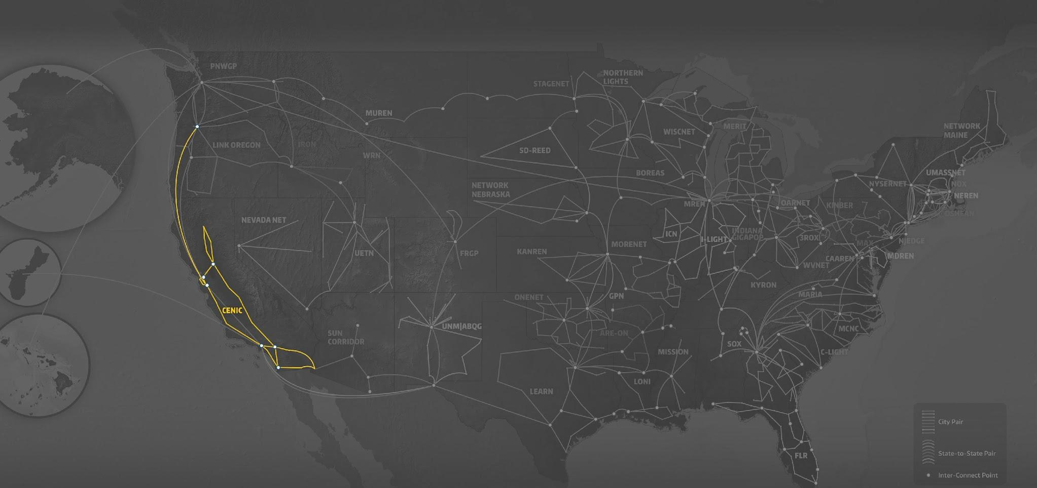
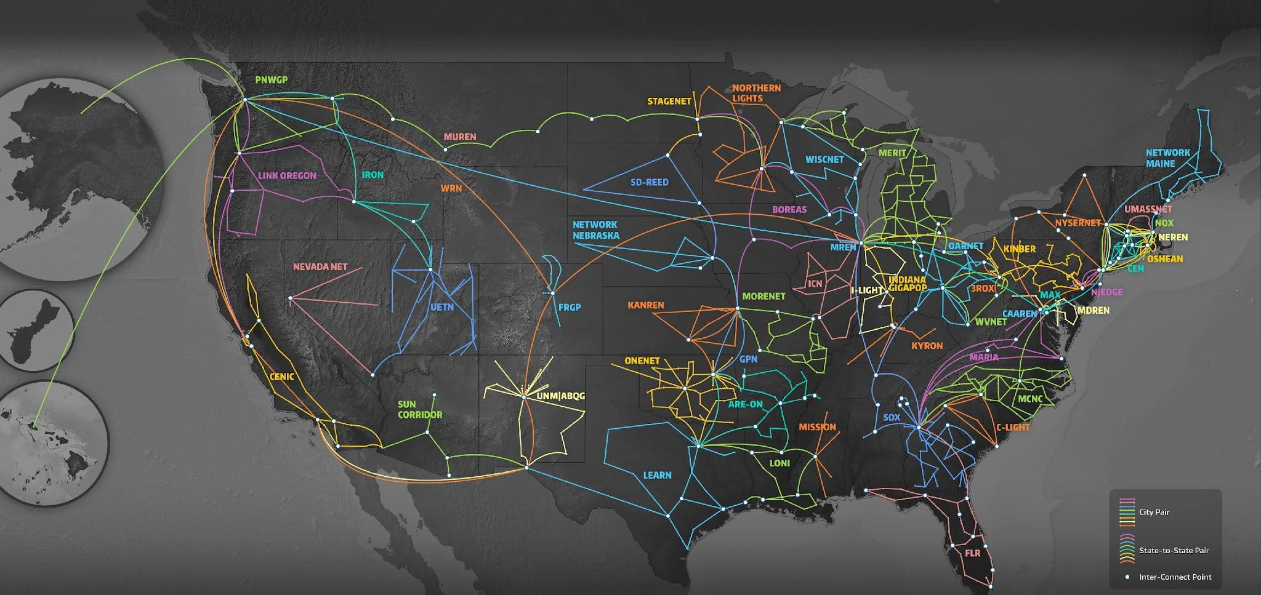
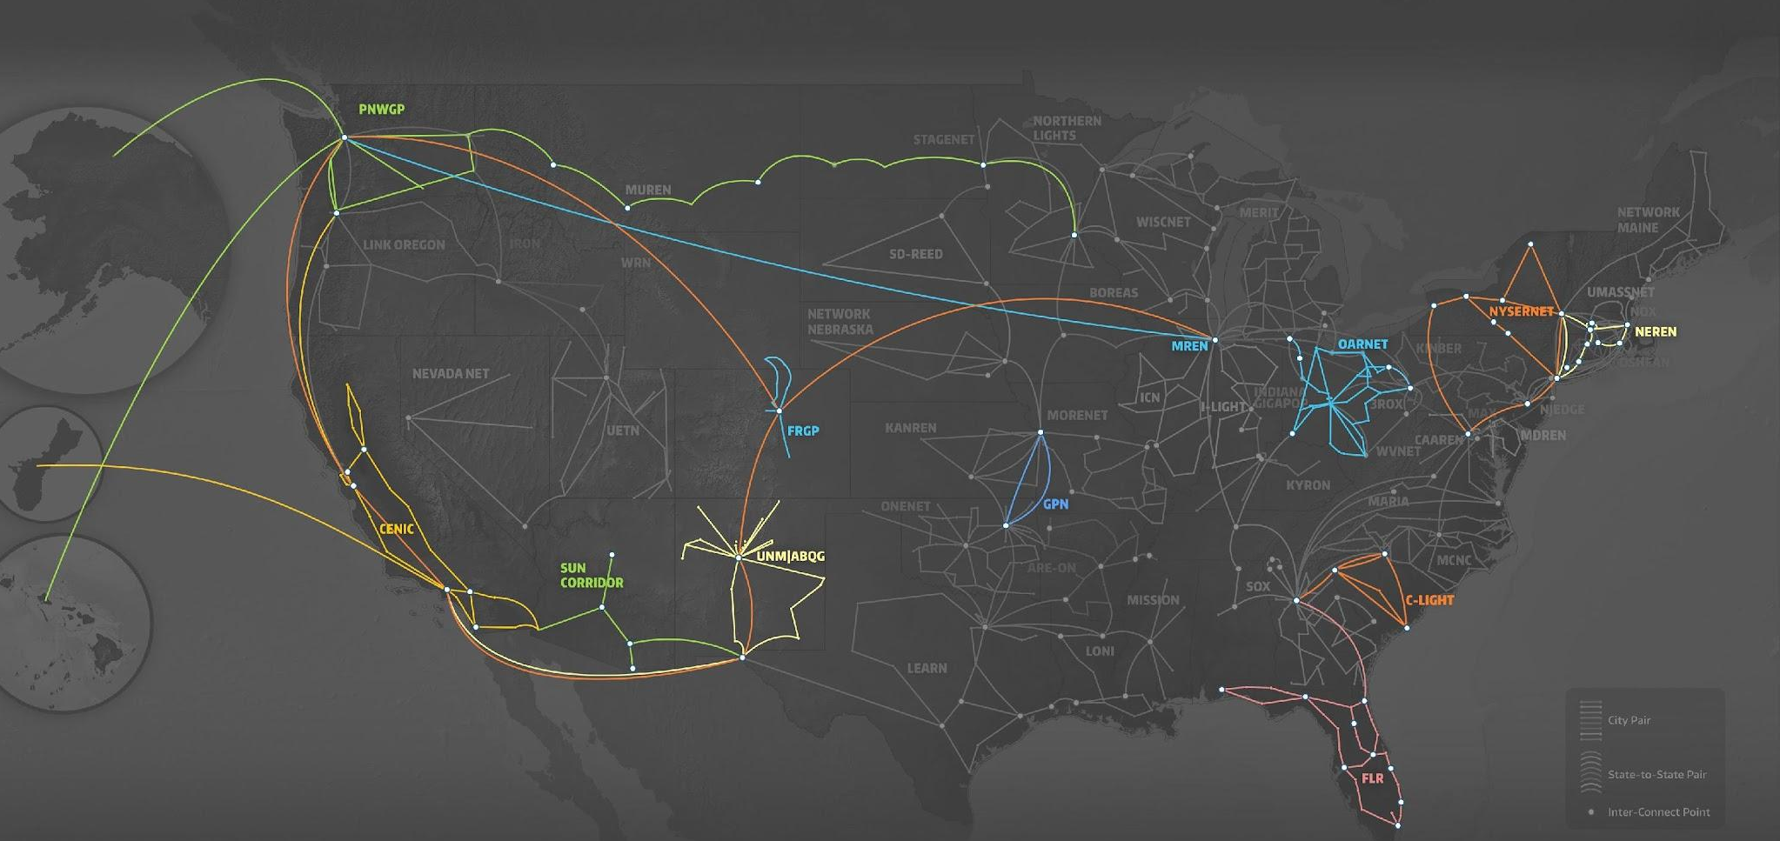
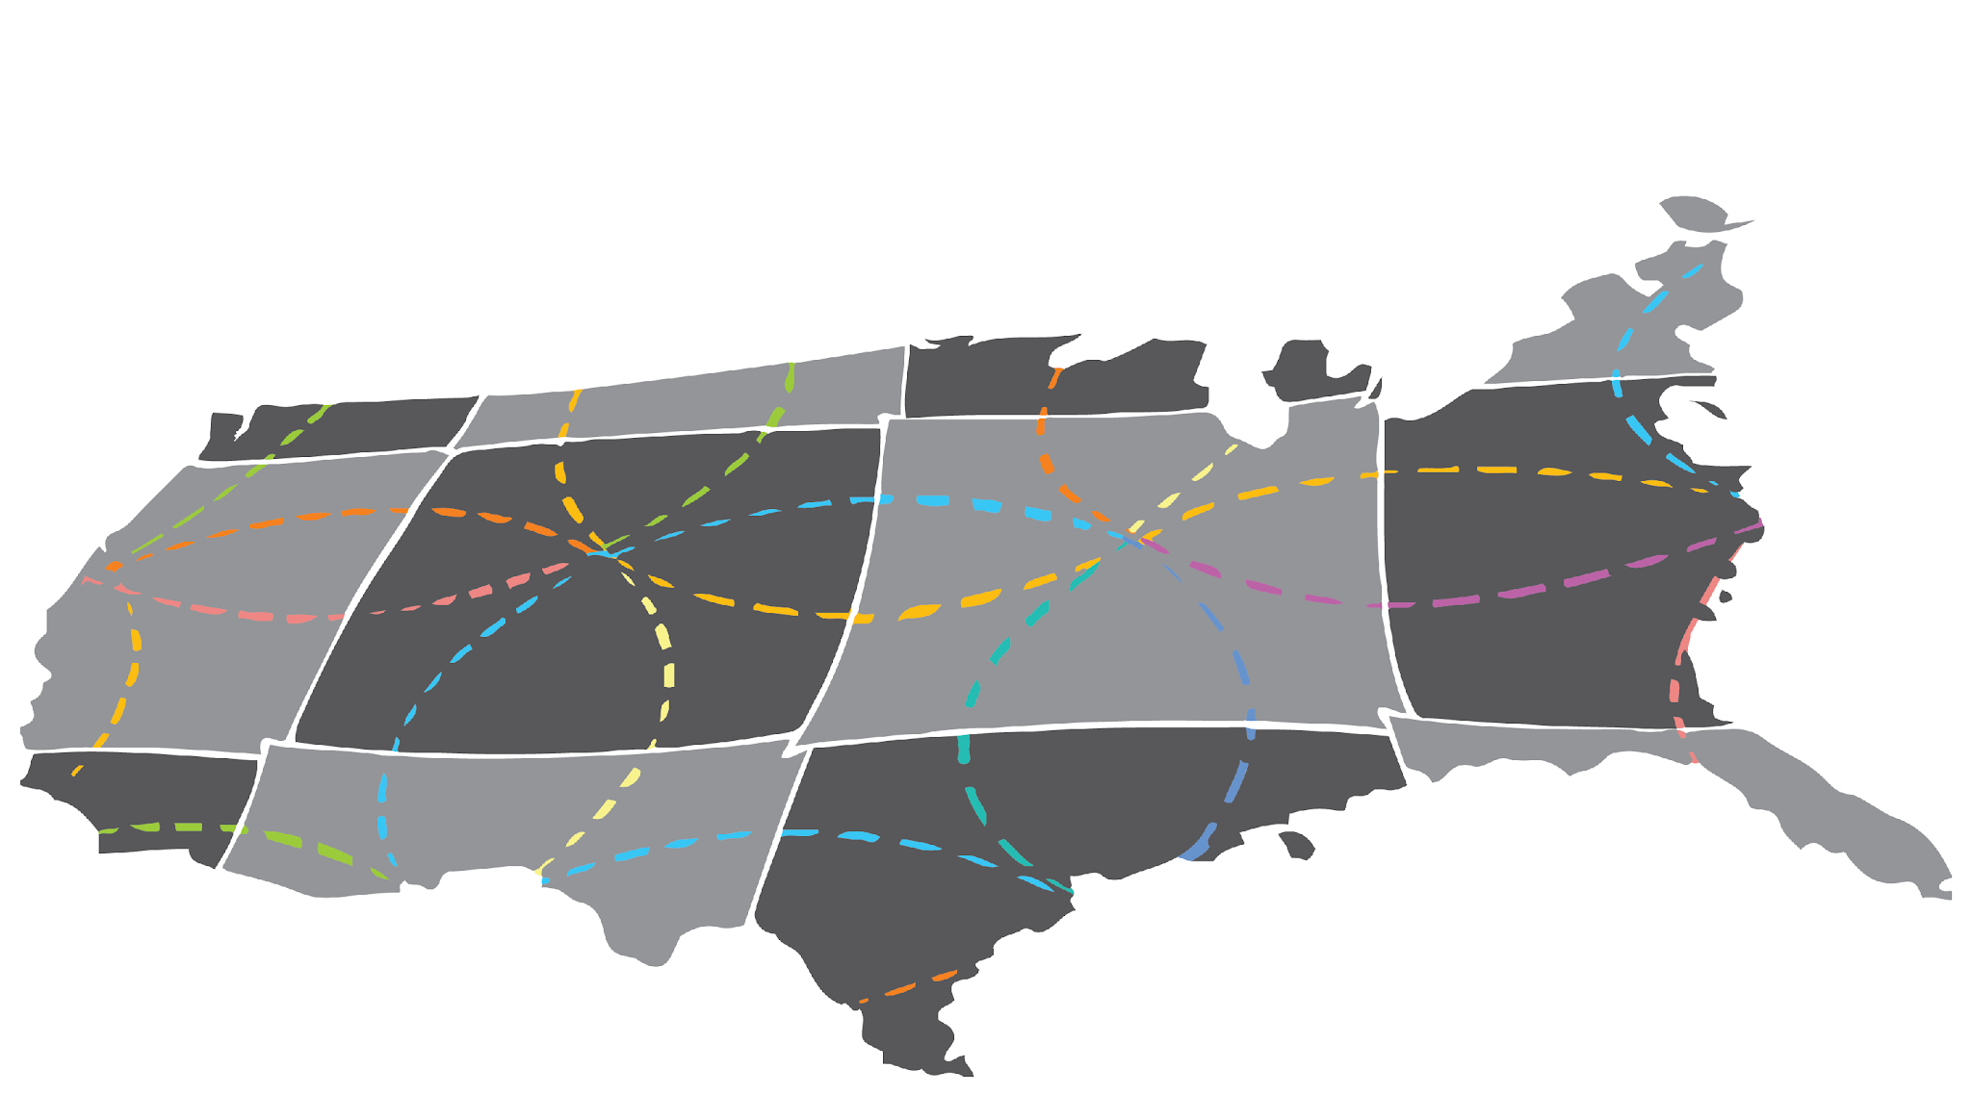
The Users of CENIC AIR Can Burst into NRP’s Nautilus Hypercluster Outside of California
# of GPUs / Regional Opt. Network
# of GPUs / Regional Opt. Network
Minority Serving Institutions
EPSCoR Institutions
Non-MSI Institutions
Minority Serving Institutions
EPSCoR Institutions
Non-MSI Institutions
U S. Dakota + SD State
NYSERNET
4 / GPN
19 / NYSERnet
U Nebraska-L
UIC
162 / GPN
10 / MREN
UCI + UCR + UCM + UCSC + UCSB
SW OK State
MGHPCC
U Guam
1 / GPN
CWRU
1 / CENIC/Pac. Wave
111 / CENIC
2 / OARnet
144 / NEREN
Kansas State U
U Missouri
CSUSB + SDSU
4 / GPN
44 / GPN
U Delaware
143 / CENIC
12 / NYSERnet
UCSD
Clemson U
U Hawaii
514 / CENIC
U New Mexico
19 / SCLR
2 / CENIC/Pac. Wave
1 / Albuquerque GigaPoP
Sun Corridor
1 / Sun Corridor
FAMU + Florida Int’l
7 / FLR

Slide 15
CENIC AIR: Implementation Strategy and Approach cont.
Hosting partners can add (and support) compute and storage resources on top of standard Nautilus as they may prefer
Noteworthy: Nationally distributed Nautilus-based NRP and CENIC AIR Science DMZs together hold the potential to become one of the largest non-commercial, managed, edge-computing resources in the US or even globally
Notes:
Standardization is, of course, the key to achieving scale for infrastructure and infrastructure services, and is key to enabling high-quality technical support at scale,
The NRP and CENIC AIR are based on a consistent, standardized approach using Science DMZs and Nautilus hw/sw configurations to create a local high-performance, high-availability set of resources dedicated to AI R+D
(see https://nationalresearchplatform.org/nautilus/)
Nautilus is a HyperCluster configuration for running containerized Big Data Applications
Kubernetes containers are the R+D environment running on Nautilus configs, and using Ceph for data storage and management
Standardization is, of course, the key to achieving scale for infrastructure and infrastructure services, and is key to enabling high-quality technical support at scale
CENIC’s technical support role in this is through the network layer for pre-install network assessment, network device installation/configuration, and on-going NetOps support (4 NetOps support options
The NRP and CENIC AIR are based on a consistent, standardized approach using Science DMZs and Nautilus hw/sw configurations to create a local high-performance, high-availability set of resources dedicated to AI R+D
(see https://nationalresearchplatform.org/nautilus/)
Nautilus is a HyperCluster configuration for running containerized Big Data Applications
Kubernetes containers are the R+D environment running on Nautilus configs, and using Ceph for data storage and management
Kubernetes is an open source system to deploy, scale, and manage containerized applications anywhere. Ceph is an open source system for storage management
Within NRP/CENIC AIR approach, Nautilus utilizes Kubernetes for managing and scaling containerized applications
Kubernetes enables bursting of processing and storage resources to other CENIC AIR and NRP Science DMZs if local CENIC AIR resources for processing and storage are approaching their headroom or at capacity
As with many value-creating assets CENIC AIR it will evolve, expand, and become an increasingly production quality
Once the new value creation capabilities of a new technology or resource become clear it grows to pervasiveness and becomes a standard, if not expected resource
There is much work to do to create and support very large scale, if not ubiquity, for CENIC AIR and the NRP more broadly. Beyond enabling considerable R+E capabilities for AI, it is noteworthy that this programmatic NRP/CENIC AIR endeavor has the potential to become one of the most pervasive and important, non-commercial edge computing resources in the world.

Slide 16
CENIC AIR: Accomplishments and Aspirations

Slide 17
CENIC-Connected Campuses Were Major Users of NRP Resources in 2024
10/1/2023 to 2/15/2024
University of California
UC Berkeley
UC Irvine
UC Los Angeles
UC Merced
UC Riverside
UC Santa Barbara
UC Santa Cruz
UC San Diego
Private Universities
Caltech
Stanford
California State Universities
Cal Poly Humboldt
Cal State Fullerton
Cal State Northridge
Cal State San Bernardino
San Diego State U.
Notes:
[Needs to be checked/updated for accuracy of number]

Slide 18
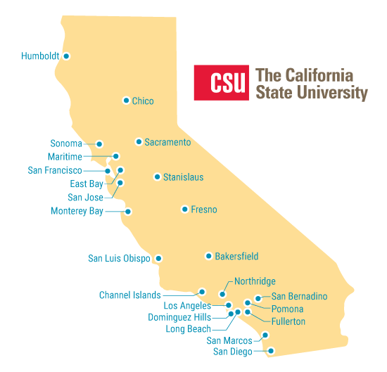
Broadening Inclusion in California: CENIC AIR is Increasingly Being Used by the California State University System

Slide 19
CENIC-Connected Campuses Are Major Users of NRP Resources
10/1/2023 to 2/15/2024
California State Universities
CENIC AIR in production: Cal State Chico, CSU Fullerton, Cal Poly Humboldt, Cal State San Bernardino, Sacramento State, Cal State Monterey Bay, San Diego State
Additional CSU campus installations in process: CSU Chancellor’s Office, Cal State Bakersfield, Cal State Fresno, Cal Poly Pomona
Additional CSU campuses pending
Notes:
[Needs to be checked/updated for accuracy of number]

Slide 20
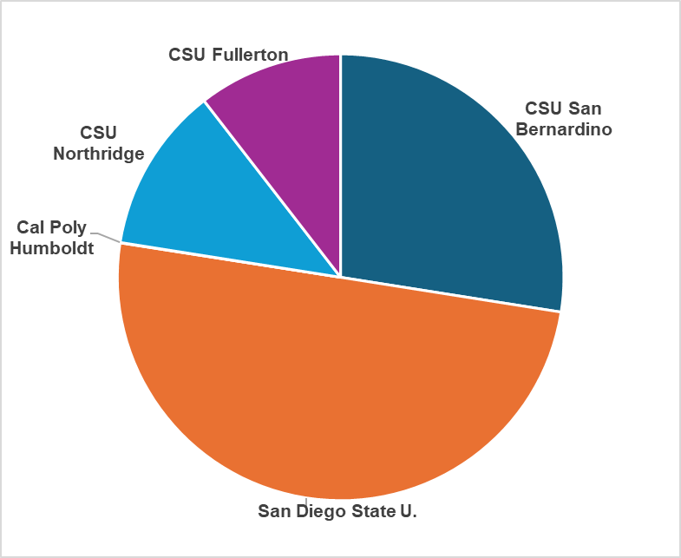
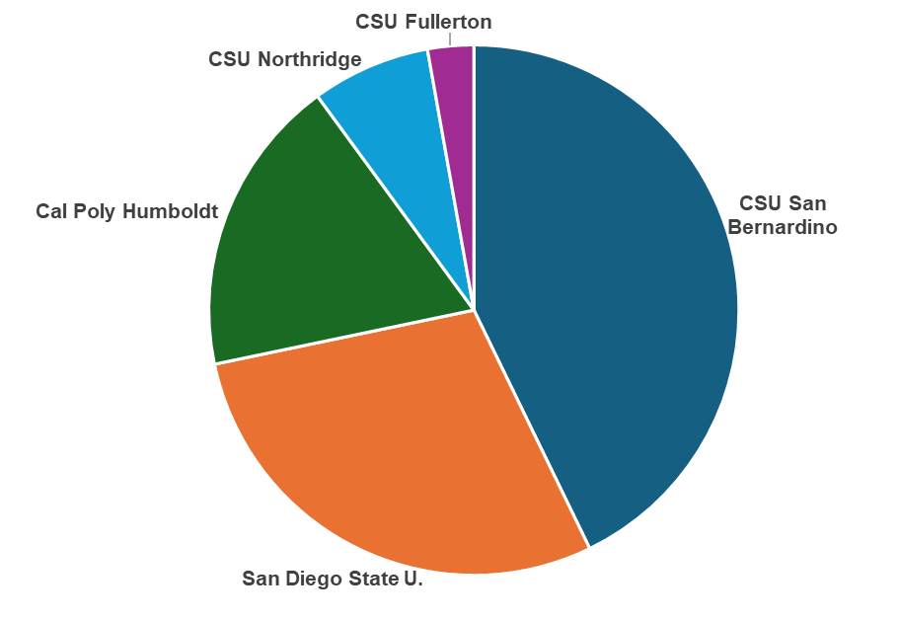
5 of 23 CSU Campuses Used Nautilus GPU and CPUs in 2024
274,687 GPU-Hours
3,996,250 CPU Core-Hours
Notes:
[Needs to be checked/updated for accuracy of number]

Slide 21
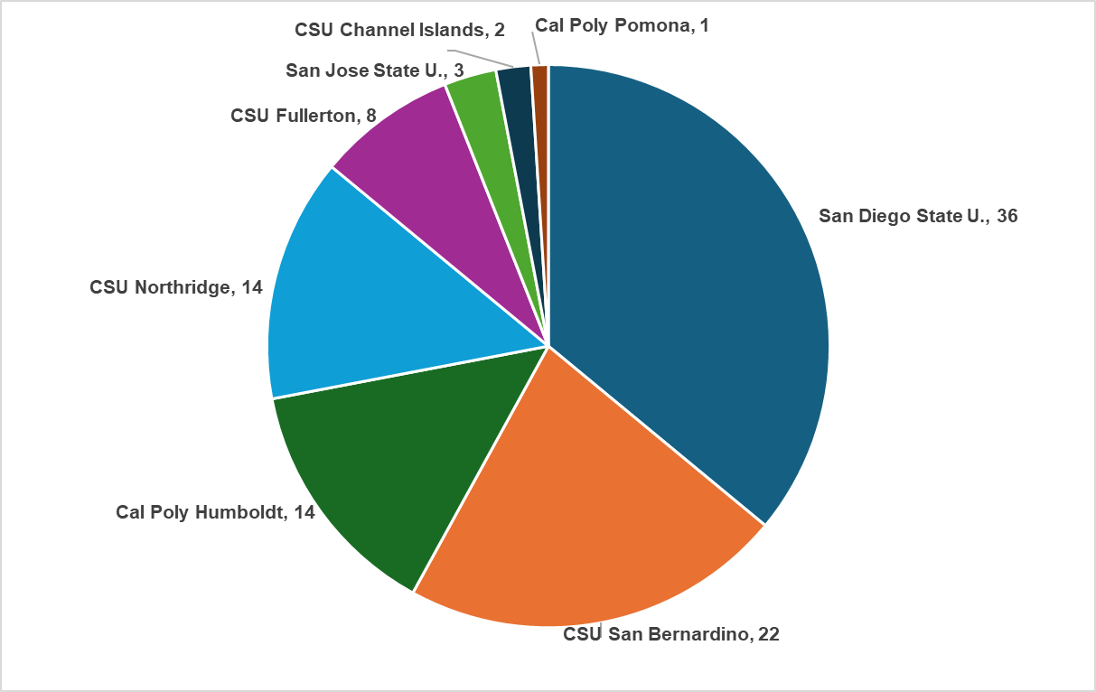
8 of 23 CSU Campuses Have Created 1 or More Nautilus Projects (Namespaces)
Total: 100 CSU Nautilus Namespaces
Notes:
[Needs to be checked/updated for accuracy of number]

Slide 22
jupyterhub is the Multi-User Version of the Jupyter Notebook
A multi-user version of the notebook designed for companies, classrooms and research labs

Slide 23
CSU Has Created Over 30 Namespaces with JupyterHub Embedded 256 CSU Users
Individual User’s GPU Hours From:
Cal Poly Humboldt
CSU Fullerton
CSU Northridge
CSU San Bernardino
San Diego State U.

Slide 24
CENIC-Connected Campuses Are Major Users of NRP Resources
10/1/2023 to 2/15/2024
California Community Colleges
San Diego CC District (4 CCs):
pioneering among the CCCs
Potential for 72 addtl CC Districts
(112 addtl CCCs)
Notes:
[Needs to be checked/updated for accuracy of number]

Slide 25
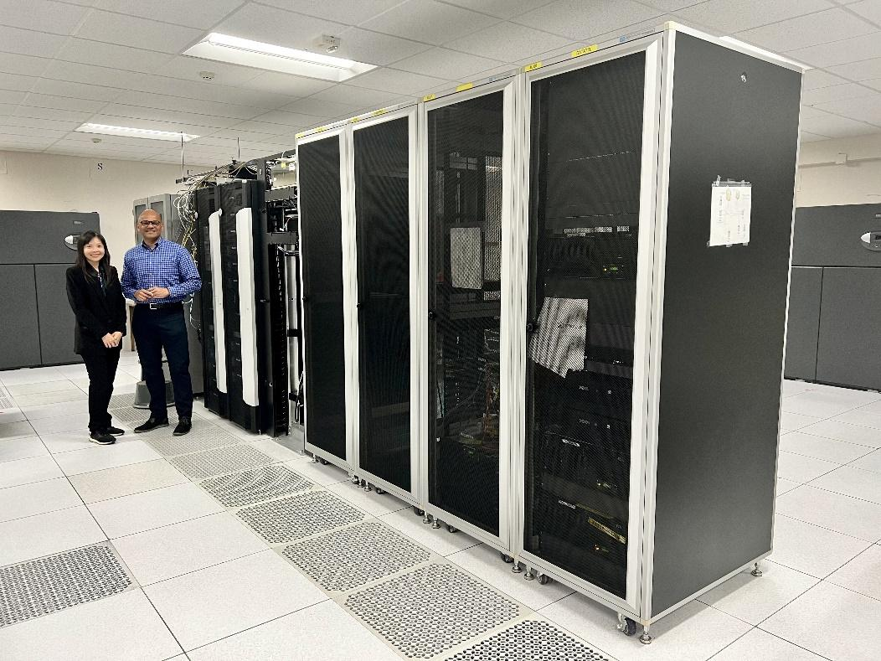
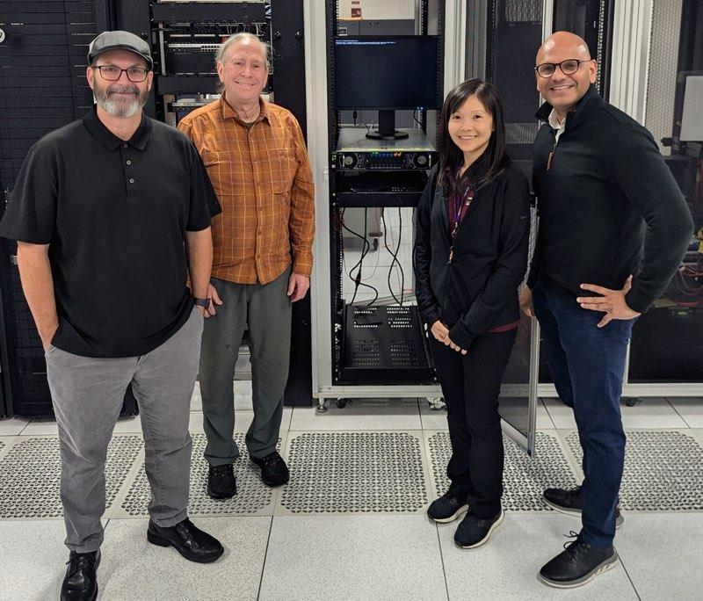
SDCCD Is a Pioneer: 1st California Community College
to Host CENIC AIR Computational Resources
First Nautilus Node server Installed
In a CCC Machine Room
August 30, 2024
Peter Maharaj, Rose Parnsoonthorn,
In the SDCCD Machine Room

Slide 26
An Attractive, Value-Added Opportunity
Notes:
CENIC AIR is an attractive, value-added option for many R+E institutions wanting to foster or grow AI-R+D capabilities and AI curricula.
Installation and technical support of an institution’s network/processing/storage infrastructure and assets of any kind, large or small, is certainly never easy
That said, CENIC AIR is, relatively speaking, an Easy Button to take advantage of for R+E institutions (of almost any type or stature) that wish to encourage, create, or expand their AI curricula, AI training, or AI-related R+D. That Easy Button itself is actually a key strategy toward achieving a proliferation of CENIC AIR Science DMZs throughout California in order to very effectively prepare the state for the AI future and the AI economy.
Join us!

Slide 27
Acknowledgements
CENIC AIR and the NRP are supported by NSF grants:
OAC-1541349, OAC-1826967, OAC-2030508, OAC-1841530, OAC-2005369, OAC-21121167, CISE-1713149, CISE-2100237, CISE-2120019, & OAC-2112167
SDSC
UCSD
And CENIC!

Slide 28
Thank you

