Slide 1
Expanding National Research Platform Usage through R&E Networks
6th National Research Platform Workshop
January 29, 2025
Notes:
Jen Leasure w/The Quilt – the national collaboration of regional research and education networks

Slide 2
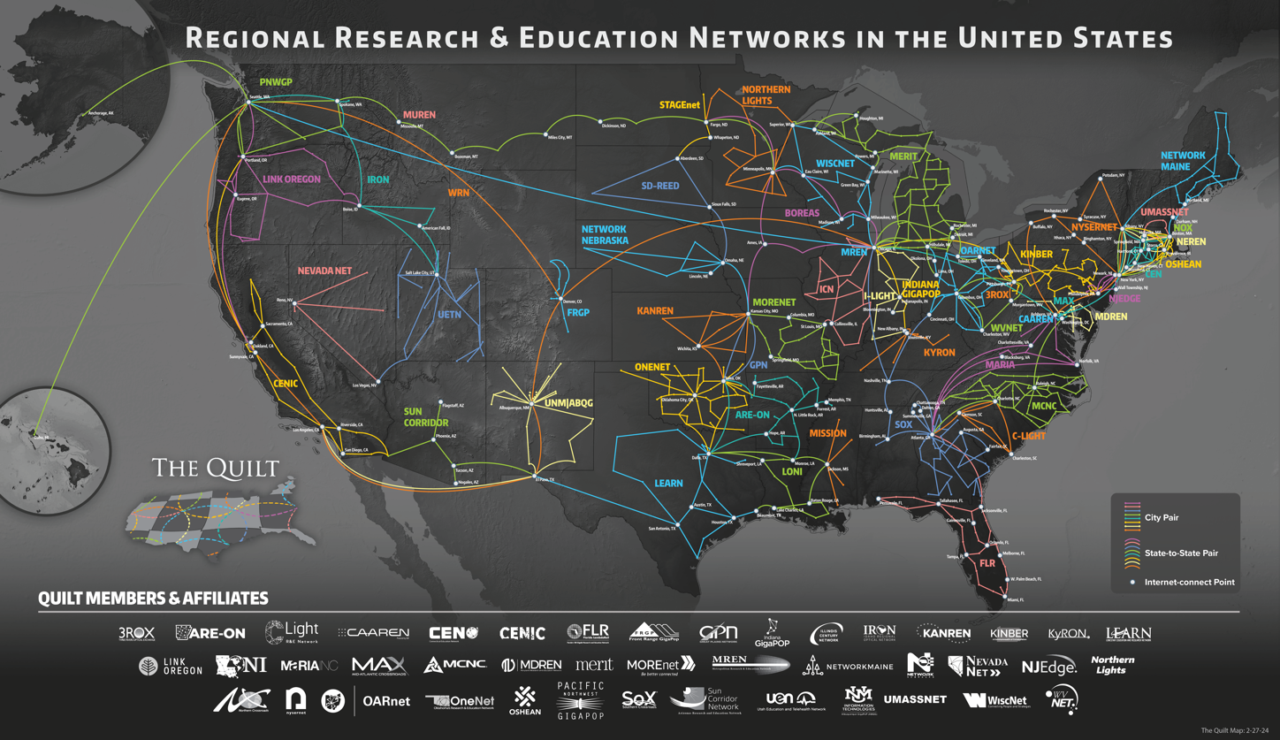
www.thequilt.net
Notes:
Many of you are familiar with this map of our country’s regional research and education networks.
We have Quilt member organizations represented here at the meeting: Show of hands?
This map represents the backbone of each of these organizations
What you don’t see are the last mile connections to approximately 1/3 of our country’s higher education institutions and other tens of thousands of community anchor institutions.

Slide 3
Profiles of Regional R&E Networks as CI Resources
Advanced networking providers
Regional aggregators of cyberinfrastructure resources connecting institutions to the national and global R&E fabric
Trusted technical consultants
Bridges to other national cyberinfrastructure resources and experts
Conveners of human networks
This support is especially important to broadening the reach of NRP and other CI Resources to Smaller Institutions
www.thequilt.net
Notes:
For today’s presentation, focusing on RENs as CI resources.
These organizations offer secure, resilient, high-capacity, high-performance networks.
They optimize advanced cloud services for demanding applications, network security, and research.
And they interconnect with Internet2, as well as other federal agency mission-driven science networks
These organizations serve as technical consultants for high-performance networking, cybersecurity, IPv6 adoption resources, MANRs, CI Plans, federated id management and other components of CI Plans mentioned in the CC* solicitation
They also serve as bridges that can recommend and connect you with other regional and national cyberinfrastructure experts like those mentioned on the previous slide.
And we know that just as important as the network infrastructure these organizations provide are the human networks that they help to foster. By nature, these organizations are collaborators and community builders so they also focus on opportunities to bring member institutions together to learn and share with one another.

Slide 4
RENs and Campus Partners with Nautilus Nodes Connected to NRP – Jan 2025
NYSERNet
OARnet
OneNet
PNWGP
SD-REED
Southern Crossroads
Sun Corridor
University of Hawaii
UIUC
Albuquerque GigaPoP
AMPATH
AREON
CENIC
C-Light
Edge
MGHPCC - Edge,OSHEAN, CEN, NYSERNet
Florida LambaRail
FRGP
GPN
KanREN
Merit
MOREnet
MREN
Network Nebraska
Northern Lights
Northern Crossroads

Slide 5
Regional Network Example: Georgia Tech / Southern Crossroads (SoX)
Participating with multiple nodes in the Southeast
Clemson University is also participating
Presentations from Dr. Alex Feltus and Dr. Larry Smarr to SoX community
FIONA nodes purchased as DTNs or perfSONAR test points are in process of redeploying as Nautilus nodes
Goal is to enable research within our community and looking to assist faculty unfamiliar with the platform
SoX is looking to collaborate on toolkits, demos, training we can share, invite, host, etc. for our community to help take advantage of the NRP
SoX offers connectivity and space for those interested in hosting nodes
Recent upgrade to 400G connectivity to ESnet and Internet2 – includes ESnet BW Challenge

Slide 6
CENIC AIR as a Blueprint for Other RENs
Quilt Focus this year on potential to leverage CENIC AIR as a model for other RENs
Panel at upcoming Quilt member meeting next week with CENIC and its community member stakeholders to share CENIC AIR with regional network community
Potential for a future REN-focused CENIC AIR workshop to share additional details about the model

