Slide 1
“Internet2 and QUILT Initiatives with Regional Networks”
Panel Presentation:
Larry Smarr (UCSD), Jen Leasure (Quilt), Mickey Slimp (GPN), Eric Buckhalt (SoX), James Deaton (Internet2)
Sixth National Research Platform Conference (6NRP)
UC San Diego
January 29, 2024

Slide 2
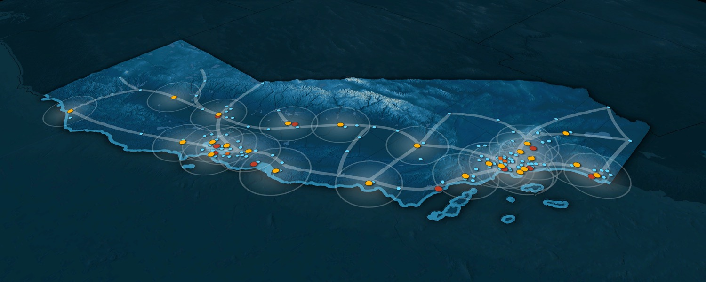
CENIC AI Resource (CENIC-AIR)
816 GPUs
UC Riverside
CENIC ADD/DROP
CENIC CAMPUS SITES
CENIC NON-CAMPUS SITES
227
24
431TB
C
P
U
G
P
U
CSU Chico
Sacramento State (soon)
28
8
0TB
CSU San Bernardino
C
P
U
G
P
U
28
8
0TB
Palo Cedro
C
P
U
G
P
U
196
16
0TB
Chico
C
P
U
G
P
U
Corning
UC Merced
CSU Fullerton
Humboldt
Sacramento
84
15
0TB
Colusa
C
P
U
G
P
U
572
96
0TB
Merced
C
P
U
G
P
U
Cal Poly Humboldt
Emeryville
Sunnyvale
Fresno
Riverside
88
8
0TB
Palm
Desert
El Centro
C
P
U
G
P
U
Bakersfield
Fullerton
San
Francisco
Palo
Alto
Soledad
Santa
Cruz
Monterey
Los
Angeles
Joining the
CENIC-Connected
CI Commons
gives the user access to:
816 GPUs; 11,417 CPU Cores; 4561 TB Storage and Growing!
San Luis
Obispo
San
Diego
Sunnyvale (CENIC)
Santa
Barbara
UC Los Angeles
UC San Diego
C
P
U
G
P
U
48
0
0TB
C
P
U
G
P
U
UC Santa Barbara
72
0
0TB
C
P
U
G
P
U
7568
521
2386TB
CPU cores/site
Sunnyvale (Internet2)
124
12
129TB
C
P
U
G
P
U
UC Irvine
San Diego State U
C
P
U
G
P
U
72
1
240TB
C
P
U
G
P
U
132
14
0TB
C
P
U
G
P
U
GPUs/site
1880
127
154TB
Stanford U
Caltech
32
0
318TB
Storage TB/site
C
P
U
G
P
U
72
0
350TB
C
P
U
G
P
U
UC Santa Cruz
LAX (CENIC)
433
28
594TB
Surrounded by additional resources in the:
National Research Platform
Open Science Grid
San Diego Supercomputer Center
Commercial Clouds
C
P
U
G
P
U
48
0
240TB
C
P
U
G
P
U
CSU Monterey Bay (soon)
28
8
594TB
C
P
U
G
P
U
CENIC 7/3/2024

Slide 3
Jen Leasure, President & CEO, The Quilt
www.thequilt.net

Slide 4
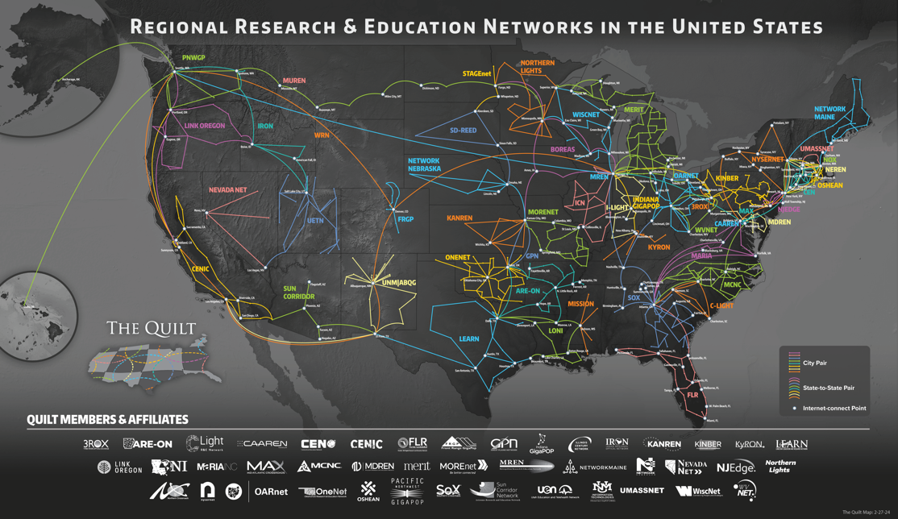
www.thequilt.net
Notes:
Many of you are familiar with this map of our country’s regional research and education networks.
We have Quilt member organizations represented here at the meeting: Show of hands?
This map represents the backbone of each of these organizations
What you don’t see are the last mile connections to approximately 1/3 of our country’s higher education institutions and other tens of thousands of community anchor institutions.

Slide 5
Profiles of Regional R&E Networks as CI Resources
Advanced networking providers
Regional aggregators of cyberinfrastructure resources connecting institutions to the national and global R&E fabric
Trusted technical consultants
Bridges to other national cyberinfrastructure resources and experts
Conveners of human networks
This support is especially important to broadening the reach of NRP and other CI Resources to Smaller Institutions
www.thequilt.net
Notes:
For today’s presentation, focusing on RENs as CI resources.
These organizations offer secure, resilient, high-capacity, high-performance networks.
They optimize advanced cloud services for demanding applications, network security, and research.
And they interconnect with Internet2, as well as other federal agency mission-driven science networks
These organizations serve as technical consultants for high-performance networking, cybersecurity, IPv6 adoption resources, MANRs, CI Plans, federated id management and other components of CI Plans mentioned in the CC* solicitation
They also serve as bridges that can recommend and connect you with other regional and national cyberinfrastructure experts like those mentioned on the previous slide.
And we know that just as important as the network infrastructure these organizations provide are the human networks that they help to foster. By nature, these organizations are collaborators and community builders so they also focus on opportunities to bring member institutions together to learn and share with one another.

Slide 6
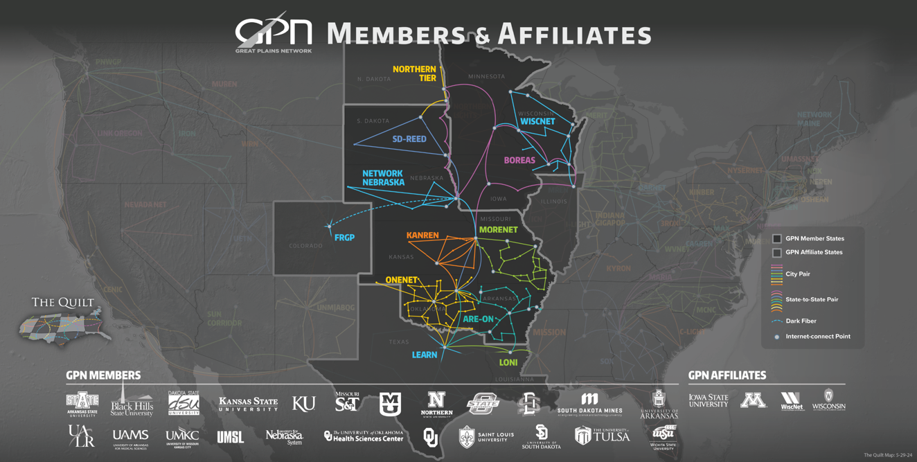
Great Plains Network AI Resource (GPN AIR) 255 GPUs
U S. Dakota + SD State
7/ GPN
U Nebraska-L
205 / GPN
Kansas State U
4 / GPN
U Missouri
27 / GPN
U. Of Tulsa
U. Arkansas
4 / GPN
8 / GPN

Slide 7
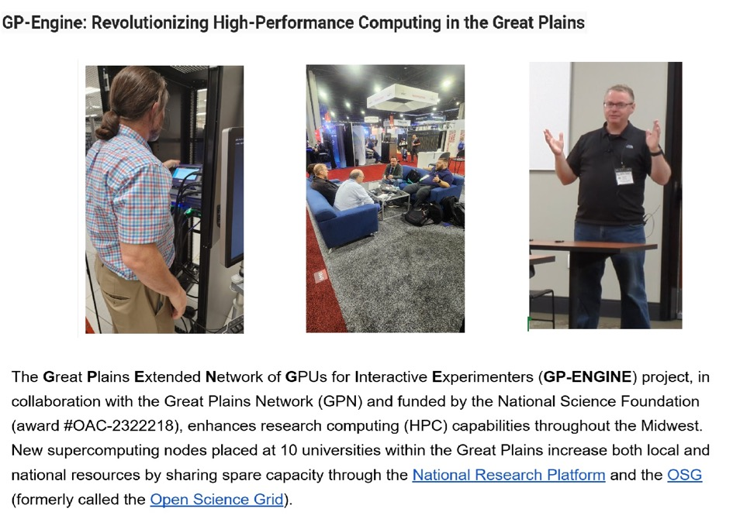
GP-Engine: Revolutionizing High-Performance Computing in the Great Plains

Slide 8
Regional Network Example: Georgia Tech / Southern Crossroads (SoX)
Participating with multiple nodes in the Southeast
Clemson University is also participating
Presentations from Dr. Alex Feltus and Dr. Larry Smarr to SoX community
FIONA nodes purchased as DTNs or perfSONAR test points are in process of redeploying as Nautilus nodes
Goal is to enable research within our community and looking to assist faculty unfamiliar with the platform
SoX is looking to collaborate on toolkits, demos, training we can share, invite, host, etc. for our community to help take advantage of the NRP
SoX offers connectivity and space for those interested in hosting nodes
Recent upgrade to 400G connectivity to ESnet and Internet2 – includes ESnet BW Challenge

Slide 9
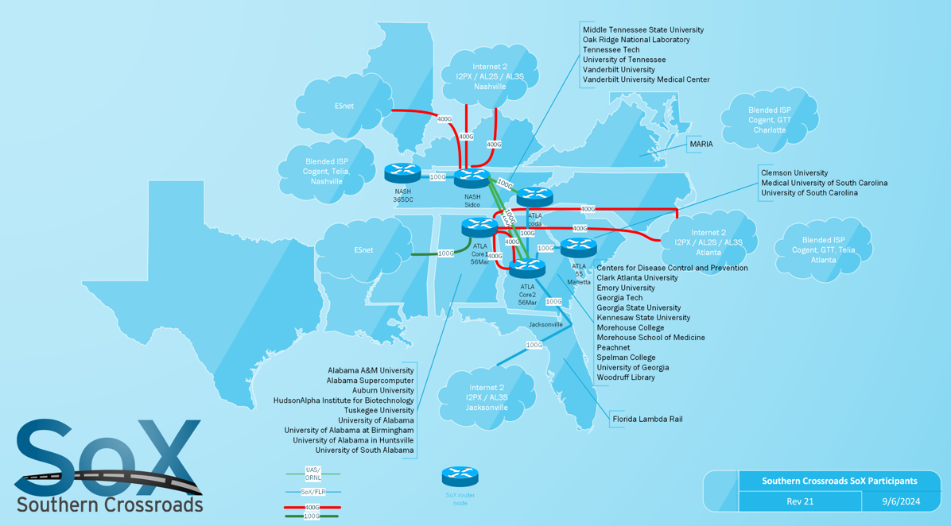
Southern Crossroads AI Resource (SoX AIR) 42 GPUs
Clemson U
18 / SCLR
Georgia Tech
16 / SCLR
FAMU + Florida Int’l
8 / FLR

Slide 10
RENs and Campus Partners with Nautilus Nodes Connected to NRP – Jan 2025
NYSERNet
OARnet
OneNet
PNWGP
SD-REED
Southern Crossroads
Sun Corridor
University of Hawaii
UIUC
Albuquerque GigaPoP
AMPATH
AREON
CENIC
C-Light
Edge
MGHPCC - Edge, OSHEAN, CEN, NYSERNet
Florida LambaRail
FRGP
GPN
KanREN
Merit
MOREnet
MREN
Network Nebraska
Northern Lights
Northern Crossroads
www.thequilt.net

Slide 11
CENIC AIR as a Blueprint for Other RENs
Quilt Focus this year on potential to leverage CENIC AIR as a model for other RENs
Panel at upcoming Quilt member meeting next week with CENIC and its community member stakeholders to share CENIC AIR with regional network community
Potential for a future REN-focused CENIC AIR workshop to share additional details about the model
www.thequilt.net

Slide 13
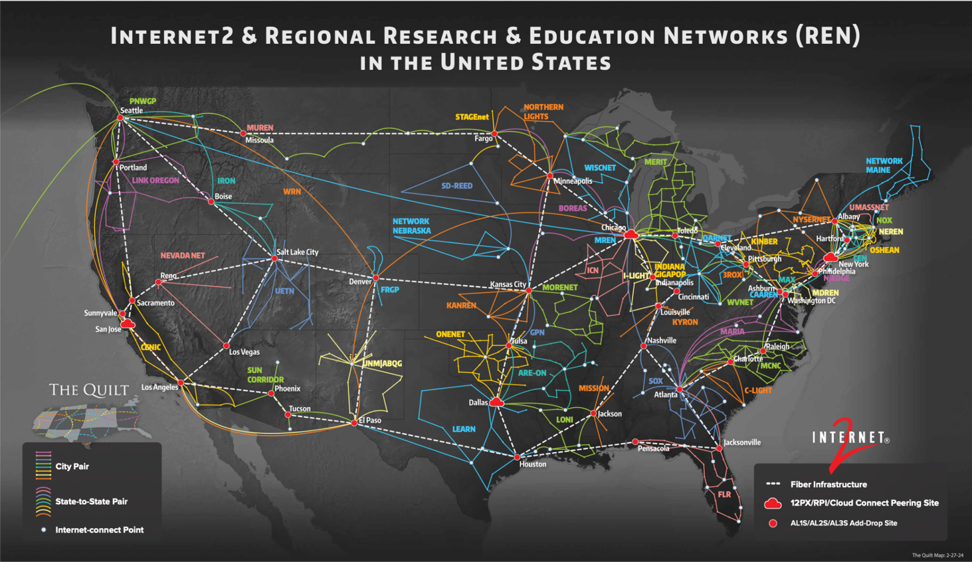

Slide 14
Benefits to RENs of Contributing to NRP via the CENIC AIR Blueprint
Provides a low barrier method to increase infrastructure for research and education efforts – minimally impactful to REN staff
Provides a mechanism for RENs to promote the identity and education efforts of institutions of all sizes
Proven models to follow for seeking NSF funding through a variety of Campus Cyberinfrastructure (CC*) opportunities
Based on Nautilus practices, provides network vantage points to help assure network performance from campus Science DMZs and opportunities to contribute to network research data

Slide 15
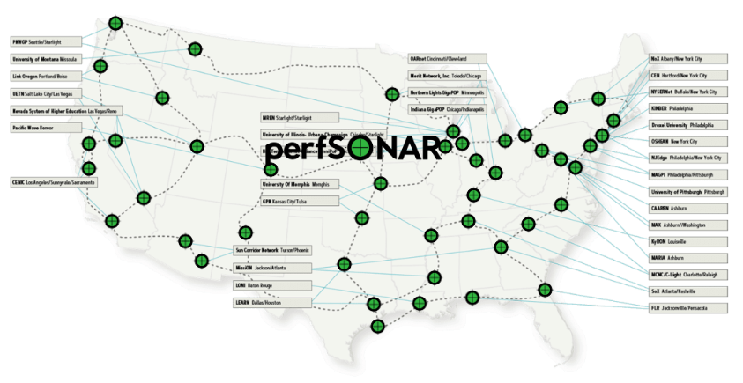
Internet2’s 40+ Performance Assurance Service Nodes
are being added to NRP and will be running Ark, RIPE Atlas and perfSONAR
Approximately 6TB of RAM and 1000 cores of CPU across these nodes
Currently these nodes are only running perfSONAR

Slide 16
