Slide 1



Connecting Your Institution
to CENIC AIR
6NRP Tutorial
January 28, 2025
Christopher Bruton
Tom DeFanti

Slide 2

The Problem:
CENIC
CalREN
Campus enterprise networks are not always suitable for high-performance computing.
Border Routers
Firewalls
Core Routers
Switches
NRP Nautilus Nodes

Slide 3
Solution:
The Science DMZ Model
CENIC
CalREN
Dedicated high-throughput, low-latency network access for research computing.
Border Routers
Firewalls
Core Routers
Switches
NRP Nautilus Nodes

Slide 4
What network resources do Nautilus nodes need?
CENIC CalREN
CalREN DC (Digital California)
  Internet access
    OS and software updates
    DNS/NTP/etc.
  Standard MTU (1500 bytes)
CalREN HPR (High Performance Research)
  Nautilus infrastructure and other nodes
  Jumbo MTU (9000 bytes)
DC and HPR are separate networks with separate routing tables.
DC
HPR
NRP Nautilus Nodes

Slide 5
Traditional Model: Campus-managed routing
CENIC CalREN
Campus maintains separate BGP sessions for DC and HPR
Science DMZ routing for Nautilus is the campus’s responsibility.
Many campuses still use and prefer this model:
  Fine-tuned control over routing policy, bandwidth/QoS, and firewall rules.
  No CENIC involvement needed in Science DMZ config.
May be complicated to set up from scratch and requires campus network staff to be confident in BGP knowledge.
DC
HPR
DC BGP
sessions
HPR BGP
sessions
Campus
Border Router
NRP Nautilus Nodes
Campus
Enterprise

Slide 6
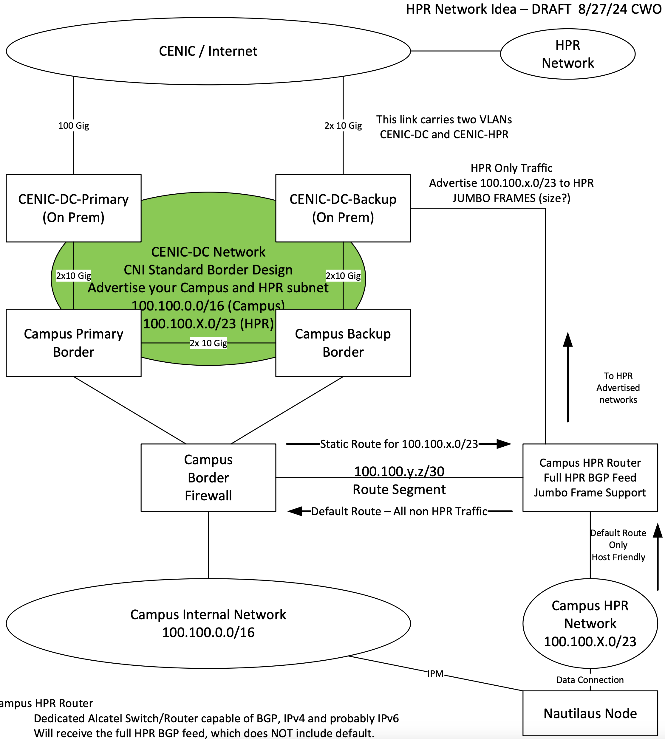
Variation:
CSU “Standard Model”
DC/Internet traffic to/from the Science DMZ passes through the campus firewall.
HPR traffic bypasses the firewall.
Model in use by Fullerton, Humboldt, maybe others?
Nautilus Node
Source: Carl Oakes (Sac State)

Slide 7
Combined Handoff Model: CENIC-managed routing
CENIC CalREN
DC
HPR
CENIC now offers a dedicated Science DMZ handoff option.
CENIC handles the routing internally.
Handoff from the CPE is simply a local LAN for the Science DMZ with a static default gateway.
No BGP configuration needed.
DC BGP
sessions
HPR BGP
sessions
CENIC CPE
Science DMZ
Local LAN
Campus
Border Router
NRP Nautilus Nodes
Campus
Enterprise

Slide 8
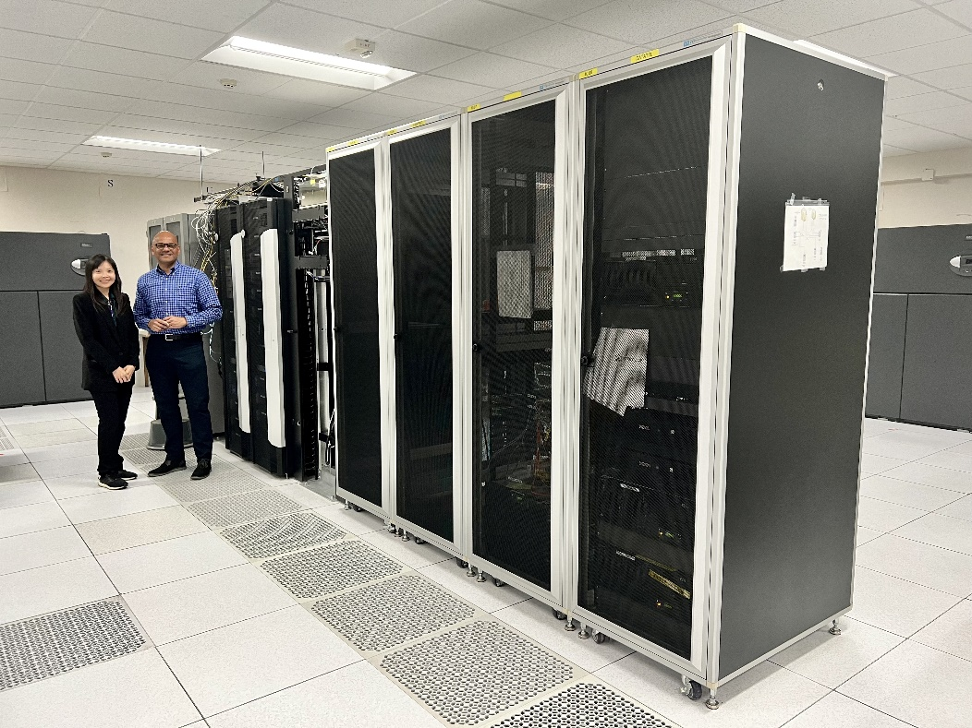
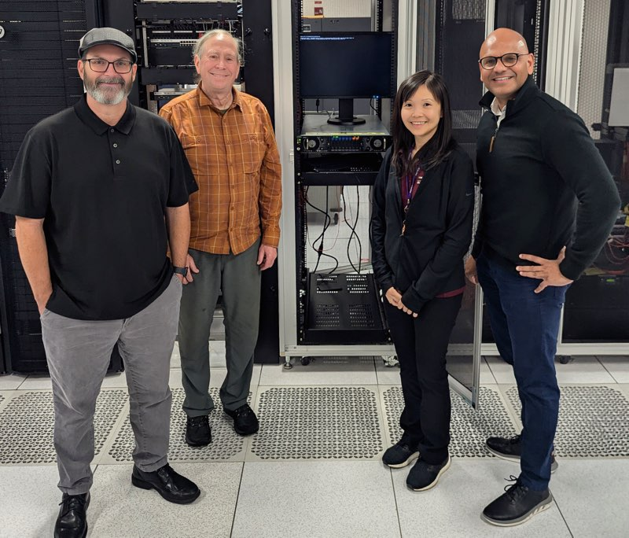
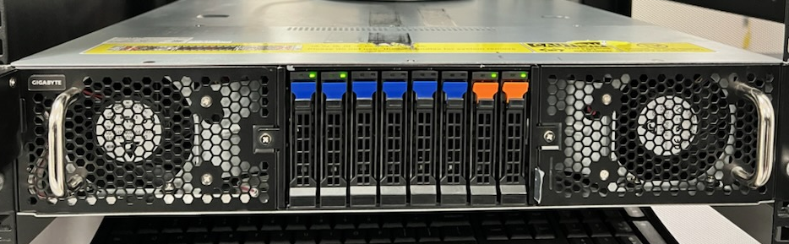
By Collaborating with UCSD, SDSU, and CENIC,
SDCCD Became the 1st California Community College to Host a CENIC AIR Node
Peter Maharaj, Rose Parnsoonthorn,
In the SDCCD Machine Room
First Nautilus Node Installed
In a CCC Machine Room
August 30, 2024

Slide 9
Original state:
10G DC Handoffs only
SDCCD was served by two 10G circuits to the CENIC backbone:
  10G to UCSD via AT&T (primary).
  10G to Riverside via Spectrum (secondary).
Redundant 10G DC handoffs were provided from the CPEs.
SDCCD did not have existing HPR service.

Slide 10
Science DMZ Phase 1:
10G DC/HPR Handoff
In phase 1, HPR service was provisioned over the existing 10G circuit to Riverside. This ensured that CENIC-AIR traffic would not impact SDCCD’s primary 10G circuit.
One CPE had a Science DMZ routing instance configured, providing a combined DC/HPR routing table for the Science DMZ handoff.
SDCCD provided its own switch for the Science DMZ.

Slide 11
Science DMZ Phase 2:
100G DC/HPR Handoff
In phase 2, the 10G AT&T circuit will be upgraded to 100G.
The HPR service will be moved to the new 100G circuit, and the Science DMZ handoff will be upgraded to 100G.
The 10G Spectrum circuit will remain as a secondary path for DC and HPR.
The existing CPEs are 100G-capable, so no new hardware is needed except for 100G optics.

Slide 12
Thank You!
Contact us:
Christopher Bruton cbruton@cenic.org
Tom DeFanti tdefanti@cenic.org

