Slide 1


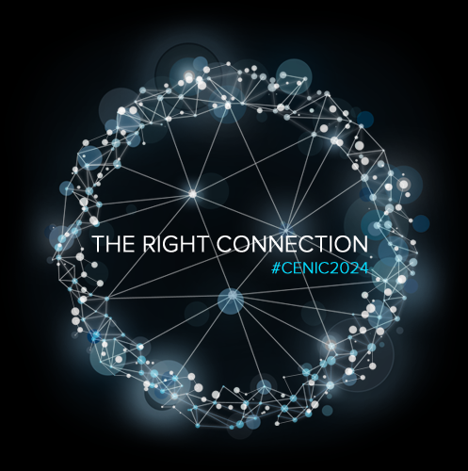



CENIC AIR FAQ
6NRP Tutorial Workshop Presentation January 28, 2025
Tom DeFanti and Christopher Bruton
With Slides from Larry Smarr and Frank Wuerthwein and Text from the CENIC AIR Website
https://cenic.org/initiatives/cenic-air
And other Contributors as Noted
Original Concept: Jerry Sheehan

Slide 3
THIS CENIC AIR TUTORIAL
An Introduction to CENIC AIR: Tom will give the history of the CENIC AI Resource (CENIC
AIR), why it was created, what it consists of, and how it relates to the National Research
Platform (NRP).
CENIC AIR for Research and Instruction: Tom will address FAQs from researchers and
faculty at universities and colleges on how to access the computers and storage provided
by CENIC AIR institutions. The NRP is developing a similar set of FAQs.
Connecting Your Institution to CENIC AIR: Christopher Bruton will address
infrastructure-related questions about connection bandwidth, implementing a Science
DMZ, adding compute and storage resources, obtaining funding, and the roles and
responsibilities of your institution, CENIC, and the National Research Platform regarding
design, implementation, maintenance, and support.

Slide 4
Some Distinctions and Caveats
CENIC AIR is a research endeavor, not a product. While the intention is to develop a sustainable, long-term production infrastructure, equipment can be recalled and repurposed for use by owners outside Nautilus at will.
As CENIC AIR takes on more and more instructional lab usage, it will need to become more of a supported product and production-quality system, at least in major subsets.
Part of the National Research Platform (PNRP), called the Prototype National Research Platform (PNRP), is providing educational resources to the National Artificial Intelligence Research Resource (NAIRR) Pilot through NAIRR Classroom.
While the NAIRR pilot is focused on providing a national allocation mechanism for AI research and education resources, NRP and CENIC AIR are focused on increasing ownership of AI resources for education and research across educational institutions. The PNRP plan is for it to become a long-term supported resource.

Slide 5
FAQ 1.1: What is CENIC AIR?
CENIC AIR is the CENIC-connected part of the National Research Platform providing California’s research and education communities a means for faculty and students to
  develop and refine topical AI curricula,
  constructively contribute to the transformations promised by these new technologies and,
  collaborate extensively with colleagues nationwide over the NRP infrastructure.
CENIC AIR adds CENIC’s network planning, engineering, operations, and outreach activities to these efforts to expanding AI resources beyond the partner research-focused campuses.

Slide 6
More on FAQ 1.1
CENIC AIR is the CENIC-connected subset of the National Research Platform (NRP), a partnership of more than 50 institutions nationwide and growing. It is led by researchers and cyberinfrastructure professionals at UC San Diego and partner campuses, and it is supported in part by grants from the National Science Foundation.
At the core of NRP is Nautilus: a large, distributed compute and storage cluster optimized to run Data Science/AI applications.
Institutions voluntarily contribute to Nautilus’ hardware and software, becoming co-owners. These resources are interconnected and accessed via regional and national research and education networks such as CENIC’s CalREN and Internet2.
System administration and remote operations are handled by IT professionals funded in major part by awards to SDSC and the Qualcomm Institute at UC San Diego.
Like NRP, CENIC AIR is a program; the computers in Nautilus and the network infrastructure that connects them comprise the resource.

Slide 7
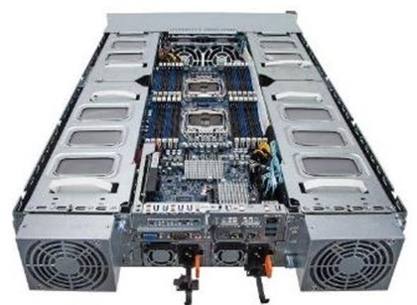
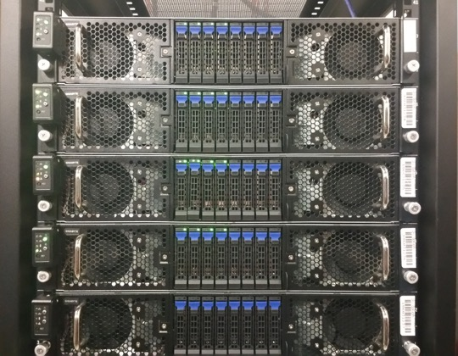



Nautilus GPU Nodes Connect to CENIC’s Fiber Optics on Campuses:
Add Up to 8 Nvidia GPUs Per 2U Node
To Add Machine Learning Capability
Up to 240TB Storage
Nautilus Nodes Are Rack Mounted
FIONAs Designed by UCSD’s Phil Papadopoulos,
John Graham, Joe Keefe, and Tom DeFanti

Slide 8
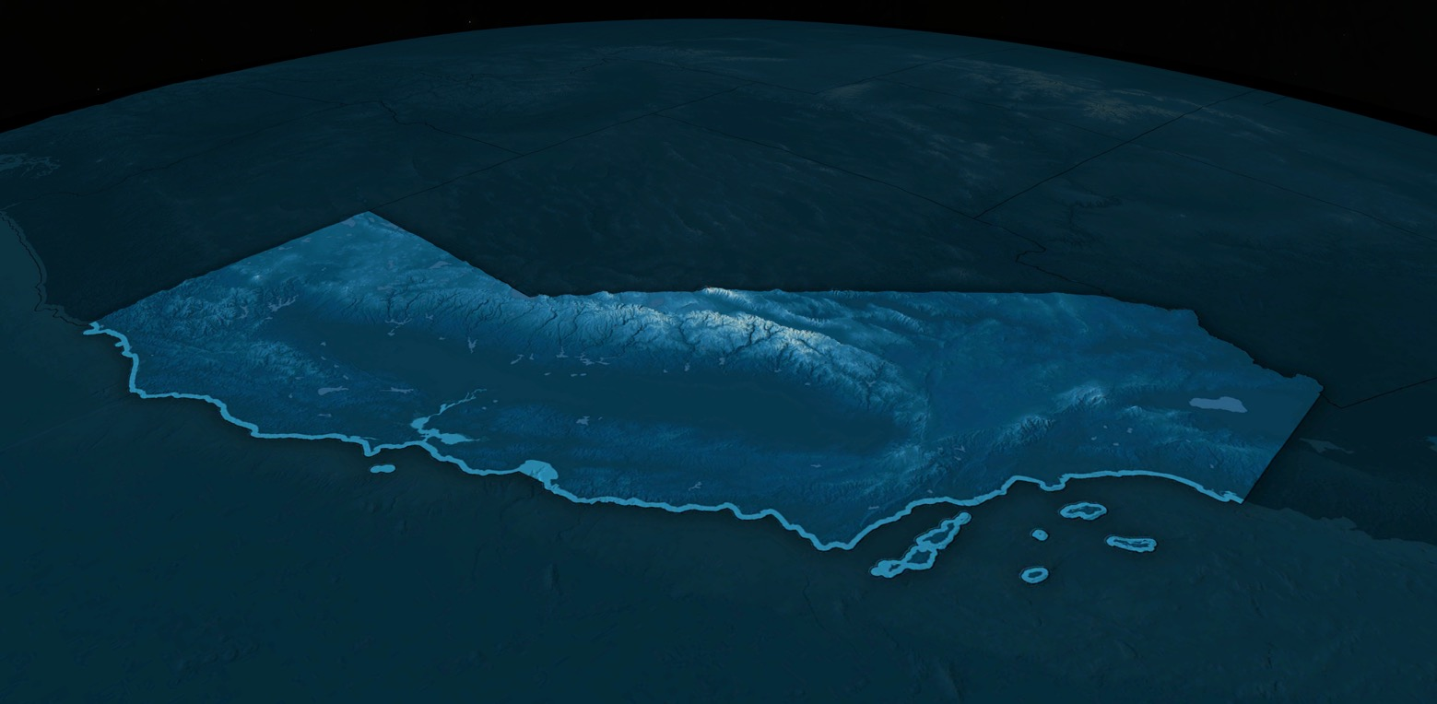
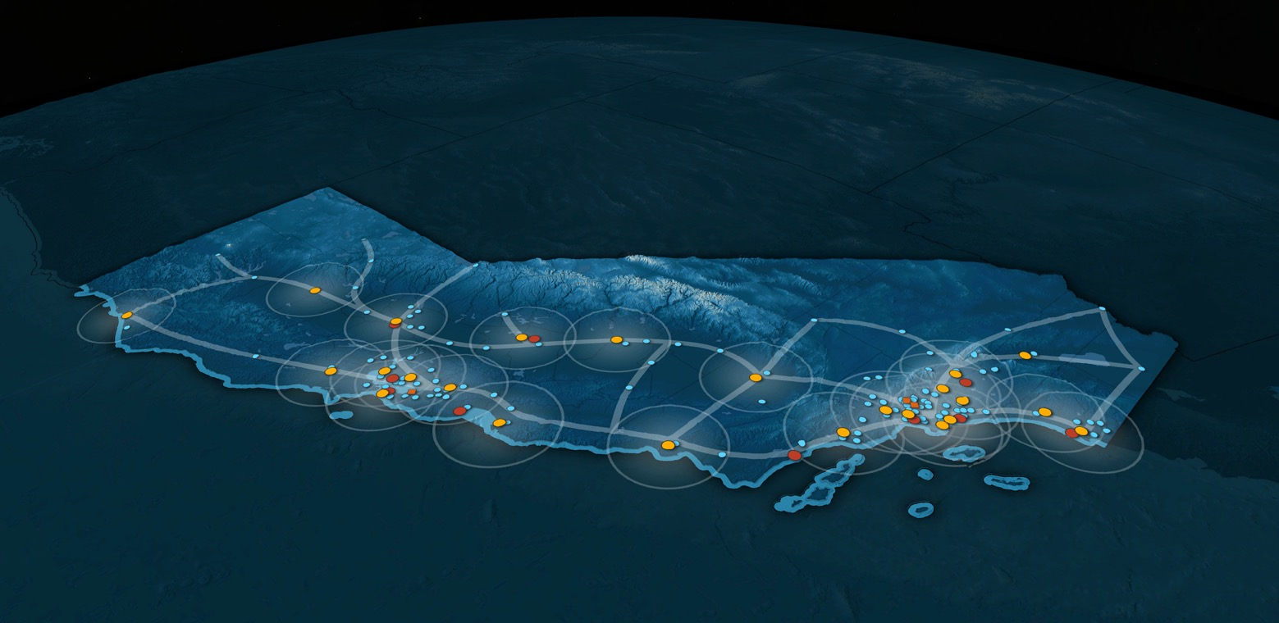
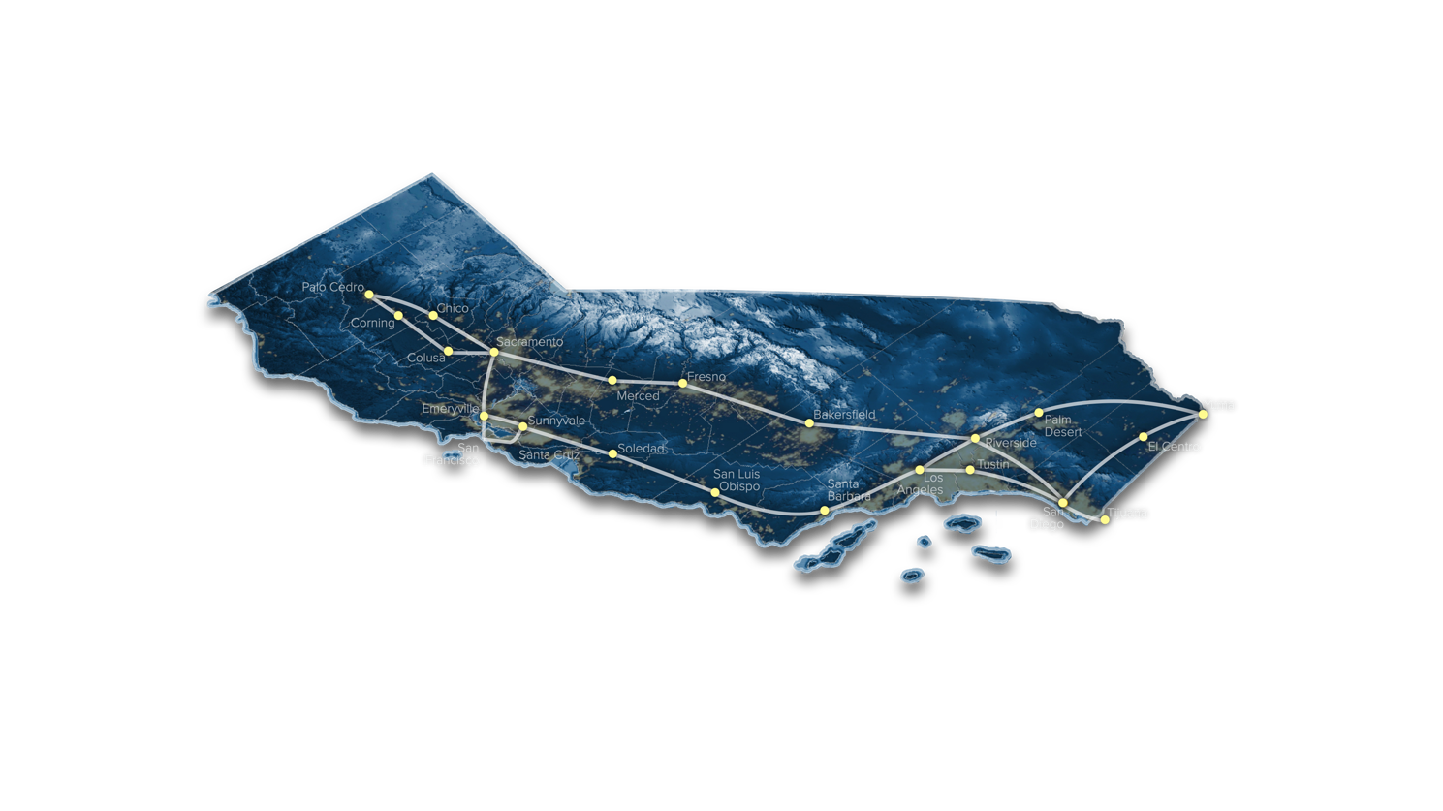
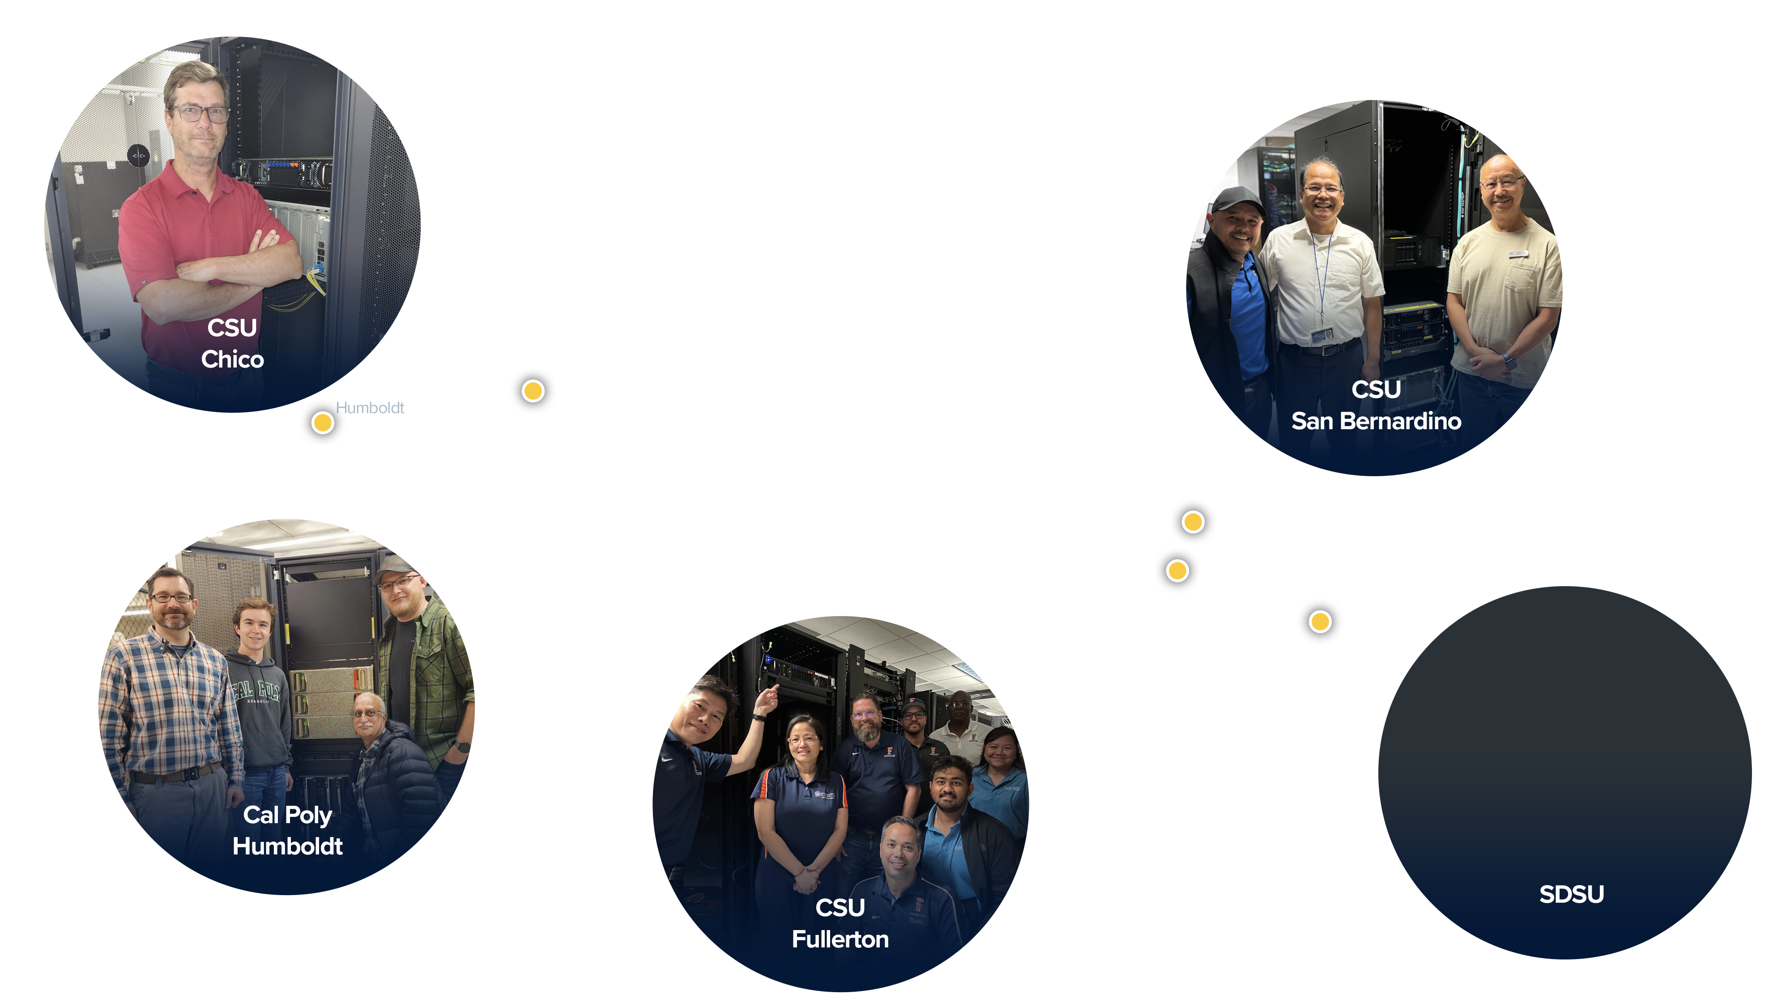
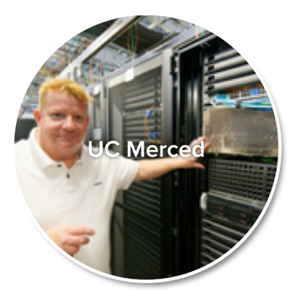
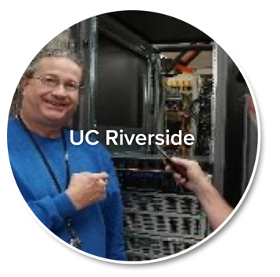
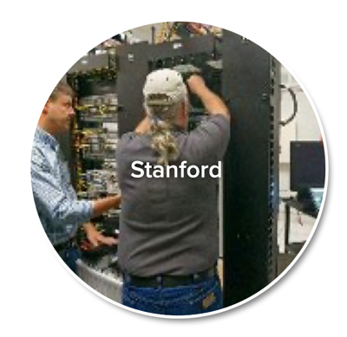
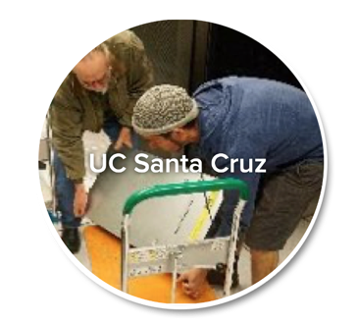
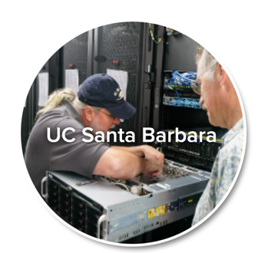
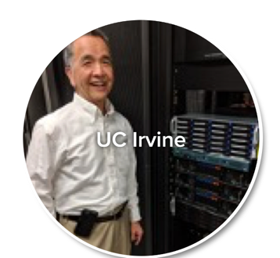
Servers at CSUs as part of CENIC AIR/Nautilus
Nautilus Hosting Campuses:
Originally Built Out On Research University Campuses

Slide 9
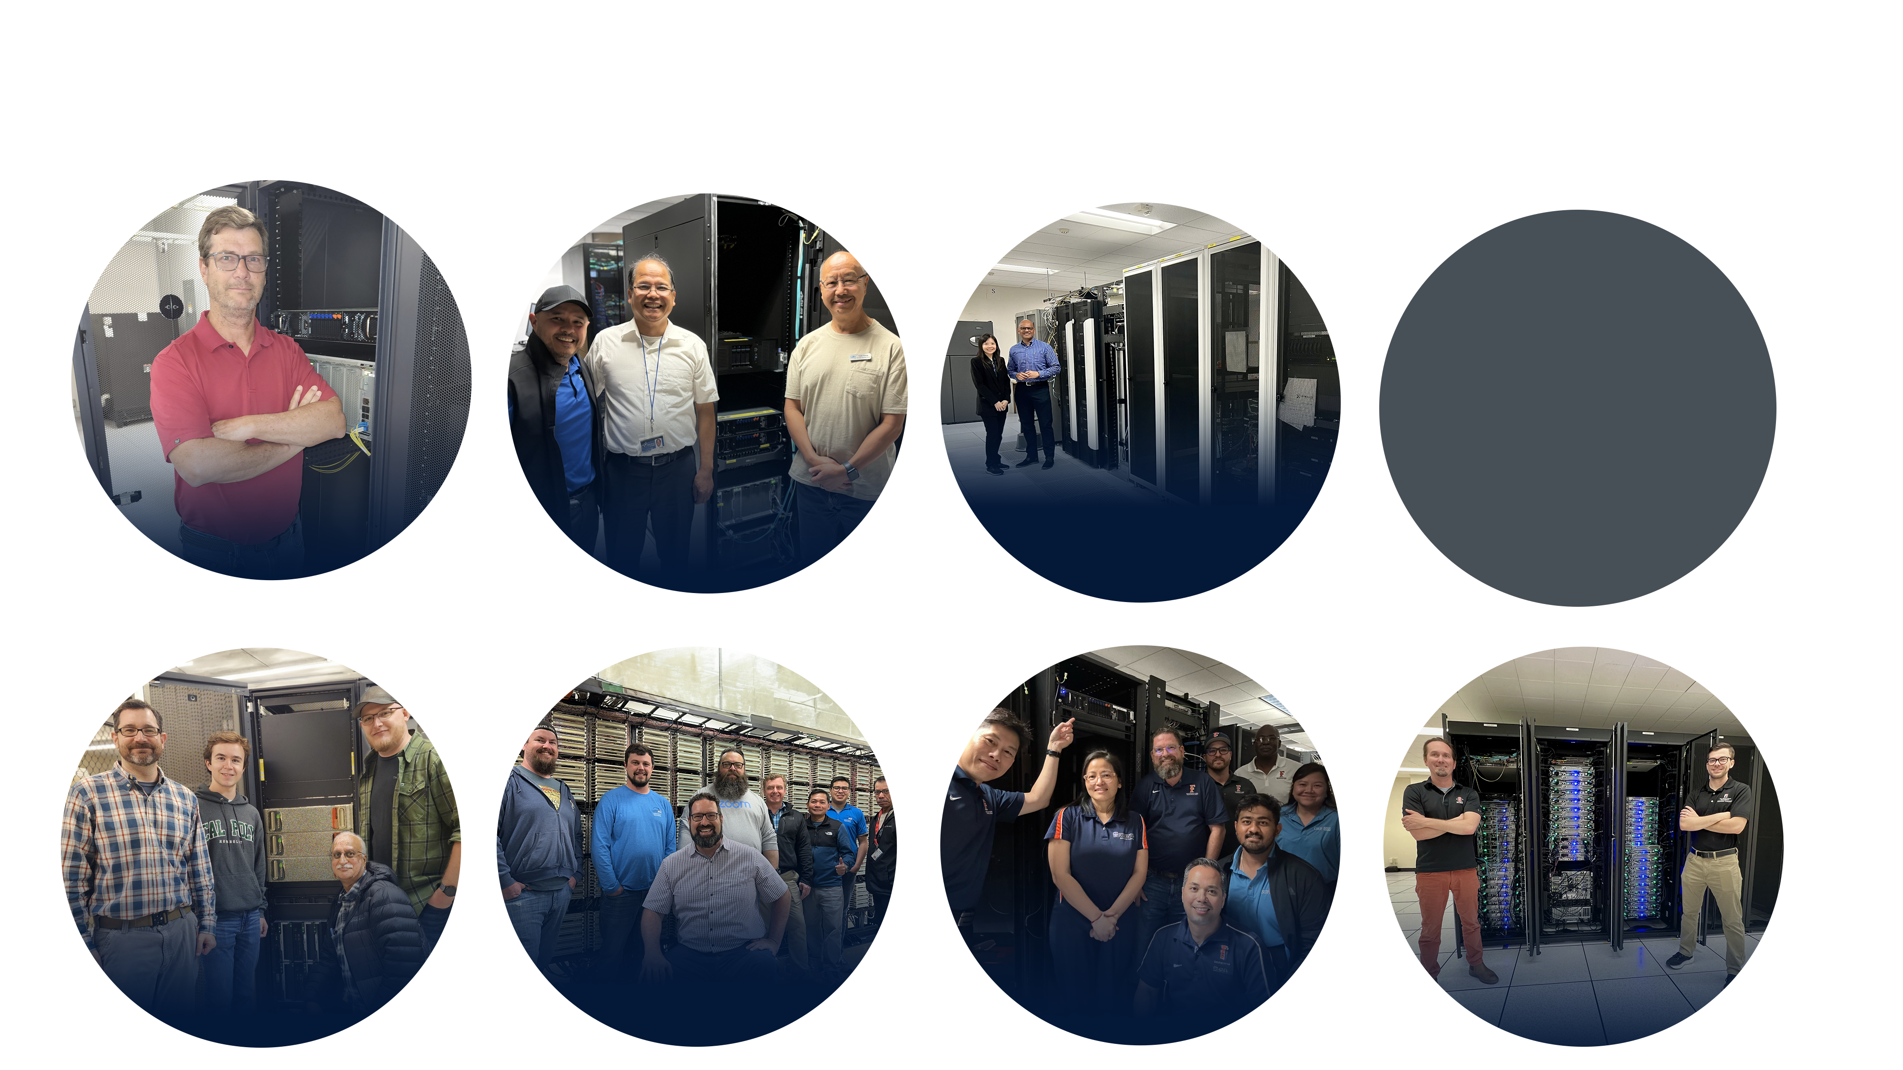
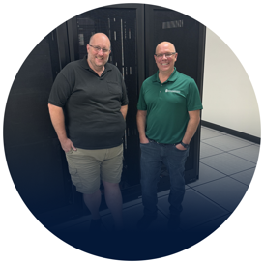

Servers at CSUs as part of CENIC AIR/Nautilus
CENIC AIR Hosting Campuses:
CSUs & CCCs – The Next Generation
CSU
Chico
Sacramento State U
CSU San
Bernardino
San Diego Community College Dist.
Cal Poly
Humboldt
Monterey
Bay
CSU
Fullerton
San Diego
State U

Slide 10


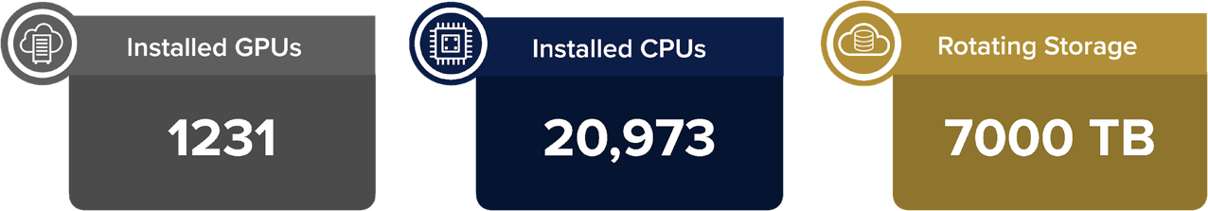
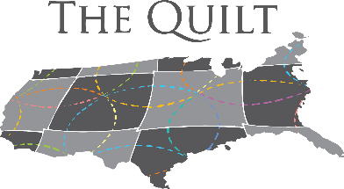


Nautilus is a Community Owned and Operated “AI Resource”
>400 Nautilus nodes at 71 Partner Campuses
Networked Together at 10-200Gbps
Installed CPU Cores
1422
23855

Slide 11
Nautilus-Accessible LLMs
John says we have DeepSeek-R1-Distill-Qwen-14B running on a single Qualcomm AI 100 Ultra https://huggingface.co/deepseek-ai/DeepSeek-R1-Distill-Qwen-14B
Search NRP.ai for LLM and see: https://docs.nationalresearchplatform.org/userdocs/ai/llm-managed/
According to Dima we have, as of today:
  intfloat/e5-mistral-7b-instruct
  meta-llama/Llama-3.2-11B-Vision-Instruct
  microsoft/Phi-3.5-vision-instruct
  google/gemma-2-27b-it
  meta-llama/Meta-Llama-3.1-70B-Instruct
  llava-hf/llava-onevision-qwen2-7b-ov-hf
  mistralai/Mixtral-8x7B-Instruct-v0.1
  llava-hf/llava-v1.6-vicuna-7b-hf
  allenai/OLMo-2-1124-13B-Instruct
  gorilla-llm/gorilla-openfunctions-v2
  Groq/Llama-3-Groq-8B-Tool-Use

Slide 12
FAQ 1.2: Does using Nautilus cost me or my institution anything?
Nautilus is provided at no cost to faculty, staff, and students at non-profit educational institutions. It is supported in large part by several NSF awards.
Faculty/staff gain access to Nautilus by first joining Nautilus at the NRP.ai website.
Use your CILogon credentials to access Nautilus. There are JupyterLab examples and other documentation (mostly oriented toward experienced data scientists at the moment). Students gain access through their instructors.

Slide 13
FAQ 1.3: How do I get access to Nautilus?
Go to the NRP website (nrp.ai) and pull down the Join/Contact tab. That will get you on the NRP mailing list.
You can start using Nautilus with your CILogon sign-on (see docs.nrp.ai).
Experienced users with containerized applications ready to go should click on the Get Quick Access options on the NRP website.
There are also JupyterLab examples and brief instructions (also at docs.nrp.ai).

Slide 14

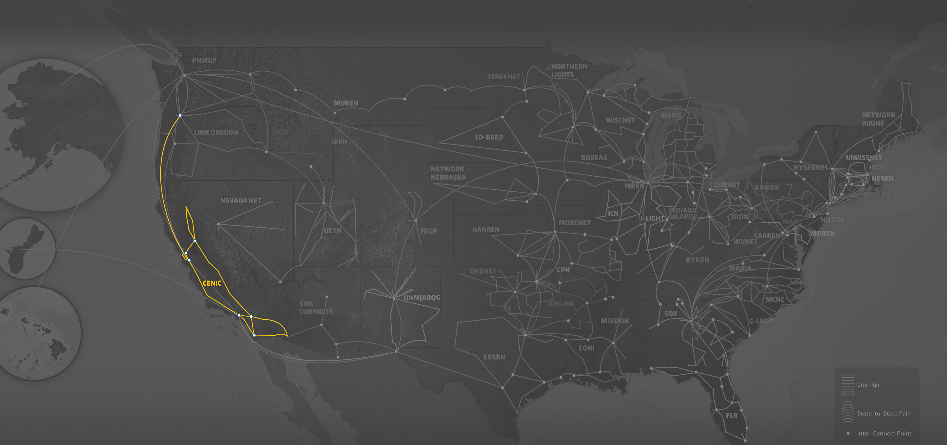
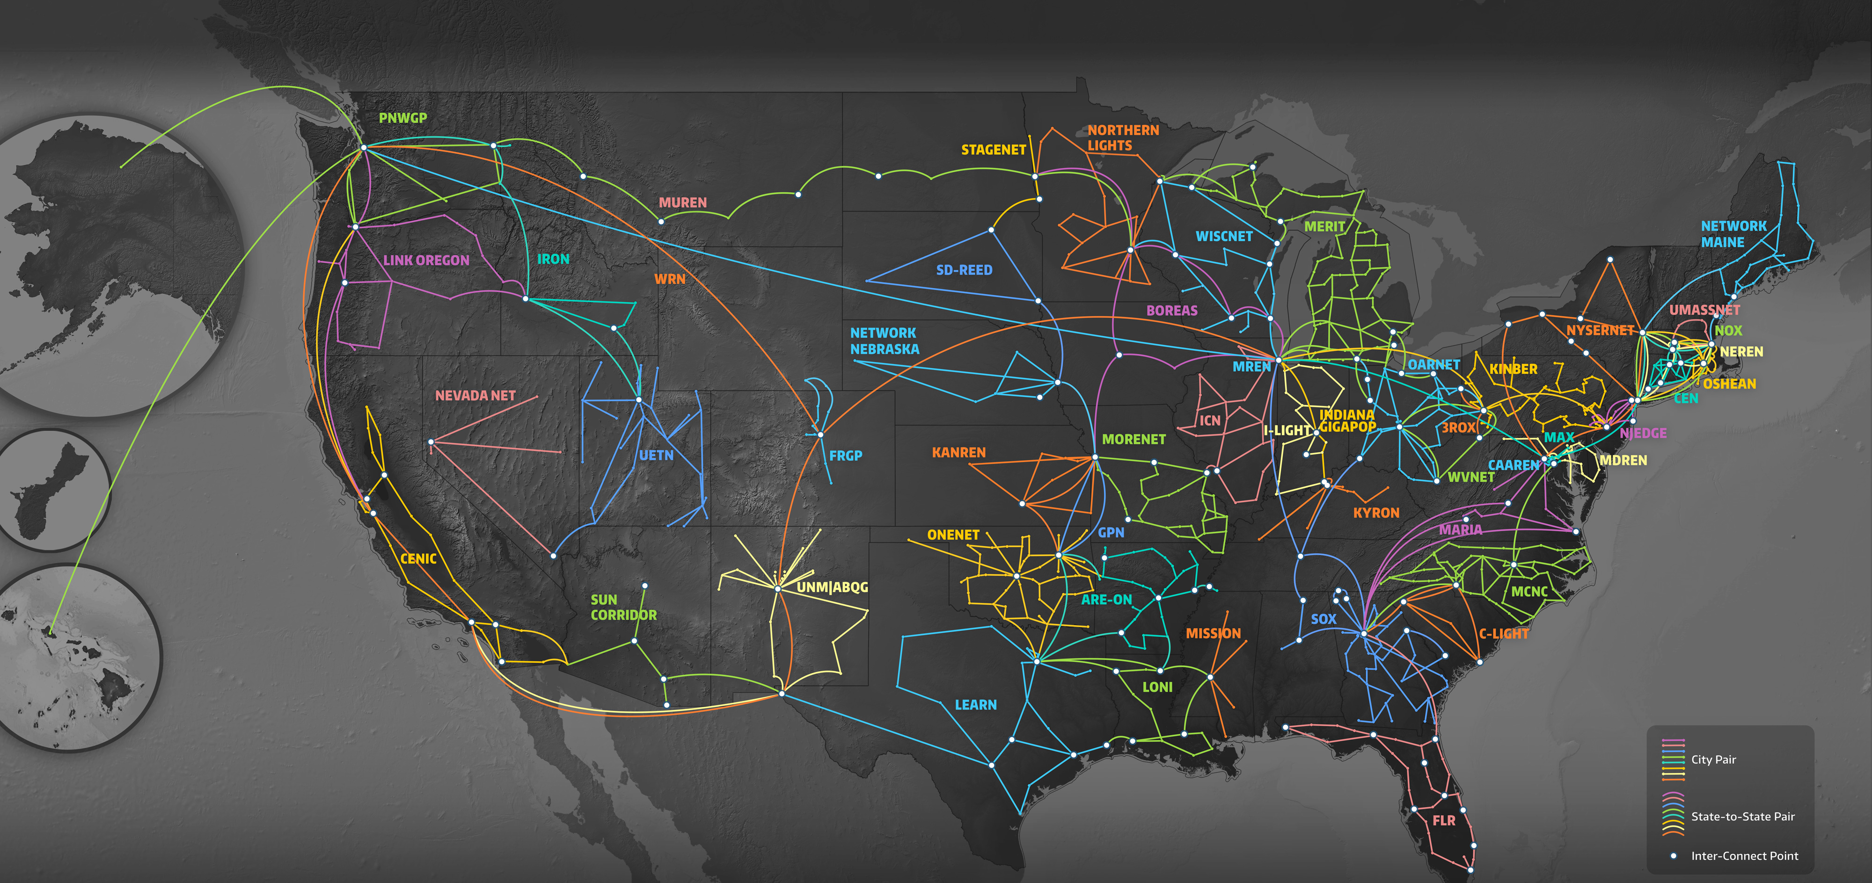
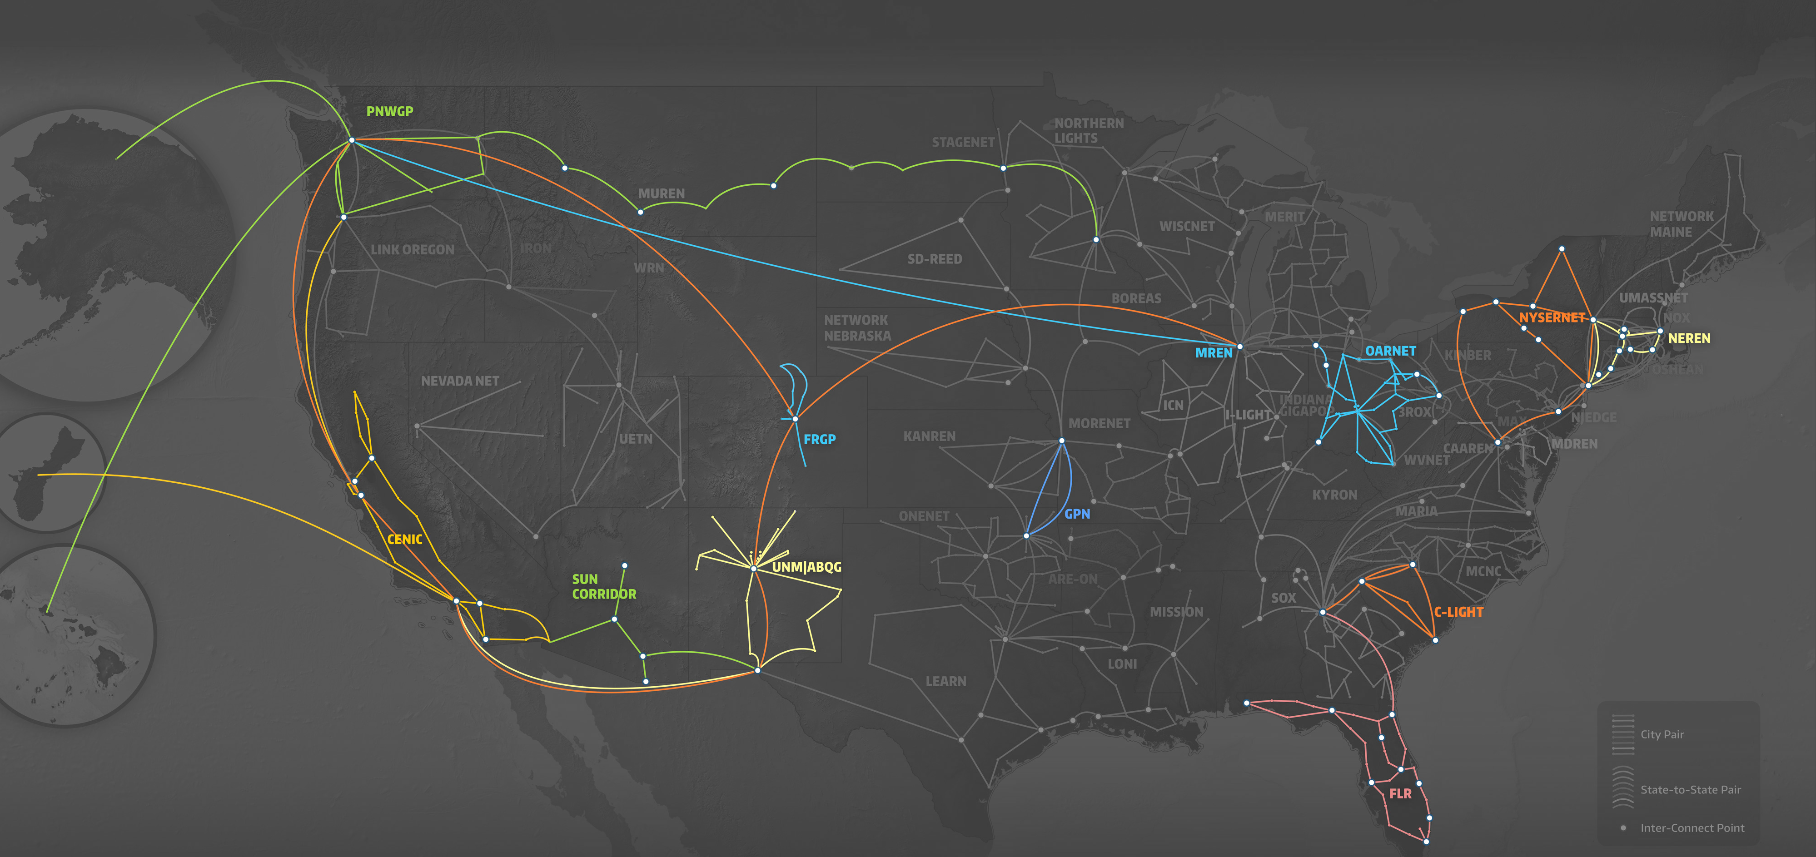

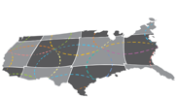


The Users of CENIC AIR Automatically Use
NRP’s Nautilus Hypercluster Outside of California
# of GPUs / Regional Opt. Network
# of GPUs / Regional Opt. Network
Minority Serving Institutions
EPSCoR Institutions
Non-MSI Institutions
Minority Serving Institutions
EPSCoR Institutions
Non-MSI Institutions
U S. Dakota + SD State
NYSERNET
4 / GPN
19 / NYSERnet
U Nebraska-L
UIC
162 / GPN
10 / MREN
UCI + UCR + UCM + UCSC + UCSB
SW OK State
U Guam
UCI + UCR + UCM + UCSC + UCSB
CWRU
MGHPCC
1 / GPN
144 / NEREN
1 / CENIC/Pac. Wave
111 / CENIC
2 / OARnet
111 / CENIC
Kansas State U
U Missouri
CSUSB + SDSU
4 / GPN
44 / GPN
U Delaware
CSUSB + SDSU
12 / NYSERnet
143 / CENIC
143 / CENIC
UCSD
Clemson U
UCSD
19 / SCLR
514 / CENIC
U New Mexico
U Hawaii
514 / CENIC
2 / CENIC/Pac. Wave
1 / Albuquerque GigaPoP
Sun Corridor
1 / Sun Corridor
FAMU + Florida Int’l
7 / FLR

Slide 15
FAQ 1.4: Do CENIC AIR users have access to other NRP resources?
Compute jobs can “burst” to computers and storage beyond California and into the national-level infrastructure and community resources of the NRP. Nautilus uses the open-source Kubernetes software to orchestrate user-containerized applications based on users’ requests.
In general, users need not be concerned about where the computation physically takes place. (There are, however, options to customize locality and resource types available to advanced users.)
Some Nautilus users have successfully ported their software containers to run in commercial clouds when they obtain the necessary credits.

Slide 16
FAQ 1.4: Continued
Nautilus can accommodate thousands of researchers, faculty, and students with modest data science aspirations.
Thanks to National Science Foundation grants and existing campus support, Nautilus’ compute capacity is comfortably provisioned except for the very popular, most expensive high-memory GPUs which are in great demand by some researchers.
The resources in Nautilus are very dynamic by design, old resources disappear, new resources get added, owners of resources may temporarily restrict access, and federal agency-provided resources may be subject to allocation mechanisms.
Nautilus capacity continues to grow as a result of being community-owned and driven.
If overall utilization ever becomes overly high, some researchers from institutions not contributing resources may be required to run in “background scavenger” mode.

Slide 17
FAQ 1.5: Where is my data stored when I use CENIC AIR?
Nautilus maintains its own storage intended to hold data while you are computing or sharing ("hot storage”). Some storage is held in regional Ceph pools
There are various means to import your data into Nautilus, such as the Open Science Data Federation or Globus or the National Data Platform. Naturally, there are rules about what is deemed appropriate use of Nautilus’ storage (see the NRP website).
For example, some of the storage offerings for the NRP are: S3 compatible storage, Ceph block devices, CVMFS, Linstor, and Seaweed FS. The discussion of storage technologies and their trade-offs are beyond the scope of this presentation. Local scratch storage is also provided. Note: archival storage is not provided nor is storage backed up by Nautilus; it is assumed you can reload your data if needed, and that you will delete unused storage on Nautilus.

Slide 18
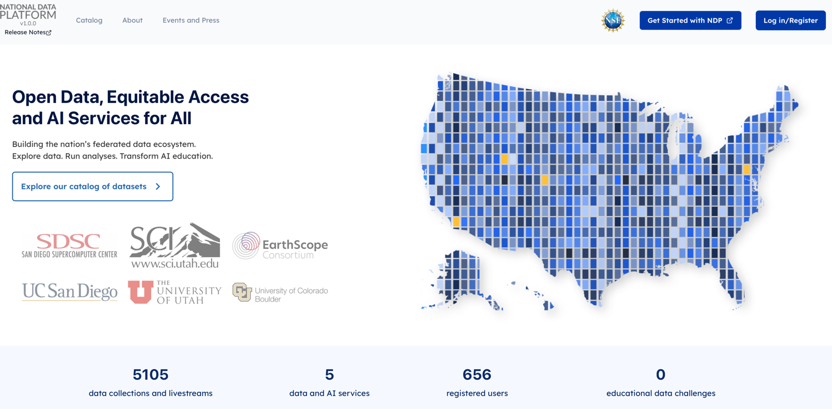
The National Data Platform is integrated with NRP

Slide 19
FAQ 1.6 How does public cloud access relate to CENIC AIR?
Researchers, faculty, and students at your institution can make use of commercial cloud services (e.g., AWS or Azure) via CloudBank, which provides information, education, training, and allocations for public clouds -- currently, Amazon Web Services, Google Cloud, IBM Cloud, and Microsoft Azure.

Slide 20
FAQ 1.7: How do I get support?
NRP uses Matrix for all communications; please don’t send emails!
Matrix is deployed in Nautilus, and you can create an account for yourself.
NRP provides support through Matrix with various channels (topics), one of which is dedicated to JupyterLab instructors and another to JupyterLab admins.
There are also channels for support to sysadmins contributing resources and grant writers looking to use or contribute to the NRP.
“Easy buttons” for accessing Matrix and JupyterLab “Hello World!” examples are under construction; the documentation at NRP.ai right now is mainly targeted to campus IT support professionals and experienced computer scientists.

Slide 21
Next Section FAQs: How do I add equipment to Nautilus?
If you want to add resources to Nautilus, your institution must have implemented a Science DMZ, install the equipment in that Science DMZ, and allow Nautilus’s operations staff IPMI access for monitoring, software installation, and maintenance.
CENIC is developing implementation and support models so CENIC engineers can help member institutions assess their existing CalREN connectivity for purposes of implementing and supporting a new, CENIC AIR Science DMZ; some of these models can be CENIC-managed through the network to varying degrees, as contracted.
There are various charges associated with these fuller-service CENIC-managed options.
CENIC Engineer Christopher Bruton will address these models next.

Slide 22
Christopher Bruton’s Slides next

Slide 23

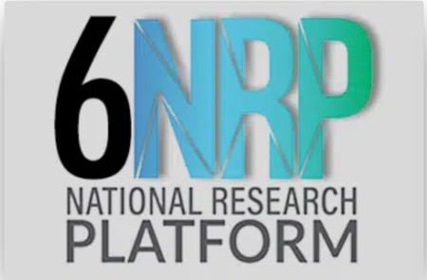
Acknowledgements
We are Supported by NSF grants OAC-1541349, OAC-1826967, OAC-2030508, OAC-1841530, OAC-2005369, OAC-21121167, CISE-1713149, CISE-2100237, CISE-2120019, & OAC-2112167
And CENIC!
January 28-30 at UCSD
Thank you for Attending!

