Slide 1
SENSE
Justas Balcas
Software Engineer
ESnet
6NRP
SDSC, La Jolla
2025-01-28

Slide 2
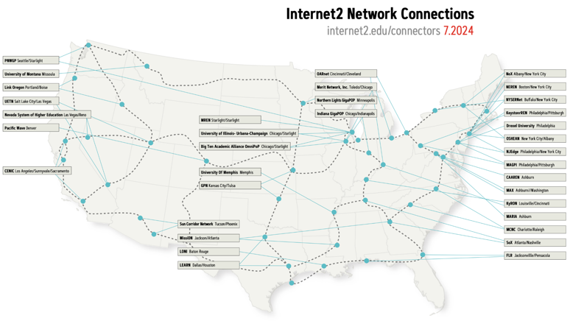
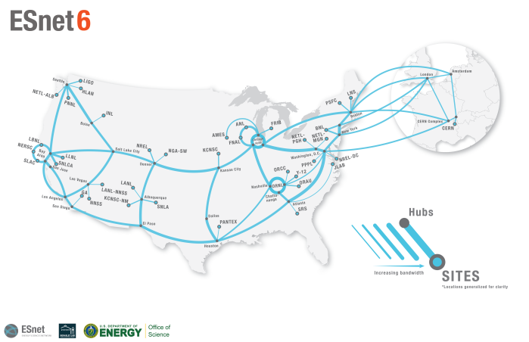
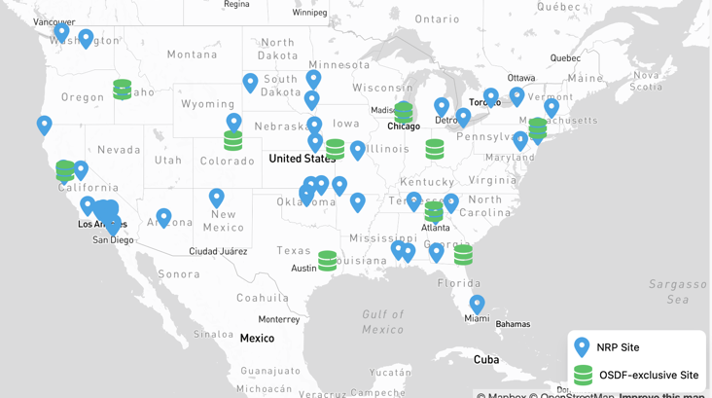
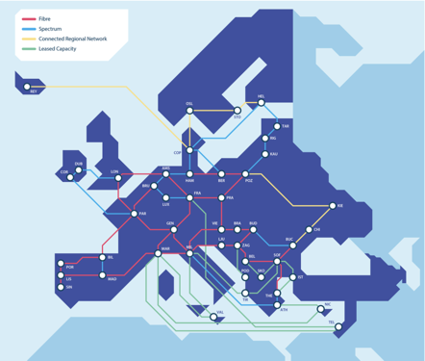
Network landscape

Slide 3
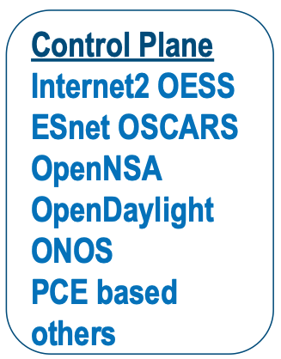
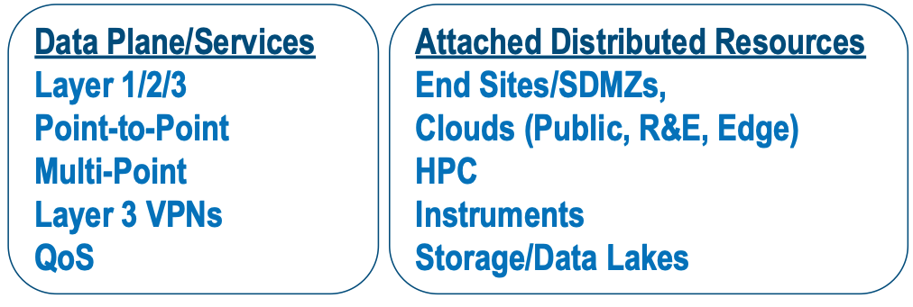
The SDN Layer is Complex and Heterogeneous
SDN Layer

Slide 4
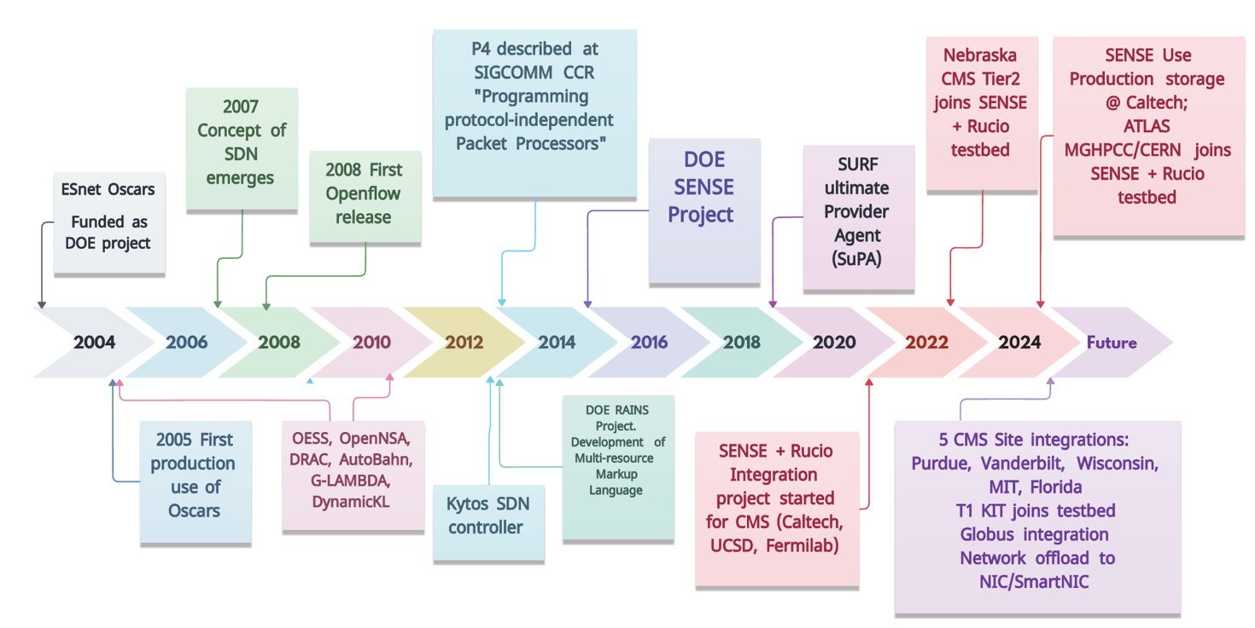
It all started >20 years ago…

Slide 5
The SENSE Architecture
Application Workflow Agent
Intent-based APIs with resource discovery, negotiation, service lifecycle management & monitoring
Real-time system based on Resource Manager developed infrastructure and service models
SENSE Orchestrator
SENSE End-to-End Model
RM
RM
RM
DTN
DTN
DTN
RM
UMD
RM
RM
RM
DTN
DTN
RM
SENSE Resource Manager

Slide 6
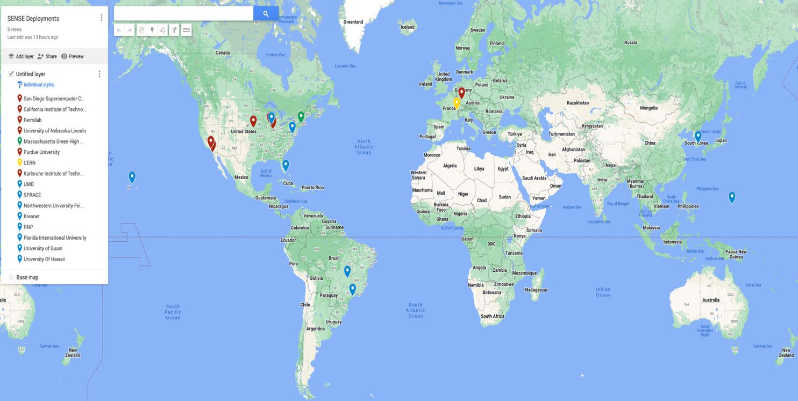
SENSE deployments: 82 servers, 22 sites, 20 network domains
16 (East and Southern Africa) + 7 (North Africa) + 9 (West and Central Africa) + 24 (Asia Pacific) + 23 (North America) + 12 (Canada) + 15 (Latin America) + 4 (Caribbean) + 37 (Europe) + 6 (Nordic countries) + 8 (Middle East) + 7 (Central Asia) = 168 unique NRENs. (Based on Wikipedia)
15 NRP Nodes (out of 428 - only 5%)
expanding on Internet2/NYCERNet in coming month

Slide 7
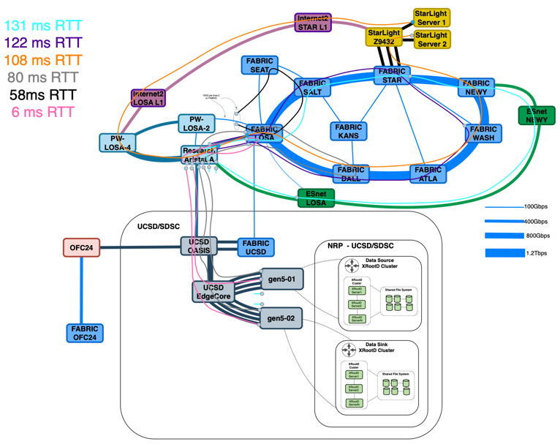
SENSE/Fabric/XRootD/NRP/Kubernetes/Multus
2 Servers:
2U Supermicro (SYS-621H-TN12R)
2x 32 core CPU (Intel Gold 6430)
1TB DDR5 (64GB DDR5-5600)
12x Samsung PM1733A (Raid0, 42TB)
400G NVIDIA CX7
Can we sustain 400Gbps to/from the site using XRootD HTTPs?
Where are the Software limitations?
How does latency affects throughput?
How do jumbo frames affect throughput?
Should hyperthreading be ON or OFF for storage endpoints?
What are CPU and Memory Requirements?
What is the overhead when adding storage (Memdisk, local NVMe Raid, DFS)?

Slide 8
Special thank you to many colleagues
Frank Würthwein, Jonathan Guiang, Aashay Arora, Diego Davila, John Graham, Dima Mishin, Thomas Hutton, Chris Hughes, Igor Sfiligoi, Harvey Newman, Maria Spiropulu, Justas Balcas, Raimondas Sirvinskas, Preeti Bhat, Marcos Schwarz, Sravya Uppalapati, Andres Moya, Tom Lehman, Inder Monga, Xi Yang, Chin Guok, John MacAuley, Hans Trompert, Evangelos Chaniotakis, Joe Mambretti, Sana Bellamine, Christopher Bruton, Oliver Gutsche, Asif Shah, Chih-Hao Huang, Dmitry Litvinsev, Phil Demar, Andrew Melo, David A Mason, Garhan Attebury, Hans Trompert, Rafael Coelho, Jessa Westclark, Moya Andres, Mohammad Fidas Sada and many others from NREN communities

Slide 9
More details
Software-Defined Network for End-to-end Networked Science at the Exascale, Future Generation Computer Systems, Volume 110, September 2020, Pages 181-201, https://doi.org/10.1016/j.future.2020.04.018
7th Rucio Workshop (SDSC, Sep 30th, 2024) - Making SENSE of Application-Network Interfaces by Inder Monga: https://videos.cern.ch/record/2300780
(SC24, Nov 2024) Network control that makes SENSE: https://docs.google.com/presentation/d/1TlZgL8_JMZsPjoJM16aYC-5rGfsOSM1boCI6U2cB6ac/edit?usp=sharing
Email: sense-info@es.net

