Slide 1
Good morning!
Take a moment to answer a few questions…
https://pollev.com/sdsumike

Slide 2
(Review Poll Results)

Slide 3
Tutorial: Expanding AI/ML Coursework on Your Campus Using
Jupyter Notebooks powered by NRP
Tuesday, January 28 10am-12pm
Access this presentation:
https://docs.google.com/presentation/d/1QM7Ta1RFxmVtXftyqIlQDrcJwmXTFFb12cQytLhhU7Y/edit?usp=sharing

Slide 4
Today at a Glance
Time | Topic | Who
10:00 am - 10:05 am | Introduction | Mike Farley
10:05 am - 10:45 am | Using JupyterHub for Teaching and Learning | Kyle Krick
10:45 am - 11:05 am | Building a Lesson Plan for AI/ML Coursework Example | Alex Hurt
11:05 am - 11:15 am | Break
11:15 am - 11:45 am | Building Hands-on Lessons | Alex Hurt
11:45 am - noon | Q&A | Matt Hughes

Slide 5
Today’s Presenters
Mike Farley
San Diego State
mfarley@sdsu.edu
Kyle Krick
San Diego State
kkrick@sdsu.edu
Alex Hurt
University of Missouri
jhurt@missouri.edu
Matt Hughes
CSU Chancellor’s Office
mhughes@calstate.edu

Slide 6
Why we’re here
71%
Students stating that AI will become an essential part of most professions
Artificial Intelligence (AI) and Machine Learning (ML) have become everyday terms, transforming industries, research, and education. The purpose of today’s focus on JupyterHub and the National Research Platform (NRP) is to explore how these tools can be leveraged in teaching and learning, particularly for AI and ML.
Why JupyterHub and NRP?
Accessible Computational Environment
Hands-On Learning for AI/ML
Consistent, Reproducible Environments
Scalability (Many faculty start with instruction and move to research)
Takeaways: Nuts and Bolts for Leveraging JupyterHub on NRP for AI/ML Instruction
Results from the 2024 SDSU Student AI Survey (n = 10,162)
https://aaai.sdsu.edu/
Notes:
(Mike)
Dr. David Goldberg will be speaking about the Equitable AI Alliance and some of the work SDSU, SDCCD, and UCSD are doing around AI specific to education and teaching and learning.

Slide 7
Agenda
What is JupyterHub
What SDSU has done
JupyterHub options on NRP
NRP hosted JupyterHub
Custom JupyterHub Deployment
Deployment guide
CI/CD for automatic deployments
Distributing Notebooks
GitHub
GitHub Classroom
Data sharing
Drag-and-Drop through UI
Shared storage
Linux utilities and scripts
S3-compatible object storage
Building your own containers
Supporting your JupyterHub
Ticketing
Documentation

Slide 8
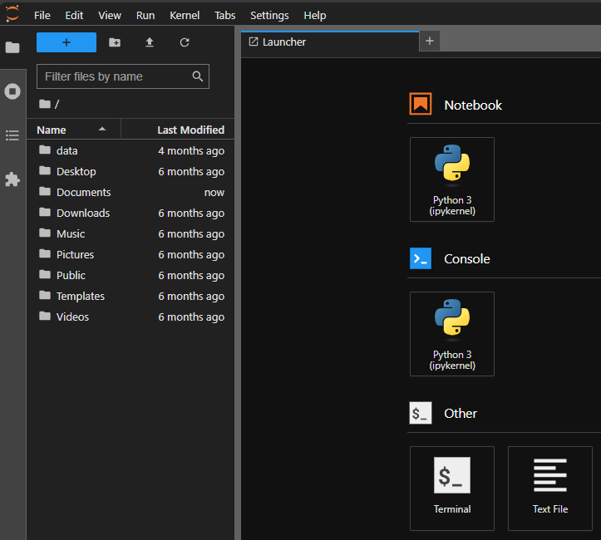
What is JupyterHub
JupyterHub is a multi-user server for Jupyter Notebooks
Designed to support many users by spawning, managing, and proxying many singular Jupyter Notebook servers
Enables running JupyterLab at scale
Web-based interactive development environment for notebooks, code, and data
Flexible interface allows users to configure and arrange workflows in data science, scientific computing, computational journalism, and machine learning
Supports languages such as Python, R, and Julia along with popular libraries like Pandas, PyTorch, and TensorFlow
Notes:
Kyle

Slide 9
What SDSU has done
Followed the Bring-Your-Own-Resource (BYOR) model with the VERNE instructional cluster
Set up a single, central JupyterHub instance for instruction
Started with same containers as NRP
Eventually started creating custom containers for courses
Piloted with 2 courses in the Spring of 2023, up to 19 courses for Fall 2024
Courses from several colleges and academic disciplines spanning graduate and undergraduate level
ASTR 201 Astronomy for Science Majors
LING 572 Python Scripting
MIS 429 Artificial Intelligence
PH 700A Principle Program Data Structures in Public Health
Notes:
Speak to what we did before

Slide 10
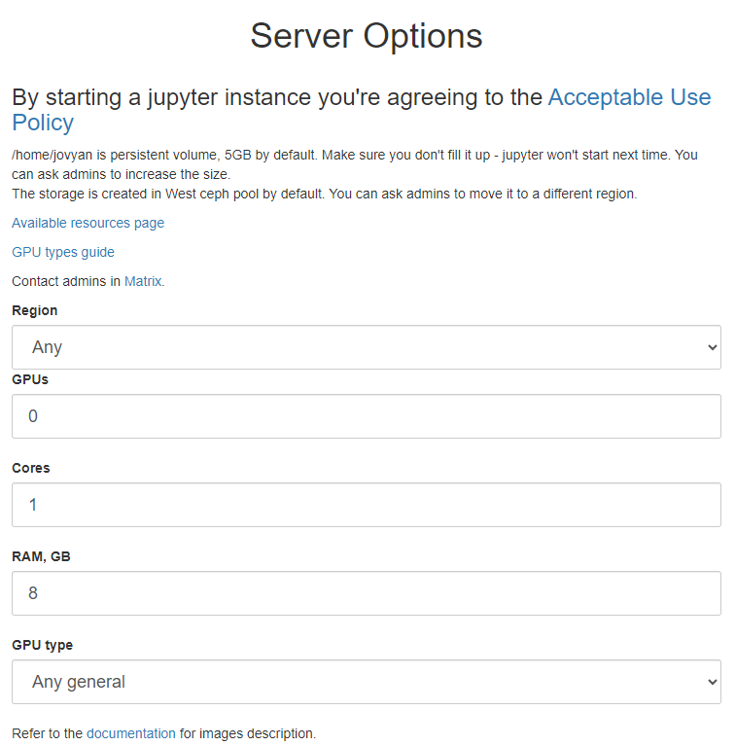
JupyterHub options on NRP
Option 1: Use the NRP hosted JupyterHub
See the JupyterHub Service docs
Easy way to get started
5 GB initial storage per user, must be increased per user
Option 2: Custom deployment
Management models
One JupyterHub for all courses
Customized JupyterHub per course
Resources
Use the NRP
BYOR

Slide 11
Custom JupyterHub Deployment
Don’t need to BYOR to start, just use the resources available on NRP
NRP deploying JupyterHub guide
Ask to become a namespace admin in the NRP Matrix Nautilus Support channel
Create a namespace for your JupyterHub instance
Register a new CILogon application
Enables users to authenticate with their institutional SSO credentials
Install Helm command line tool
“Helm is the best way to find, share, and use software built for Kubernetes”
Deploy the official JupyterHub Helm chart
Follow the instructions in the official JupyterHub deployment guide
Customize NRP provided template configuration file

Slide 12
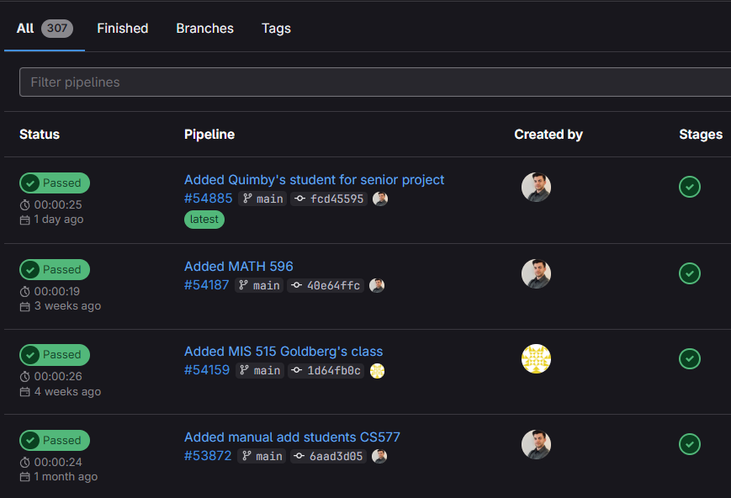
CI/CD for automatic deployments
Continuous Integration and Continuous Delivery (CI/CD)
Fancy term for automating the deployment process
Why set up automatic deployments?
Helps reduce manual error when making changes
May need to update container images each term or academic year
May need to add users throughout the term
May need to upgrade JupyterHub
May need to revert changes
NRP has an integrating GitLab and Kubernetes guide
Requires making an NRP GitLab account
Not to be confused with a gitlab.com account
Create a project
Upload code
Define CI/CD Pipeline in .gitlab-ci.yml file
Reference GitLab project

Slide 13
Distributing Notebooks
All of the official Jupyter notebook containers come with git pre-installed
GitHub
Straightforward and does not require students to have an account for cloning/downloading notebooks
Does require students to make an account for submitting work
GitHub Classroom
Free service from GitHub tailored to teaching
Individual and group assignments, submission deadlines, and automatic grading
Optional roster integration with several LMS (Canvas, Google Classroom, LTI-compatible)
Assignments can be reused across classrooms
Requires faculty to create an organization
Requires students to create an account
More info: GitHub Classroom

Slide 14
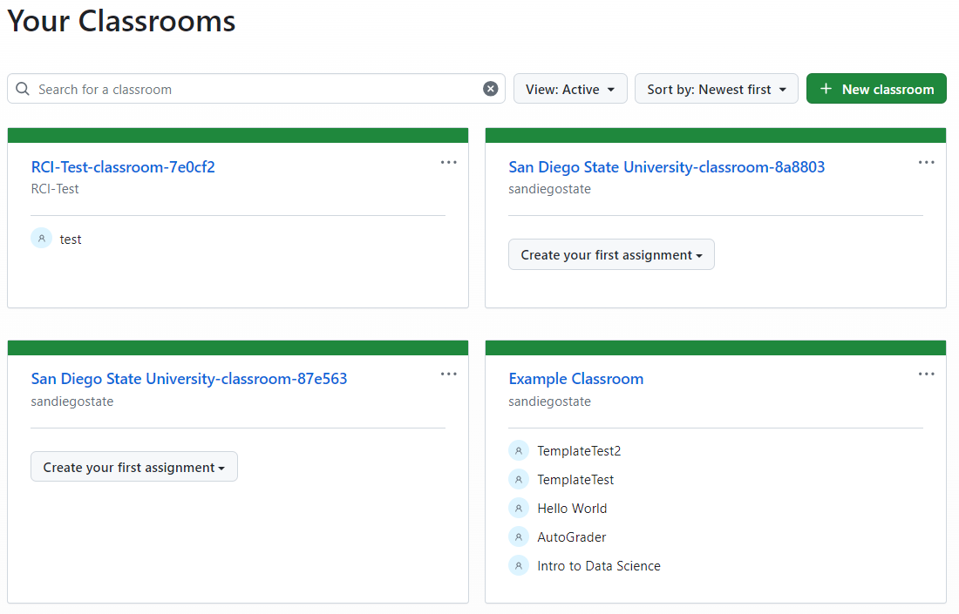
Distributing Notebooks: GitHub Classroom

Slide 15
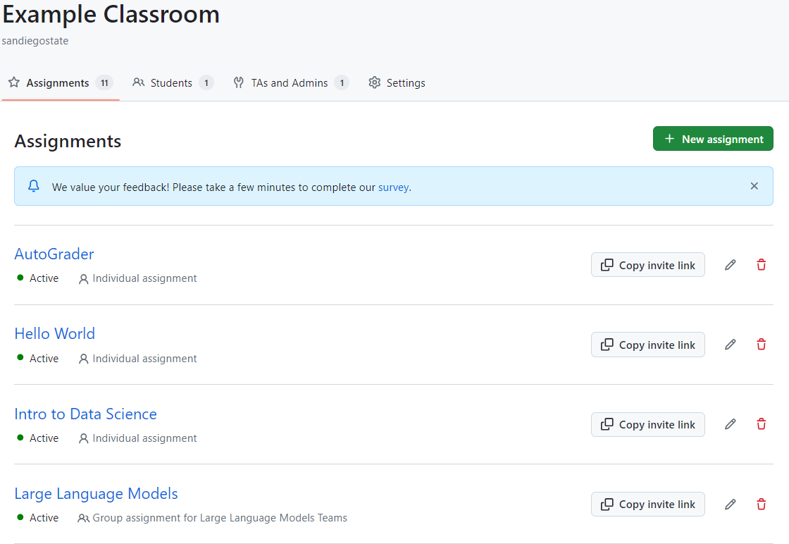
Distributing Notebooks: GitHub Classroom

Slide 16
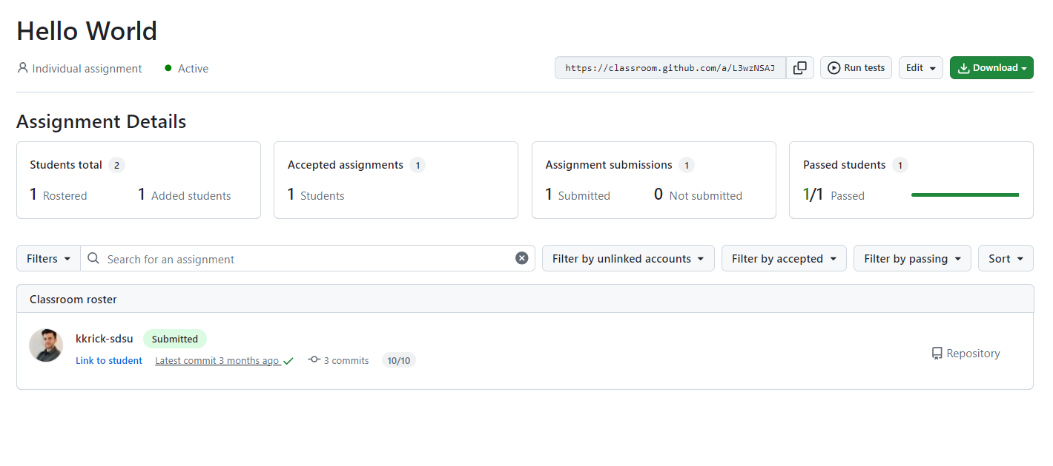
Distributing Notebooks: GitHub Classroom

Slide 17
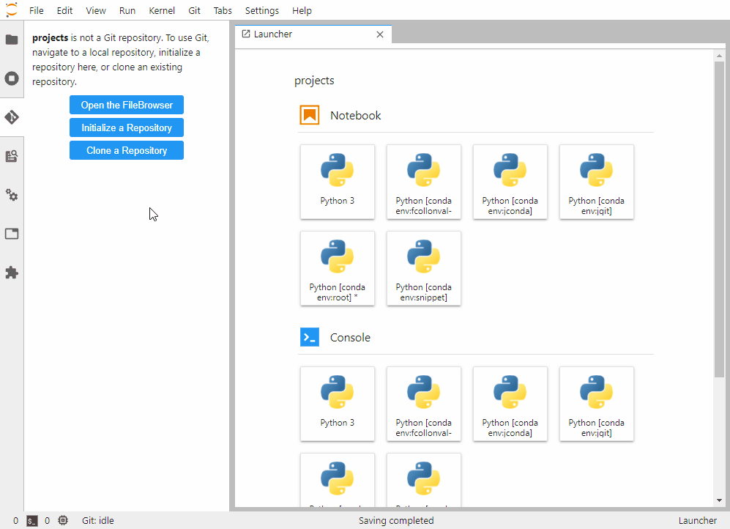
Distributing Notebooks: JupyterLab Git Extension
Image credit: jupyterlab/jupyterlab-git: A Git extension for JupyterLab

Slide 18
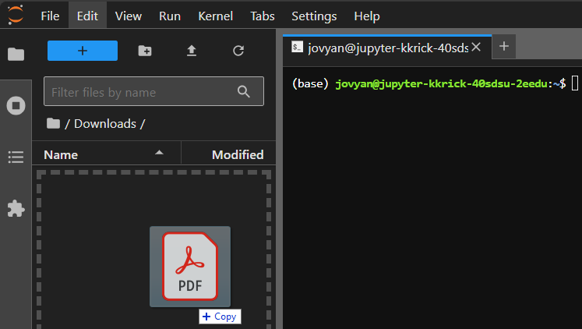
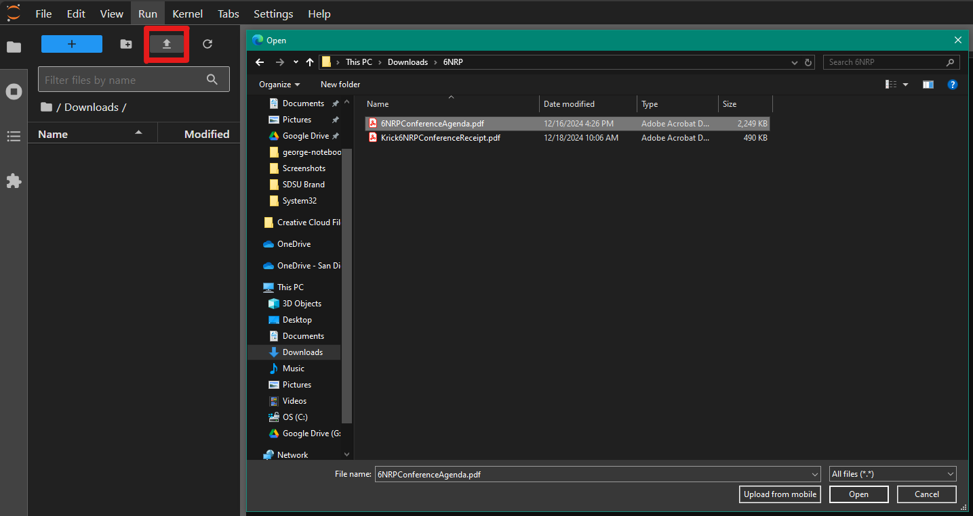
Data Sharing: JupyterLab UI
JupyterLab has drag-and-drop and file selection upload options
Good for small datasets of < 50MB
Can provide files in your institution’s learning management system (LMS)
Students can download and then upload files

Slide 19
Data Sharing: Mounting Shared Storage
File Storage
Allows multiple users access to the same data at the same time
Create a PersistentVolumeClaim (PVC) with support for ReadWriteMany (RWX) in your namespace
Choose a CephFS storage pool close to the physical location/region of the nodes you want to run on
Modify “storageClassName” value in the next slide as appropriate
Modify “storage” value in next slide as appropriate for data size
You may schedule a pod in the same namespace to transfer files
After files are transferred, recommend running “chown -R 1000:100 /path/to/pvc”
Add the PVC to the singleuser spec in your helm-values.yaml
Recommend mounting it as read-only so that students do not overwrite the data
Recommend mountPath of “/home/jovyan/shared”

Slide 20
Data Sharing: Mounting Shared Storage - Make RWX PVC
apiVersion: v1
kind: PersistentVolumeClaim
metadata:
name: shared
spec:
accessModes:
- ReadWriteMany
resources:
requests:
storage: 5Gi
storageClassName: rook-cephfs
Save contents to the left in file “shared-pvc.yaml”
Run the commands below:
kubectl apply -f shared-pvc.yaml
kubectl get pvc | grep shared
Verify your new PVC was created and is the desired size

Slide 21
Data Sharing: Mounting Shared Storage - Data Transfer
apiVersion: v1
kind: Pod
metadata:
name: shared-data-pod
spec:
restartPolicy: Never
containers:
- name: shared-data
image: ubuntu:latest
resources:
limits:
memory: 2Gi
cpu: 1
requests:
memory: 2Gi
cpu: 1
command: ["sleep", "infinity"]
volumeMounts:
- name: shared-data-volume
mountPath: /data
volumes:
- name: shared-data-volume
persistentVolumeClaim:
claimName: shared
Save contents to the left in file “shared-data-pod.yaml”
Run the commands below:
kubectl apply -f shared-data-pod.yaml
kubectl exec -it shared-data-pod -- bash
Transfer files via preferred method
wget, curl, script, rclone etc.
When done, run the commands below
chown -R 1000:100 /data
exit
kubectl delete -f shared-data-pod.yaml

Slide 22
Data Sharing: Mounting Shared Storage in Notebooks
singleuser:
storage:
extraVolumes:
- name: shared-data-volume
persistentVolumeClaim:
claimName: shared
extraVolumeMounts:
- name: shared-data-volume
mountPath: /home/jovyan/shared
readOnly: true
Modify your helm-values.yaml file to include the extraVolumes and extraVolumeMounts logic under your singleuser > storage section
Deploy these changes to your hub
This may be manual or via CI/CD depending on how you configured it
Start a notebook via your hub and verify that you see the files you expect at the path /home/jovyan/shared

Slide 23
Data Sharing: Linux scripting
Official Jupyter notebook images come with curl and wget
Can add commands to notebooks to download publicly available datasets
Can distribute shell scripts to execute in JupyterLab’s linux terminal

Slide 24
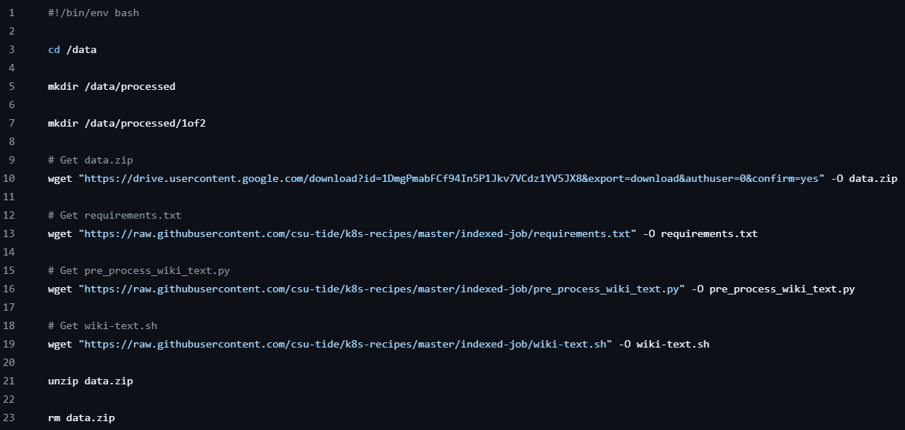
Data Sharing: Example data transfer script

Slide 25
Data Sharing: NRP S3-compatible object storage
Can use NRP S3-compatible object storage
Best for large datasets I.E. > 1GB
Recommend using rclone
Most likely will need to install this
sudo -v ; curl https://rclone.org/install.sh | sudo bash
If building your own containers, recommend baking this utility in
Can distribute shared credentials to bucket
Recommend read-only credentials
Can distribute credentials as a file “rclone.conf”
Students can then copy the file where it belongs
mkdir ~/.config/rclone
cp ~/rclone.conf ~/.config/rclone/rclone.conf

Slide 26
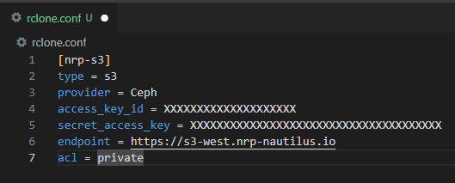
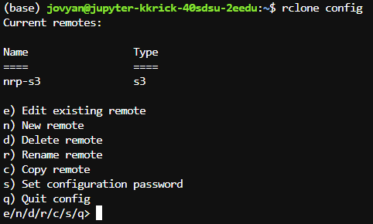
Data Sharing: Rclone for S3-compatible object storage

Slide 27
Building your own containers
Why build your own containers?
Need specialized software i.e. linux binaries
Need a lot of packages or an entire pip/conda environment
Don’t want to install a package every time after startup anymore
Start with NRP docker tutorial
Install Docker
Find good base images
Jupyter official images are a great place to start
Upload to Docker Hub or NRP GitLab
Add to your JupyterHub Helm values and re-deploy your hub

Slide 28
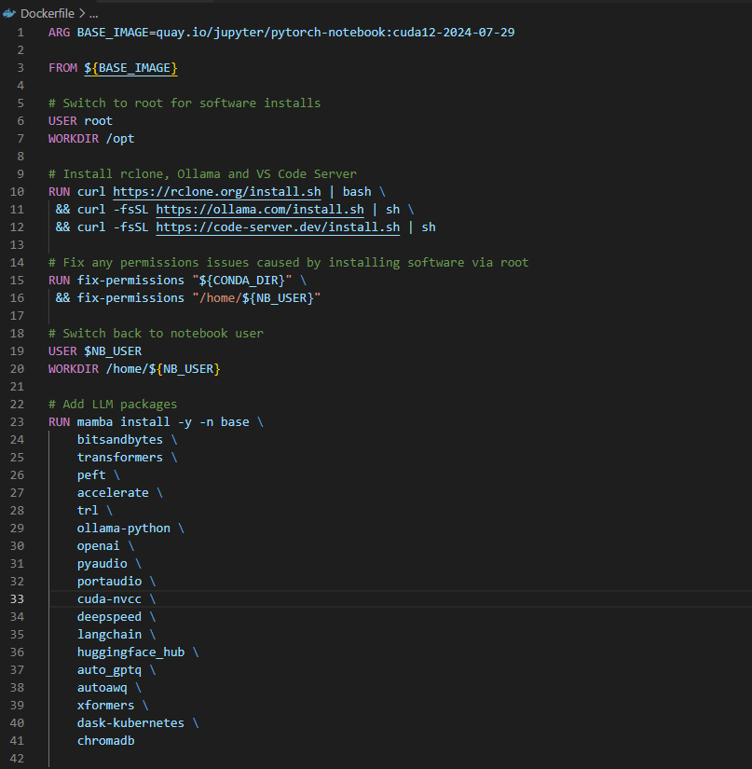
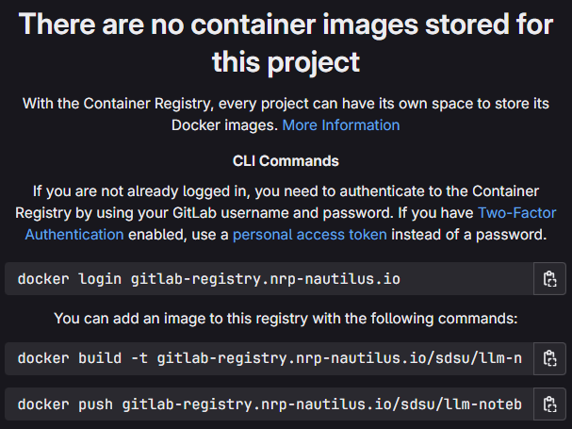
Building your own containers: Example “LLM Notebook”

Slide 29
Supporting your JupyterHub: Documentation
Questions to answer in your documentation
How to request access?
What resources are available?
How much storage capacity is available?
What is the data retention policy?
What software is available?
GitHub pages hosts static sites for free

Slide 30
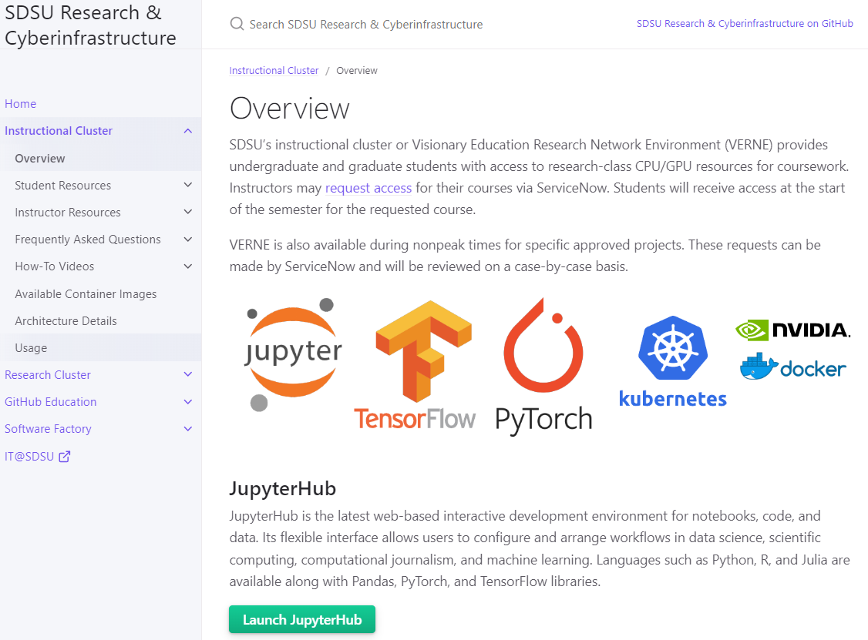
Supporting your JupyterHub: Documentation example
https://sdsu-research-ci.github.io/instructionalcluster

Slide 31
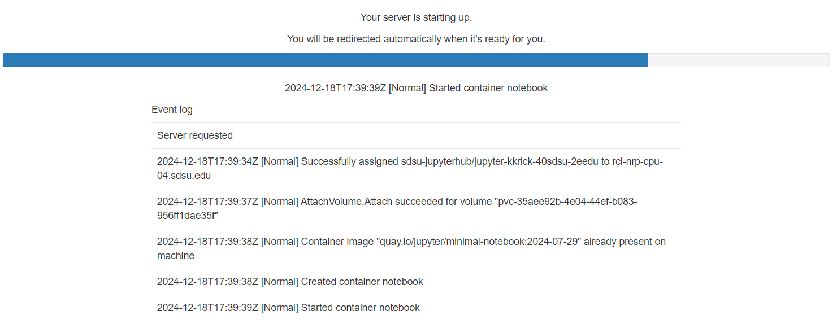
Supporting your JupyterHub: Reporting Issues
Provide instructions for how faculty and/or students can get support
How to request access
Instructions for reporting issues
what information they should report
I.E. Recommend including screenshot of the start up logs

Slide 32
JupyterHub Cookbook
1. Try out NRP JupyterHub | https://docs.nationalresearchplatform.org/userdocs/jupyter/jupyterhub-service/
2. Deploy your own JupyterHub Create namespace Register CILogon Configure custom helm chart Deploy JupyterHub helm chart | https://docs.nationalresearchplatform.org/userdocs/jupyter/jupyterhub/
3. Automate your JupyterHub Deployment | https://docs.nationalresearchplatform.org/userdocs/development/k8s-integration/
4. Build and publish your own containers | https://docs.nationalresearchplatform.org/userdocs/tutorial/docker/
Notes:
(steps, high level to do what we just covered)

