Slide 1
Expanding AI/ML Coursework on Your Campus Using Jupyter Notebooks powered by NRP
Building Hands-on Lessons
with Jupyter Notebooks
J. Alex Hurt
University of Missouri
Electrical Engineering and Computer Science

Slide 2
Introduction
The previous set of slides and examples went over how to go from a standard slide / homework-based Syllabus to a Lesson Plan using Jupyter
This portion of the tutorial will go more in-depth on building hands-on lessons for topics in AI/ML, including topics such as:
General Approach and Methodology
Module Layout and Setup
Jupyter Cell Types and their usage for instruction
Hands-on Example building a Jupyter Notebook Lab for AI/ML

Slide 3
General Approach
The general approach to building Jupyter notebooks for AI/ML coursework:
Each notebook is a standalone, fully independent example that leans on prior knowledge and exercises to introduce, reinforce, or assess the understanding of a concept, theory, or application of AI/ML

Slide 4
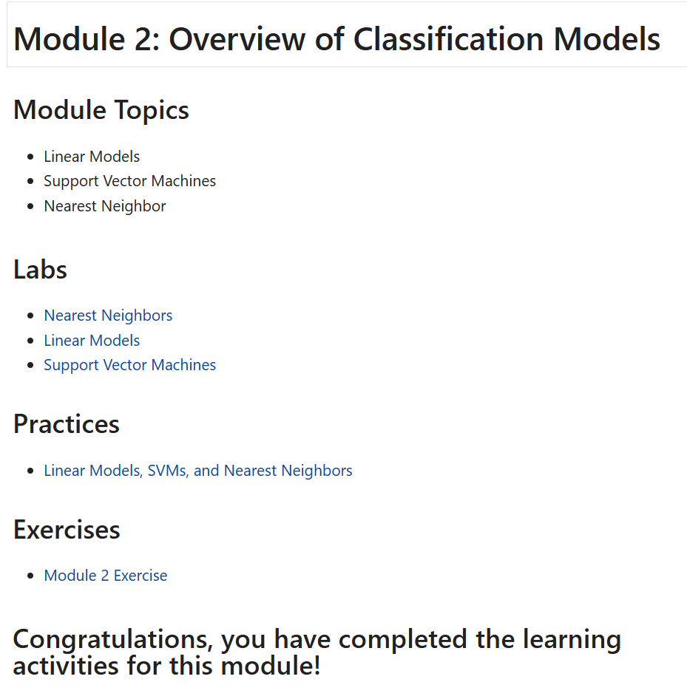
Module Layout and Setup
Modules can be laid out a variety of ways
This tutorial will provide the most common one used at MU for AI/ML Coursework
Each module is broken down into three types of notebooks:
Lab - Concept / Application Introduction
95% - 100% worked out examples with little to no student involvement / input
Practice - Concept / Application Reinforcement
Alternatively, Concept Reinforcement with Concept / Application Introduction
50% - 80% worked out examples with some student involvement / input
Exercise - Concept / Application Assessment
Alternatively, Concept Assessment with Concept / Application Reinforcement
0% - 10% worked out examples with almost entirely student input

Slide 5
Module Labs
Module Layout
Each lab is a completely or nearly completely filled out example used to introduce a concept, in which all concepts are explained clearly using a variety of Code, Markdown, Math, and External Links
Labs serve to introduce a student to a concept or application
K-Nearest Neighbors
Differences Between Fully and Semi-Supervised Learning
Calculating Performance Metrics of Trained ML Models
Generally, the only student involvement (if any) is to copy and paste a previous cell and change very little:
Change K = 5 to K = 7 for K-Nearest Neighbors Classifier
Change K = 5 to K = 10 for K-Fold Cross Validation
The labs are the “lecture” material, i.e., they are what are walked through in class and what students use as a basis for Practices and Exercises

Slide 6
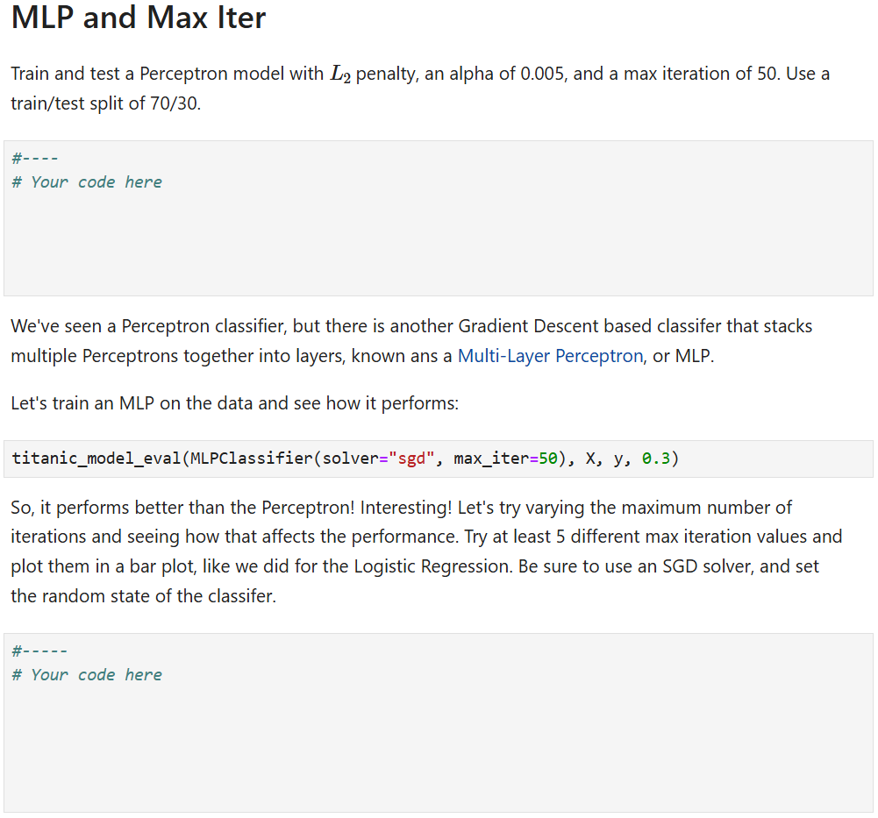
Module Practices
Module Layout
Each practice is a partially filled out example used to reinforce a concept, in which some of the concepts are fully worked out using a variety of Code, Markdown, Math, and External Links
Students use the same model (reinforcing that model’s behavior), but a new dataset or experimental design pattern is introduced
Students must create, train, and test model but all preprocessing is fully worked out
Generally, the student involvement is derived from previous labs and practices within the current module and previous modules
Oftentimes, copying code from previous modules and then editing from there
The practices are the advanced lecture material or small homework assignments
Answers to practices are covered in lecture and distributed to students prior to Concept Assessment with Exercises
I generally encourage my students to try new ideas in Practices, letting their curiosity and intuition grow
Intentionally vague questions that allow students to set parameters: “Train a Linear ML model”
Require a certain number or style of response without requiring an exact answer: “Try three more permutations and state the best performer along with your analysis of why that model performed best”

Slide 7
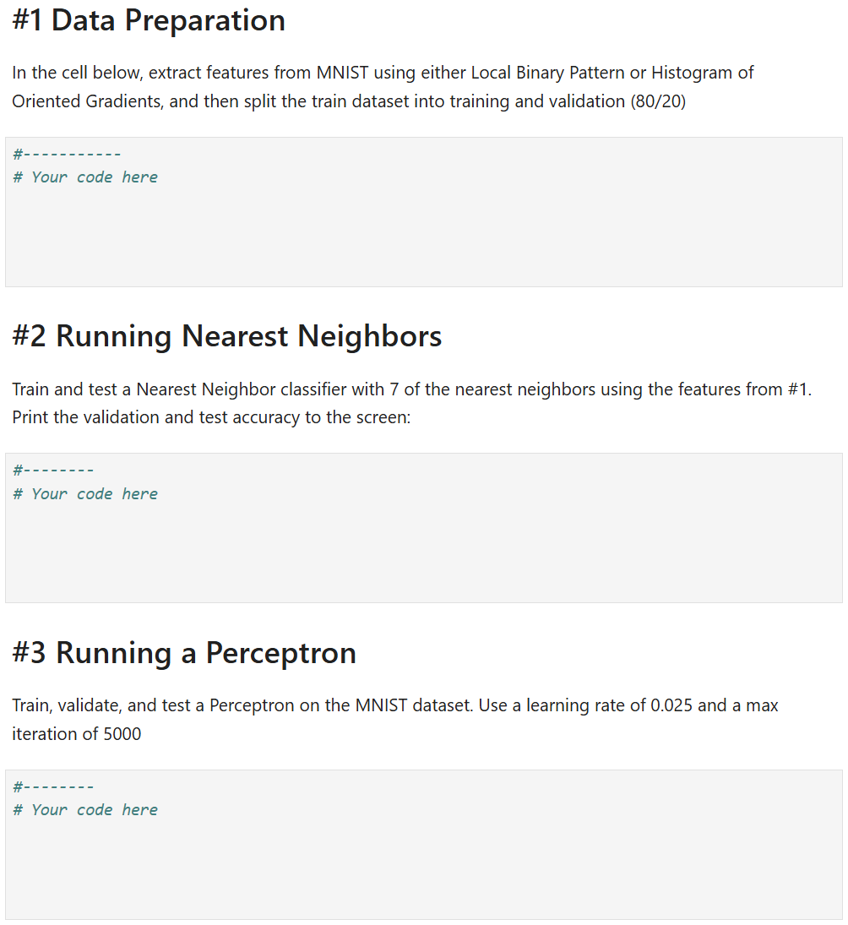
Module Exercises
Module Layout
Each exercise is a nearly empty notebook used to assess student’s understanding of previously introduced and reinforced concepts
Exercises serve to ensure that the concepts and applications being taught in a given module are being understood
Students are required to do nearly everything in these modules, usually with only the library imports being given to them
This ensures that students can go from nothing to fully functional ML workflows using the concepts in a given module
Difficulty generally varies, with the exercise becoming more difficult and requiring more in-depth understanding as it progresses
Exercises almost always combine multiple concepts so that previous module’s content are continually being reinforced and used
If Module 2 is feature selection, then not only will that be assessed in Module 2’s exercise, but the exercise for Module 3 or 4 will also use feature selection in combination with the new concepts for that module
The exercises are the larger homework assignments
Answers to exercises are covered in lecture following the due date to ensure students have a functional understanding of a module’s concepts before moving to the next

Slide 8
Jupyter Cell Types Introduction
Jupyter Cell Types
To build the labs, practices, and exercises needed for a given module, I generally utilize multiple types of Jupyter Cells:
Code Cells
Markdown Cells
Raw NBConvert Cells
Each cell has a usefulness for building instructional materials in AI/ML coursework

Slide 9
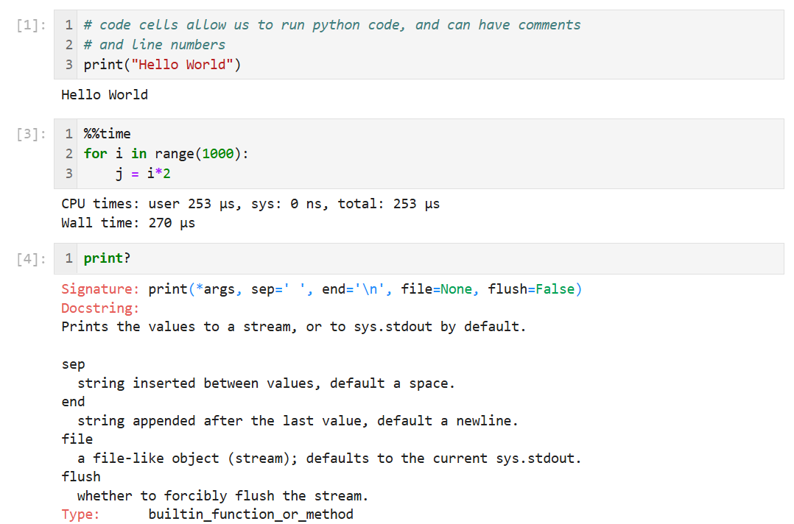
Jupyter Cell Types: Code
Jupyter Cell Types
Code cells are the bread-and-butter of Jupyter Notebook Lessons
They are the “hands-on” element of Jupyter Notebook lessons
Labs use code cells for fully worked examples and to guide students through practical usage and application of concepts in Python (or other languages)
Practices use code cells for the partially worked out examples and for students to fill in the missing pieces
Exercises use code cells as the answer block for most of the questions
Code cells have full functionality of Python3, and some particularly helpful features for coursework include:
Code Completion
Line Numbers
Block and Line Commenting
IPython Magic: Automatic Runtime, Package Management, Automatic Documentation

Slide 10
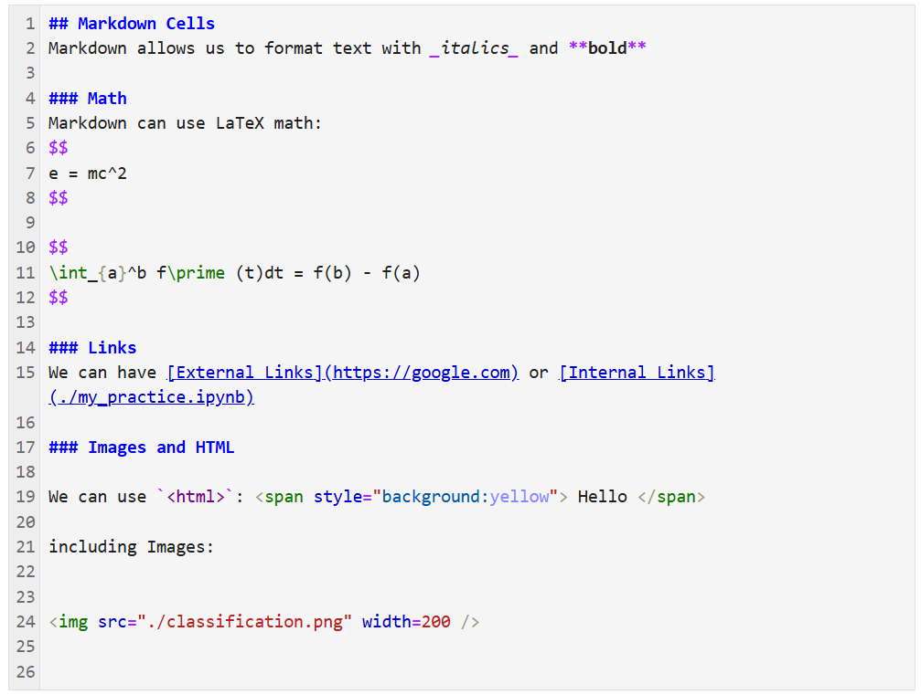
Jupyter Cell Types: Markdown
Jupyter Cell Types
Markdown cells are the “explanatory” and textual component of Jupyter Notebook Lessons
We can use Markdown between and among code cells to split notebooks into sub-regions, add headers and separators, and add additional elements to build standalone lessons inside of Jupyter
Markdown cells have full compatibility with external Markdown renderers, such as GitHub and other documentation. Some particularly helpful features include:
Text formatting
Math via LaTex
Links, both internal and external
HTML Support
Code Block Inlays

Slide 11
Jupyter Cell Types: Markdown
Jupyter Cell Types

Slide 12
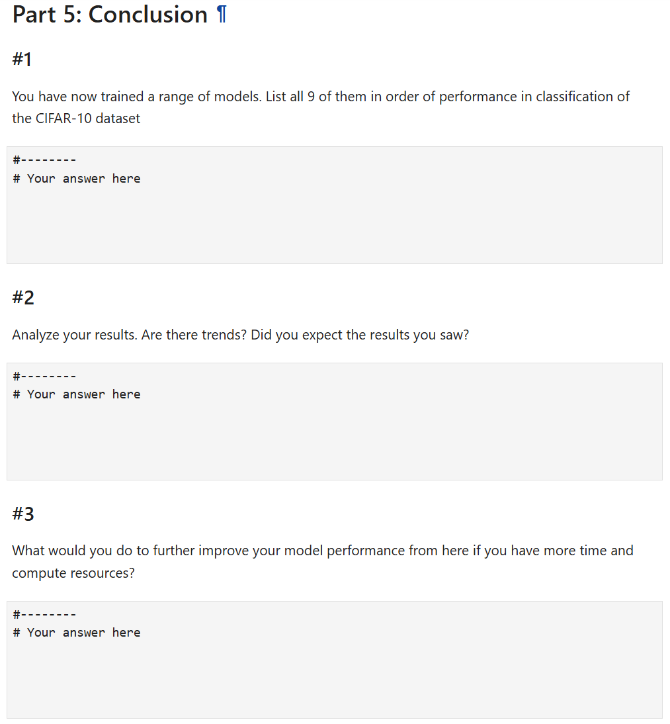
Jupyter Cell Types: Raw NBConvert
Jupyter Cell Types
Raw NBConvert cells are non-formatted, non-code cells
Raw NBConvert are generally used as “enter your answer that is not code here”
Often used after a code cell that produces results to have students use their own words
Good questions for Raw NBConvert cells are hypothetical questions:
How would you go about improving performance if given additional resources?
How do you think this model would perform on out-of-distribution data? Why?
Much less used than cell or markdown cells

Slide 13
Thank you!
Questions?

Slide 14
Hands-On Example:
Jupyter Instance: gp-engine.nrp-nautilus.io
Code: github.com/MUAMLL/CourseworkTutorial

Slide 15
Resources
NRP Homepage: https://nationalresearchplatform.org/
NRP Documentation: https://ucsd-prp.gitlab.io/
MU Resources for AI/ML Researchers using NRP: https://github.com/MUAMLL/nautilus
Sample Dockerfiles, YAMLs, and Wiki
Deploying JupyterHub on NRP: https://github.com/MUAMLL/nautilus/wiki/JupyterHub
GP-ENGINE Tutorial Resources: https://github.com/MUAMLL/gp-engine-tutorials
Step-by-step for getting started using NRP including account creation, PVC setup, and basic pod and job running
Matrix Chat: https://nationalresearchplatform.org/updates/matrix-chat-for-nautilus-users/
Chat-service (similar to slack) for discussion and help using NRP

