Slide 1
“AI/ML Computing
Across Scientific Disciplines”
Invited Presentation
Sixth National Research Platform Conference (6NRP)
UC San Diego
January 29, 2024
Dr. Larry Smarr
Founding Director Emeritus, California Institute for Telecommunications and Information Technology;
Distinguished Professor Emeritus, Dept. of Computer Science and Engineering
Jacobs School of Engineering, UCSD
http://lsmarr.calit2.net

Slide 2
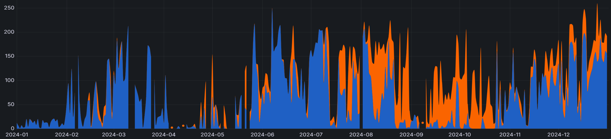
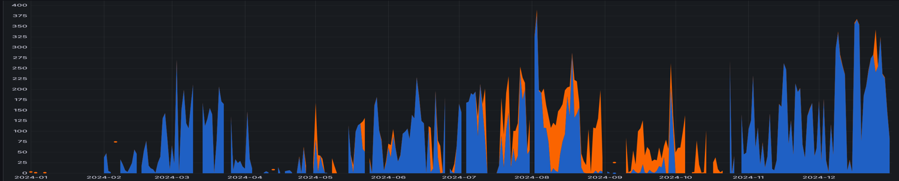

IceCube Neutrino & LIGO Gravitational Wave Detectors Are Major NRP Users -
GPU/CPU Core Usage Per Day, Calendar 2024
Peaking at 260 GPUs
800,000 GPU-hrs
NRP
GPUs
NRP
CPU Cores
Peaking at 390 CPU Cores
1,300,000 CPU-hrs
Namespaces osg-icecube & osg-ligo

Slide 3
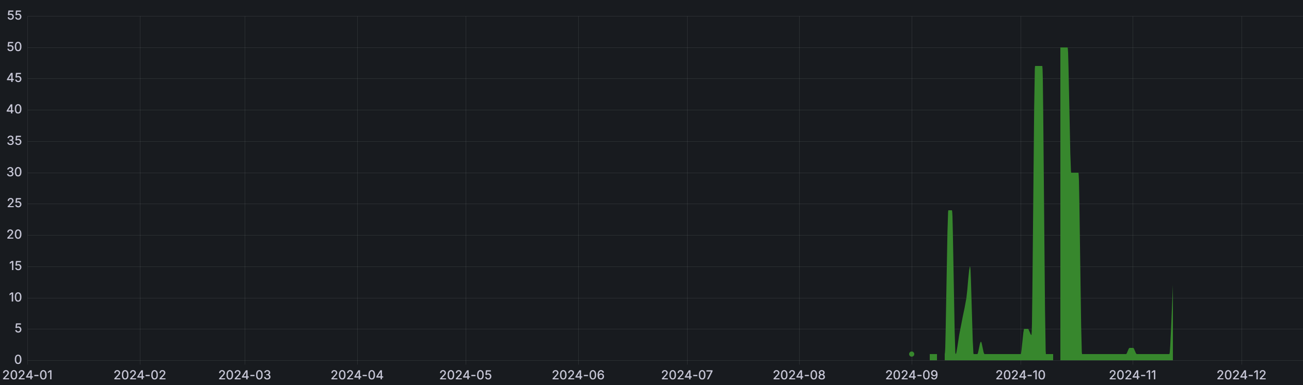
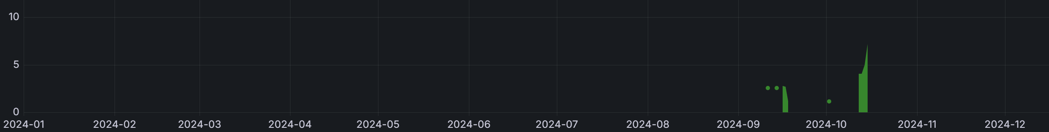
IceCube Neutrino Detector Is Just Beginning to use ML
GPU/CPU Core Usage Per Day, Calendar 2024
Peaking at 50 GPUs
29,019 GPU-hrs
NRP
GPUs
NRP
CPU Cores
Peaking at 5 CPU Cores
14,283 CPU-hrs
Namespaces icecube-ml

Slide 4
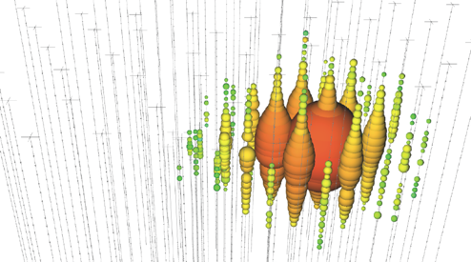
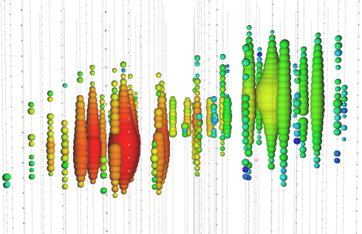
IceCube ML – Differentiate Event Topology
Cascade - Ball
Double Bang – Dumb Bell
Track – Line
Using a CNN to differentiate topologies
in a single algorithm for the first time
Source: Benedikt Riedel
IceCube Neutrino Observatory
Accelerated AI Algorithms for Data-Driven Discovery
University of Wisconsin-Madison

Slide 5

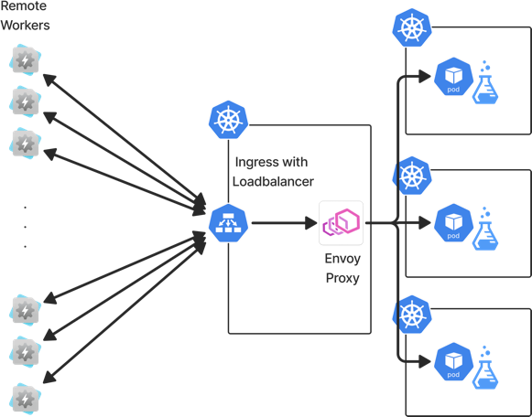
ML Inference-as-a-Service –
Taking it to Production
CMS, LIGO, ATLAS and IceCube are essentially doing/wanting to do the same thing – Lets work together!
SuperSONIC
  Common Helm chart to deploy SONIC on NRP (or other Kubernetes cluster)
  Enough config parameters to make it work for all experiments!
  Biggest Change is using envoy proxy and KEDA for scaling pods

Slide 6
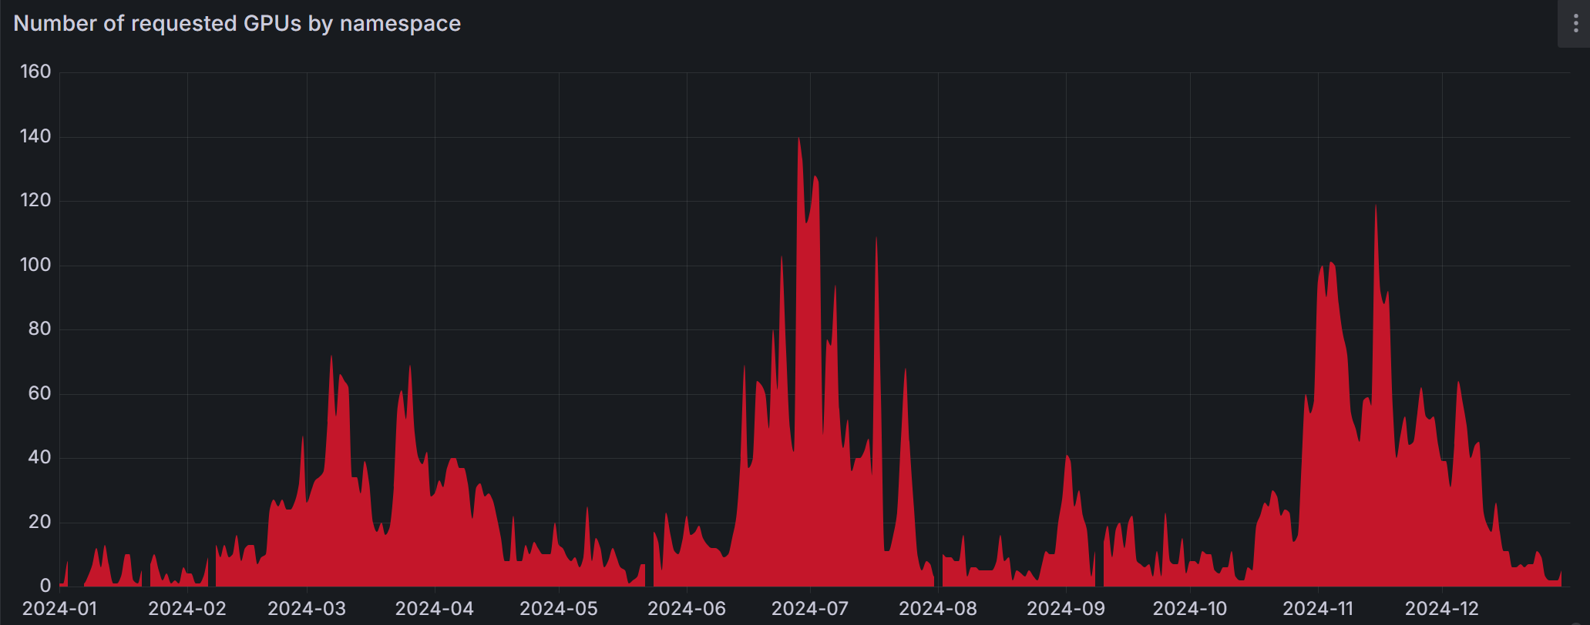
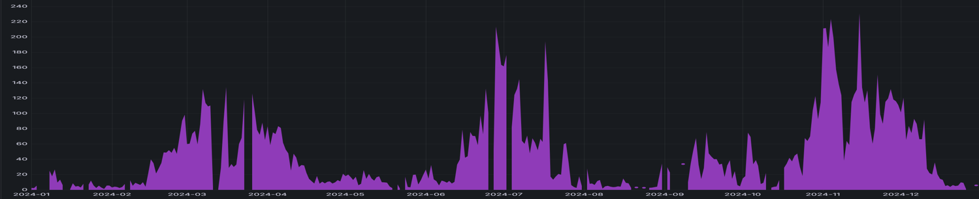
NRP Namespace cms-ml
GPU/CPU Core Usage Per Day, Calendar 2024
Peaking at 140 GPUs
222,296 GPU-hrs
NRP
GPUs
Peaking at 230 CPU Cores
1,254,757 CPU-hrs
NRP
CPU Cores
Namespace cms-ml

Slide 7
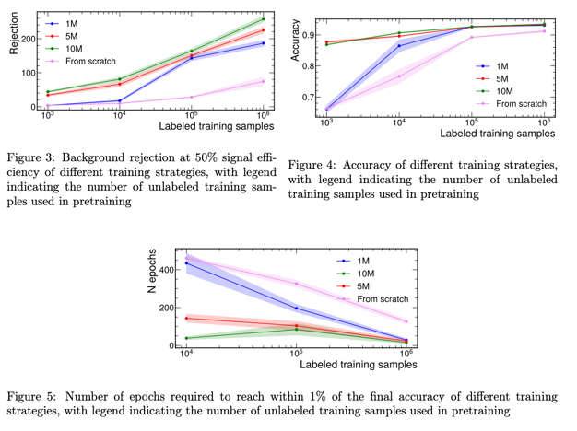
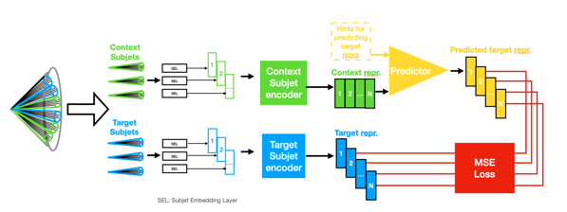
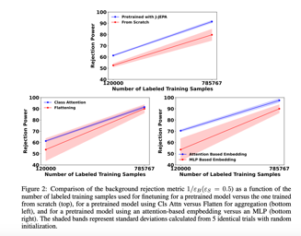
Self-Supervised Learning (SSL) for Jet Tagging
Using NRP to train and evaluate foundation models for jet tagging, and (in the future) other jet related tasks
Evaluating the dataset scalability of foundation models
Developing new SSL strategies for training foundation models
https://arxiv.org/abs/2408.09343
https://arxiv.org/abs/2412.05333
Zihan Zhao, Billy Li

Slide 8
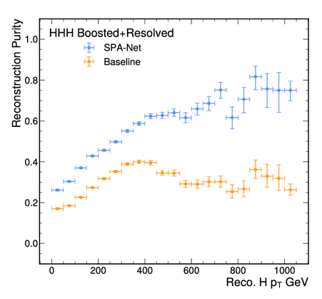
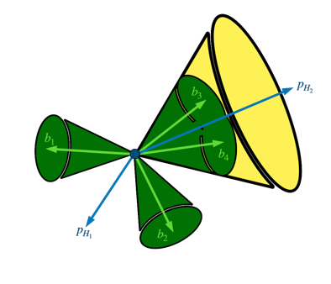
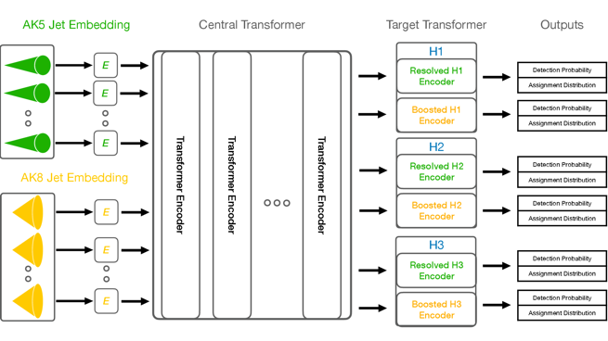
Reconstructing Higgs Bosons with Symmetry-Preserving Transformers
Symmetry-preserving transformers applied to simultaneously reconstruct multiple Higgs bosons from low to high energies at the CERN LHC
https://arxiv.org/abs/2412.03819
Billy Li

Slide 9
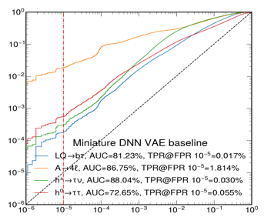
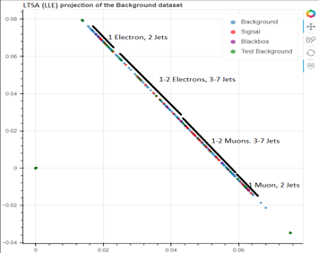
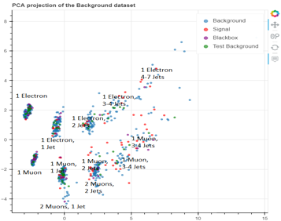
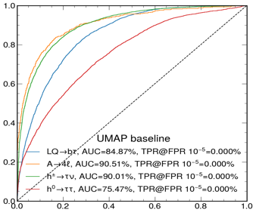
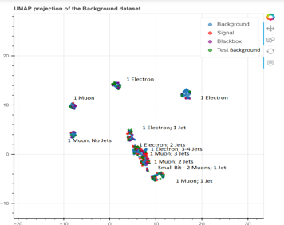
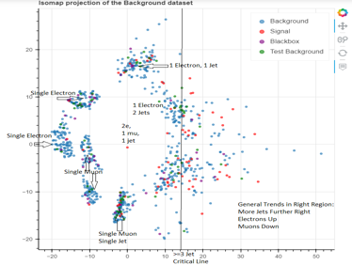
Anomaly Detection for LHC Trigger
Exploring Alternative Dimension Reduction Based ML Architectures & Algorithms
for Unsupervised Anomaly Detection Using Public CMS Dataset as a Benchmark
Benchmark variational autoencoder vs. UMAP, LDLE, t-SNE …
Rohan Sachdeva, Melissa Quinnan

Slide 10
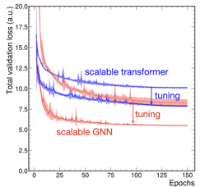
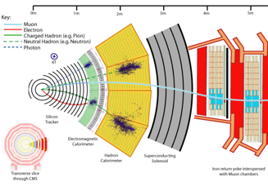
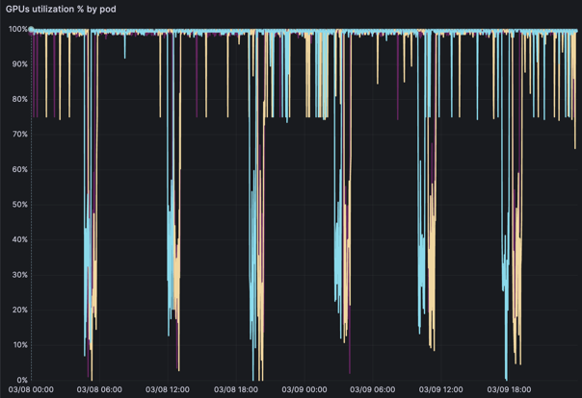
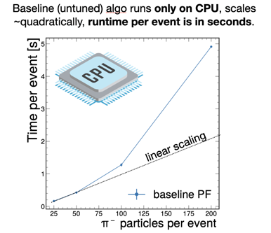
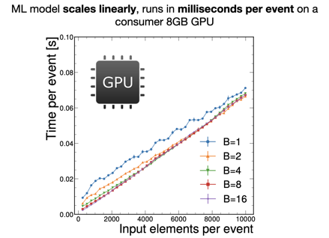
Machine-Learned Particle-Flow Reconstruction
We study Scalable neural networks for event reconstruction at current and future colliders.
Current and future multilayered detectors need complex data reconstruction → particle flow algorithm
Model hypertuning achieves better than SOTA performance!
Farouk Mokhtar

Slide 11

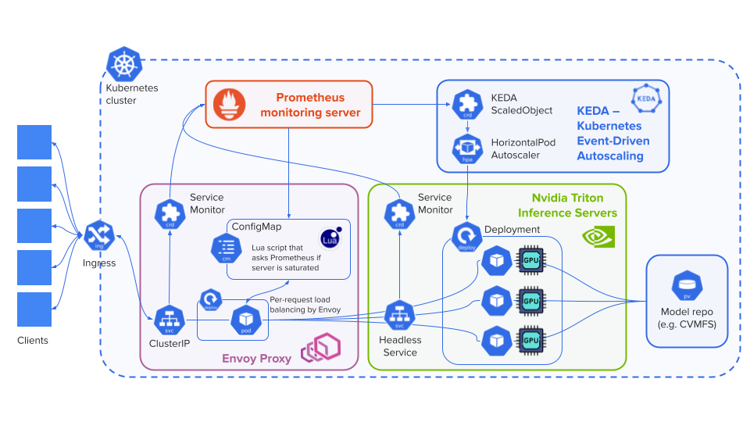
SuperSONIC:
GPU Inference As-a-Service for Science
SONIC is a computing paradigm for integration of coprocessors as-a-service in large physics experiments
CMS, ATLAS, IceCube, LIGO are working on integrating SONIC in their workflows
SuperSONIC: portable Kubernetes-based server infrastructure for GPU inference-as-a-service
  Nvidia Triton inference servers
  Envoy Proxy: load balancing, rate limiting
  KEDA: load-based autoscaling
First version of SuperSONIC Helm chart just released
Active testing at Nautilus cluster
  CMS: sonic-server namespace
  ATLAS: triton-atlas namespace
  IceCube: icecube-ml namespace
Dmitry Kondratyev

Slide 12
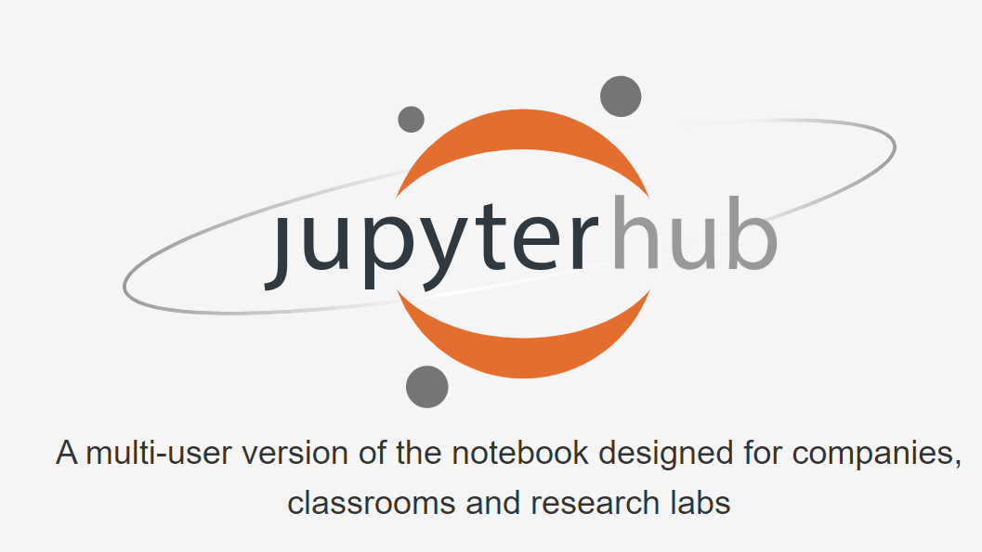
jupyterhub is the
Multi-User Version of the jupyter Notebook

Slide 13
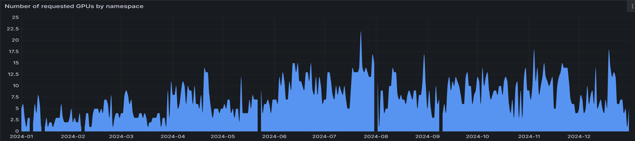
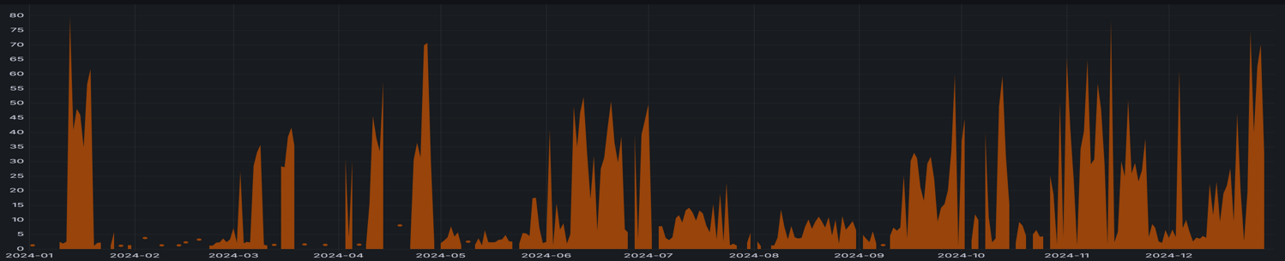

NRP Namespace jupyterlab
GPU/CPU Core Usage Per Day, Calendar 2024
Peaking at 22 GPUs
64,333 GPU-hrs
NRP
GPUs
Peaking at 80 CPUs
802,870 CPU-hrs
NRP
CPU Cores
Namespace jupyterlab

Slide 14
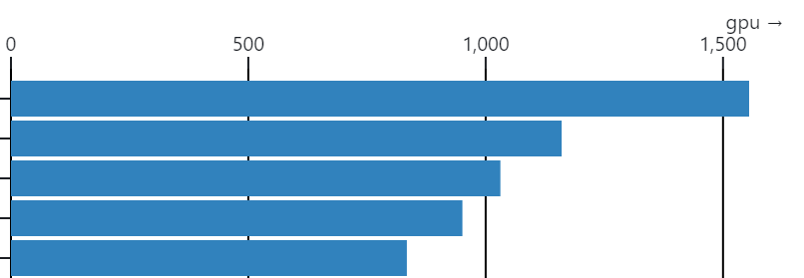
Nautilus Namespace jupyterlab Has an Active JupyterHub: jupyterlab’s Top 5 GPU-Hour Users Over March to June 2024
July 2024
GPU Hours per User
User Institution
Cal Poly Humboldt
UC Santa Cruz
UC Santa Barbara
UC San Diego
UC Santa Cruz
Users Are Identified Only by Email Addresses
https://observablehq.com/

Slide 15
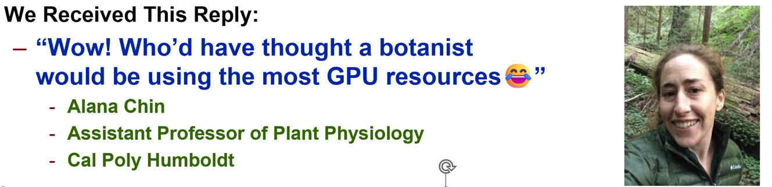

Tom DeFanti Emailed the Largest GPU User of Namespace Jupyterlab in July 2024,
Asking “Who Are You and What is Your Research Project?”
“I am running some big Fully Convolutional Network (FCN) models to segment some of the highest resolution CT scans ever made on cores of wood collected from redwood trunks across their full height, up to 100 m above ground.
We are segmenting out tissue types for 3D measurements and brightness histograms to understand wood density and hydraulic parameters.”
Source: Prof. Alana Chin
Cal Poly Humboldt

Slide 16
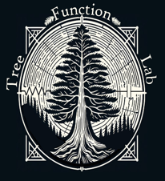
The Future of Forestry is Carbon Sequestration
The NRP is Helping Us Get There!
Forest carbon storage is tied to 2 factors –
1) biomass accumulation associated with wood growth and
2) density and the longevity and decay resistance of trees.
Dr. Alana Chin’s Tree Function Lab at Cal Poly Humboldt focuses
on questions related to the physiology of carbon storage and tree climatic tolerance aimed at predicting tree survival and improving management
for extending and optimizing natural carbon storage.
Their recent work on Nautilus asks:
1) What are the anatomical components of wood density? and
2) Can wood anatomical structure predict future carbon storage potential ?
Prof. Alana Chin
Cal Poly Humboldt

Slide 17
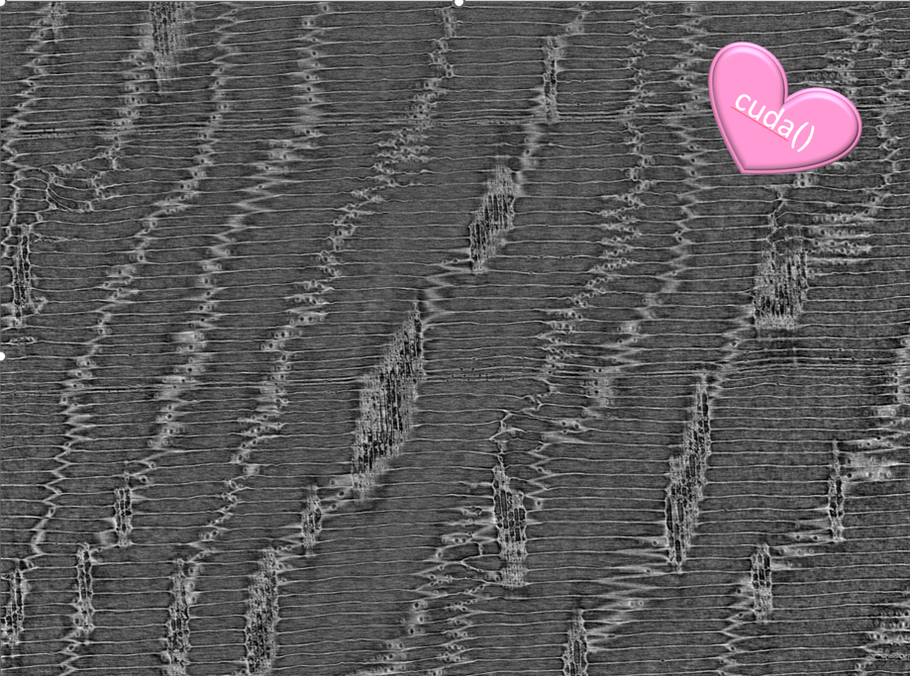
How the Heck is a Tiny Group of Tree-Climbing Botanists
Burning So Much GPU Time!?
“The Tree Function Lab works with
ultra high-resolution synchrotron-based
X-ray tomographic microscopy.
Their final wood images are often
>14 billion voxels and 50+ GB in size.
They run fully convolutional models for semantic segmentation of images into
their anatomical components
with up to 98% accuracy.
This allows for 3D anatomical measurements and the acquisition of cell-level wood density information based on brightness.
No one has ever done this before!”
Prof. Alana Chin
Cal Poly Humboldt

Slide 18
NRP ML Has Enabled a Fundamental
New Discovery in Botany!
Our NRP research project work has already allowed us
to verify the existence of a previously unrecognized
tissue sub-class in wood.
After centuries of plant anatomy research,
it is VERY rare to find something new,
but the NRP-powered ML let us recognize
the subtleties that distinguish two classes of cells.
Botanists had thought there were just one
for the last 350 years!
Chin et al. (in review). Two types of uniserate rays interact to regulate conifer heartwood formation. Submitted to: Plant, Cell & Environment

Slide 19
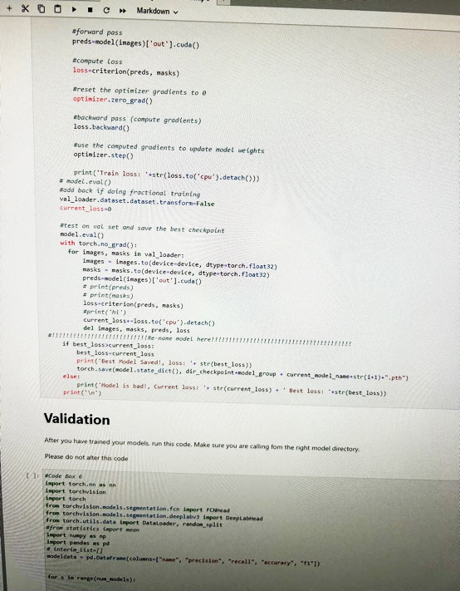
Why jupyter Notebooks?
The most honest answer is that botanists don’t bash, their training is most definitely not in computer science, and Jupyter makes it easy to share
and run Python (and sometimes R) code on a range of platforms.
It is great for handing students and less techy collaborators too!
Hooray for accessibility!
Prof. Alana Chin
Cal Poly Humboldt

Slide 20
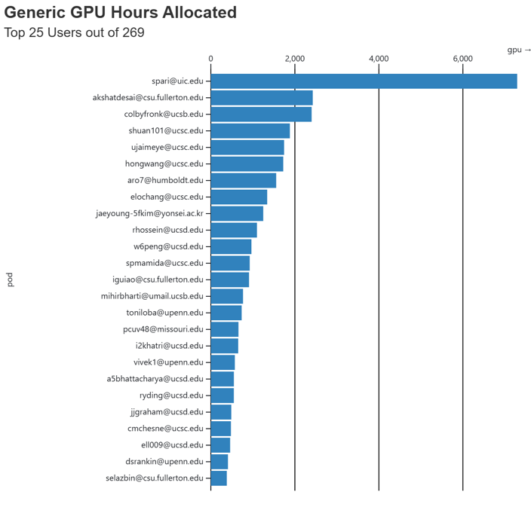
Namespace jupyterlab, PI Larry Smarr
GPU-Hours Per User, All of Calendar 2024
Top 25 Users Are From:
Cal Poly Humboldt
CSU Fullerton
UC Irvine
UC San Diego
UC Santa Barbara
UC Santa Cruz
U. Missouri-Columbia
U. Pennsylvania
Yonsei U., S. Korea
Alana Chin, CPH
1555 GPU-Hours
https://observablehq.com/

