Slide 1
Acceleration of Bioinformatics Workloads
Prof. Tajana Simunic Rosing
Contributors: Prof. Rob Knight, Prof. Niema Moshiri @UCSD,
amazing students, postdocs and staff
This work was supported in part by Semiconductor Research Corporation (SRC)

Slide 2
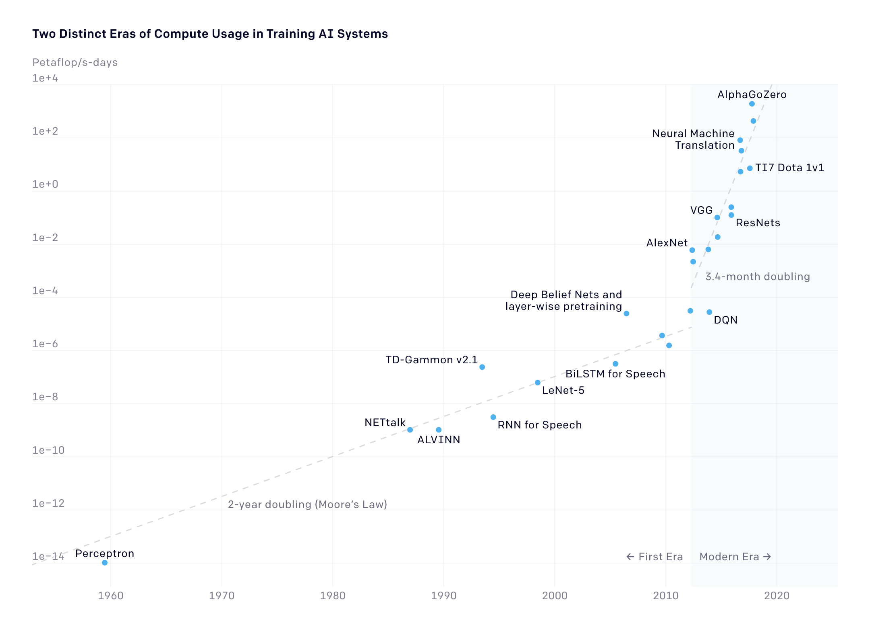
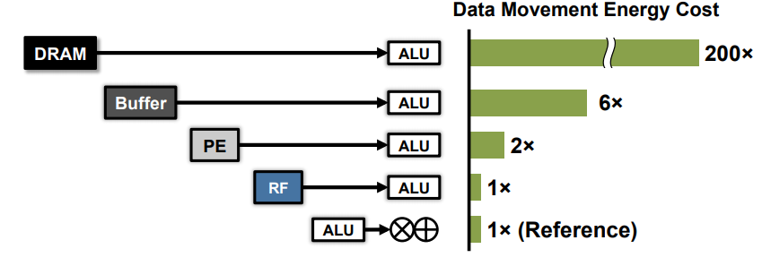
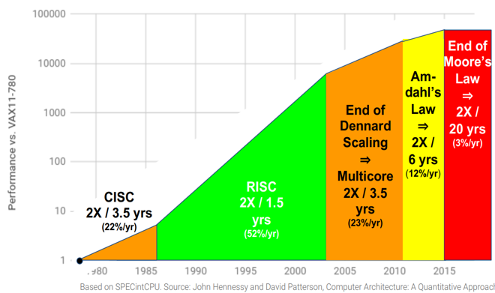
Big Data Analysis Challenges
Big data is growing annually at rate of 14%
$116 Billion by 2027
Two phases of growth in AI systems:
1959-’12: 2 year doubling time
2012 - 22 training at 10x/yr; inference 1.5x/yr
Compute has not kept up =>
Sizes of the models are exploding:
Moving data to compute is expensive!
Fundamental barriers to memory scaling
Rising complexity makes programming & optimization hard
Approach:
Bring processing closer to data via acceleration
Select algorithms that are more suited for acceleration
Computing in AI systems
Models → | GPT-1 | GPT-2 | GPT-3 | GPT-4
Parameters | 117 M | 1.5 B | 175 B | 1.76T
Sources: https://openai.com/blog/ai-and-compute; Attention is all you need; David Patterson ‘22

Slide 3
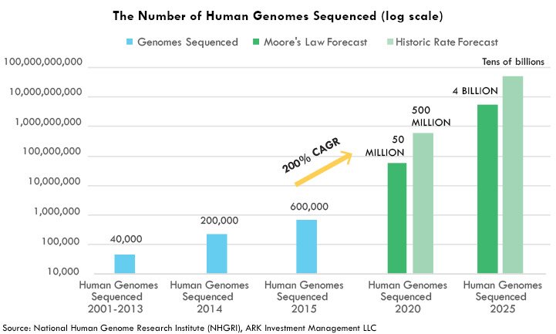
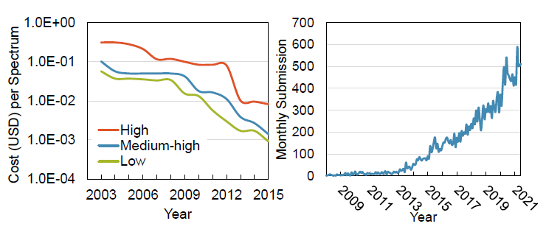
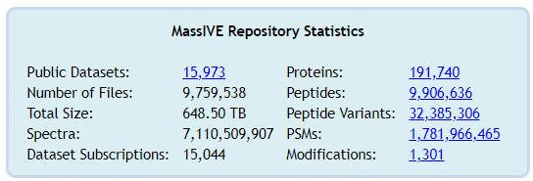
Bioinformatics data explosion
Genomics
Genome data doubles every 7 months and surpasses the Moore’s Law
It is currently reaching exabyte scale (10¹⁸) and surpassing YouTube and X
Mass Spectrometry-based Proteomics
Monthly data submissions of PRIDE database increased by 100x
Over 650TB MS data in UCSD MassIVE DB
1. PRIDE - Proteomics Identification Database: https://www.ebi.ac.uk/pride/
2. UCSD MassIVE database: https://massive.ucsd.edu/

Slide 4
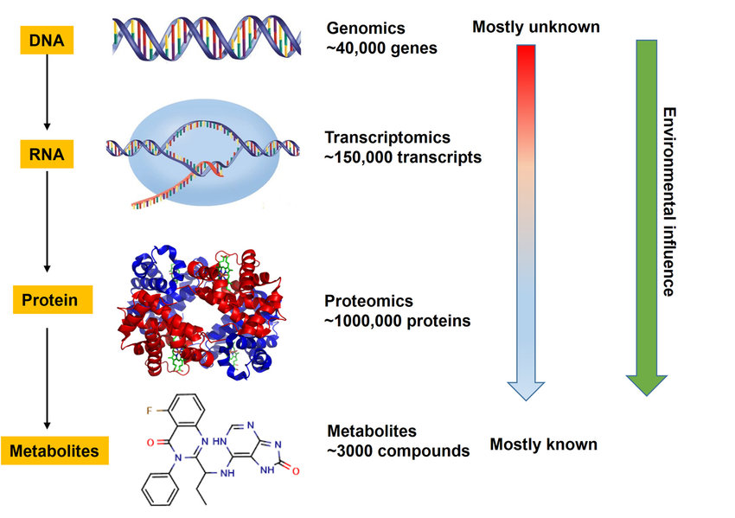
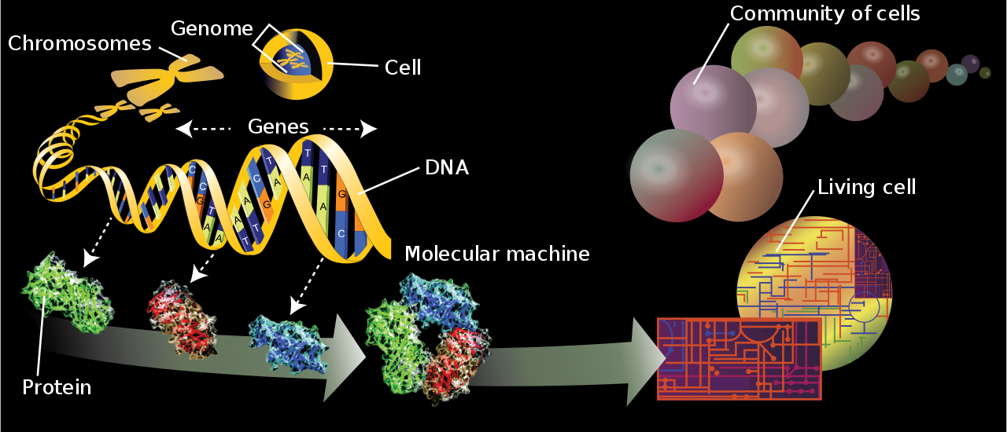
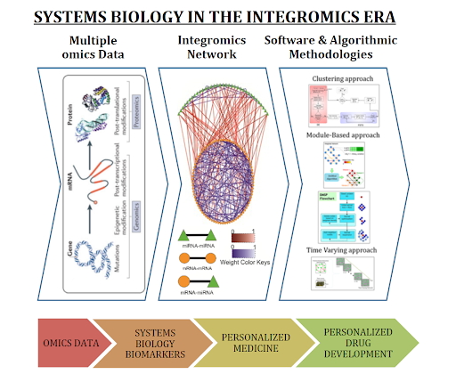
Omics and Personalized Medicine
Genomics & Transcriptomics use DNA/RNA sequence analysis tools (strings)
Proteomics/Metabolomics use Mass Spectrometry spectral analysis tools (vectors of numbers)
Both feed into downstream multivariate analyses operating on matrix or tensor of raw counts or normalized abundances
Notes:
This image shows the key components that go into creation of all cells. It all starts from DNA. DNA contains the information necessary for encoding proteins, although it does not produce proteins directly. RNA carries the information from the DNA and transforms that information into proteins that perform most cellular functions.
Genomics – study of genomes DNA;
Transcriptomics – RNA;
Proteomics – proteins,
Metabolomics studies chemical processes that sustain life. Greek metabolē, "change"

Slide 5
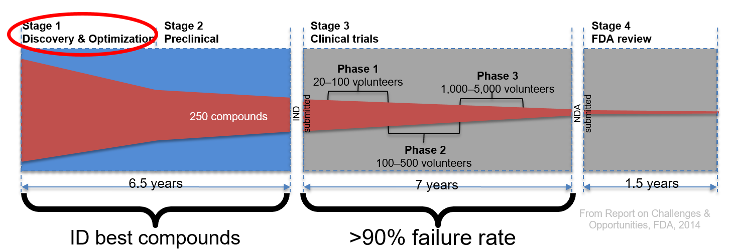
Personalized & secure drug discovery
Goal: 100x faster runtime at massive data scales
Short &Long Reads
Proteomics & Metabolomics
Virtual drug screening
Chem/Bio
HDC + graph based learning
Small-Molecule Mass Spectrometry
Data/CPU
Intensive
Identify possible molecules
Tool output
Sequence
Alignment, Host Filtering
Compare to existing proteins
Benefit
Molecule Identification and Quantification
Select the most promising drug candidate
Identify key mutations
Taxonomy, function, gene catalog, genomes
Gene Expression
Small-Molecule Profile
Clinical Associations
Disease-
Enabling Genes
Metabolic pathways
Disease Pathways
Personalized Treatment
Off-Target Drug Interactions
Novel Drug Discovery
Notes:
Our team plans to address the key issues in the first phase of the drug discovery pipeline, as that phase is the key to selection of the best compounds that go through the three phases of FDA trials and the most bottlenecked by computational constraints. More than 90% of compounds identified during the discovery phase fail in the first phase of trials [Dowden 2019]. PRISM is uniquely positioned to dramatically improve the speed, throughput and data availability for the early stages of drug discovery pipeline by leveraging developments and optimizations across the memory and storage stack. Improving the speed of drug discovery via accelerating key stages of the pipeline, and significantly increasing the amount of data analyzed (using various omics data, and evaluating billions of protein structures) would dramatically increase the chances of identifying “good bets” to take to clinical trials [Jung 2022][Cho 2022][Hu 2011][Ransohoff 2003]. As a result, we specifically focus on two key issues identified in the current work: (1) The need to better match the drug compounds (proteins) to human biology (e.g., genomics, transcriptomics, metabolomics) via use of mass spectrometry, protein sequence matching and long read sequencing; and (2) The need for a more comprehensive and open data access not just in the public sphere, but also in the pharmaceutical industry via use of multiparty computation and fully homomorphic encryption.
Cancer is one of the top two causes of death in the USA [Murphy 2021], and also one of the most challenging diseases to treat, and thus is a good target for PRISM disease diagnostics pipeline optimization. Cancers are caused by genomic irregularities that result in uncontrolled cell growth. These irregularities range from Single Nucleotide Variants (SNVs), which are single bases that are mutated (e.g., C mutates to T at a specific position of the genome), and Single Nucleotide Polymorphisms (SNPs), which are SNVs that are common to at least 1% of human population, to Structural Variants (SVs), which are larger structural modifications of genomic regions (e.g., duplication, deletion, insertion, etc.) [Vogelstein 2004]. The ability to characterize a tumor’s unique genomic features can provide critical precision medical insights into potential targeted therapeutics to treat the cancer [Belzen 2021]. In the past decade, genomic characterization of cancer has been performed primarily using short-read technologies (100-300 base pairs (bps)), but due to their short length, short-reads are unable to directly detect key structural variations that are key to cancer diagnostics.
In recent years, the advancement of long-read technologies (10k or more bps), such as the Oxford Nanopore Technologies sequencer (ONT), have improved the ability to detect large-scale structural variations [Salk 2019]. ONT systems are continually improving their throughput and accuracy, which in some cases reaches 99% today, rivaling short read technologies. The state-of-the-art Prometheon 48 ONT sequencer has 60 TB SSD Storage, 512 GB RAM, and 4 x NVIDIA A100 GPU cards for basecalling acceleration [ONT 2022] and generates 14 TB of data when running at the top throughput. This is 14x more data than the state-of-the-art short reads sequencer. Using long reads with Mass Spectrometry has been shown to improve characterization of protein variants [Miller 2022], which can yield even further improved targeting of cancer therapeutics [Cameron 2019]. As a result, these two technologies, mass spectrometry and long read genomics for structural variant calling, which are key to disease diagnostics and produce large amounts of data, currently run very slowly on today’s systems. Due to the large runtime and peak memory requirements of long-read structural variation calling pipelines even on very small datasets [Dierckxsens 2021], long-read SV detection is infeasible for ultra-large cohorts or for standard-of-care, thus delaying personalized drug discovery further.
Recent development of utilizing “reference genome graphs,” rather than a “reference genome sequence,” complicates this situation even more [Hadi 2020]. Until just a few years ago, all alignment methods aligned either short or long reads to a single human genome. However, any given human genome has, on average, 3.5–4.0 million SNPs, insertions or deletions of amino acids and ~2,500 large structural variations (SVs) compared with the reference genome. This can cause alignment to work incorrectly or to completely fail, which may cause misdiagnosis of the disease. Recent work has proposed that multigenome references should be used instead as they significantly improve the alignment accuracy, but this comes at the cost of very long runtimes due to both large dataset sizes and graphs that are used to represent multigenomic references [Rakocevic 2019].
As a part of PRISM, we plan to focus on these challenging workloads that combine graph-based methods with database search and clustering for mass spectrometry (proteomics and metabolomics), long reads with structural variant detection (genomics and transcriptomics), and protein structural variation matching, as this is key to more accurate drug design [Belzen 2021]. Due to the large scale and distributed nature of these datasets, we will (1) perform systems-level profiling of the state-of-the-art tools to identify key bottlenecks, (2) design and implement optimized end-to-end in/near memory and storage system to resolve those bottlenecks, (3) demonstrate at least 100x speedup relative to the optimized state-of-the-art tools at scale using infrastructure already available at UCSD, and enhancing it with chips and systems designed by PRISM PIs by leveraging technology developed by Themes 1-3, (4) show how our optimized system can apply to other graph, clustering, transformer network and data search based applications by using workloads from the deep-analytics grand challenge.

Slide 6
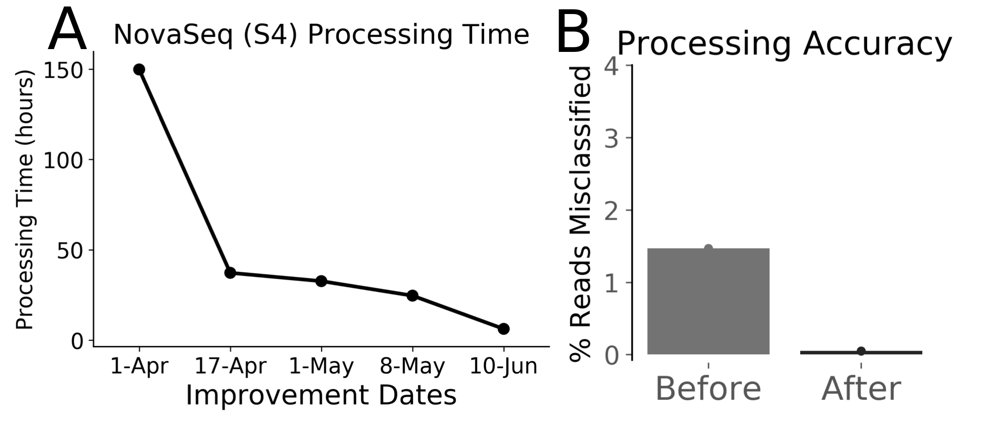
End-to-End COVID-19 Workflow Optimization
DNA/RNA Sequences
Chem/Bio
Data/CPU
Intensive
Qitta/Qiime2 Platform
Benefit
(Step 1) Adapter Trimming
Preprocessing to get aligned sequences;
common to all our genomics applications
This took days in Jan’20!
(Step 2) Alignment
(Step 3) Primer Trimming
(Step 4) Multiple sequence alignment
CPU Pipeline optimization:
START: 1 week to process
17-April Massive parallelization
1-May Better piping strategy
8-May Threading optimization
10-Jun Tool/Method optimization
Down to hours on CPU!
Collaboration with Micron
(Step 5) Phylogenetic Inference &
Transmission clustering
COVID-19 Analysis
Biological Interpretation
(e.g. Where is the infection spreading to?)
Notes:
iVAR – adaptor trimming and seq alignment are slow parts
Steps between 3-4: iVAR: consensus sequence calling (this is fast) and variant calling (would be in the green, per sample;) variant calling (where is my sample different from the ref genome) concensus is copy reference, and plug in my variants to get the genome
once have 1000s samples, do purple figure
This shows the tool flow from obtaining sequences to the final result for COVID-19; but steps 1-3 in the green box, above the purple COVID-19 analysis box, are actually common to all applications we are targeting in CRISP.
We first focused on accelerating the common steps (1-3) on CPU and got it down to hours on CPU. This is the tool flow that Rob’s and other UCSD teams are currently using for all sequence analysis for COVID-19 and ALL other data they are getting for genomics applications – it is their production pipeline ☺ Acceleration of this part was done together with Micron.
On the next slide I discuss how we focus on accelerating steps 1-3 in PIM, and our current focus on speeding up COVID specific section.

Slide 7
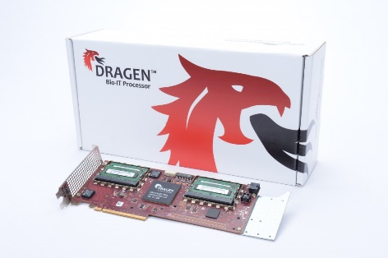
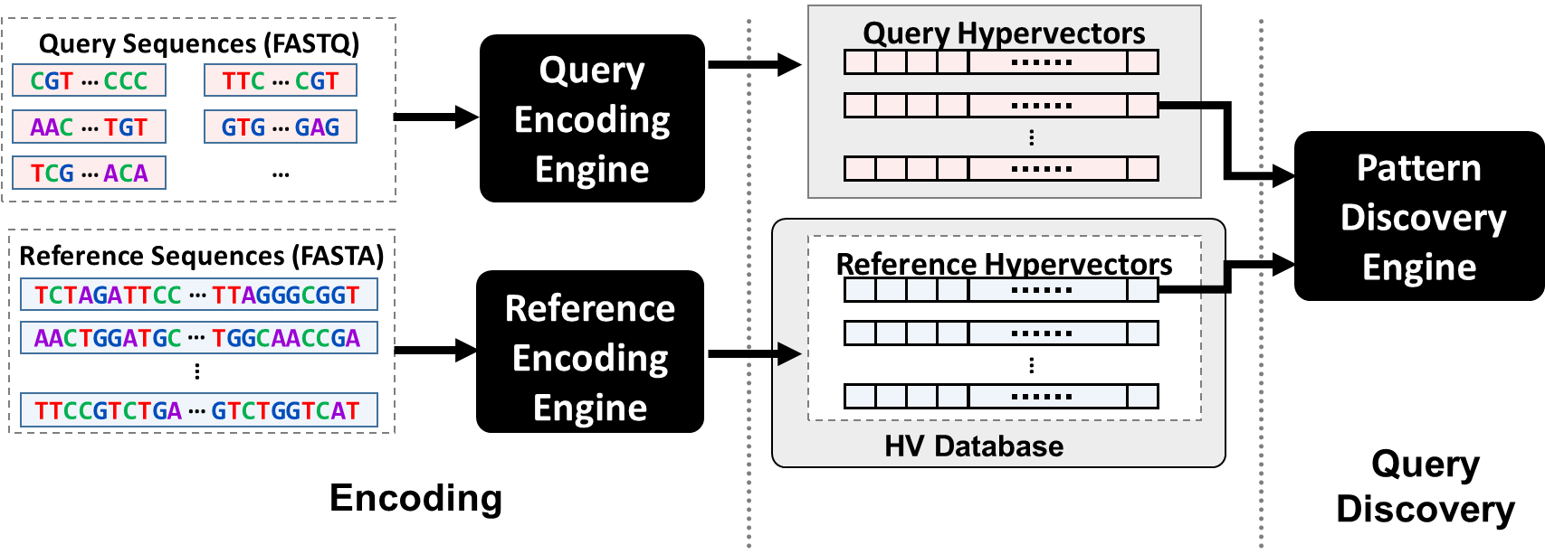
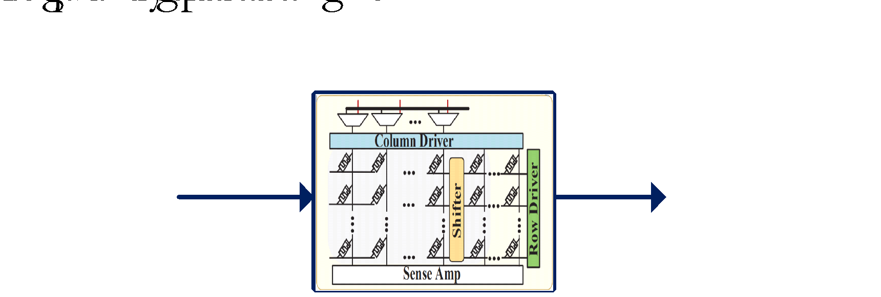
Accelerating DNA/RNA Matching & Alignment in HW
DRAGEN
FPGA-based
Local Alignment state of the art
7.5x faster vs. Minimap2 on CPU
GenieHD [DATE’20]
HD-ASIC
Pattern Matching
~200x vs. Minimap2 on CPU
RAPIDx [TCAD’22, ASHG’20, ISLPED’19]
PIM-based Alignment
~253x faster vs. DRAGEN
~1,900x faster vs Minimap2 on CPU
Notes:
These tools accelerate the same pipeline shown in previous two slides (the common section, not the COVID part) in HW

Slide 8
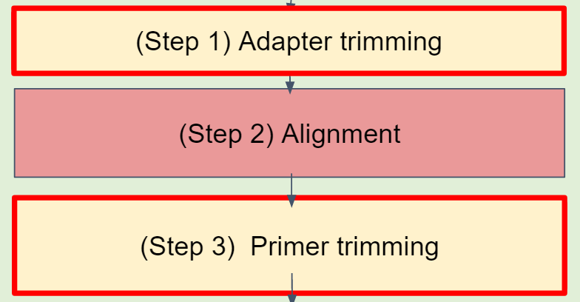
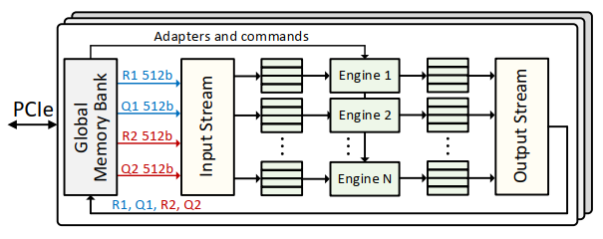
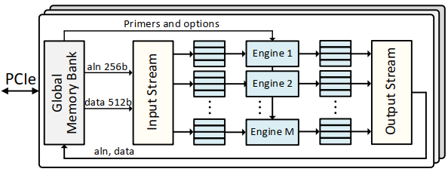
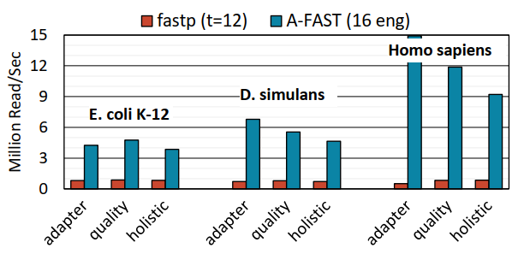
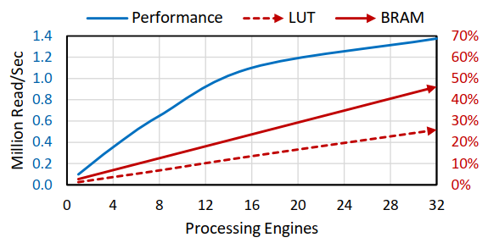
FPGA-based Acceleration of Genomic Sequence Trimming
Both adaptor & primer trimming have multiple kernels for task-level parallelism; each kernel uses multiple engines to saturate memory BW
A-FAST Architecture (pre-alignment)
P-FAST Architecture
(post-alignment)
A-FAST does adapter trimming, quality pruning and fixing; it is up p to 30× faster vs. FastP [Bioinformatics’18] with 12 threads on CPU
P-FAST is 175× faster vs. iVar, with only < 25% FPGA resource usage. It can do 1.1 million reads/second.
Results are run on Xilinx U200 FPGA
Khaleghi B, Zhang T, Shao N, Akel A, Curewitz K, Eno J, Eilert S, Moshiri N, Rosing T "FAST: FPGA-based Acceleration of Genomic Sequence Trimming." BioCAS’22
Notes:
Comparison baselines:
Fastp [Bioinformatics’18] (2-3x faster than runner-up Cutadapt) for adapter trimming
For SARS-CoV-2, the short reads are first aligned to the reference using minimap2, followed by running sorted BAM in iVar [Genome Biology’19]
3 types of operations: adapter trimming, quality pruning and fixing, holistic (both)
Adapter: 5× to 30× faster vs. 12-thread FASTP;
Adapter + quality: 4.7× to 11× faster & 10× to 55× less energy consumption
Datasets:
E. coli K-12/MG1655
SRX131047
101-bp PE
RNA-Seq of Gonads and Carcasses in D. simulans
SRR330569
101-bp PE
Homo sapiens RNA-Seq
SRR529095
100-bp SE
Implemented on Xilinx Alveo U200 FPGA
64 GB DRAM, 892K LUTs, 35 MB on-chip mem.
~20-30W power consumption

Slide 9
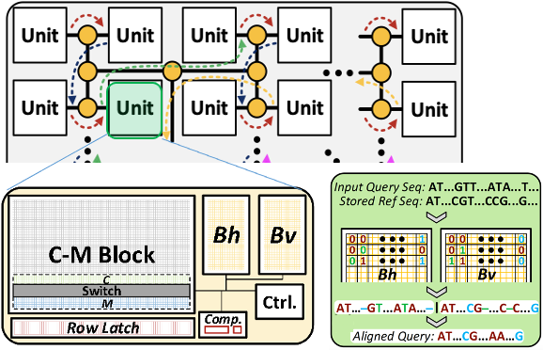
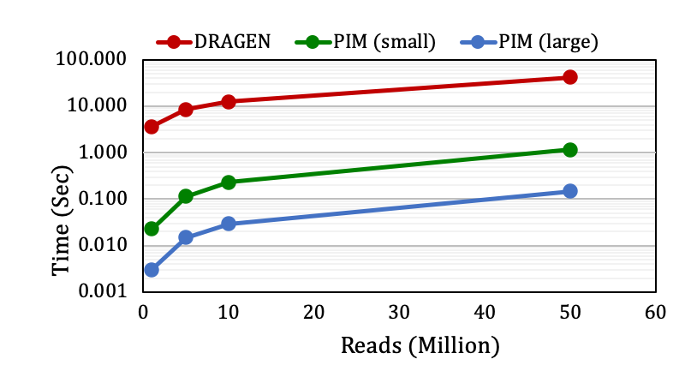
RAPIDx: a PIM Architecture for Alignment
RAPID chip has many ReRAM PIM enabled units connected with an H interconnect
C-M: forward computation using PIM operations
Bh and Bv: store traceback information
Comparator: tracks local maximum score in a unit
Makes alignment PIM-compatible by separating reference matching and score computation
RAPIDx large PIM is 253x faster vs. DRAGEN
~1,900x vs. Minimap2 on CPU
Large size fits human genome
Small PIM is 32x faster
Gupta, S, T. Rosing, et al. "RAPID: A ReRAM processing in-memory architecture for DNA sequence alignment." ISLPED’19.
Gupta S, … Rosing T "RAPIDx: A ReRAM Processing in-Memory Architecture for DNA Short Read Alignment." ASHG’20
Xu W, Gupta S, Moshiri N, Rosing T. “RAPIDx: High-performance ReRAM Processing in-Memory Accelerator for Sequence Alignment” TCAD’22 submitted

Slide 10
End-to-End COVID-19 Workflow Optimization
DNA/RNA Sequences
Chem/Bio
Data/CPU
Intensive
Qitta/Qiime2 Platform
Benefit
Get aligned sequences in seconds via RAPID PIM design
(Step 1)Adapter Trimming
(Step 2) Alignment
(Step 3) Primer Trimming
(Step 4) Multiple sequence alignment
COVID19 analysis in seconds via FPGA
(Step 5) Phylogenetic Inference &
Transmission clustering
Biological Interpretation
(e.g. Where is the infection spreading to?)
Notes:
iVAR – adaptor trimming and seq alignment are slow parts
Steps between 3-4: iVAR: consensus sequence calling (this is fast) and variant calling (would be in the green, per sample;) variant calling (where is my sample different from the ref genome) concensus is copy reference, and plug in my variants to get the genome
once have 1000s samples, do purple figure
This shows the tool flow from obtaining sequences to the final result for COVID-19; but steps 1-3 in the green box, above the purple COVID-19 analysis box, are actually common to all applications we are targeting in CRISP.
We first focused on accelerating the common steps (1-3) on CPU and got it down to hours on CPU. This is the tool flow that Rob’s and other UCSD teams are currently using for all sequence analysis for COVID-19 and ALL other data they are getting for genomics applications – it is their production pipeline ☺ Acceleration of this part was done together with Micron.
On the next slide I discuss how we focus on accelerating steps 1-3 in PIM, and our current focus on speeding up COVID specific section.

Slide 11
Understanding virus transmission
>GREEN
ACGTACGTACGT
>PURPLE
ACGTATGTACGT
>BLUE
ACATACGTACGT
?
?
?
Contact Network
Transmission Network
Viral Phylogeny
Viral Sequences
Notes:
Then, given a phylogeny and/or a Multiple Sequence Alignment, molecular epidemiologists typically want to perform transmission clustering to group individuals into local clusters of transmission.

Slide 12
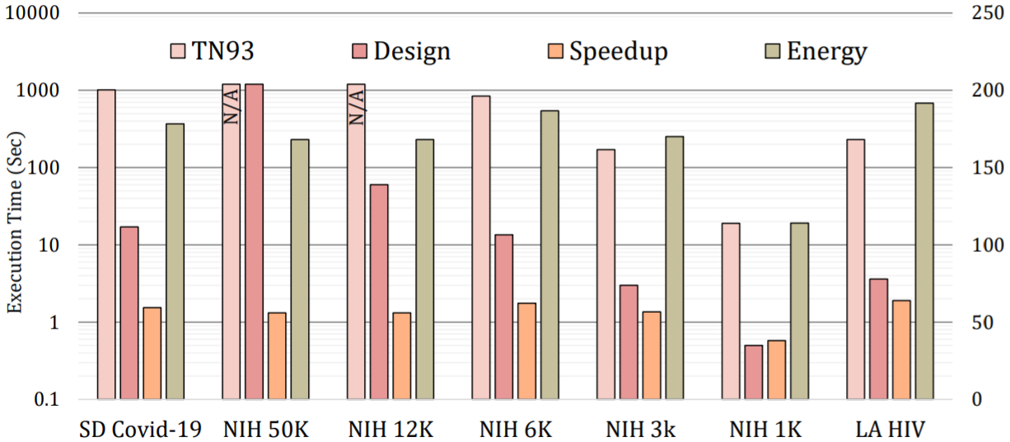
FANTAIL: Acceleration of TN93 Pairwise Distances
FANTAIL is a highly parallelized FPGA-based Accelerator for computing pairwise distaNce for viral TrAnsmIssion cLustering based on Tamura-Nei 93 (TN93) model but is generalizable to other nucleotide substitution models
Fantail on FPGA takes only 4 seconds now and consumes 168× less energy vs. TN93 running on an 8-core Intel Core-i7 CPU, while providing the same quality of results
FANTAIL
Speedup and Energy Efficiency Improvement
Salamat, Moshiri, Rosing “FANTAIL: Acceleration of TN93 Pairwise Distances” [BioCAS’21]
Notes:
Reconstructing the evolutionary history of closely related viral strains enables the identification and linkage of infected patients in an outbreak. Phylogenetic inference is often too computationally time-consuming to be performed in real-time on large datasets. To combat this, we infer linkage from pairwise distances computed between sequences directly.
One standard approach is to compute all pairwise distances between collected sequences using the Tamura-Nei 93, or TN93, model of nucleotide substitution, that considers pairs of individuals to be “linked” if their pairwise distances are below a given threshold, and outputs each component in the resulting graph as a transmission cluster.
We developed an FPGA accelerator for TN93 pairwise distance calculations. The left axis shows execution time for the CPU implementation (labeled TN93) and the FPGA accelerator, so just the light and dark pink bars, and the right axis shows speedup and energy reduction, so the orange and green bars. The FPGA accelerator achieves over 50x speedup and over 150x energy reduction compared to the existing CPU implementation on large datasets, with the speedup and energy reduction growing as dataset size increases.

Slide 13
Microbiome Pipeline Acceleration
Sequences
Chem/Bio
Sequencing Results (RNA/DNA)
Data/CPU
Intensive
Benefit
Get aligned sequences in seconds via RAPID PIM design
(Step 1) Adapter trimming
(Step 2) Alignment
(Step 3) Primer trimming
(Step 4) Microbiome clustering & classification
Bacterial diversity analysis tool, UniFrac, has been accelerated by SDSC & Knight lab on GPU by 1,000x vs. CPU
(Step 5) Beta diversity analysis (UniFrac)
Biological Interpretation
(e.g. What bacteria are infecting my wound?)
Notes:
Step 3 – Use Web of Life (Knight lab recently published) to align all reads to database of ”everything” (expensive alignment)
Step 4 – Beta diversity being sped up on GPU system (Igor)

Slide 14
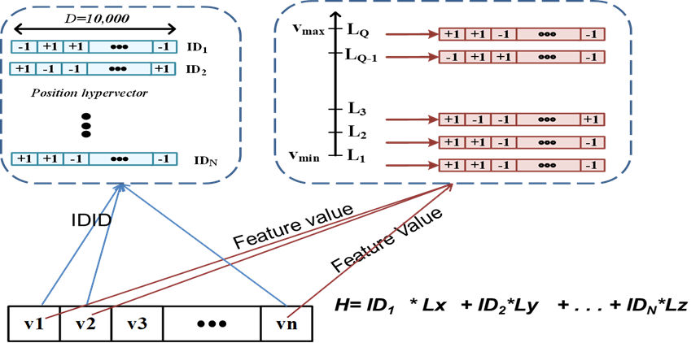
HD Computing Classification: Encoding, Training & Inference
Training
Cat hypervector
-1 +1 -1 -1 +1 . . . +1
Dog hypervector
-1 -1 +1 -1 -1 . . . +1
Similarity Check
Encoding
Testing
+1 +1 +1 -1 -1 . . . +1
Query hypervector

Slide 15
HDC Clustering
Encode data in HD space, cluster using similarity metric
Generalizes popular K-Means algorithms to HD encoded data
M. Imani, S. Pampana, S. Gupta, M. Zhou, Y. Kim, T. Rosing, “DUAL: Acceleration of Clustering Algorithms using Digital-based PIM,” MICRO 2020.

Slide 16
HD Computing: Efficiency Improvements
Our team developed HD libraries for CPU & GPU, HD2FPGA tool for mapping HD onto FPGAs; HD ASIC & PIM
Measurements on NVIDIA GPU & Xilinx u200 FPGA are compared to HDC running on Intel Xeon; PIM is simulated using VTEAM model:
HD classification inference in PIM is 167,000x faster vs. perceptron NN
HDC speedup vs. SoA @same accuracy
State of the Art | SVM | NN | MLP
Training | 3 | 1.9 | 7.3
Testing | 14 | 1.7 | 4.8
HD clustering in PIM is 855,000x faster vs. HD on CPU
Notes:
*SearcHD [Rosing TCAD’19]: Binary encoding, ~3.3% less accurate than Level-ID encoding
multi-layer perceptron (MLP) to be a subset of deep neural networks (DNN)
Encoding: 37.9s / 1271.3J
Training (single iteration): 9.85s / 38.8J
Inference: 37.8s / 1266.9J

Slide 17
Hyperdimensional Microbiome DNA Classification
Hyperdimensional (HD) classification for microbiome
Training:
Hypervectors represent each alphabet of DNA ; classes are created by combining hypervectors
Online classification:
HD encoded query is compared to all classes & the best is selected
Results:
Comparable accuracy to the state of the art running on CPU - Bayes, SVM or k-NN, MPL and Perceptron
PIM HDC is 113x faster and 812x more energy efficient vs. HDC on GPU
HDC DNA PIM design is >10,000x faster than all state of the art algorithms on CPU
Notes:
Next steps:
Developing a processing in-memory architecture to support high precision computation, e.g. floating point precision
Exploiting parallelism in-memory in order to speedup of computation
Accelerating DNN in both training and testing fully in digital processing in-memory architecture
Accelerating graph processing by PIM-enabled Memory (arithmetic operations and search)

Slide 18
Cancer Variant Detection
Sequences
Chem/Bio
Sequencing Results (RNA/DNA)
Data/CPU
Intensive
Benefit
Get aligned sequences in seconds via RAPID PIM design
(Step 1) Adapter trimming
(Step 2) Alignment
(Step 3) Primer trimming
(Step 4) Differential gene expression
Cancer variant detection via DeepVariant accelerated in memory
(Step 5) Tumor subtype classification
Biological Interpretation
(e.g. What time of treatment works best?)
Notes:
Step 4 – differential gene expression analysis
- For each alignment, see what gene did it map to – have coordinates for every read, have coordinates for each gene, see how much showed up
Step 5 – tumor subtype classification – allows us to see what tumor it is, and therefore what might be the best medicines to try for that tumor.
We have some initial work on drug discovery (see next slide)

Slide 19
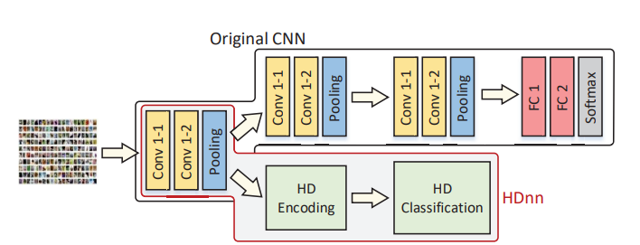
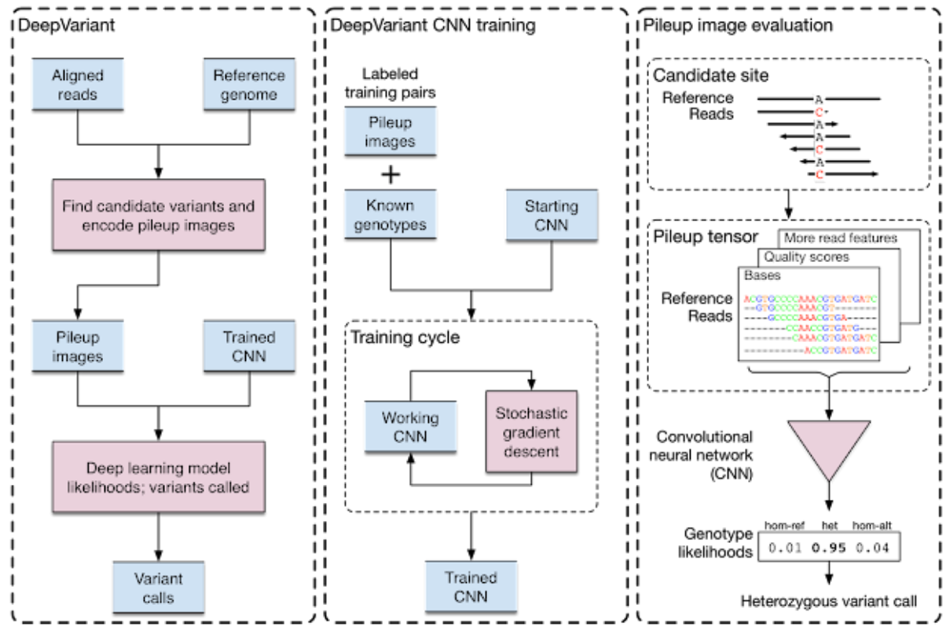
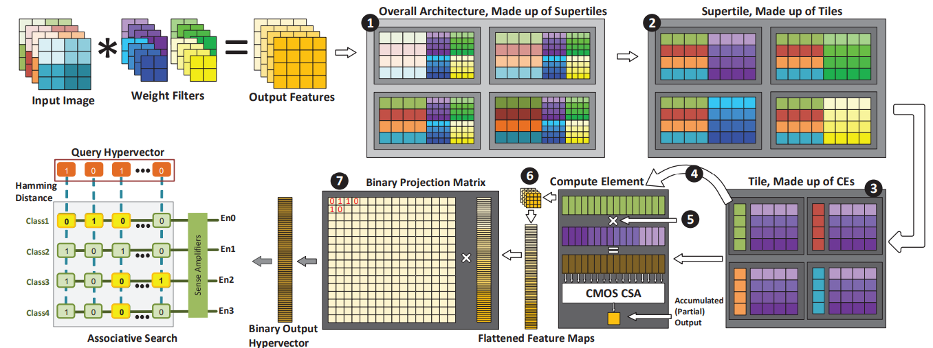
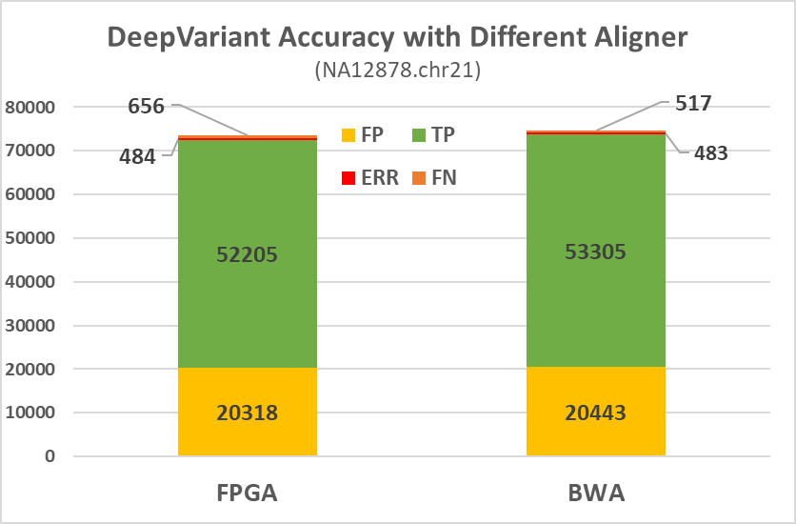
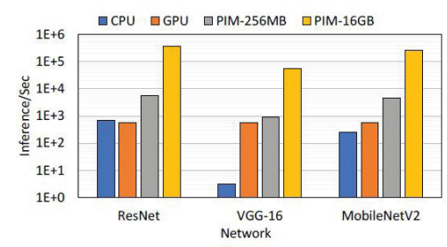
DeepVariant via HDnn PIM Acceleration
HDnn Accelerated in ReRAM
Variant calling finds changes in genomes e.g. mutations in cancer
DeepVariant[Nature’18] uses CNNs
Converts aligned sequence reads into an image & then calls variants on the image
State of the art in terms of accuracy, which is critical for finding cancer-causing mutations
Examples of DeepVariant Pileup images
No variants
Variants in two chromosomes
FPGA CPU
At least 233x higher throughput vs GPU
DeepVariant Accuracy with FPGA & CPU Alignment
A. Dutta, Gupta, S., Rosing, T et al. ”HDnn-PIM: Efficient in Memory Design of Hyperdimensional Computing with Feature Extraction,” GLVLSI’22
Poplin, Ryan, et al. "A universal SNP and small-indel variant caller using deep neural networks." Nature biotechnology’18

Slide 20
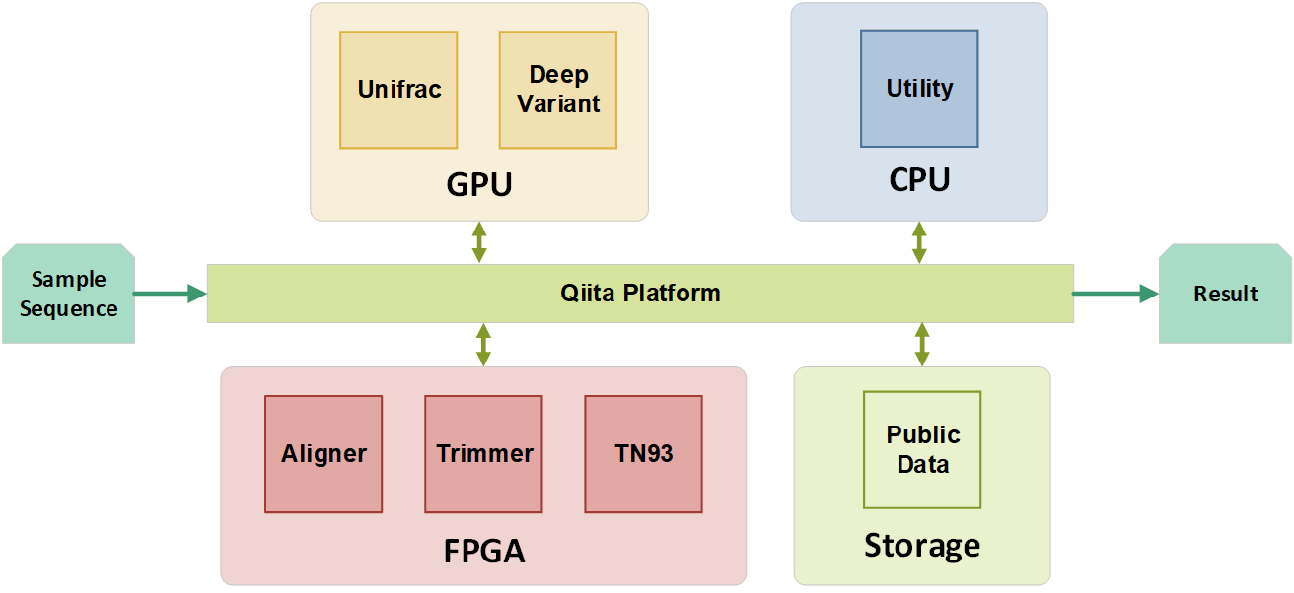
Acceleration of COVID-19, Microbiome & Cancer Analysis
DNA/RNA Sequences
Qitta/Qiime2 Platform
Acceleration of COVID-19, microbiome and cancer variant calling using a common backbone
(Step 1) Adapter trimming
Acceleration in PIM
RAPIDx: Alignment, 1,900x vs CPU
HDC Microbiome, >10,000x vs CPU
HdnnPIM: Cancer, 230x vs GPU
Acceleration in FPGA
FAST: Trimming, 175x vs CPU
FANTAIL: TN93 for virus - 4 seconds
(Step 2) Alignment
(Step 3) Primer trimming
Infrastructure
Qitta/Qiime2 Platform
Cancer variants
Viral analysis
(e.g. COVID-19)
Microbiome analysis
At least 100x better than the state of the art

Slide 21
Personalized & secure drug discovery
Goal: 100x faster runtime at massive data scales
Short &Long Reads
Proteomics & Metabolomics
Virtual drug screening
Chem/Bio
HDC + graph based learning
Small-Molecule Mass Spectrometry
Data/CPU
Intensive
Identify possible molecules
Tool output
Sequence
Alignment, Host Filtering
Compare to existing proteins
Benefit
Molecule Identification and Quantification
Select the most promising drug candidate
Identify key mutations
Taxonomy, function, gene catalog, genomes
Gene Expression
Small-Molecule Profile
Clinical Associations
Disease-
Enabling Genes
Metabolic pathways
Disease Pathways
Personalized Treatment
Off-Target Drug Interactions
Novel Drug Discovery
Notes:
Our team plans to address the key issues in the first phase of the drug discovery pipeline, as that phase is the key to selection of the best compounds that go through the three phases of FDA trials and the most bottlenecked by computational constraints. More than 90% of compounds identified during the discovery phase fail in the first phase of trials [Dowden 2019]. PRISM is uniquely positioned to dramatically improve the speed, throughput and data availability for the early stages of drug discovery pipeline by leveraging developments and optimizations across the memory and storage stack. Improving the speed of drug discovery via accelerating key stages of the pipeline, and significantly increasing the amount of data analyzed (using various omics data, and evaluating billions of protein structures) would dramatically increase the chances of identifying “good bets” to take to clinical trials [Jung 2022][Cho 2022][Hu 2011][Ransohoff 2003]. As a result, we specifically focus on two key issues identified in the current work: (1) The need to better match the drug compounds (proteins) to human biology (e.g., genomics, transcriptomics, metabolomics) via use of mass spectrometry, protein sequence matching and long read sequencing; and (2) The need for a more comprehensive and open data access not just in the public sphere, but also in the pharmaceutical industry via use of multiparty computation and fully homomorphic encryption.
Cancer is one of the top two causes of death in the USA [Murphy 2021], and also one of the most challenging diseases to treat, and thus is a good target for PRISM disease diagnostics pipeline optimization. Cancers are caused by genomic irregularities that result in uncontrolled cell growth. These irregularities range from Single Nucleotide Variants (SNVs), which are single bases that are mutated (e.g., C mutates to T at a specific position of the genome), and Single Nucleotide Polymorphisms (SNPs), which are SNVs that are common to at least 1% of human population, to Structural Variants (SVs), which are larger structural modifications of genomic regions (e.g., duplication, deletion, insertion, etc.) [Vogelstein 2004]. The ability to characterize a tumor’s unique genomic features can provide critical precision medical insights into potential targeted therapeutics to treat the cancer [Belzen 2021]. In the past decade, genomic characterization of cancer has been performed primarily using short-read technologies (100-300 base pairs (bps)), but due to their short length, short-reads are unable to directly detect key structural variations that are key to cancer diagnostics.
In recent years, the advancement of long-read technologies (10k or more bps), such as the Oxford Nanopore Technologies sequencer (ONT), have improved the ability to detect large-scale structural variations [Salk 2019]. ONT systems are continually improving their throughput and accuracy, which in some cases reaches 99% today, rivaling short read technologies. The state-of-the-art Prometheon 48 ONT sequencer has 60 TB SSD Storage, 512 GB RAM, and 4 x NVIDIA A100 GPU cards for basecalling acceleration [ONT 2022] and generates 14 TB of data when running at the top throughput. This is 14x more data than the state-of-the-art short reads sequencer. Using long reads with Mass Spectrometry has been shown to improve characterization of protein variants [Miller 2022], which can yield even further improved targeting of cancer therapeutics [Cameron 2019]. As a result, these two technologies, mass spectrometry and long read genomics for structural variant calling, which are key to disease diagnostics and produce large amounts of data, currently run very slowly on today’s systems. Due to the large runtime and peak memory requirements of long-read structural variation calling pipelines even on very small datasets [Dierckxsens 2021], long-read SV detection is infeasible for ultra-large cohorts or for standard-of-care, thus delaying personalized drug discovery further.
Recent development of utilizing “reference genome graphs,” rather than a “reference genome sequence,” complicates this situation even more [Hadi 2020]. Until just a few years ago, all alignment methods aligned either short or long reads to a single human genome. However, any given human genome has, on average, 3.5–4.0 million SNPs, insertions or deletions of amino acids and ~2,500 large structural variations (SVs) compared with the reference genome. This can cause alignment to work incorrectly or to completely fail, which may cause misdiagnosis of the disease. Recent work has proposed that multigenome references should be used instead as they significantly improve the alignment accuracy, but this comes at the cost of very long runtimes due to both large dataset sizes and graphs that are used to represent multigenomic references [Rakocevic 2019].
As a part of PRISM, we plan to focus on these challenging workloads that combine graph-based methods with database search and clustering for mass spectrometry (proteomics and metabolomics), long reads with structural variant detection (genomics and transcriptomics), and protein structural variation matching, as this is key to more accurate drug design [Belzen 2021]. Due to the large scale and distributed nature of these datasets, we will (1) perform systems-level profiling of the state-of-the-art tools to identify key bottlenecks, (2) design and implement optimized end-to-end in/near memory and storage system to resolve those bottlenecks, (3) demonstrate at least 100x speedup relative to the optimized state-of-the-art tools at scale using infrastructure already available at UCSD, and enhancing it with chips and systems designed by PRISM PIs by leveraging technology developed by Themes 1-3, (4) show how our optimized system can apply to other graph, clustering, transformer network and data search based applications by using workloads from the deep-analytics grand challenge.

Slide 22
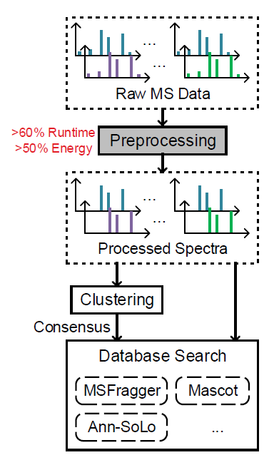
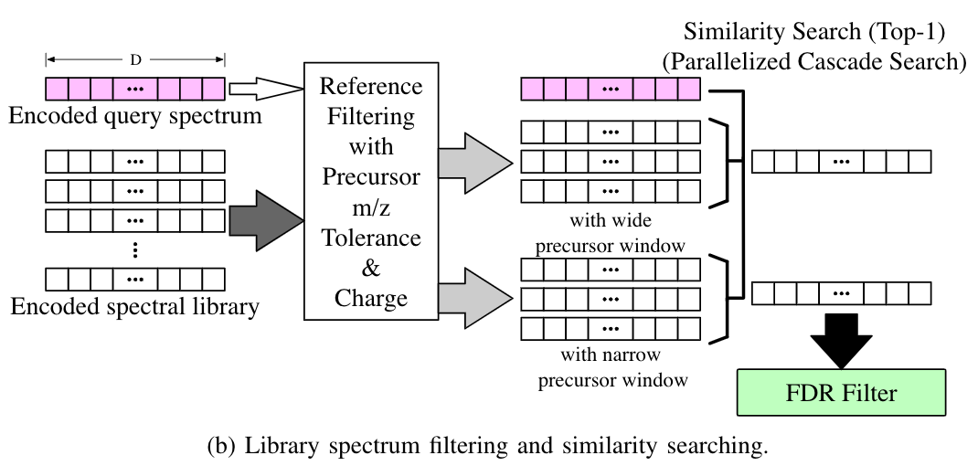
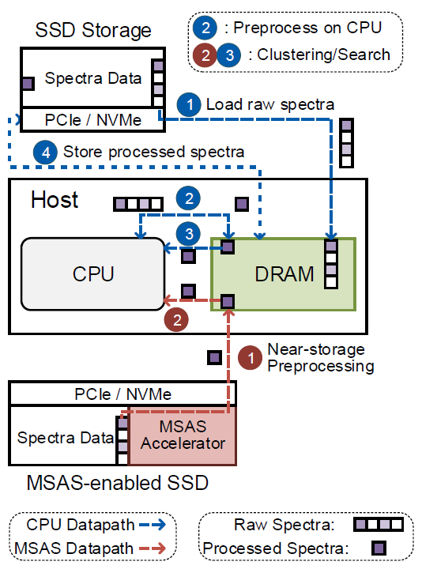
Mass Spectrometry with HD Computing Jointly with SK Hynix
Mass spectrometry data is growing rapidly
UCSD’s MassIVE database has >650 TB of protein and peptide spectra
We use HD computing to accelerate analysis of Mass Spectrometry data, including clustering and classification
ID-level hypervector encoding is used for raw spectra
Preprocessing was accelerated in storage at the channel level
187x faster than msCRUSH clustering algorithm [JProteome’18]
J. Kang, W. Xu, W. Bittremieux, T. Rosing, “Massively Parallel Open Modification Spectral Library Searching with HD Computing,” PACT’22.

Slide 23
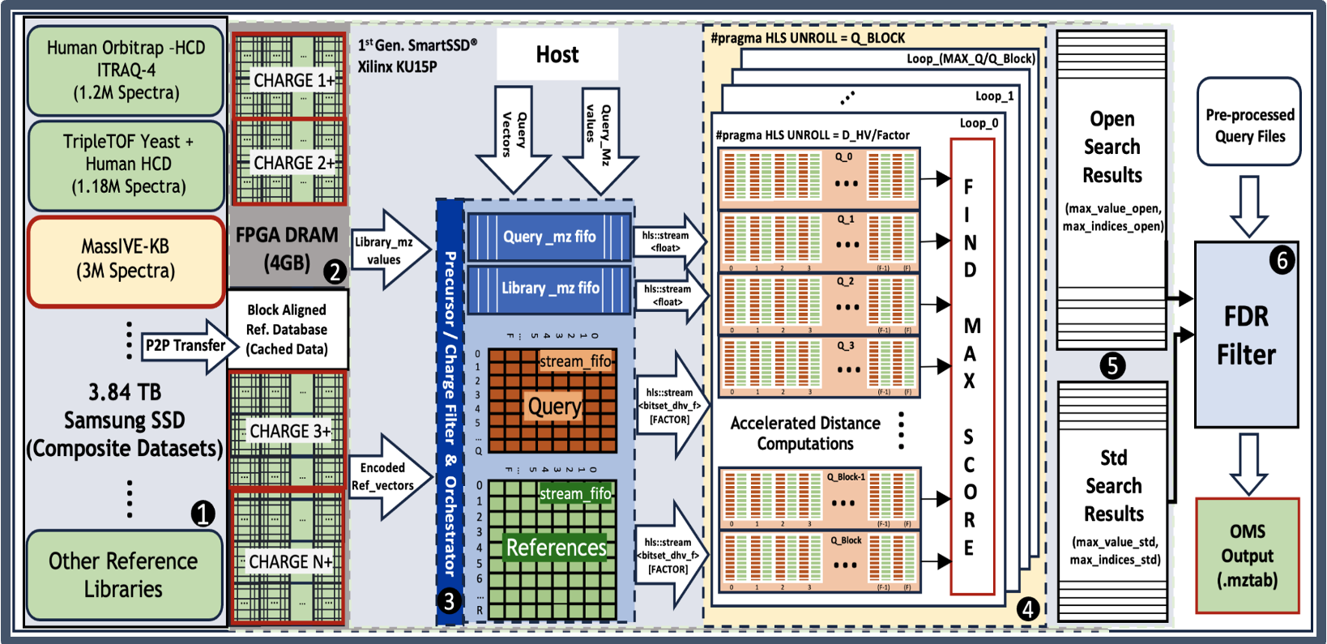
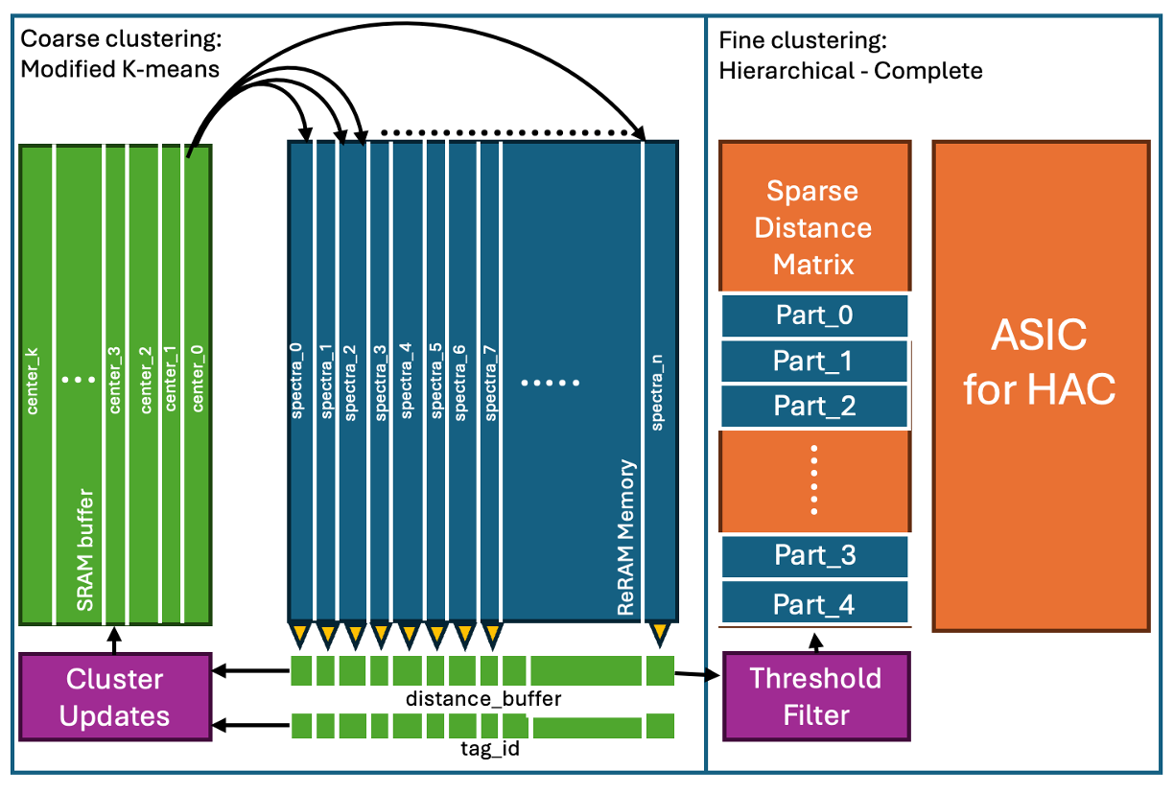
Accelerating Large-Scale Proteomics: FPGA-Enhanced OMS and IMC-based MS Clustering with Hyperdimensional Computing
Tajana Rosing (PI@UCSD), Sang-Woo Jun(PI@UCSD), Sumukh Pinge (PhD@UCSD), Weihong Xu (PhD@UCSD), Keming Fan (PhD@UCSD), Zheyu Li (Postdoc@UCSD) Niema Moshiri (PI@UCSD), Wout Bittremeux (Prof@UAntwerp), Ameen Akel (Micron)
Problem & Opportunity:
Clustering and database search scale poorly with big data,
e.g. proteomics mass spectrometry application
Exponentially expanding MaSSIVE dataset (>650 TB) overwhelms clustering & OMS applications; memory-bound and inefficient.
Technical Approach:
Two-step clustering: first, data partitioning within a novel in-memory acceleration architecture, followed by hierarchical clustering (complete) with a near-storage ASIC.
RapidOMS leverages SmartSSDs to reduce data movement across storage system and accelerate OMS through HDC.
Key results and metrics vs. SoTA:
New matrix sparsification for hierarchical clustering is 5x faster vs. SpecHD[DATE’24]
38x lower latency and 2,873x better energy efficiency over FPGA baseline for distance matrix calculations with ReRAM.
Up to 60× faster than ANN-SoLo [JPR’18], 2.72× over HyperOMS [PACT’22], 11× more efficient than HyperOMS [PACT’22] and 68× improvement over ANN-SoLo [JPR’18].
Figure.(a) RapidOMS Kernel-Level Acceleration
Figure.(b) Two-step clustering approach
Pinge, S., Xu, W., Bittremieux, W., Moshiri, N., Jun, S.-W., & Rosing, T. (2024). RapidOMS: FPGA-Based Open Modification Spectral Library Searching with HD Computing. In Proceedings of the 2024 IEEE Biomedical Circuits and Systems Conference (BIOCAS). 2) Pinge, S., Xu, W., Kang, J., Zhang, T., Moshiri, N., Bittremieux, W., & Rosing, T. (2024). SpecHD: Hyperdimensional Computing Framework for FPGA-based Mass Spectrometry Clustering. In Proceedings of the Design, Automation and Test in Europe Conference (DATE'24). SRC Publication Number (236081)
Notes:
Xilinx KU15P Kintex UltraScale FPGA
SmartSSD with 3.2TB SSD

Slide 24
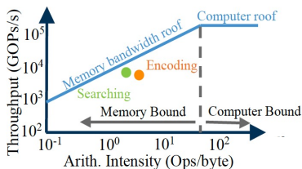
DARPA/SRC JUMP 2.0 PRISM, CHIMES & SUPREME: Accelerating Mass Spec Database Search in Memory & Storage PIs: T1: Vikram Adve T2: Jason Cong, Sang-Woo Jun, Tajana Rosing T3: Eric Pop, Mingu Kang, Philip Wong, Shimeng Yu, Suman Datta Other PIs: Niema Moshiri@UCSD, Pieter Dorrestein Pharmacy@UCSD, Rob Knight, Medicine@UCSD, Sourav Dutta@UTD, Wout Bittremieux@UAntwerp JUMP 2.0 Centers: Asif Khan, SUPREME; Shimeng Yu, Suman Datta, CHIMES Industry: Micron, Samsung, IBM, TSMC
Motivation:
Proteomics and metabolomics relay on mass spectrometry as a key tool in design of precision drugs
CPU/GPU state of the art tool, AnnSoLo [Journal Proteome Research’23] is very slow due to memory boundedness → gating development of future drugs
Novel memory and storage devices provide a capability for in/near memory computation, but have higher bit error rates & do not have compiler support
Goal: understand & quantify what procesisng in/near novel Theme 3 & SUPREME memories can offer to big data analysis on real applications
Technical approach:
Leverage resiliency of hyperdimensional computing to benefit from higher capacity along with high parallelism in and near memory/storage compute
Automate compiling of HDC-based workloads onto multiple types of accelerators: CPU, GPU, FPGA, and PIM
HPVM produces 15x less lines of code that run >3x faster due to optimizations
Grand challenge application: Open modification search for mass spectrometry based on HDC [BioOxford’23] with comparable accuracy to AnnSoLo [JPR’19]
Smaller dataset:
Reference: Yeast and Human HCD spectral library (1,188,168 spectra; 1GB in HDC representation); Query: iPRG2012 (17,993 spectra, each query is 8,192 bits)
Larger dataset: 154TB from MaSSiVE database at UCSD
Reference: 1,000,000,000 spectra (8TB in HDC), Query: 15,000 spectra (typical for a single instrument run)
HDC++
HPVM-HDC
Compiler
Optimization Configuration
CPU
GPU
FPGA
DRAM PIM
HD ReRAM
HD PCM
Demo A.3
Notes:
FeNAND want to get 1000 layer capacity

Slide 25
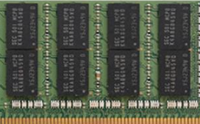
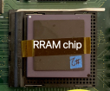
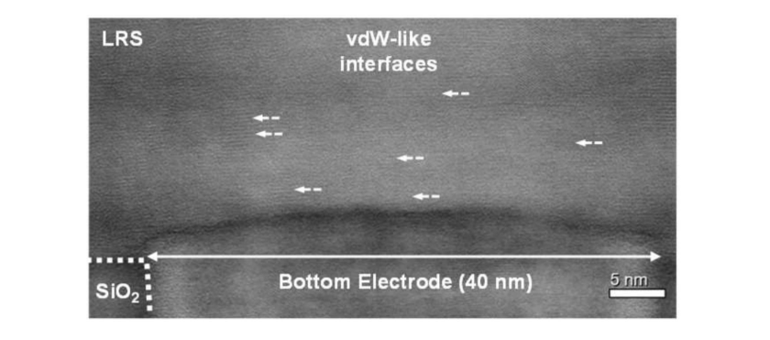
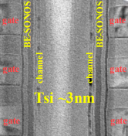
DARPA/SRC JUMP 2.0 PRISM, CHIMES & SUPREME: Accelerating Mass Spec Database Search in Memory & Storage PIs: T1: Vikram Adve T2: Jason Cong, Sang-Woo Jun, Tajana Rosing T3: Eric Pop, Mingu Kang, Philip Wong, Shimeng Yu, Suman Datta Other PIs: Niema Moshiri@UCSD, Pieter Dorrestein Pharmacy@UCSD, Rob Knight, Medicine@UCSD, Sourav Dutta@UTD, Wout Bittremieux@UAntwerp JUMP 2.0 Centers: Asif Khan, SUPREME; Shimeng Yu, Suman Datta, CHIMES Industry: Micron, Samsung, IBM, TSMC
Small Data Comparison | GPU (not HDC) [JPR’19] | GPU [Bio’23] | GPU [Bio’23] | FPGA [BioSys24] | DRAM [TCAD’23] | MLC ReRAM [DAC’24] | MLC ReRAM [DAC’24] | MLC PCM [JXCDC’24] | 3D NAND [MEMSYS’23] | 3D FeNAND [DAC’25 submit]
Algorithm | ANN-SoLo | HOMS-TC | HOMS-TC | RapidOMS | HyperOMS | HyperOMSdec | HyperOMSdec | HyperOMS | HyperOMS | HyperOMS
Technology Node(nm) | RTX 4090 (5nm) | RTX 4090 (5nm) | H100 (5nm) | Versal Prem. VP1902 (7nm) | 22nm DDR4 28nm compute | 130nm RRAM | 40nm RRAM | 40nm PCM | NAND: 14nm ASIC: 7nm FinFET | FeNAND:14nm ASIC: 7nm FinFET
Speed | 1x (62s) | 36x | 108x | 172x | 89x | 62.2x | 197x | 1,269x | 57x | 905x
Energy Efficiency | 1x (9,079J) | 16x | 25x | 187x | 1,621x | 26,901x | 403,528x | 453,970x | 36,317x | 145,270x
Energy Eff. (ref write) | 1x (9,081J) | 16x | 25x | 187x | 1,520x | 24,219x | 302,895x | 375,912x | 31,244x | 124,979x
Demo’23
Demo’23
Poster’23
Demo’23
Demo’24
Poster’23
Poster’24
Measured Measured & simulated
Key assumptions:
All designs can fit the small reference database into memory. All accelerators have the same capacity and area at the same technology node. PIM capacity reduction is ~50%.
Accelerators are characterized at the device level via measurement, architecture & circuits are simulated; both periphery and memory are accounted for.
All implementations except for SOTA [JPR’19] are based on HDC; GPU uses int8, ReRAM decimal; the rest use binary representation, but all meet SOTA accuracy.
Key takeaways:
MLC PCM & ReRAM offer the largest improvement in speed & efficiency due to their high parallelism, simple operations & high resilience of HDC-based hypervectors
Capacity, scalability and error resilience remain challenging for more general data applications
3D FeNAND is 15x faster than 3D NAND due to shorter and more parallel strings; both suffer from having to read data out sequentially as compared to PCM/ReRAM
GPU and FPGAs are a better choice when the overhead of data movement is relatively small, but where energy efficiency and speed are critical, PIM provides a better tradeoff

Slide 26
DARPA/SRC JUMP 2.0 PRISM, CHIMES & SUPREME: Accelerating Mass Spec Database Search in Memory & Storage PIs: T1: Vikram Adve T2: Jason Cong, Sang-Woo Jun, Tajana Rosing T3: Eric Pop, Mingu Kang, Philip Wong, Shimeng Yu, Suman Datta Other PIs: Niema Moshiri@UCSD, Pieter Dorrestein Pharmacy@UCSD, Rob Knight, Medicine@UCSD, Sourav Dutta@UTD, Wout Bittremieux@UAntwerp JUMP 2.0 Centers: Asif Khan, SUPREME; Shimeng Yu, Suman Datta, CHIMES Industry: Micron, Samsung, IBM, TSMC
Large Data Comparison | GPU (not HDC) [JPR’19] | GPU [Bio’23] | FPGA [BioSys24] | DRAM [TCAD’24] | MLC ReRAM [DAC’24] | MLC ReRAM [DAC’24] | MLC PCM [JXCDC’24] | 3D NAND [MEMSYS’23] | 3D FeNAND [DAC’25 submit]
Algorithm | ANN-SoLo | HOMS-TC | RapidOMS | HyperOMS | HyperOMS | HyperOMS | HyperOMS | HyperOMS | HyperOMS
Technology Node(nm) | H100 w 8TB SSD (5nm) | H100 (5nm) | VP1902 with 1TB SSD (7nm) | 22nm DDR4 28nm Compute | 130nm RRAM | 40nm RRAM | 40nm PCM | NAND: 14nm ASIC: 7nm FinFET | FeNAND:14nm ASIC: 7nm FinFET
Speed of search | 1x | 24x | 97x | 149x | 259x | 823x | 5,303x | 175x | 3,779x
Energy Efficiency | 1x | 34x | 272x | 955x | 48,462x | 726,941x | 817,808x | 65,424x | 261,698x
Measured
Demo’23
Demo’23
Poster’23
Demo’23
Demo’24
Poster’23
Poster’24
Measured &
simulated
Key assumptions:
All designs have the reference database in NVM (SSD or PIM). All accelerators have the same capacity and area at the same technology node.
We assumed maximum 1.67 Tb per package, with 64 bit interface per package. Query is broadcast to PIM on 200 MHz bus with sequential result readout for index & score.
Accelerators are characterized at the device level via measurement, architecture & circuits are simulated; both periphery and memory are accounted for. Results match SOTA accuracy.
Key takeaways:
Processing in/near memory/storage results are up to 221x faster vs GPUs with big data due to decrease in the need for data movement
800 GPUs would be needed to be able to fully fit the reference dataset in GPU memory for SOTA [JPR’19], and 100 GPUs for HDC version [Bio’23]
MLC PCM & ReRAM again have the largest improvement in energy efficiency; challenge is scaling and accuracy for more error sensitive workloads;
ReRAM used decimals with 64 parallel banks, while PCM used binary with data packing (3x faster) and 128 banks (2x faster) → speed and efficiency are comparable
3D FeNAND offers impressive scalability and significantly higher speed and energy efficiency due to packing more strings in parallel, and not having as long strings as 3D NAND
Both suffer from having to read data out sequentially as compared to PCM/ReRAM & would not do as well on applications with many writes
Notes:
MS generates 5,000-70,000 spectra/run
GPU-AnnSolo: 800 GPUs, estimate performance: 800x (1/6 performance of single board PCM: 5,303x)
GPU-HDC : 100 GPUs, estimate performance: 2,405x (½ performance of single board PCM: 5,303x)
FPGA : 32 FPGAs, estimate performance: 3,116x (⅔ performance of single board PCM: 5,303x)
For DRAM near bank big data we assume 4 PCIe connections, each with 256 GB DDR6 DIMMs, so 1TB data fits
From Prasana: read energy is similar in both 3D NAND and FE-NAND because the major fraction of the energy goes towards SSL setup and WL change both of which are independent of the technology. The BL line energy is only a minor fraction of the energy. However, periphery also influences energy efficiency
What is the largest commercially available Data density ( Gb/mm2)?
Samsung has announced 28.5 Gb/mm² at ISSCC 2024 based on QLC. DOI: 10.1109/ISSCC49657.2024.10454343
Intel presented a PLC based NAND at ISSCC 2023 (23.3 Gb/mm²) DOI: 10.1109/LSSC.2023.3285508
What is the largest commercially available SSD?
Nimbusdata Exadrive 100TB (https://nimbusdata.com/products/exadrive/)
There are other options at lower sizes (https://www.techradar.com/best/large-hard-drives-and-ssds#section-the-largest-ssd-on-the-market)
How to increase the bandwidth while accessing SSDs? Can NAND be stacked like HBM?
FBI (frequency boosting interface) in packaging technology – Samsung has been able to achieve 3 Gb/s/pin for 16 GB NAND as per their VLSI 2023 paper
https://doi.org/10.4071/isom-2015-WA22
10.23919/VLSITechnologyandCir57934.2023.10185391 (references)
Kioxia has used similar techniques to achieve 6.4 Gb/s/pin as per their IEEE SSC letters earlier this year. (10.1109/LSSC.2024.3377263)

Slide 27
Personalized & secure drug discovery
Goal: 100x faster runtime at massive data scales
Long Reads DNA & protein
Proteomics & Metabolomics
Virtual drug screening
Chem/Bio
HDC + graph based learning
Small-Molecule Mass Spectrometry
Data/CPU
Intensive
Identify possible molecules
Tool output
Sequence
Alignment, Host Filtering
Compare to existing proteins
Benefit
Molecule Identification and Quantification
Identify key mutations
Select the most promising drug candidate
Next steps
Taxonomy, function, gene catalog, genomes
Gene Expression
Small-Molecule Profile
Clinical Associations
Disease-
Enabling Genes
Metabolic pathways
Disease Pathways
Personalized Treatment
Off-Target Drug Interactions
Novel Drug Discovery
Notes:
Our team plans to address the key issues in the first phase of the drug discovery pipeline, as that phase is the key to selection of the best compounds that go through the three phases of FDA trials and the most bottlenecked by computational constraints. More than 90% of compounds identified during the discovery phase fail in the first phase of trials [Dowden 2019]. PRISM is uniquely positioned to dramatically improve the speed, throughput and data availability for the early stages of drug discovery pipeline by leveraging developments and optimizations across the memory and storage stack. Improving the speed of drug discovery via accelerating key stages of the pipeline, and significantly increasing the amount of data analyzed (using various omics data, and evaluating billions of protein structures) would dramatically increase the chances of identifying “good bets” to take to clinical trials [Jung 2022][Cho 2022][Hu 2011][Ransohoff 2003]. As a result, we specifically focus on two key issues identified in the current work: (1) The need to better match the drug compounds (proteins) to human biology (e.g., genomics, transcriptomics, metabolomics) via use of mass spectrometry, protein sequence matching and long read sequencing; and (2) The need for a more comprehensive and open data access not just in the public sphere, but also in the pharmaceutical industry via use of multiparty computation and fully homomorphic encryption.
Cancer is one of the top two causes of death in the USA [Murphy 2021], and also one of the most challenging diseases to treat, and thus is a good target for PRISM disease diagnostics pipeline optimization. Cancers are caused by genomic irregularities that result in uncontrolled cell growth. These irregularities range from Single Nucleotide Variants (SNVs), which are single bases that are mutated (e.g., C mutates to T at a specific position of the genome), and Single Nucleotide Polymorphisms (SNPs), which are SNVs that are common to at least 1% of human population, to Structural Variants (SVs), which are larger structural modifications of genomic regions (e.g., duplication, deletion, insertion, etc.) [Vogelstein 2004]. The ability to characterize a tumor’s unique genomic features can provide critical precision medical insights into potential targeted therapeutics to treat the cancer [Belzen 2021]. In the past decade, genomic characterization of cancer has been performed primarily using short-read technologies (100-300 base pairs (bps)), but due to their short length, short-reads are unable to directly detect key structural variations that are key to cancer diagnostics.
In recent years, the advancement of long-read technologies (10k or more bps), such as the Oxford Nanopore Technologies sequencer (ONT), have improved the ability to detect large-scale structural variations [Salk 2019]. ONT systems are continually improving their throughput and accuracy, which in some cases reaches 99% today, rivaling short read technologies. The state-of-the-art Prometheon 48 ONT sequencer has 60 TB SSD Storage, 512 GB RAM, and 4 x NVIDIA A100 GPU cards for basecalling acceleration [ONT 2022] and generates 14 TB of data when running at the top throughput. This is 14x more data than the state-of-the-art short reads sequencer. Using long reads with Mass Spectrometry has been shown to improve characterization of protein variants [Miller 2022], which can yield even further improved targeting of cancer therapeutics [Cameron 2019]. As a result, these two technologies, mass spectrometry and long read genomics for structural variant calling, which are key to disease diagnostics and produce large amounts of data, currently run very slowly on today’s systems. Due to the large runtime and peak memory requirements of long-read structural variation calling pipelines even on very small datasets [Dierckxsens 2021], long-read SV detection is infeasible for ultra-large cohorts or for standard-of-care, thus delaying personalized drug discovery further.
Recent development of utilizing “reference genome graphs,” rather than a “reference genome sequence,” complicates this situation even more [Hadi 2020]. Until just a few years ago, all alignment methods aligned either short or long reads to a single human genome. However, any given human genome has, on average, 3.5–4.0 million SNPs, insertions or deletions of amino acids and ~2,500 large structural variations (SVs) compared with the reference genome. This can cause alignment to work incorrectly or to completely fail, which may cause misdiagnosis of the disease. Recent work has proposed that multigenome references should be used instead as they significantly improve the alignment accuracy, but this comes at the cost of very long runtimes due to both large dataset sizes and graphs that are used to represent multigenomic references [Rakocevic 2019].
As a part of PRISM, we plan to focus on these challenging workloads that combine graph-based methods with database search and clustering for mass spectrometry (proteomics and metabolomics), long reads with structural variant detection (genomics and transcriptomics), and protein structural variation matching, as this is key to more accurate drug design [Belzen 2021]. Due to the large scale and distributed nature of these datasets, we will (1) perform systems-level profiling of the state-of-the-art tools to identify key bottlenecks, (2) design and implement optimized end-to-end in/near memory and storage system to resolve those bottlenecks, (3) demonstrate at least 100x speedup relative to the optimized state-of-the-art tools at scale using infrastructure already available at UCSD, and enhancing it with chips and systems designed by PRISM PIs by leveraging technology developed by Themes 1-3, (4) show how our optimized system can apply to other graph, clustering, transformer network and data search based applications by using workloads from the deep-analytics grand challenge.

Slide 28
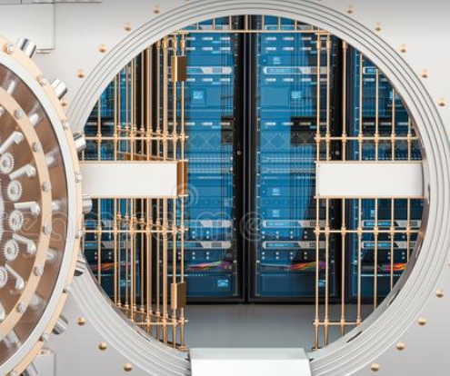
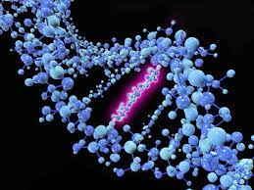
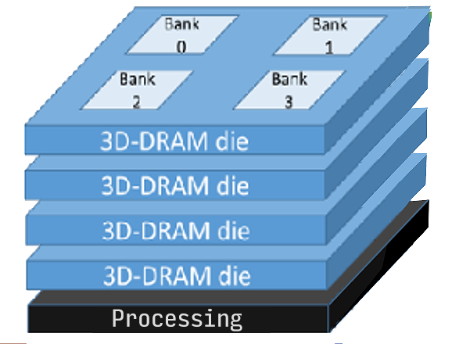
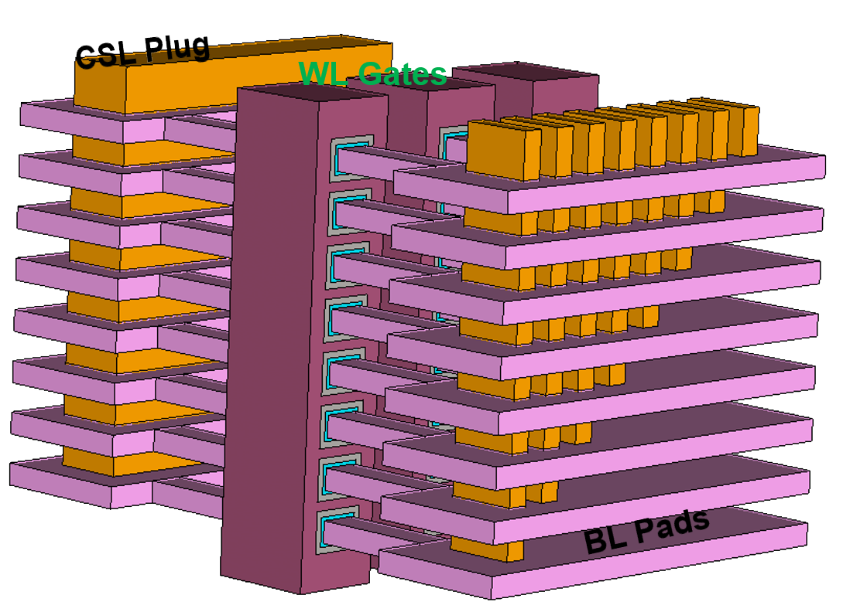
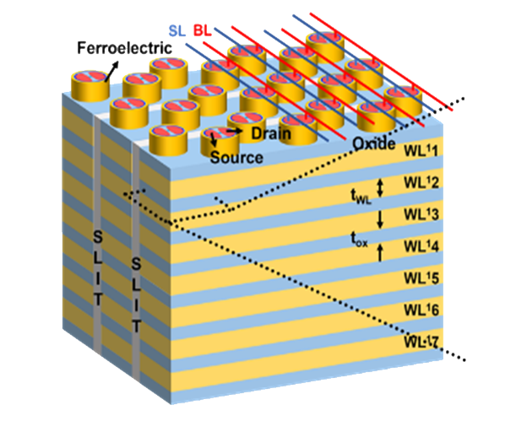
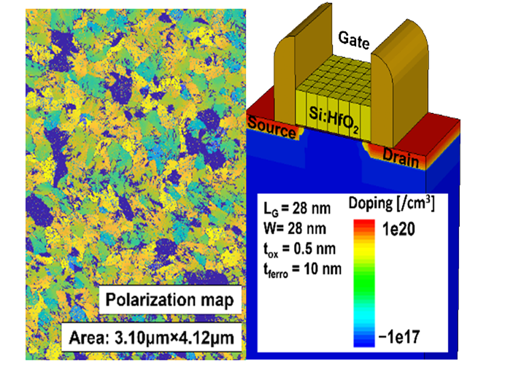
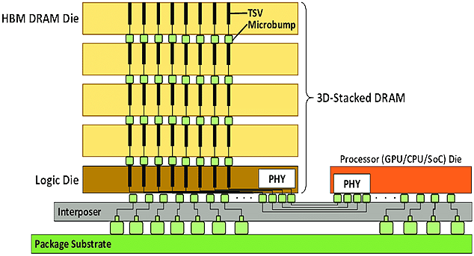
PRISM – Processing with Intelligent Storage and Memory Director: Tajana Rosing, UCSD Co-director: Nam Sung Kim, UIUC
Theme 1: Systems & Software
Leads: Emmett Witchel & Ada Gavrilovska
Theme 4:
Grand Challenges
Platform
Abstractions
AIMS Controls
Scheduling & Placement
Programming & Compilers
Cross-cuts
Performance
Programmability
Energy Efficiency
Security
Scalability
Virtualization
Composability
Reliability
Resilience
Availability
Leads: Vijay Narayanan
Yizhou Sun
Security & Privacy
Leads: Nam Sung Kim & Jishen Zhao
Theme 2: Architecture
Personalized & Secure Drug Discovery
Memory & Storage
Architecture
AIMS Architecture
Controllers & Interfaces
Disaggregated IMS Design
Hardware Security
Architecture Integration
Leads: Suman Datta & Shimeng Yu
Deep
Insights
Theme 3: Devices & Circuits
Intelligent
Memory
IntelligentStorage
Metrology & Modeling
Co-design & Benchmarks
Emerging Memory
24 PIs, 13 universities, >230 students

Slide 29
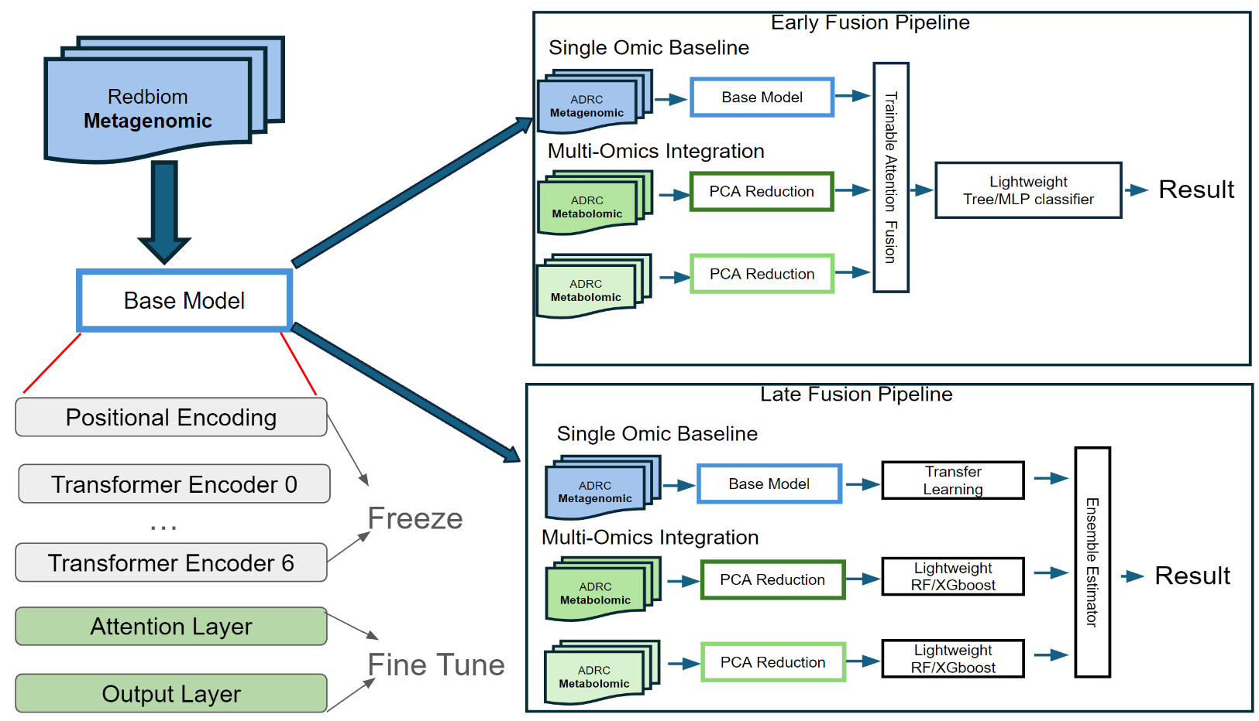
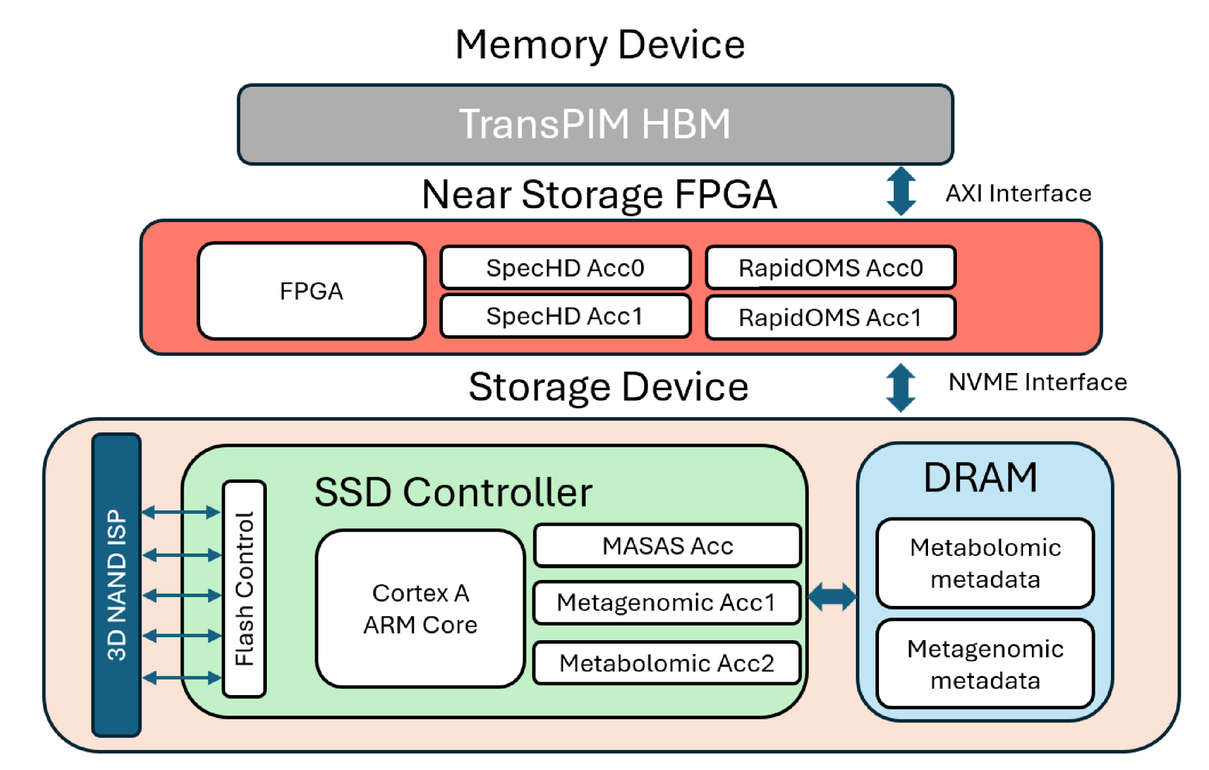
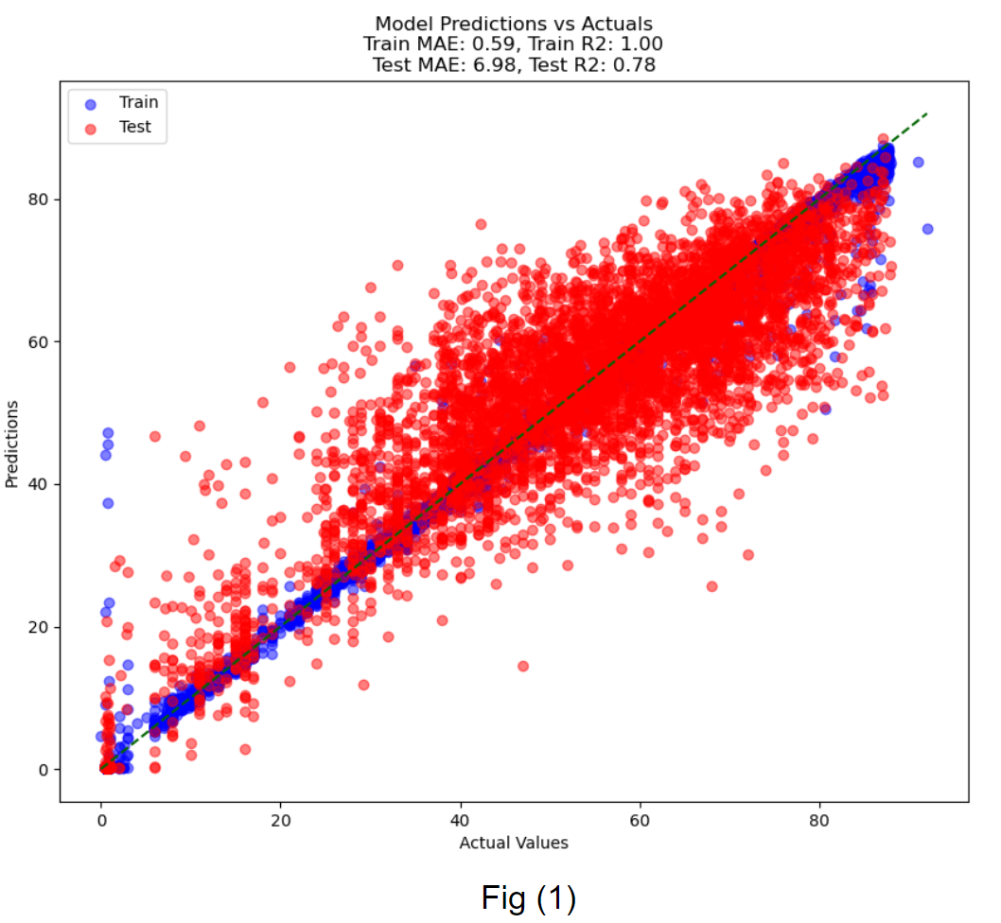
Towards Faster Drug Discovery: Accelerating Analysis of Multi-omics Workloads
Problem & Opportunity:
Faster drug discovery requires input from various omics disciplines
Today’s systems primarily leverage SOTA machine learning approaches running on CPUs
We have accelerators for all omics applications:
Genomics/Transcriptomics: RapidX, NMpore,GenMIX,SALIENT
Proteomics/Metabolomics: SpecHD,RapidOMS,PIM (ReRAM, 3D NAND, PCM, FeNAND)
Technical Approach:
Leverage genomics and metabolomics data & results from Alzheimer disease study by Profs. Knight & Dorrestein
Utilizing transfer learning techniques, then fine-tune on Alzheimer specific datasets.
Integrate multi-omics data with early and late fusion
Leverage memory-centric in/near memory architecture to scale the multi-omics analysis pipeline
TransPIM, our transformer accelerator near memory, can be leveraged
Multi-omics feature fusion strategies
Overall memory-centric architecture for accelerating end-to-end multi-omics analysis pipeline
Transformer model evaluations on combined datasets using Mean Absolute Error(MAE)

Slide 30
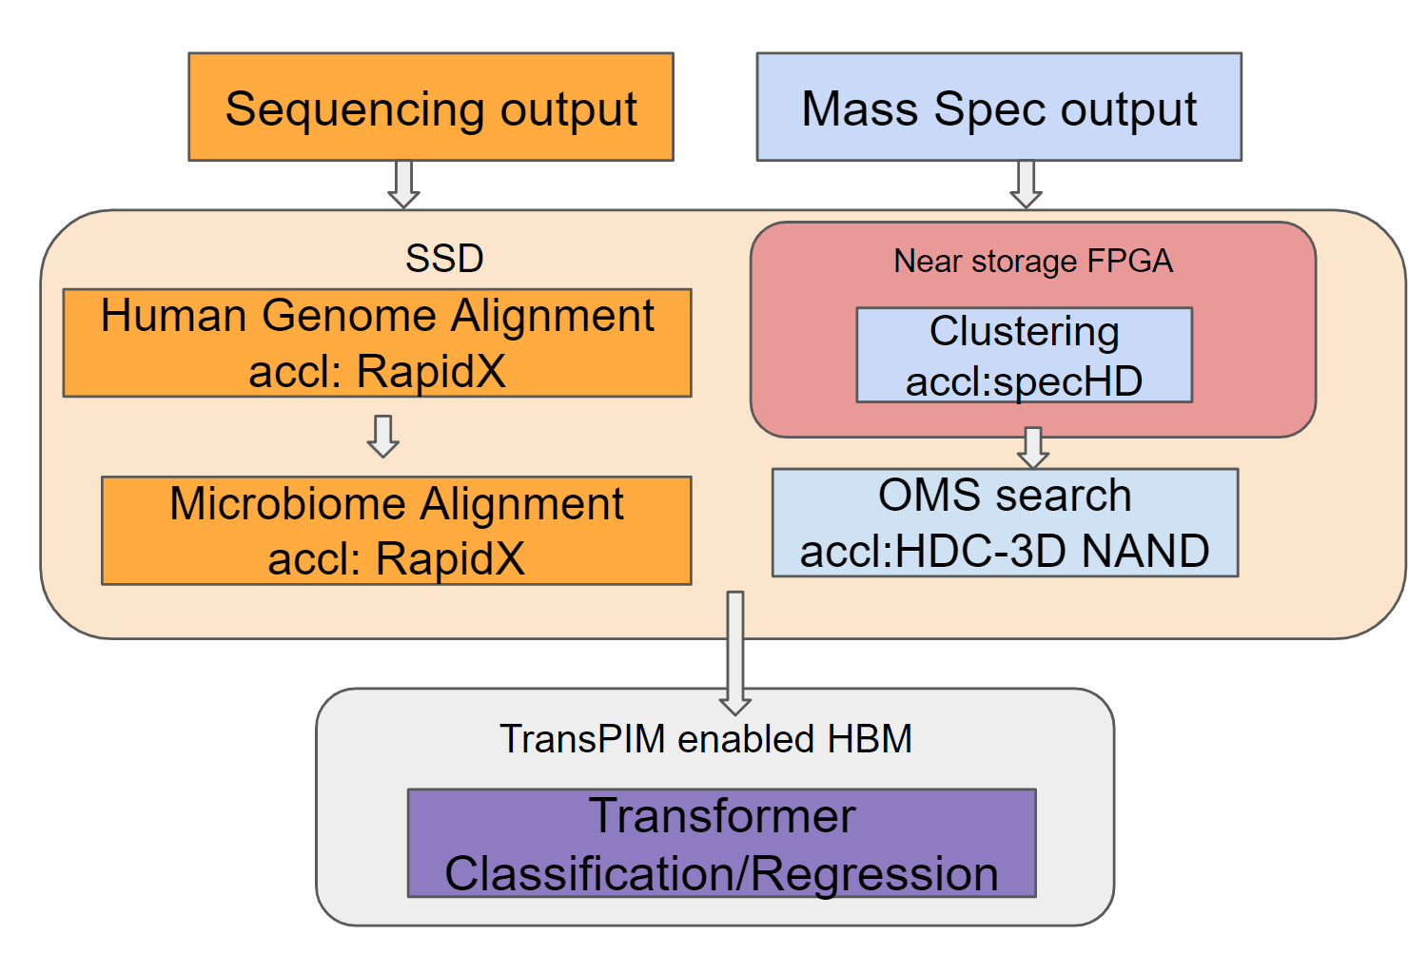
In & Near Memory Acceleration of Multi-omics Workloads
Multi-omics workflow leverage multi-level accelerators
Metagenomics
Sequencing output → human genome alignment and filtering → microbiome alignment → relative microbiome abundance analysis
Metabolomics
Mass spec output → Clustering → OMS search
Prediction using metagenomics and metabolomics with classification/regression
Transformer baseline with ensemble models currently gives SOTA accuracy results
>50% better than single-omic SOTA[R. Knight Nature Oncogene’24] for regression task
>5% better than single-omic SOTA[R. Knight Nature Oncogene’24] for classification task
Current work:
Evaluate the best architecture vs. SOTA

