Slide 1
Advanced Technology session:
New Compute Architectures & FPGA Software Environments on NRP
Mohammad Sada
Sixth National Research Platform (6NRP) Workshop
San Diego Supercomputer Center
January 30th, 2025

Slide 2
FPGAs
2

Slide 3
FPGAs
- Field-Programmable Gate Arrays
- Unlike CPUs/GPUs (general-purpose), FPGAs are programmed for specific applications.
- Analogy: CPU = Swiss Army knife, handles variety of tasks, but not optimized. FPGA = Custom-rebuilt machinery, designed for a specific job.
- High Throughput, Low Latency, Energy Efficiency, Flexibility
3

Slide 4
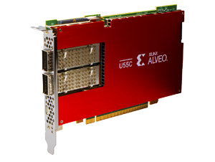
AMD/Xilinx Alveo U55C
PCI Express Interface
Gen3 x16 or 2 x Gen4 x8
Networking
2 x QSFP28 connectors (100 Gb/s each)
Memory
16 GB High-Bandwidth Memory (HBM2)
HBM2 Bandwidth
460 GB/s
Internal SRAM Capacity
43 MB
Internal SRAM Bandwidth
35 TB/s
LUTs
1,304,000
Registers
2,607,000
DSP Slices
9,024
Dimensions
Full Height, Half Length, Single Slot
Power
Maximum: 150W, Typical: 115W
4

Slide 5
FPGAs and HPC – Use Cases
1- Machine Learning and AI Acceleration:
- hls4ml converts machine learning models into FPGA-ready HLS designs.
- Optimizes machine learning algorithms for FPGA deployment.
- Is open-source.
2- FPGAs as SmartNICs
- FPGAs are used as SmartNICs for customizable packet processing at high bandwidth (2x100Gbps).
- Supports P4 programming for custom network processing.
- Ideal for high-bandwidth, low-latency networking.
5

Slide 6
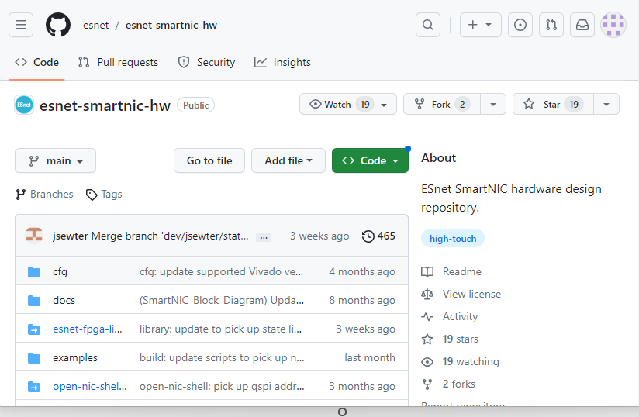
ESnet P4 SmartNIC
- ESnet SmartNIC framework provides an entire workflow for Xilinx Alveo FPGAs.
- It is open-source (on github).
- It seamlessly integrates Xilinx tools along with various tools like DPDK to provide an easy way of programming Alveo FPGAs as SmartNICs.
- Various debugging, testing and simulating tools.
- Containerized environment that makes it as easy as plug-and-play for P4 on FPGAs.
6

Slide 7
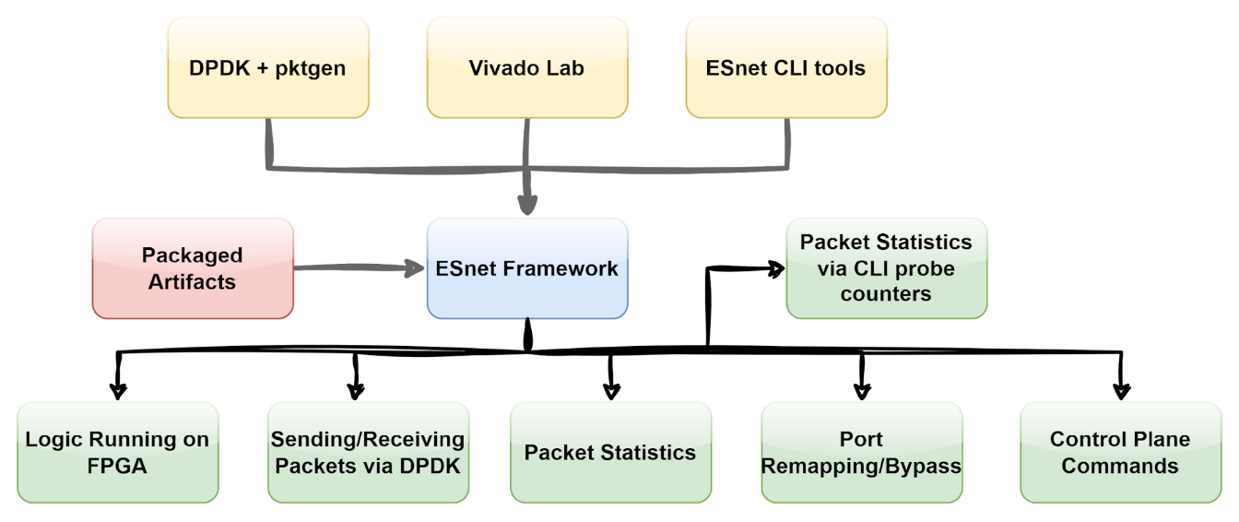
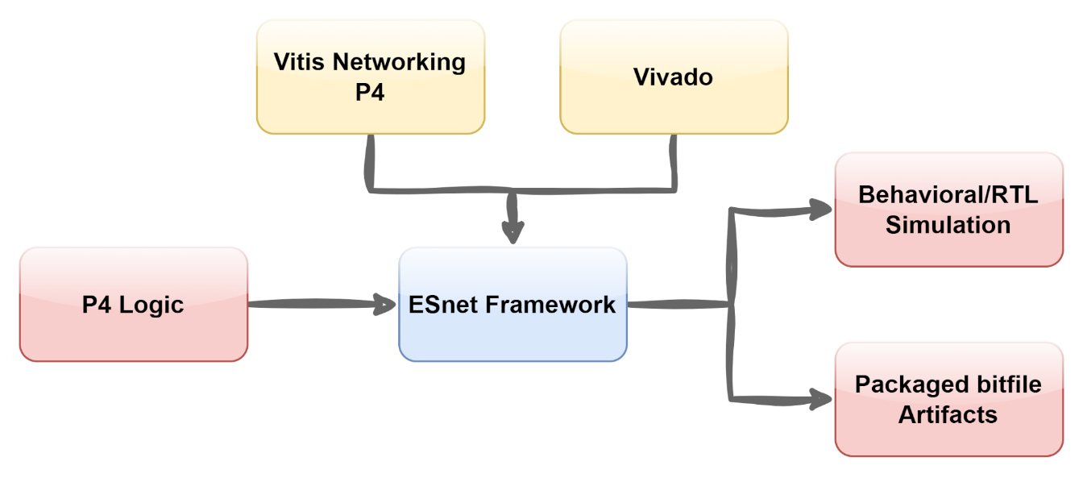
ESnet P4 SmartNIC
https://docs.nrp.ai/userdocs/fpgas/esnet/
7

Slide 8
FPGAs on Nautilus
HLS Code
Allocated resources: (Total limits may be over 100 percent, i.e., overcommitted.) Resource Requests Limits -------- -------- ------ amd.com/xilinx_u55c_gen3x16_xdma_base_3-0 4 4
HDL
Bitstream
resources:
requests:
amd.com/xilinx_u55c_gen3x16_xdma_base_3-0: 1
limits:
amd.com/xilinx_u55c_gen3x16_xdma_base_3-0: 1
8

Slide 9
Coder
9

Slide 10
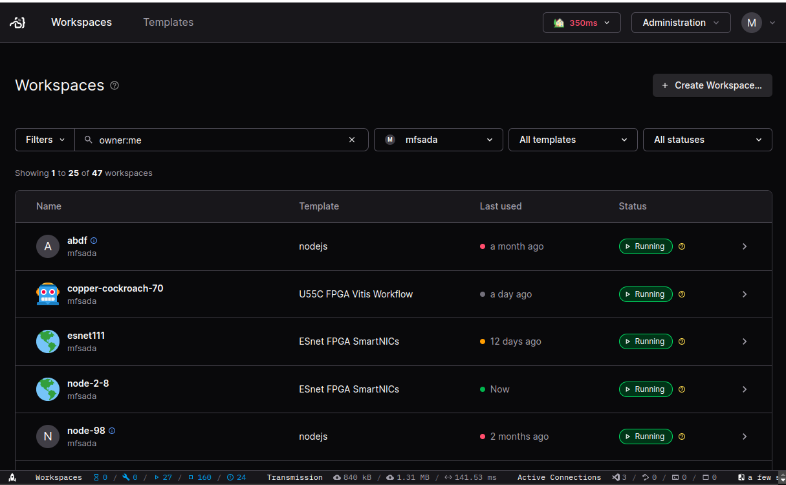
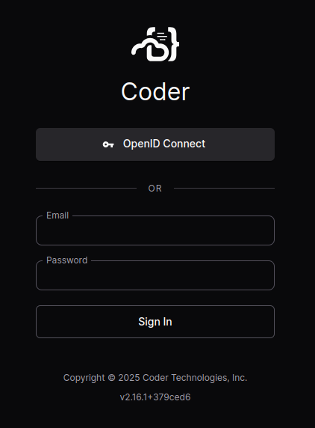
Coder
Coder is a web service (coder.nrp-nautilus.io)
10

Slide 11
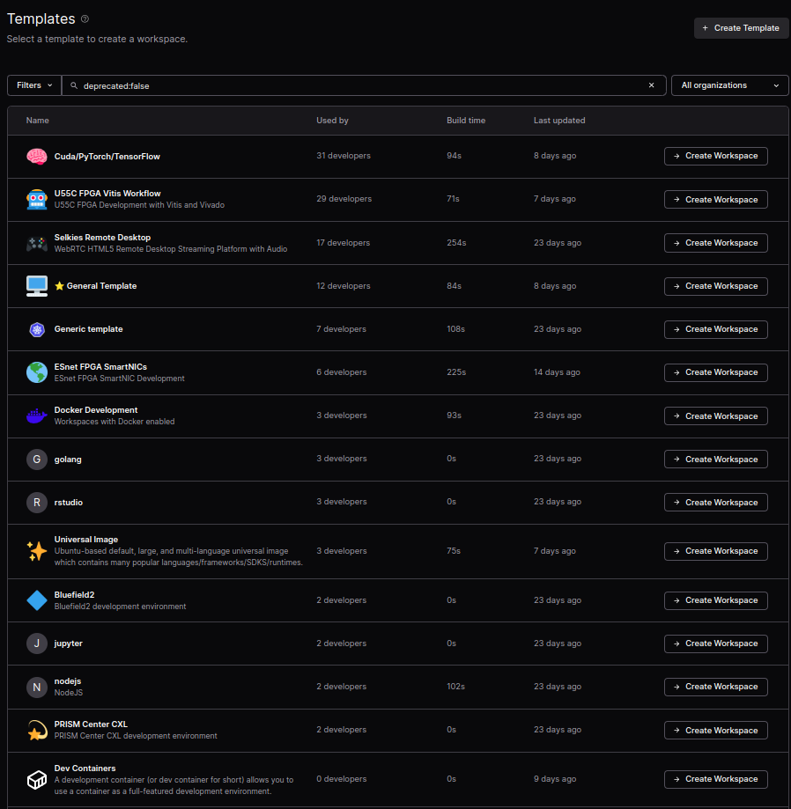
Coder
Workspace = Personal Pod
Template = Image + Config
U55C FPGA Vitis Workflow
ESnet FPGA SmartNICs
Come preloaded with:
1- Xilinx Runtime Tools
2- Configuration to point to license server
3- Xilinx Tools (Vivado, Vitis, Vitis_HLS...)
4- Requests for Hardware
11

Slide 12
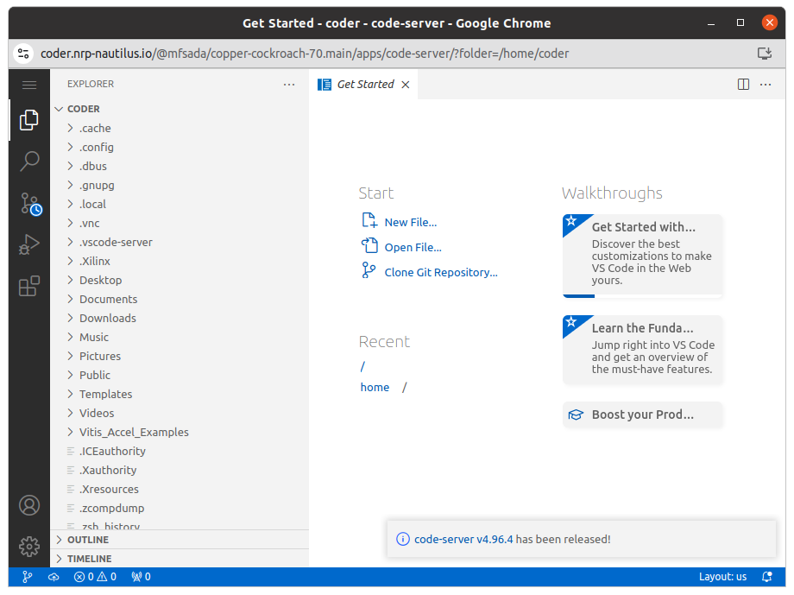
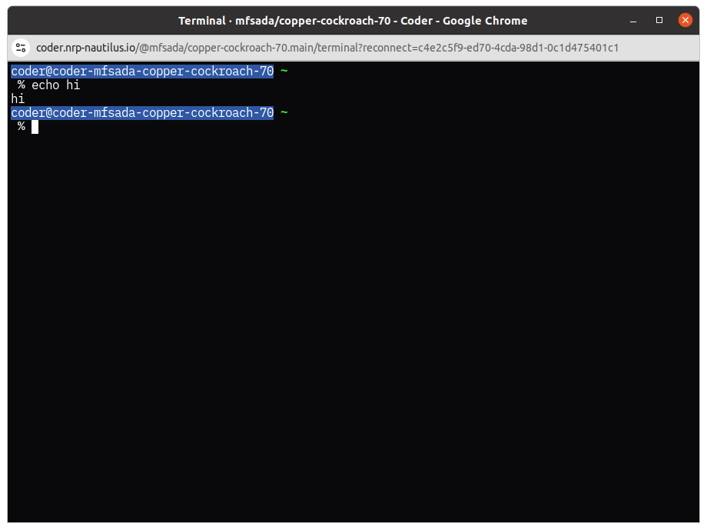
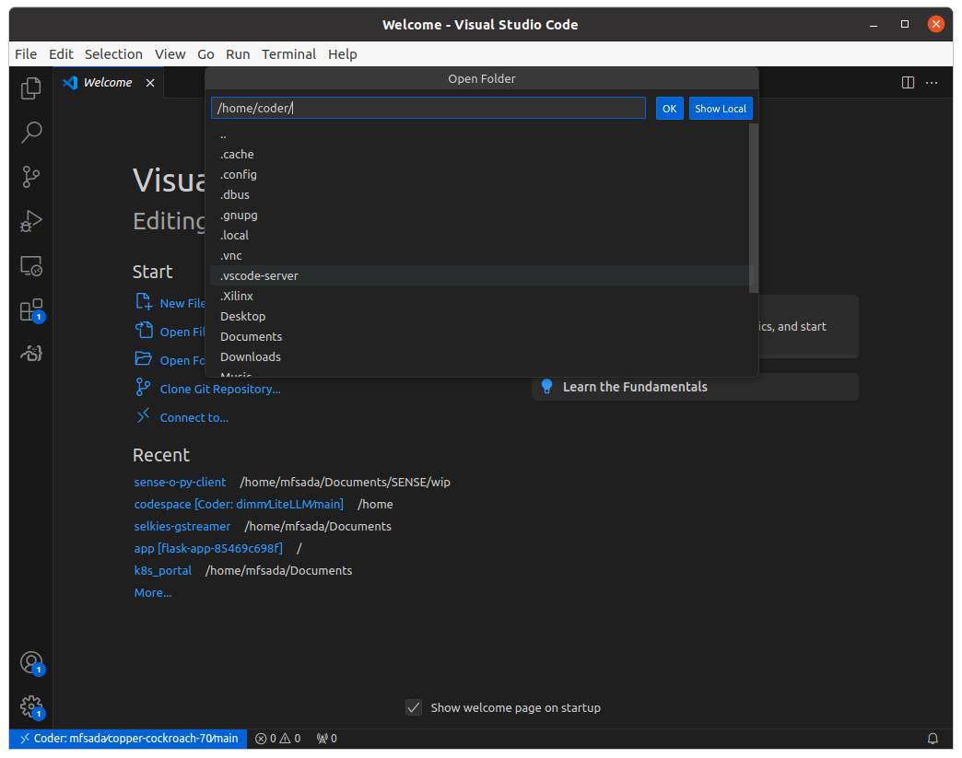
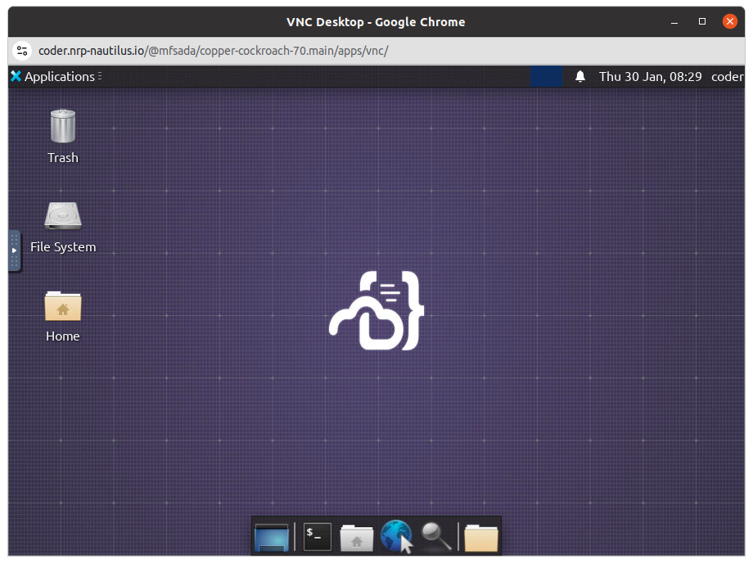
Coder
Features:
1- Custom Kubernetes Workflows with Terraform
(Pods, Deployments, VMs...)
2- Remote Desktop in Browser
3- VS Code Desktop AND in Browser
4- Terminal in Browser
5- Persistent Personal SSH Key
6- Apps!
12

Slide 13
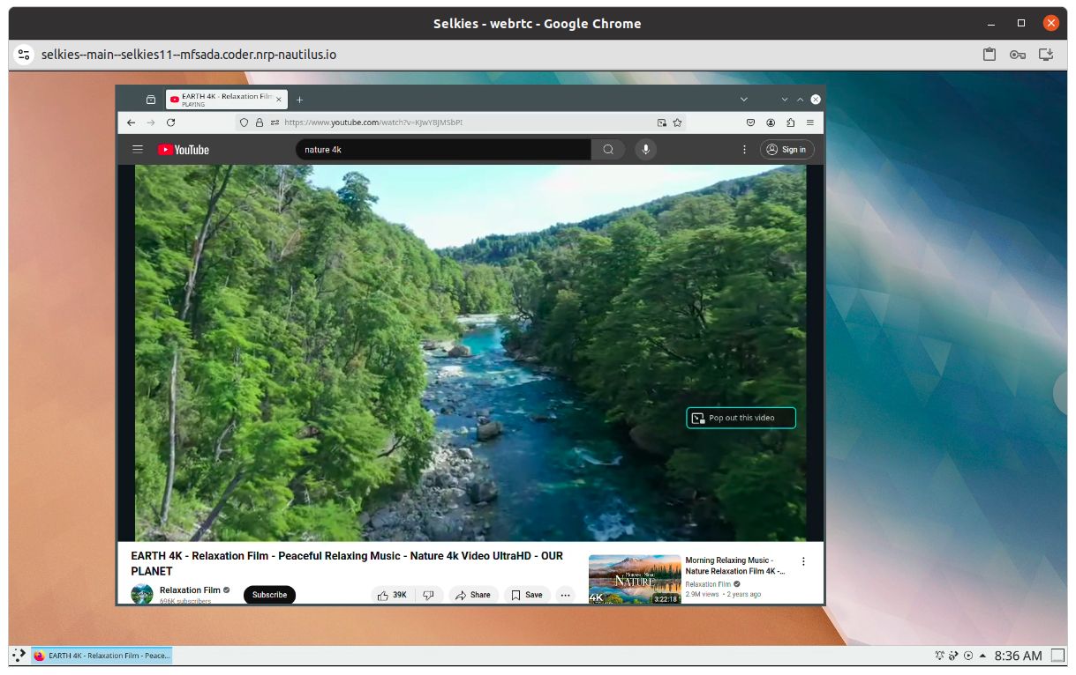
Selkies on Coder
Selkies allows for CPU/GPU accelerated Remote Desktop with Audio.
13

Slide 14
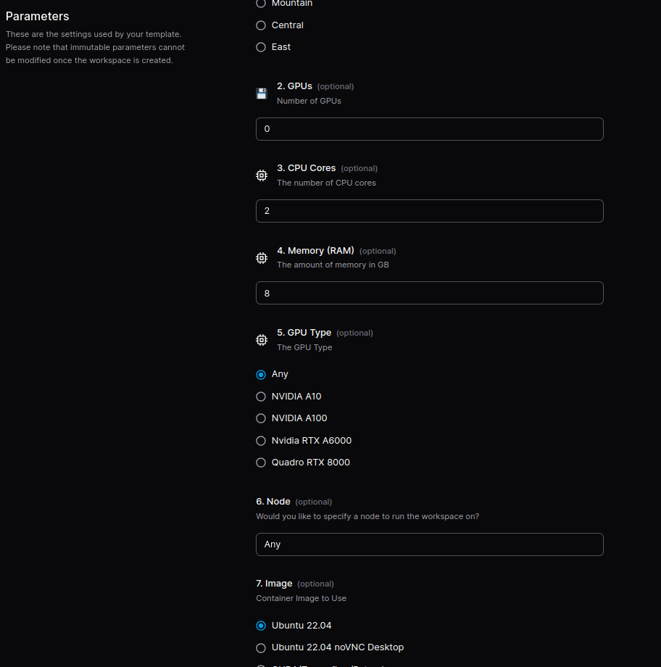
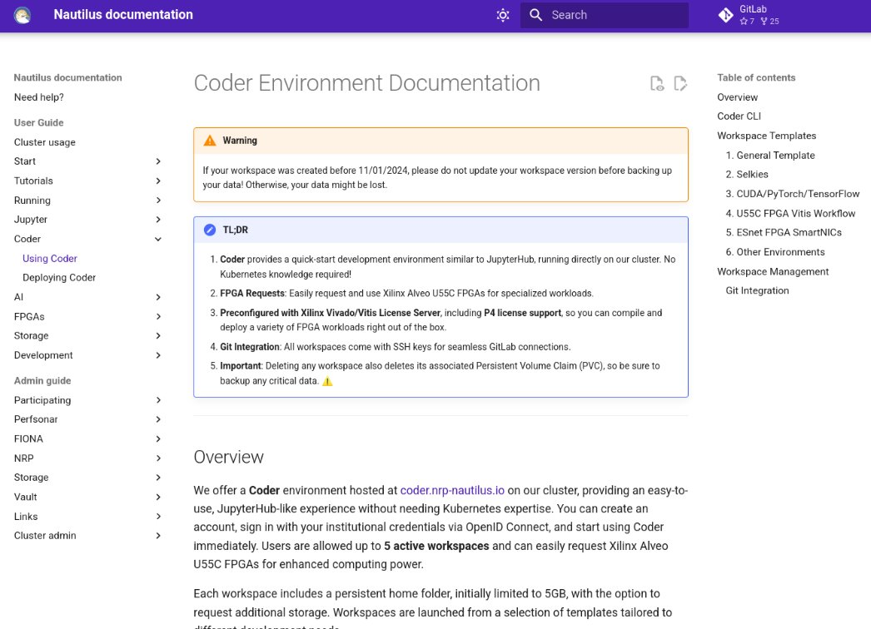
Coder
General Template is similar to the JupyterHub Deployments we have.
You can start your own Coder deployment in your namespace.
docs.nrp.ai
14

Slide 15
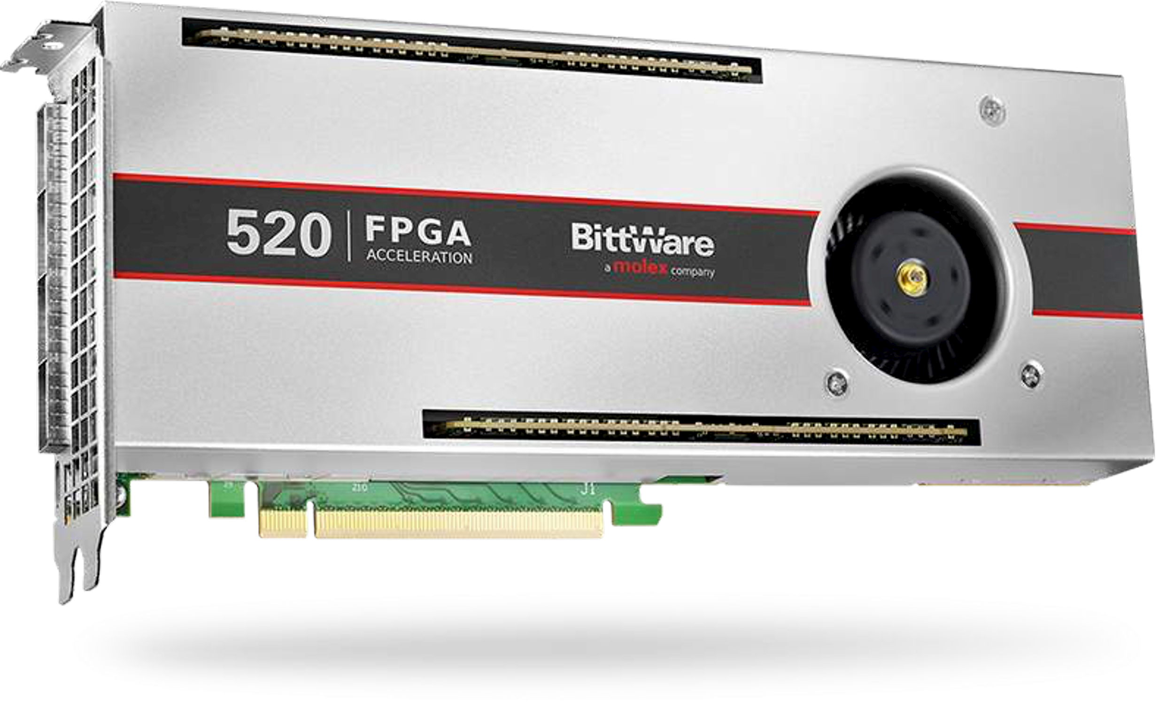
BittWare 520N-MX (Intel Stratix 10 MX)
Key Specifications
FPGA: Intel Stratix 10 NX2100
Memory:
16GB HBM2 (410 GB/s bandwidth)
32GB onboard DDR4 (expandable to 256GB)
Networking & I/O:
4x QSFP28 (up to 100GbE per port)
2x QSFP28 (100GbE MAC hard IP)
PCIe Gen3 x16 Interface
AI Acceleration:
143 INT8 TOPS via AI Tensor Blocks
Cooling Options:
Active, passive, or liquid cooling
Power Consumption:
Max 225W
Software Environment:
Intel Quartus Prime Pro
Intel oneAPI Support
15

Slide 16
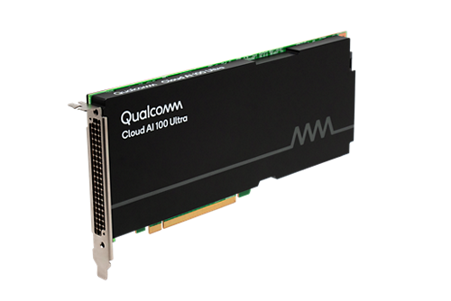
Qualcomm Cloud AI 100
Ultra
MultiSoC
P2P
Finetuning
QAIC:
Ultras with drawing
SPECS
Finetuning ..
Show in action: LLM, Audio, Stable Diffusion
16

Slide 17
Qualcomm Cloud AI 100
Device
Ultra
Device
Qualcomm Cloud AI 100 Ultra
Device
Device
Roughly 25B Parameters
17

Slide 18
Qualcomm Cloud AI 100
Ultra
Device
Device
Device
Device
Device
Device
Device
Device
Qualcomm Cloud AI 100 Ultra
Qualcomm Cloud AI 100 Ultra
Qualcomm Cloud AI 100 Ultra
Qualcomm Cloud AI 100 Ultra
Device
Device
Device
Device
Allocated resources: (Total limits may be over 100 percent, i.e., overcommitted.) Resource Requests Limits -------- -------- ------
qualcomm.com/qaic 32 32
Device
Device
Device
Device
PCI Switch
PCI Switch
resources:
requests:
qualcomm.com/qaic:
limits:
qualcomm.com/qaic:
Device
Device
Device
Device
Device
Device
Device
Device
Qualcomm Cloud AI 100 Ultra
Qualcomm Cloud AI 100 Ultra
Qualcomm Cloud AI 100 Ultra
Qualcomm Cloud AI 100 Ultra
Device
Device
Device
Device
Device
Device
Device
Device
18

Slide 19
Qualcomm Cloud AI 100
Ultra
Device
Device
Device
Device
Device
Device
Device
Device
Qualcomm Cloud AI 100 Ultra
Qualcomm Cloud AI 100 Ultra
Qualcomm Cloud AI 100 Ultra
Qualcomm Cloud AI 100 Ultra
Device
Device
Device
Device
Allocated resources: (Total limits may be over 100 percent, i.e., overcommitted.) Resource Requests Limits -------- -------- ------
qualcomm.com/qaic 32 32
Device
Device
Device
Device
PCI Switch
PCI Switch
resources:
requests:
qualcomm.com/qaic: 5
limits:
qualcomm.com/qaic: 5
Device
Device
Device
Device
Device
Device
Device
Device
Qualcomm Cloud AI 100 Ultra
Qualcomm Cloud AI 100 Ultra
Qualcomm Cloud AI 100 Ultra
Qualcomm Cloud AI 100 Ultra
Device
Device
Device
Device
Device
Device
Device
Device
19

Slide 20
Uses – Stable Diffusion
Key Specifications
FPGA: Intel Stratix 10 NX2100
Memory:
8GB HBM2 (410 GB/s bandwidth)
32GB onboard DDR4 (expandable to 256GB)
Networking & I/O:
4x QSFP28 (up to 100GbE per port)
2x QSFP28 (100GbE MAC hard IP)
PCIe Gen3 x16 Interface
AI Acceleration:
143 INT8 TOPS via AI Tensor Blocks
Cooling Options:
Active, passive, or liquid cooling
Power Consumption:
Max 225W
Software Environment:
Intel Quartus Prime Pro
Intel oneAPI Support
20

Slide 21
Uses – Audio Models
Key Specifications
FPGA: Intel Stratix 10 NX2100
Memory:
8GB HBM2 (410 GB/s bandwidth)
32GB onboard DDR4 (expandable to 256GB)
Networking & I/O:
4x QSFP28 (up to 100GbE per port)
2x QSFP28 (100GbE MAC hard IP)
PCIe Gen3 x16 Interface
AI Acceleration:
143 INT8 TOPS via AI Tensor Blocks
Cooling Options:
Active, passive, or liquid cooling
Power Consumption:
Max 225W
Software Environment:
Intel Quartus Prime Pro
Intel oneAPI Support
21

Slide 22
Uses – Computer Vision
Key Specifications
FPGA: Intel Stratix 10 NX2100
Memory:
8GB HBM2 (410 GB/s bandwidth)
32GB onboard DDR4 (expandable to 256GB)
Networking & I/O:
4x QSFP28 (up to 100GbE per port)
2x QSFP28 (100GbE MAC hard IP)
PCIe Gen3 x16 Interface
AI Acceleration:
143 INT8 TOPS via AI Tensor Blocks
Cooling Options:
Active, passive, or liquid cooling
Power Consumption:
Max 225W
Software Environment:
Intel Quartus Prime Pro
Intel oneAPI Support
22

Slide 23
Uses – C++ SDK
Key Specifications
FPGA: Intel Stratix 10 NX2100
Memory:
8GB HBM2 (410 GB/s bandwidth)
32GB onboard DDR4 (expandable to 256GB)
Networking & I/O:
4x QSFP28 (up to 100GbE per port)
2x QSFP28 (100GbE MAC hard IP)
PCIe Gen3 x16 Interface
AI Acceleration:
143 INT8 TOPS via AI Tensor Blocks
Cooling Options:
Active, passive, or liquid cooling
Power Consumption:
Max 225W
Software Environment:
Intel Quartus Prime Pro
Intel oneAPI Support
23

Slide 24
Uses – LLMs & Finetuning
Key Specifications
FPGA: Intel Stratix 10 NX2100
Memory:
8GB HBM2 (410 GB/s bandwidth)
32GB onboard DDR4 (expandable to 256GB)
Networking & I/O:
4x QSFP28 (up to 100GbE per port)
2x QSFP28 (100GbE MAC hard IP)
PCIe Gen3 x16 Interface
AI Acceleration:
143 INT8 TOPS via AI Tensor Blocks
Cooling Options:
Active, passive, or liquid cooling
Power Consumption:
Max 225W
Software Environment:
Intel Quartus Prime Pro
Intel oneAPI Support
24

Slide 26
Questions
26

