Slide 1
Programmable Networking & Testbed Integration
Mohammad Sada (UCSD) and Justas Balcas (ESNET)
Sixth National Research Platform (6NRP) Workshop
San Diego Supercomputer Center
January 28th, 2025

Slide 2
The Slides can be found at:
https://github.com/nrp-nautilus/6nrp-smartnic
2

Slide 3
SmartNICs
3

Slide 4
SmartNICs (Smart Network Interface Cards)
SmartNICs (Smart Network Interface Cards) are advanced network interface cards that offload processing tasks from the CPU to specialized hardware, improving performance and efficiency.
4

Slide 5
What is Available
5

Slide 6
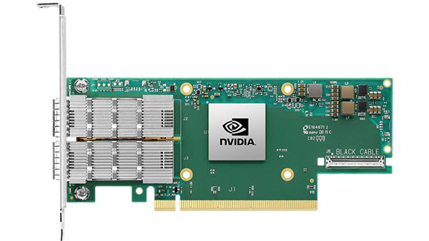
What is Available
ConnectX-6 2x100Gbps NICs:
Support RDMA (Remote Direct Memory Access) for low-latency networking.
Advanced virtualization features for multi-tenant environments.
Up to 200Gbps bi-directional throughput.
VPP: Leverages vectorized packet processing for fast and efficient network traffic handling.
DPDK: Enables high-performance packet processing by bypassing the kernel, achieving ultra-low latency.
6

Slide 7
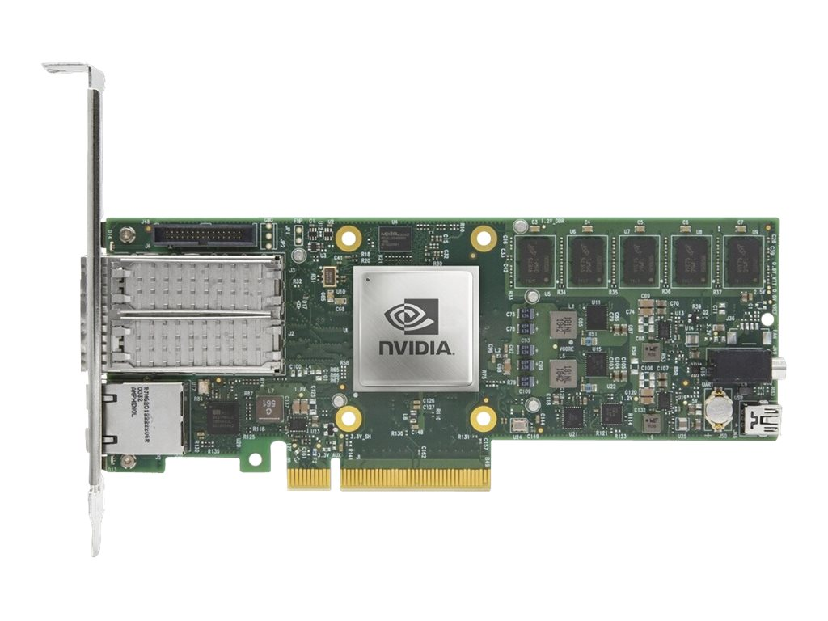
What is Available
Nvidia BlueField-2 SmartNICs:
7 available on Nautilus.
Capabilities:
- Combine NIC functionality with DPU.
- Offload tasks like storage, networking, and security.
- Feature programmable Arm cores for custom applications.
- Deliver up to 200Gbps throughput.
7

Slide 8
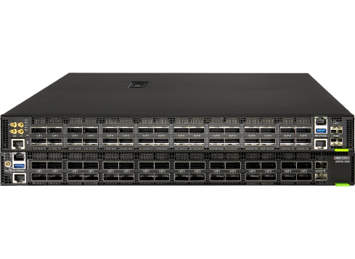
What is Available
Tofino2 P4-Programmable Switches:
Allow for fully programmable data plane using the P4 language.
Support line-rate performance for advanced telemetry and custom forwarding.
8

Slide 9
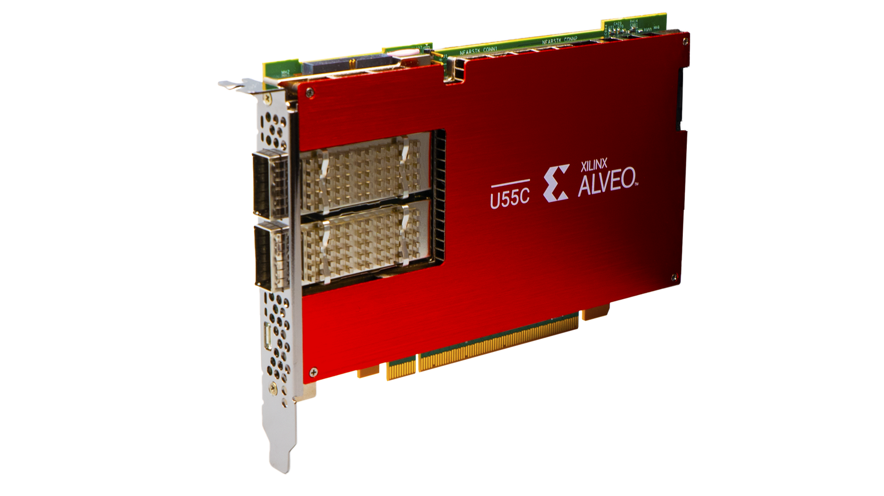
What is Available
AMD/Xilinx Alveo U55C FPGAs:
High-performance programmable accelerators with FPGA technology for enhanced computational efficiency.
Offloading computational workloads in networking (NFV, SDN), security (encryption, intrusion detection), HPC (scientific simulations), and AI (deep learning inference).
Dual 100Gbps Ethernet ports for programmable SmartNIC functionality and efficient packet processing.
Compatibility with AMD/Xilinx OpenNIC shell for custom networking applications.
PCIe Gen3 interface for low-latency data transfer to the host CPU with high bandwidth.
Support for Vitis HLS for hardware accelerator development using C/C++ for rapid prototyping.
Integration with Vitis AI for optimizing AI inference workloads, including model optimization and quantization.
Advanced memory architecture with high-bandwidth memory (HBM) for improved performance on memory-intensive tasks.
9

Slide 10
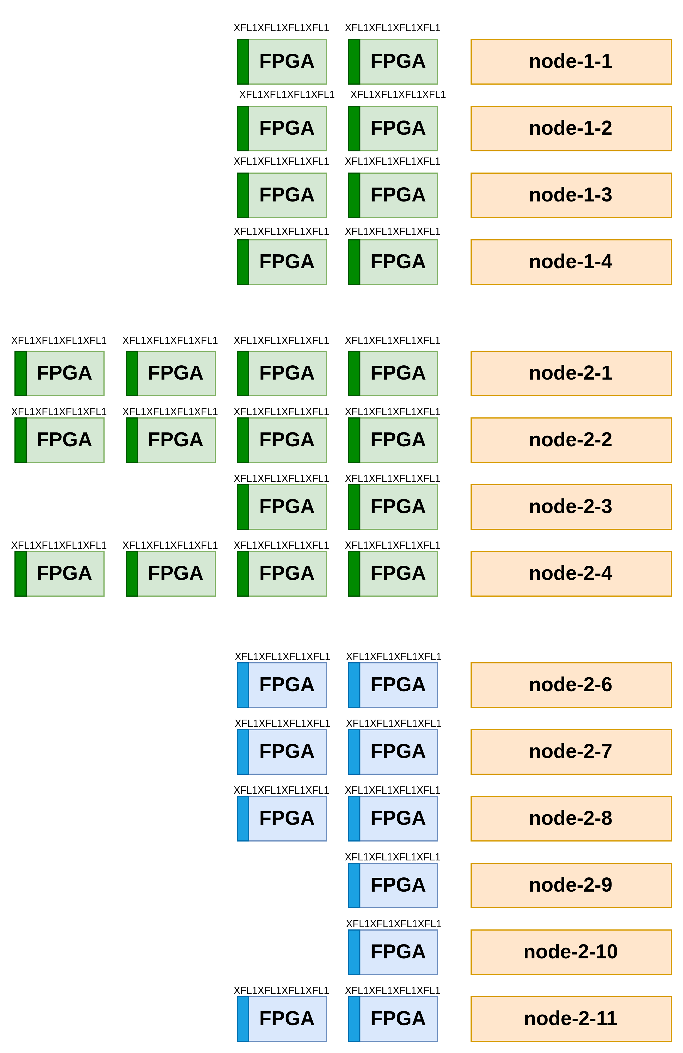
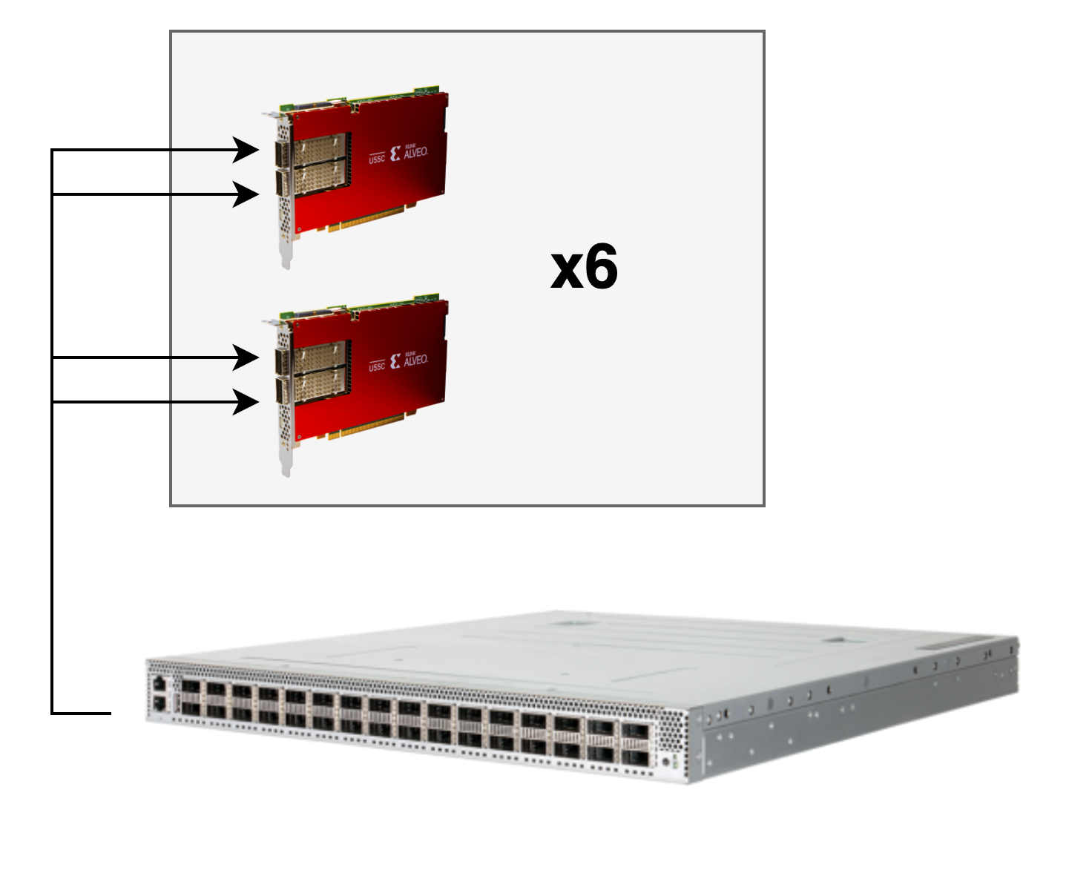
FPGAs on Nautilus
32 FPGAs
10

Slide 11
Network Experiments on Nautilus
11

Slide 12
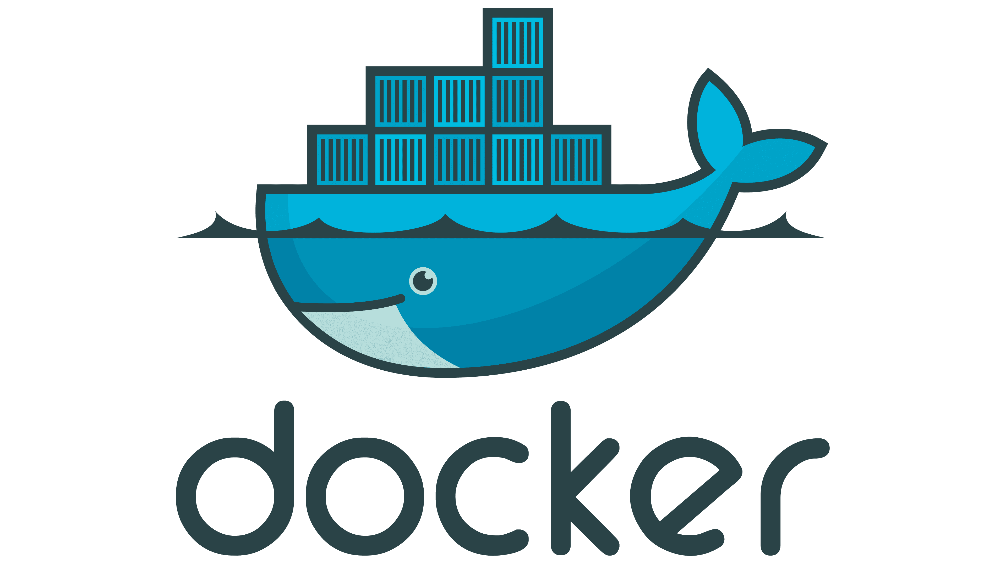
ESnet SENSE (L2 Path)
Network Experiments on Nautilus
SENSE Path Provisioning
- Establish L2 path between Nautilus nodes using ESnet SENSE.
- SENSE dynamically configures VLAN interfaces across multi-domain networks.
- Once configured, SENSE creates and activates VLAN network interfaces on the nodes involved in the experiment.
Multus Network Definition
- Multus CNI enables pods to have multiple network interfaces beyond the default.
- A NetworkAttachmentDefinition (NAD) is created for the VLAN interfaces provisioned by SENSE.
- Specifies the VLAN network (e.g., vlan-10).
- Connects the pods to the configured L2 path.
Experiment Pod Deployment
- Pods are deployed to run the experiments.
- Pods include a default network (typically for control-plane communication).
- The VLAN network is attached using Multus to enable data-plane communication over the SENSE-provisioned L2 path.
- Each pod is attached to the correct VLAN network as specified in the Multus NetworkAttachmentDefinition.
- This creates a dedicated, isolated L2 communication channel for the experiment.
Multus (Network Definition)
Pod Deployment
12

Slide 13
SENSE
13

Slide 14
SENSE Kubernetes Operator
14

Slide 15
SENSE Kubernetes Operator
The SENSE Operator allows users to declare a network path using a custom Kubernetes resource: SensePath.
apiVersion: 6nrp.example.com/v1
kind: SensePath
metadata:
name: my-sense-path
spec:
uri1: "urn:ogf:network:nrp-nautilus.io:2020:node-2-6.sdsc.optiputer.net:enp65s0f1np1"
uri2: "urn:ogf:network:nrp-nautilus.io:2020:node-2-7.sdsc.optiputer.net:enp65s0f1np1"
bandwidth: 1000
vlan_tag: 3115
15

Slide 16
Testbed Integration
16

Slide 17
Testbed Integration
The FABRIC testbed is a research infrastructure designed to support networking and computing experiments.
It provides a platform for designing, deploying, and testing large-scale network experiments and services.
FABRIC offers network and compute resources, including connections and virtualized environments.
17

Slide 18
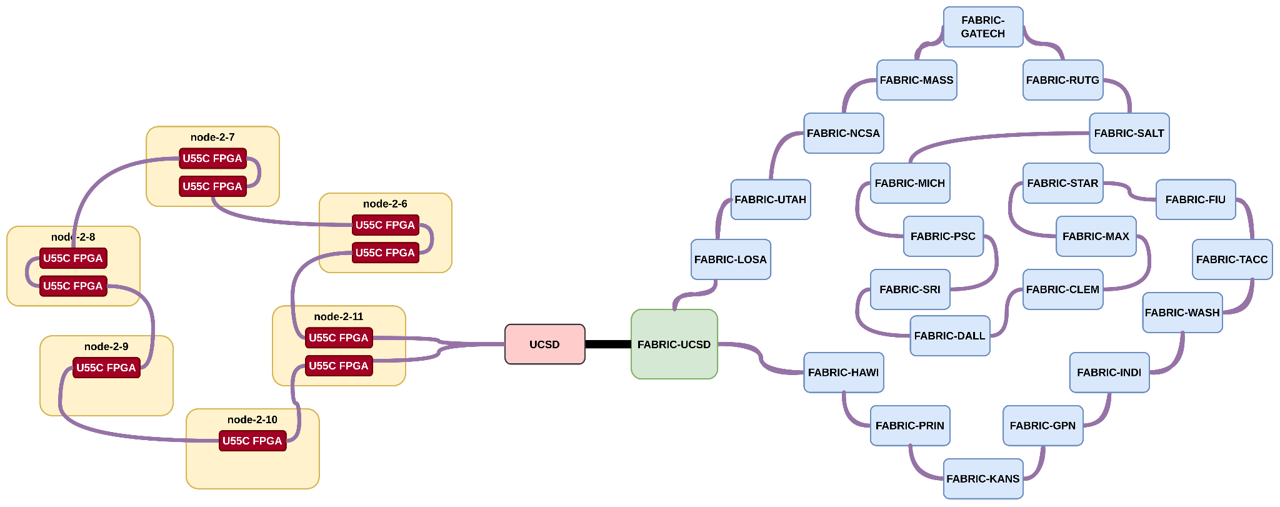
Testbed Integration
18

Slide 19
Hands-On Example
19

Slide 20
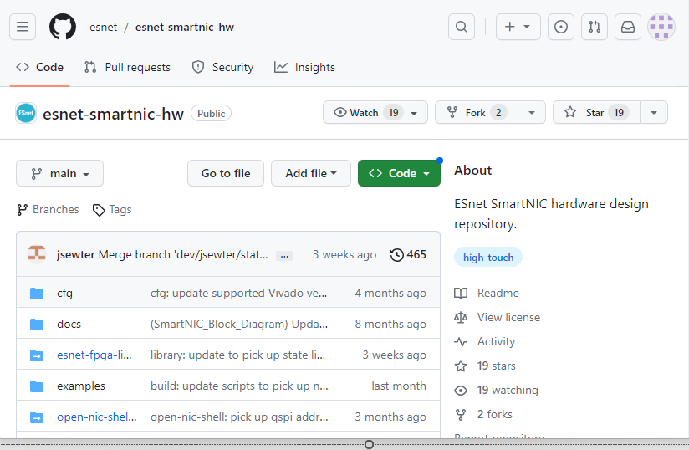
ESnet P4 SmartNIC
- ESnet SmartNIC framework provides an entire workflow for Xilinx Alveo FPGAs.
- It is open-source (on github).
- It seamlessly integrates Xilinx tools along with various tools like DPDK to provide an easy way of programming Alveo FPGAs as SmartNICs.
- Various debugging, testing and simulating tools.
- Containerized environment that makes it as easy as plug-and-play for P4 on FPGAs.
20

Slide 21
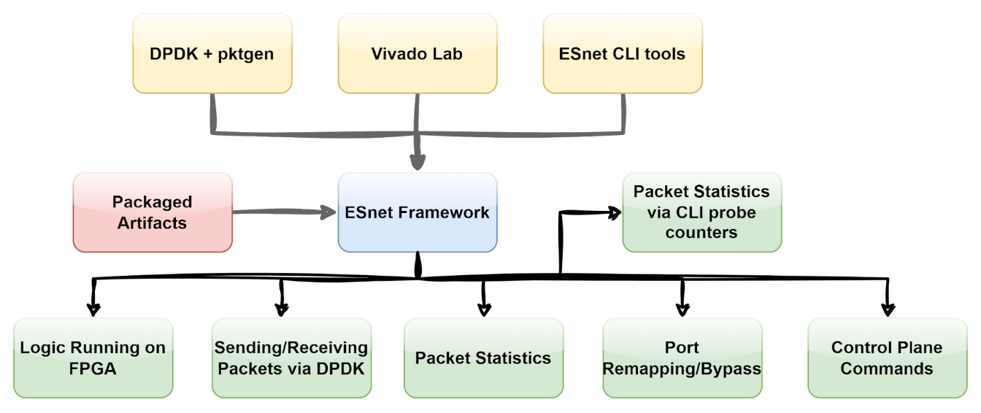
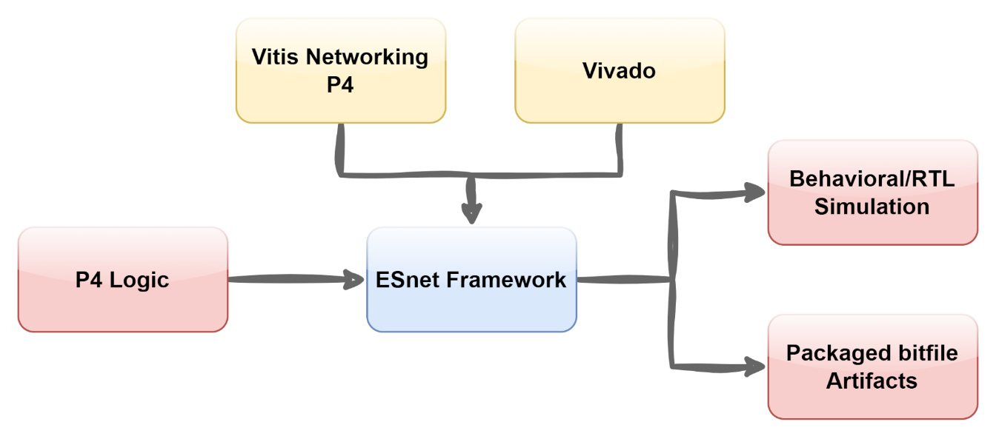
ESnet P4 SmartNIC
https://docs.nrp.ai/userdocs/fpgas/esnet/
https://groundsada.github.io/esnet-smartnic-tutorial/
21

Slide 22
What's Next?
- Intel Stratix 10 MX FPGAs
- P4 Pipeline for Tofino Switches
- SEAM
22

