Slide 1
Writing a successful CC* Grant
Fifth National Research Platform (5NRP) Workshop
Jerry Sheehan
jsheehan@salk.edu
CIO
Salk Institute
Derek Weitzel
dweitzel@unl.edu
Research Assistant Professor
University of Nebraska-Lincoln
Jason Zurawski
zurawski@es.net
Co-PI, EPOC
ESnet / Lawrence Berkeley National Laboratory

Slide 2
OUTLINE for CC* Tutorial
Overview of 2024 CC* from EPOC
Approaches to Identifying Your Science Drivers
Best Practices for Creating Your Technology Plan
Meeting your 20% Sharing Requirement
Broader Impact
NSF Program Officer Q&A with Kevin Thompson

Slide 3
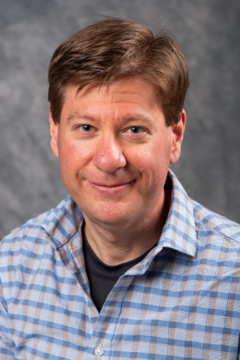
Who are We: Jason Zurawski
ESnet/LBNL for 10+ Years. Science Engagement Engineer
Co-PI of EPOC (joint effort with TACC): http://epoc.global
Have advised ~100 proposals to CC* since inception via both ESnet and EPOC
Notes:
Jason

Slide 4
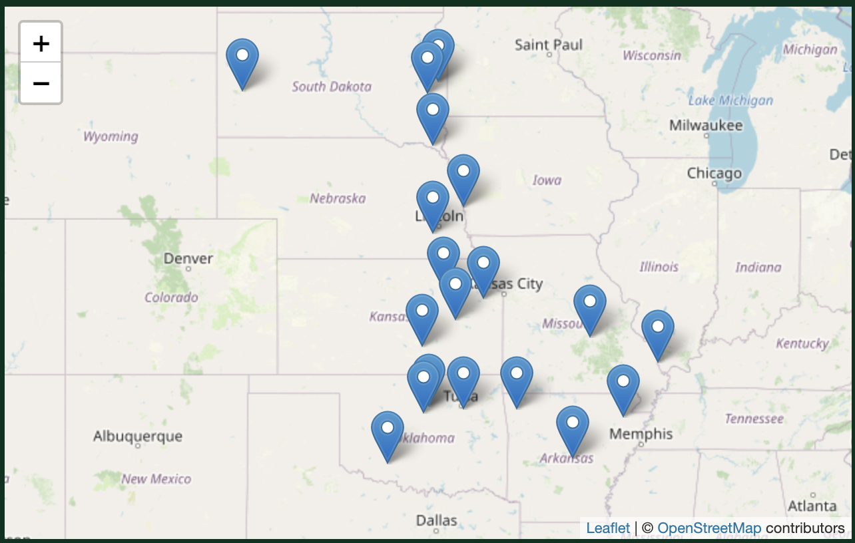
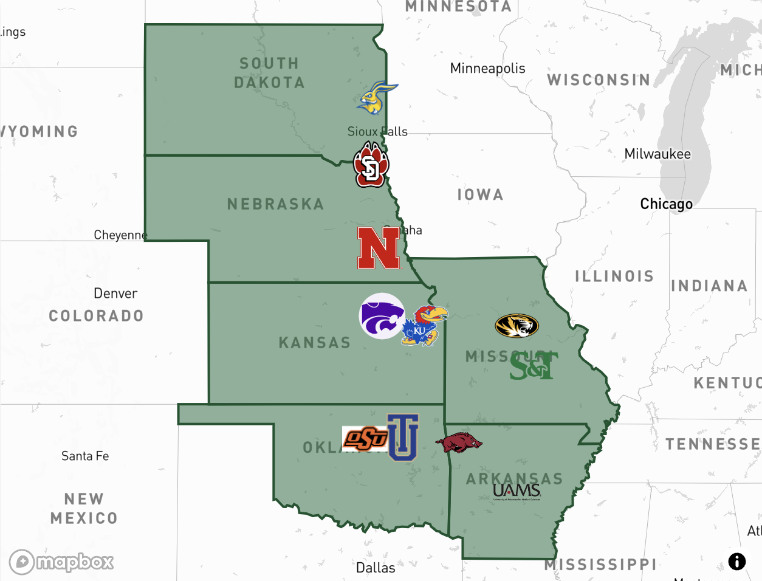
Who are We: Derek Weitzel
Research Assistant Professor at University of Nebraska-Lincoln
Been associated with several CC* programs:
GP-ARGO
GP-ENGINE
NRDStor
https://gp-argo.greatplains.net
https://gp-engine.org
Notes:
Derek

Slide 5
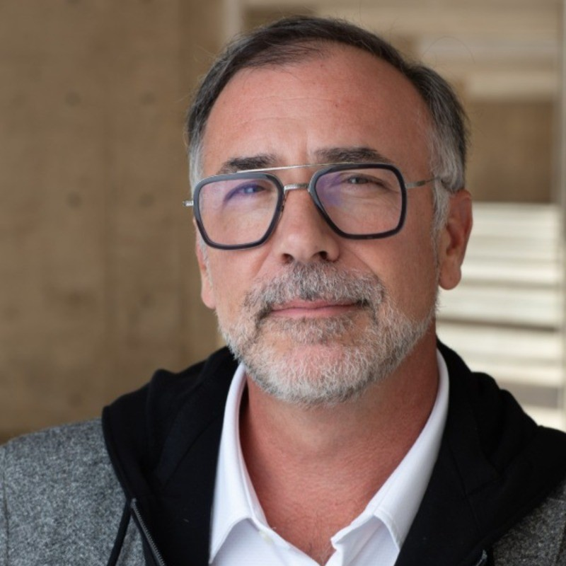
Who are We: Jerry Sheehan
Thirty years of higher education IT experience, primarily in research intensive (R1) universities.
VPIT/CIO for 10 years: Montana State, San Diego State; CIO-Salk Institute currently.
CC* Awardee in 2015 for CC*DNI, 2023 awardee for Regional Computing; prior CC* reviewer for NSF OAC.
Notes:
Jerry

Slide 6
OUTLINE for CC* Tutorial
Overview of 2024 CC* from EPOC
Approaches to Identifying Your Science Drivers
Best Practices for Creating Your Technology Plan
Meeting your 20% Sharing Requirement
Broader Impact
NSF Program Officer Q&A with Kevin Thompson

Slide 7
NOTE!
Any of our comments on this solicitation are just that - our comments from past experience
NSF and the NSF POs are your best resources for solicitation questions, regardless
The following is simply our opinion
Notes:
Jason

Slide 8
EPOC:
Engagement and Performance Operations Center
Joint project between TACC and ESnet
Part of CC* program for domestic science support
  Program Officer: Kevin Thompson
Partnerships with regional, infrastructure, and science communities that span the NSF and DOE continuum of funding
Notes:
Jason

Slide 9
NSF Campus Cyberinfrastructure #24-530
Mostly annual NSF Solicitation that supports networking and other CI elements at a campus
Every version has different updates
READ THE WHOLE SOLICITATION
https://new.nsf.gov/funding/opportunities/campus-cyberinfrastructure-cc/nsf24-530/solicitation
NSF (Amy Apon, Kevin Thompson) for questions
  NOTE - New Lead PO!
Notes:
Jason

Slide 10
Significant Changes for 2024
Two Deadlines: April 24, 2024 and October 15, 2024
5 areas- similar to 7 areas in 2023, but reorganized, revised
  Large and small for each
  Each with their own requirements (MANY requirements)
Anticipated funding level and number of awards changed
Maintained emphasis on EPSCoR, democratization of access, and broadening participation
Notes:
Jason

Slide 11
Significant Changes for 2024 (2)
Additional emphasis on
  Student engagement, education, and training
  Supporting quantitative information describing science driver’s need for project
  Provide training and support
You can use supplemental documents for data architecture diagrams
Clarifications on funding for contractors
Notes:
Jason

Slide 12
Five Areas for 2023
Data-Driven Networking Infrastructure - Campus/Region
Computing & Computing Continuum- Campus/Region
Network Integration & Applied Innovation - Small/Large
Data Storage & Digital Archives -Campus/Region
Strategy - Campus/Region
Notes:
Jason

Slide 13
Clarification For Campus-wide proposals
Must address science drivers for multiple domains
“A proposal focusing on a single science domain or project use will not be considered for funding”
Notes:
Jason

Slide 14
Clarification when Applying as a “Region”
Must address needs spanning multiple under-resourced institutions
  Address research and/or education needs
What is the definition of “small and under resourced”?
  You need to make this argument
Coordination activities are required
  One or more meeting events starting in Year 1
  Participant support costs for these activities are permitted (when justified)
Notes:
Jason

Slide 15
Who can apply
Read through Eligibility Information Carefully
  Not everyone can do all areas
Don’t do a Collaborative proposal - one project with multiple proposal submissions from different organizations
  Must be done as a main with subawards
Prior awardees have some constraints
  If you’ve received an award in last 5 years for same area, can’t re-apply
Ask PO is you’re not sure BEFORE you do the work
Notes:
Jason

Slide 16
New with the Proposal Application Process
Fastlane has been retired
  Use research.gov or grants.gov
New requirements for personnel documents
  Leave time for you biosketch, COI, and C&P docs
  You can do these the first day you decide to think about a proposal!
IMPORTANT
Notes:
Jason

Slide 17
Significant Similarities
Science and education-driven requirements are the primary motivation for any proposed activity
Partnerships across a campus/region (Document!)
Each area has many requirements, be sure to double check
Campus CI Plan needed as supplemental document
Documentation of partnerships required via Letter of Collaboration
Documentation of sustainability plan
Goals and metrics needed
Notes:
Jason

Slide 18
Campus CI Plan Request (mostly the same)
Every proposal except planning (Area 5) must include on
5 pages
No set content or structure
EPOC’s advice and samples here:
  https://fasterdata.es.net/nsf-docs/campusCIplanning/
Notes:
Jason

Slide 19
Letters of Collaboration (mostly the same)
Note: This solicitation lets you submit “real” letters and its very much to your advantage to do so!
Some university SRO’s argue against this, but the PAPPG guideline is “suggested” not “required”
When in doubt, ask the PO
Notes:
Jason

Slide 20
LoC Requirements- NSF PAPPG
https://www.nsf.gov/pubs/policydocs/pappg22_1/pappg_2.jsp#IIC2j
Letters of collaboration should be limited to stating the intent to collaborate and should not contain endorsements or evaluation of the proposed project. The recommended format for letters of collaboration is as follows:
“If the proposal submitted by Dr. [insert the full name]...”
“Recommended” is not equivalent to “Required”
If needed by your SRO, contact PO for clarification
Notes:
Jason

Slide 21
What is allowed in the budget (mostly the same)
This will vary area by Area- none allow explicit cost sharing
For example, Area 1 ( Networking):
  Budgets dominated by non-networking equipment are strongly discouraged: “All Area (1) proposals should allocate at least 50% of the budget to network equipment.”
  If a DTN is included, less than 15% overall budget
  Compute resources should not be included unless integral to DTN platform
Budget SHOULD include all costs for project
  PI and coPI time for project management
  Staff time - deployment , ongoing support
  Language around contractors- ask the PO if you’re in doubt
Notes:
Jason

Slide 22
What is allowed in the budget (2)
If you’re doing a regional proposal, include funds for regional collaboration event(s)
All proposals (small or large) should also include funds to attend annual PI meeting
Several areas require vendor quotes that cover full equipment ask, or Return without Review (RWR)
Explicit call out - “Cannot use funding for software licenses”
Notes:
Jason

Slide 23
Timing
Writing a proposal takes MUCH longer than you think
  Partner discussion
  Writing and reviewing
  Quotes for all equipment
  Creating budgets, biosketch, etc
  Getting letters of collaboration
  Getting everything uploaded into research.gov
Your institution may have internal deadlines for grant submissions earlier than the NSF due date
Notes:
Jason

Slide 24
OUTLINE for CC* Tutorial
Overview of 2024 CC* from EPOC
Approaches to Identifying Your Science Drivers
Best Practices for Creating Your Technology Plan
Meeting your 20% Sharing Requirement
Broader Impact
NSF Program Officer Q&A with Kevin Thompson

Slide 25
Science Drivers: Campus and Regional Strategies-Jerry
Campus-Based Science Driver Identification
  Engage the ”squeaky wheel” faculty requesting additional resources or support.
  Discussions with VPRs, Review of Institutional Press Releases, Review of NSF Awards database.
  Use any existing cyberinfrastructure usage to help identify potential partners (special networking needs, Globus users, HPC users).
  Review course offerings to see if there are data-intensive or HPC needs.
  Review with Grants and Contracts any awards that have substantial IT or HPC budget needs.
Regional-Based Science Driver Identification
  These conversations are more challenging because the heart of a good science driver is existing or the opportunity to build a “trust relationship” with a researcher.
  Work with any appropriate existing regional organizations; these can range from regional optical networks to campus or system-level structures.
  EPOC NetSage has data for many of the US regional networks: https://epoc.netsage.io
    Helpful to understand science flows in/out of a location
Notes:
Jerry

Slide 26
Approaches to Identifying Science Drivers
Science driver table!
The table is your chance to give a summary to the reviewer
Give as many details as you can fit in the table. Ex: What application is the research group using? How many cores / gpus / storage does it require per run, per workflow?
A vague table is can be a cause for concern for a reviewer
Notes:
Jerry

Slide 27
Science Drivers
Science (and educational) drivers must motivate the infrastructure requests
Common Missteps
  Science drivers say they need specific tech (e.g. storage, data movement hardware), but proposal asks for something different (e.g. networking upgrades)
  Science drivers too general (“High energy physics” vs “Dr. Chris Smith’s virus modeling project”)
Notes:
Jerry

Slide 28
OUTLINE for CC* Tutorial
Overview of 2024 CC* from EPOC
Approaches to Identifying Your Science Drivers
Best Practices for Creating Your Technology Plan
Meeting your 20% Sharing Requirement
Broader Impact
NSF Program Officer Q&A with Kevin Thompson

Slide 29
Best Practices for A Technology Plan
Driven by the science drivers!
Talk about how you are going to be monitoring the usage, how you are going to do accounting (especially how you are going to measure the 20% contribution).
Notes:
Jason

Slide 30
Technology Plan: Vendor Partnerships
Many smaller and medium-sized institutions may need or want additional technical assistance in developing the “technology” for their CC* award.
Various vendors, from networking companies to computing companies, may be willing to offer technical assistance in developing a plan.
  Vendors often have great insight into best practices, current pricing, and roadmaps for upcoming features.
While working with vendors does have advantages, there are two items to be careful about in these engagements.
  You must understand the technical details of the plan and feel comfortable evaluating and implementing (even with vendor assistance) the proposed details. It isn’t possible to “outsource” your technical plan without risking review and implementation challenges.
  It is always best to double-check any pricing you receive with other trusted sources to ensure you are receiving the best available cost builds.
Notes:
Jerry

Slide 31
Data Architecture Review
Most Areas require specification of infrastructure and diagrams - some will be RWR if you don’t include this
This should include more than just the network
  These can be Supplementary Documents!!
Biggest Missteps
  Sometimes a vendor will recommend what they’d like to sell, not what meets your needs - Connect “how this will be used” to “what will be used”
  Important to have end-to-end path “match” to ensure good performance along full path
Security and Intrusion Detection Systems
  Recommendation: Contact Trusted CI
  Jim Basney, https://www.trustedci.org/
Notes:
Jason

Slide 32
Data Architecture Review (2)
Think about how it will be used in real life, not just the theoretical
Make sure your request matches your science drivers
For example: DTN Sizing
  What are typical needs for science use cases? Other end of the data transfer? What can your campus backbone support?
  One resource: https://fasterdata.es.net/performance-testing/performance-expectations-for-a-100g-host/
…“evaluated on the tangible metrics addressing measures of success of the system or set of activities”
Baseline Testing has known good end points to test against
  We encourage .edu sites to aim for a TeraByte in an Hour for performance
Notes:
Jason

Slide 33
Measurement and Monitoring Plan
Requirement of perfSONAR-based measurement for several portions of CC* solicitation
  Read the solicitation carefully!
Simply setting up a node which isn’t used is NOT sufficient
Ask the community on where to test, and what kind of pS node to use
  perfSONAR Consortium: https://www.perfsonar.net/
NRP can help with this! We run perfSONAR all over!
Notes:
Jason

Slide 34
Campus CI Plan
Required for all areas except planning grants
  5 page supplemental document
Campus-wide CI Plan, not just the proposed work
  May need someone senior to you to weigh in on this
Show how the request fits within this space
Samples available at https://fasterdata.es.net/campusCIplanning/
Notes:
Jason

Slide 35
OUTLINE for CC* Tutorial
Overview of 2024 CC* from EPOC
Approaches to Identifying Your Science Drivers
Best Practices for Creating Your Technology Plan
Meeting your 20% Sharing Requirement
Broader Impact
NSF Program Officer Q&A with Kevin Thompson

Slide 36
Meeting your 20% Sharing Requirement
Share your resources: “shared resource external to the state/region and the institution(s) being primarily served”
How are you going to measure it?
Notes:
Derek

Slide 37
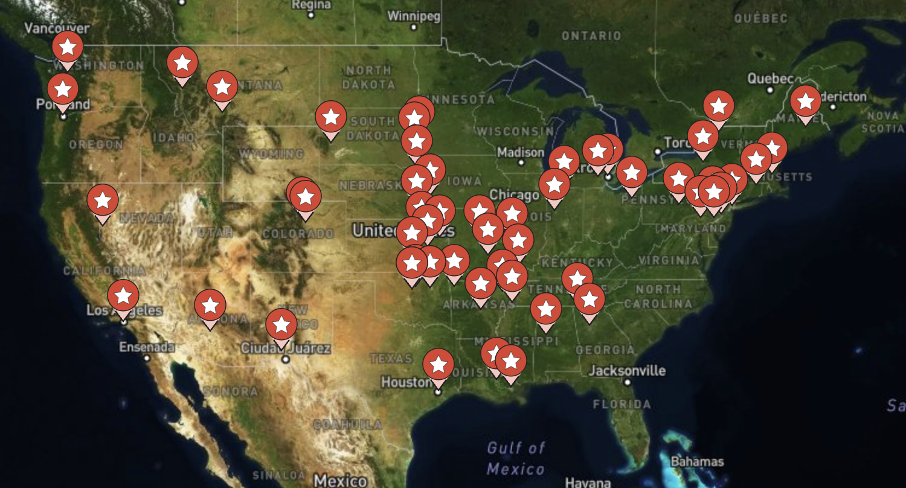
Sharing: OSG - Compute
Setup a meeting with the OSG to discuss your proposal:
https://osg-htc.org/campus-cyberinfrastructure
For compute, it will normally require an SSH login to the cluster to submit OSG Jobs (pilots)
CC* Sites on the OSG
Notes:
Derek

Slide 38
Sharing: OSG - Storage
Setup a meeting with the OSG to discuss your proposal:
https://osg-htc.org/campus-cyberinfrastructure
For storage, it will require an Open Science Data Federation “origin” (sorta like a gateway node) node that will serve as the gateway to your storage. The gateway node could be an NRP node!
CC* Sites on the OSG
Notes:
Derek

Slide 39
Sharing: National Research Platform
For Compute:
  The compute nodes can join the NRP at the OS level.
  Job submissions would be through the NRP
  Leverage all of NRP’s existing services such as storage, monitoring…
For Storage:
  Integrate with the OSDF, and therefore would be roughly the same as integration with the OSG
Notes:
Derek

Slide 40
OUTLINE for CC* Tutorial
Overview of 2024 CC* from EPOC
Approaches to Identifying Your Science Drivers
Best Practices for Creating Your Technology Plan
Meeting your 20% Sharing Requirement
Broader Impact
NSF Program Officer Q&A with Kevin Thompson

Slide 41
Broader Impact in Your Proposal
NSF’s broader impact is one of the two vital evaluation criteria (intellectual merit and broader impact) for merit review.
NSF has provided good recent guidance in their Perspectives on Broader Impacts in 2022, including examples from funded PIs.
  https://nsf-gov-resources.nsf.gov/2022-09/Broader_Impacts_0.pdf
Advancing Research Impact in Society also has a toolkit for helping develop Broader impact statements.
  ARIS Broader Impact Toolkit contains Guiding principles, a Planning checklist, a BI wizard, Project Rubic, and a tutorial.
  See https://aris.marine.rutgers.edu/index.php
Notes:
Jerry

Slide 42
Broader Impact: Instructional and Classroom Usage
The new CC* solicitation explicitly allows instructional and classroom impact to be part of your broader impact story.
Classroom and instructional usage is amenable to direct quantitative measurement for annual reporting purposes.
  How many students, courses, disciplinary lenses, hours or usage, and integration into the curriculum? These metrics also allow you to leverage existing student information system data for more complex data-driven analysis.
  Make sure to balance the production is “test” reality of research infrastructure with classroom expectations and support needs to avoid friction.
Notes:
Jerry

Slide 43
OUTLINE for CC* Tutorial
Overview of 2024 CC* from EPOC
Approaches to Identifying Your Science Drivers
Best Practices for Creating Your Technology Plan
Meeting your 20% Sharing Requirement
Broader Impact
NSF Program Officer Q&A with Kevin Thompson

Slide 44
NSF Q&A
Notes:
Kevin

Slide 45
Writing a successful CC* Grant
Fifth National Research Platform (5NRP) Workshop
Jerry Sheehan
jsheehan@salk.edu
CIO
Salk Institute
Derek Weitzel
dweitzel@unl.edu
Research Assistant Professor
University of Nebraska-Lincoln
Jason Zurawski
zurawski@es.net
Co-PI, EPOC
ESnet / Lawrence Berkeley National Laboratory

