Slide 1
“The Rise of NRP AI/ML Computing Across Diverse Disciplines”
Invited Presentation
Fifth National Research Platform Conference (5NRP)
UC San Diego
March 21, 2024
Dr. Larry Smarr
Founding Director Emeritus, California Institute for Telecommunications and Information Technology;
Distinguished Professor Emeritus, Dept. of Computer Science and Engineering
Jacobs School of Engineering, UCSD
http://lsmarr.calit2.net

Slide 2
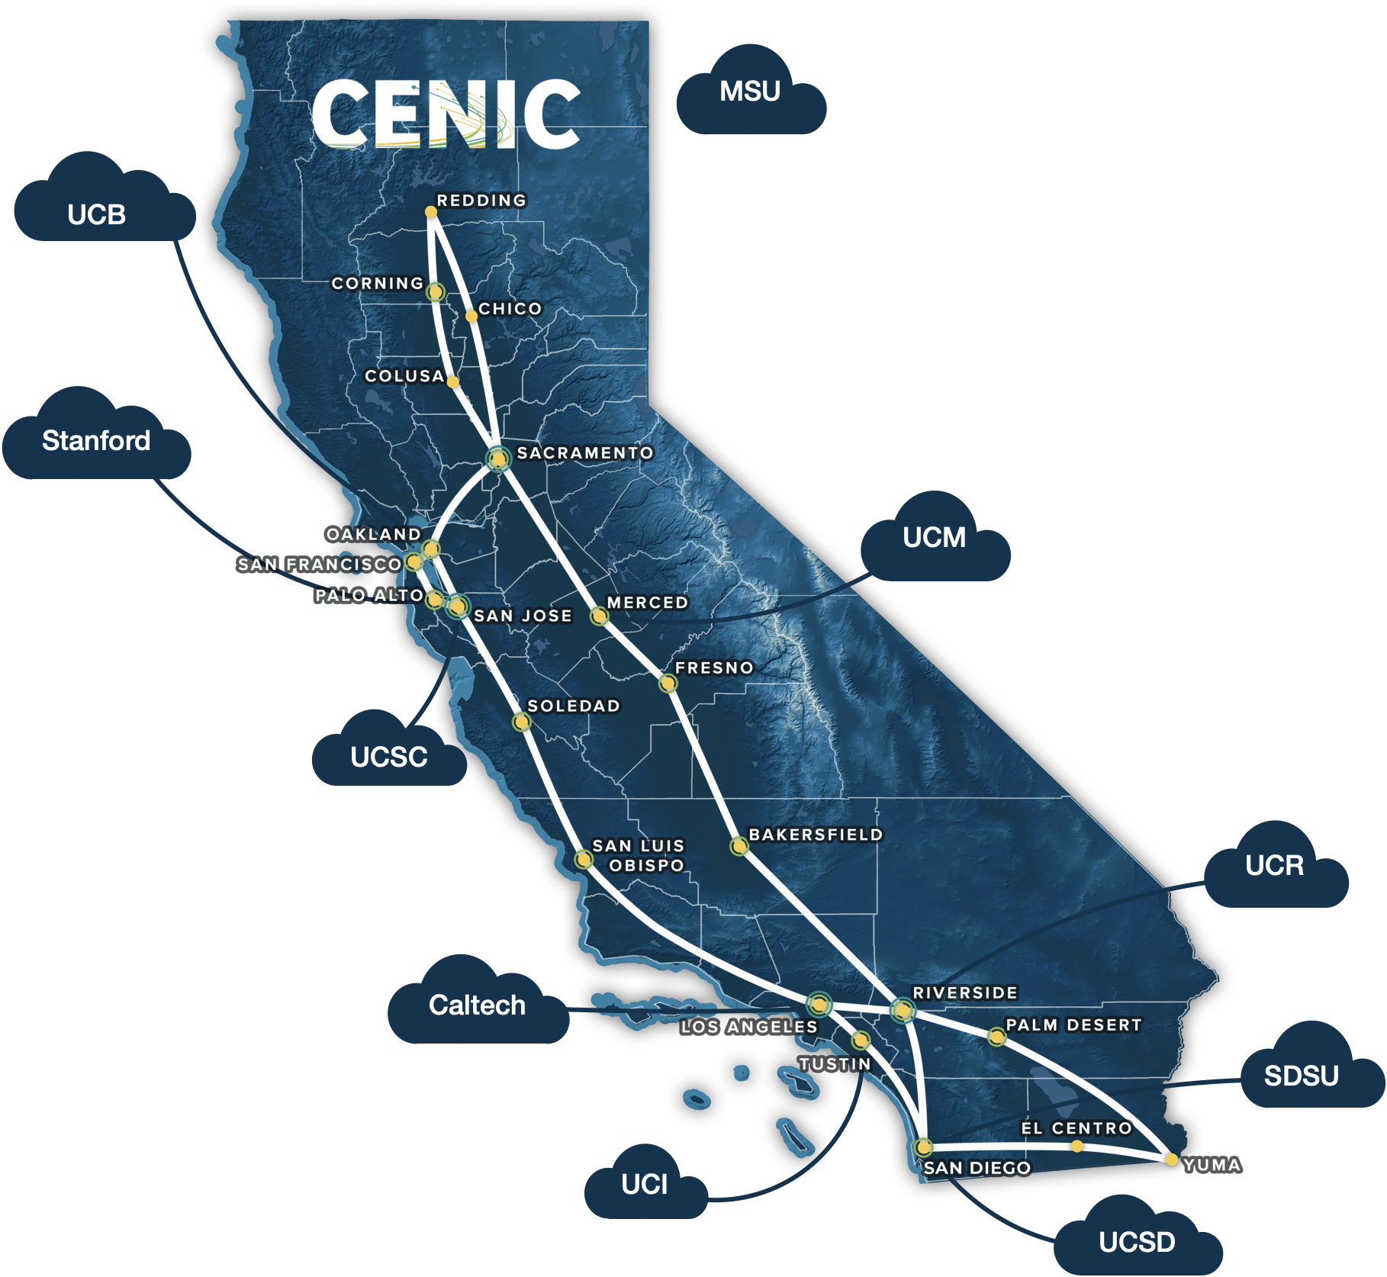
2017-2020: NSF CHASE-CI Grant Adds a Machine Learning Layer Built on Top of the Pacific Research Platform
CI-New: Cognitive Hardware and Software Ecosystem Community Infrastructure (CHASE-CI)
For the Period September 1, 2017 – August 21, 2020
SUBMITTED – January 18, 2017
PI: Larry Smarr, Professor of Computer Science and Engineering, Director Calit2, UCSD
Co-PI: Tajana Rosing, Professor of Computer Science and Engineering, UCSD
Co-PI: Ken Kreutz-Delgado, Professor of Electrical and Computer Engineering, UCSD
Co-PI: Ilkay Altintas, Chief Data Science Officer, San Diego Supercomputer Center, UCSD
Co-PI: Tom DeFanti, Research Scientist, Calit2, UCSD
NSF Grant for High Speed “Cloud” of 256 GPUs
For 30 ML Faculty & Their Students at 10 Campuses for Training AI Algorithms on Big Data
NSF Grant for High Speed “Cloud” of 256 GPUs
For 30 ML Faculty & Their Students at 10 Campuses for Training AI Algorithms on Big Data

Slide 3
2023: The New Pacific Research Platform Video Shown at 4NRP Highlighted 3 Applications, But Had No Mention of AI/ML
Pacific Research Platform Video:
https://nationalresearchplatform.org/media/pacific-research-platform-video/

Slide 4
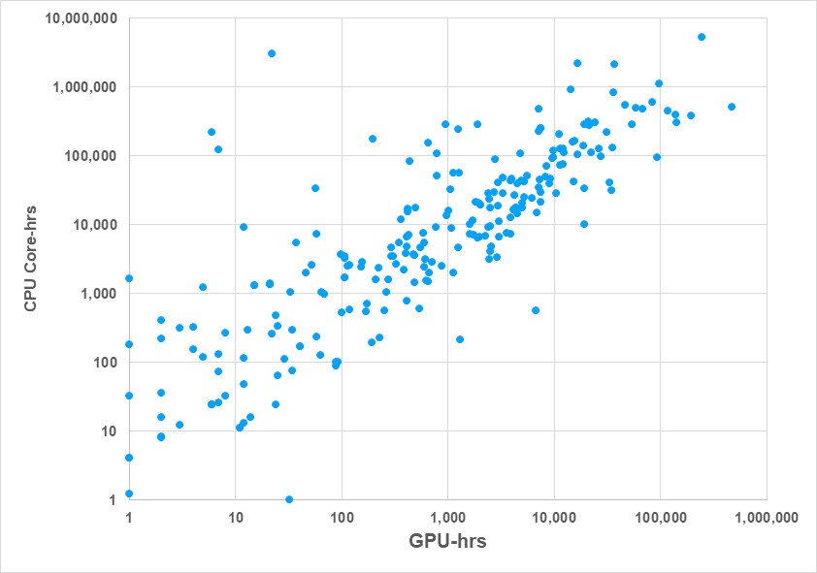
2024: By 5NRP Almost All NRP Namespaces Use AI/ML
Hao Su
OSG
Ravi
Dinesh
Xiaolong
3 Massive Physics/Chemistry Community Projects
OFF
Ben
Aman
Mai
Frank
IceCube
Rose
John
Bingbing
Phil
5NRP
Speakers:
Weds/Thurs
My Talk
250 Active
NRP Namespaces
GPU/CPU Usage
Last Six Months

Slide 5
The Rise of Machine Learning ML Applications on the NRP

Slide 6
NRP’s Nautilus Cyberinfrastructure Supports a Wide Array of AI/ML Algorithms
Nautilus was Designed to Support Research in 6 Broadly Defined Families of Information Extraction and Pattern Recognition Algorithms that are Commonly Used in AI/ML Research:
Deep Neural Network (DNN) and Recurrent Neural Network (RNN) algorithms including layered networks:
Convolutional layers (CNNs),
Generative adversarial networks (GANs), &
Transformer Neural Networks (e.g., LLMs).
Reinforcement Learning (RL) and inverse-RL algorithms & related Markov decision process (MDP) algorithms.
Variational Autoencoder (VAE) and Markov Chain Monte Carlo (MCMC) stochastic sampling
Support Vector Machine (SVM) algorithms and various ensemble ML algorithms
Sparse Signal Processing (SSP) algorithms, including Sparse Bayesian Learning (SBL)
Latent Variable (LVA) Algorithms for source separation algorithms.
Source: CHASE-CI Proposal

Slide 7
Today’s Over 1000 Nautilus Namespaces Have Utilized Many of These Algorithms
The Great Majority of Nautilus AI/ML Namespaces are Using Some Form of NNs or RL
For NNs PyTorch, TensorFlow, and Keras are the preferred (in that order) open-source deep learning (DL) frameworks used on Nautilus.
Our AI/ML researchers use different subtypes of DNNs, including:
Deep Belief Networks (DBN),
Quantum NNs (QNN),
Graph NNs (GNNs) and
Long Short-Term Memory (LSTM) RNNs-specifically designed to handle sequential data, such as time series, speech, and text.
Nautilus namespaces use RL and inverse-RL algorithms in many areas of dynamic decision-making, robotics, and human/robotic transfer learning.
Nautilus Namespaces with Descriptions:
https://portal.nrp-nautilus.io/namespaces-g

Slide 8
NRP’s Largest GPU-Consuming AI/ML Researchers Point to the Rapid Growth of Transformer NNs
Transformer NNs Have Become the Default Architecture for Applications Involving Images, Sound, or ext
A growing number of NRP namespaces are using Transformer-based Large Language Models (LLMs), such as GPT, LLaMa, and BERT in Natural Language Processing (NLP), or Vision Language Models, such as CLIP and ViT, for image understanding research.
Also popular are Generative models, such as GANs and Diffusion models, which are prevalent in data synthesis, such as for text to image generation, like Stable Diffusion.
Finally, we see many namespaces working in fields such as Learning for Dynamics and Control (L4DC), Computer Vision (CV), and Trustworthy ML.

Slide 9
Namespace OpenForceField Surpasses Namespace osg-icecube GPU Usage Over Last 6 Months
Peaking at 290 GPUs
196,000 GPU-hrs
NRP
GPUs
Peaking at 300 GPUs
473,000 GPU-hrs
NRP
GPUs
#1 NRP GPU
Namespaces osg-icecube, openforcefield

Slide 10
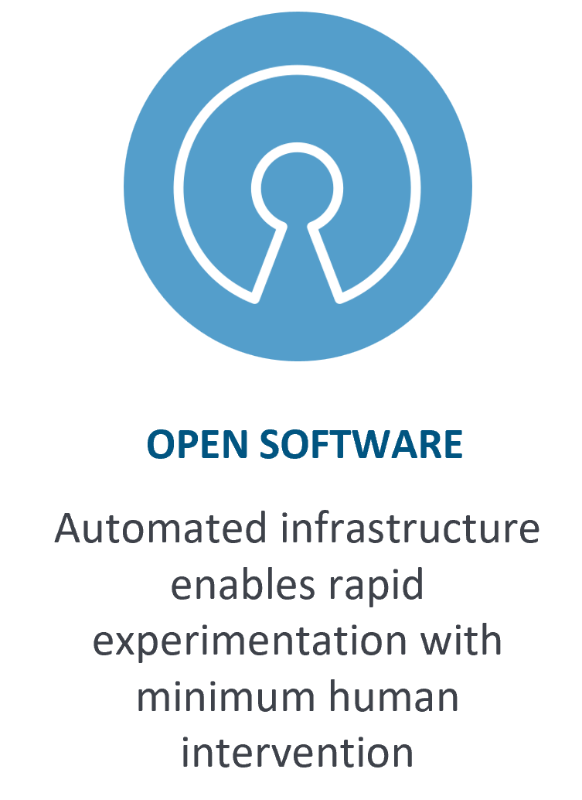
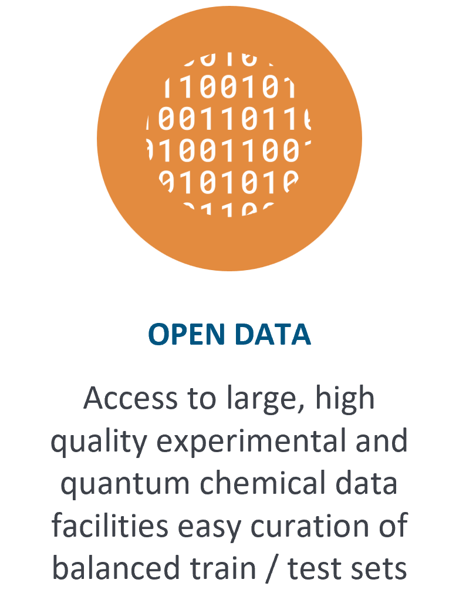
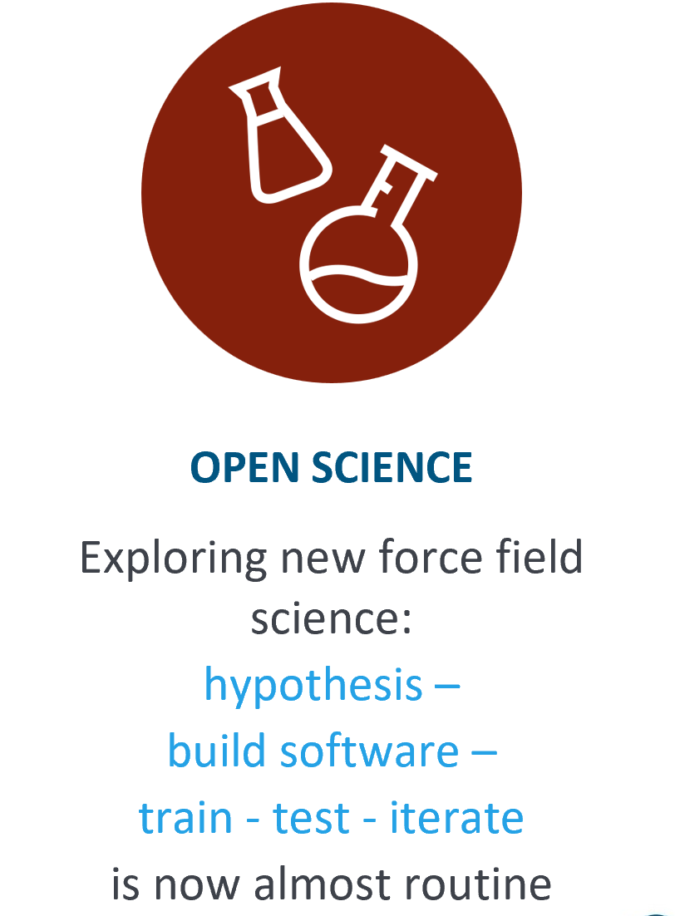
OpenForceField Uses OPEN Software, OPEN Data, OPEN Science and PRP to Generate Quantum Chemistry Datasets for Druglike Molecules
OFF Open-Source Models are Used in Drug Discovery, Including in the COVID-19 Computing on Folding@Home.
www.openforcefield.org

Slide 11
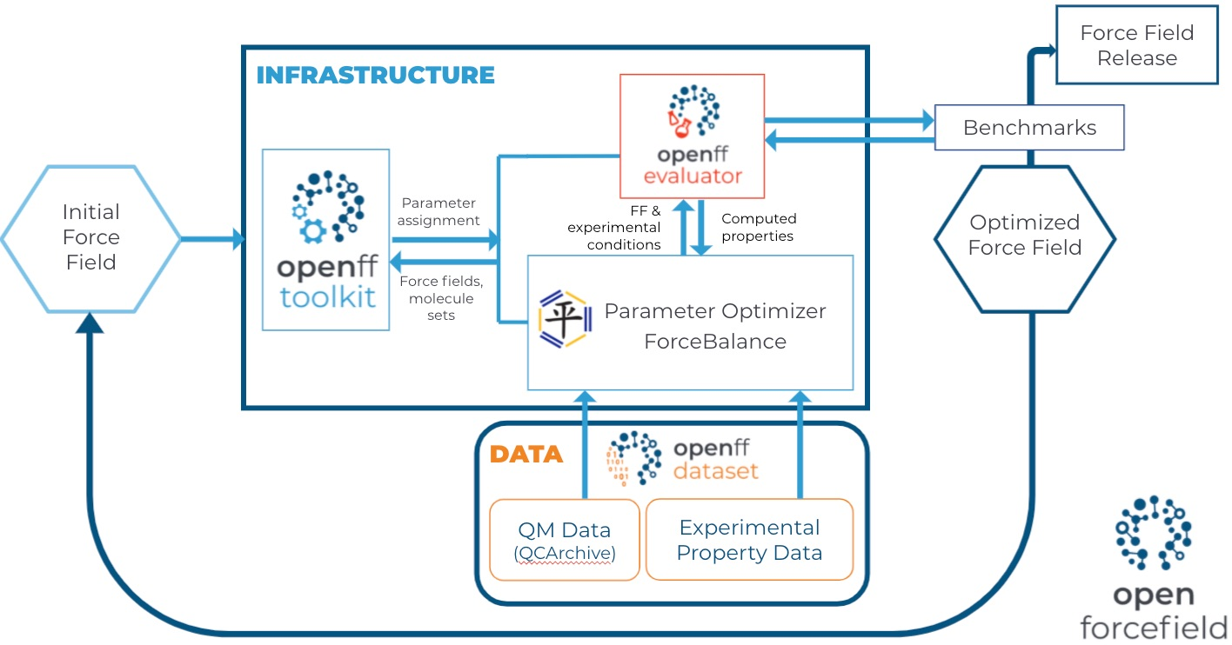
OFF Runs Quantum Mechanical Computations on Many Molecules to Determine Their Optimized Force Fields
Notes:
PRP is used heavily in this force field creation workflow during the QC data generation stage.

Slide 12
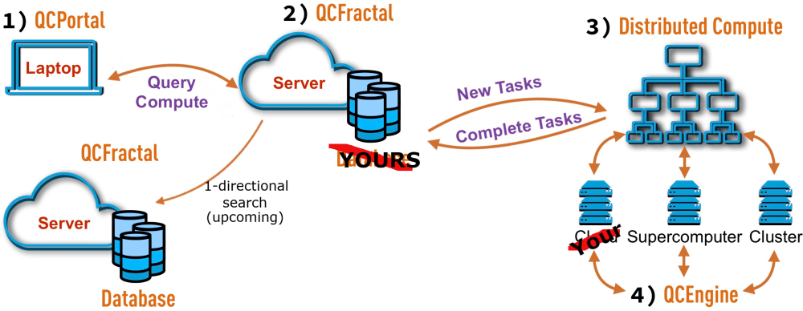
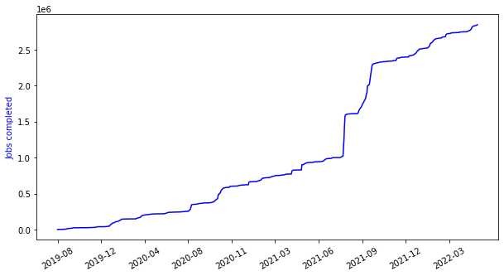
PRP is Capable of Running Millions of Quantum Chemistry Workloads
www.openforcefield.org
We run "workers" that pull down QC jobs for computation from a central project queue. These jobs require between minutes and hours, and results are uploaded to the central, public QCArchive server. Workers are deployed from Docker images and scheduled on PRP's Kubernetes system. Due to the short job duration, these deployments can still be effective if interrupted every few hours.
OpenFF begins using Nautilus
50% of OFF compute is run on Nautilus.
OpenFF-1.0.0 released
OpenFF-2.0.0 released
Notes:
This is all a pretty tall task, but fortunately it’s mostly a solved problem. We use QCArchive, which is a project out of the molecular software sciences institute at virginia tech. It’s basically a public archive of QM calculations but also includes a lot of infrastructure for generating new data, including talking to different QM engines via a unified interface (QCEngine). Two of the key contributors to the projects (Daniel Smith and Lori Burns) gave a SciPy talk about this project a few years ago. The scale of the project has grown and the backend has been partially rewritten since then, but the talk holds up today. QCArchive handles most of the hard stuff - storing results in a database, running QM calculations with Psi4 - and we built a tool that makes our communication with it a little easier, since there’s some pre-processing we need to do before sending stuff off to QM. This tool is called QCSubmit and pretty elegantly handles the tasks of “I have a bunch of molecules, please run QM calculations on these” and, later, “please go fetch for me QM calculations on these molecules”
Some of our calculations are run by grad students and postdocs running “QC managers” as cluster jobs at their respective universities. But something like half of our total compute is run on Nautilus. It’s a uniquely suitable compute backend to pair with the NSF-funded MolSSI QCArchive project, which was designed to take advantage of preemptible compute. Our datasets consist of hundreds to millions of jobs, each requiring tens to thousands of CPU-hours and 8-32 GB of RAM.

Slide 13
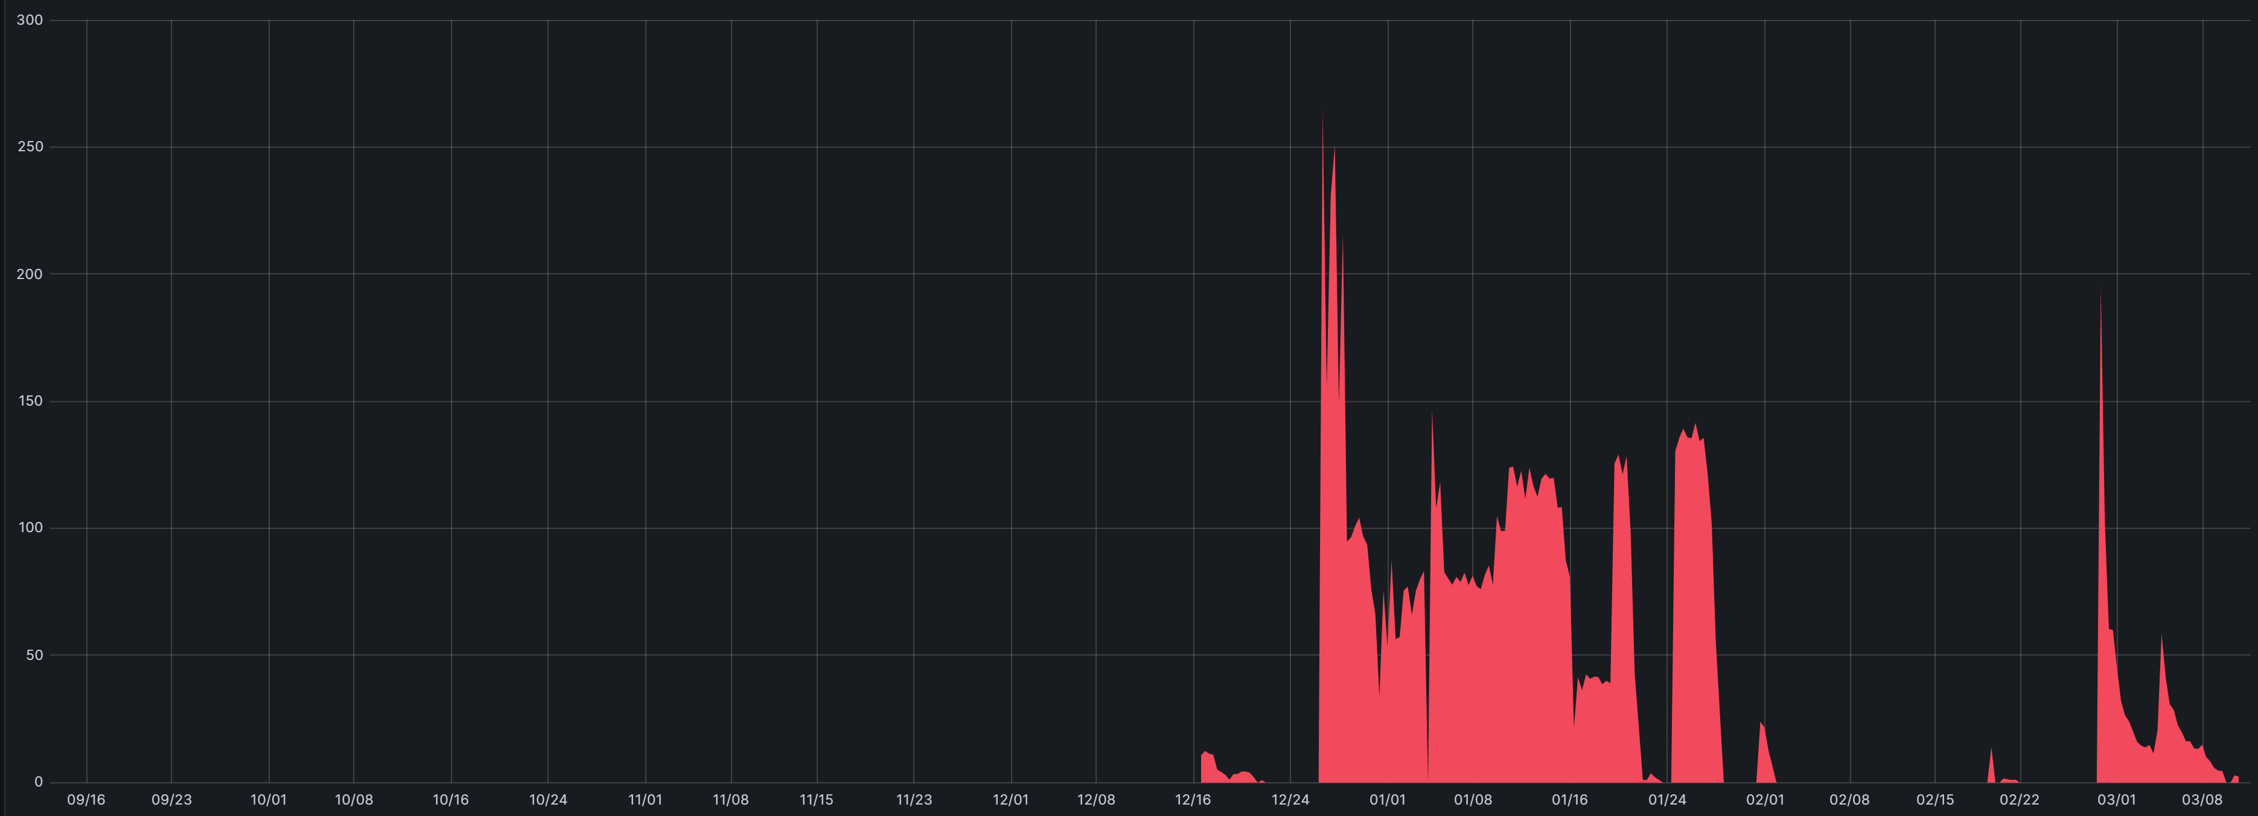
John Chodera, Memorial Sloan-Kettering Cancer Center GPU/CPU Usage Per Day, Last 6 Months
NRP
GPUs
Peaking at 242 GPUs
94,000 GPU-hrs
NRP
CPUs
Peaking at 265 CPUs
94,000 CPU-hrs
Namespace choderalab

Slide 14
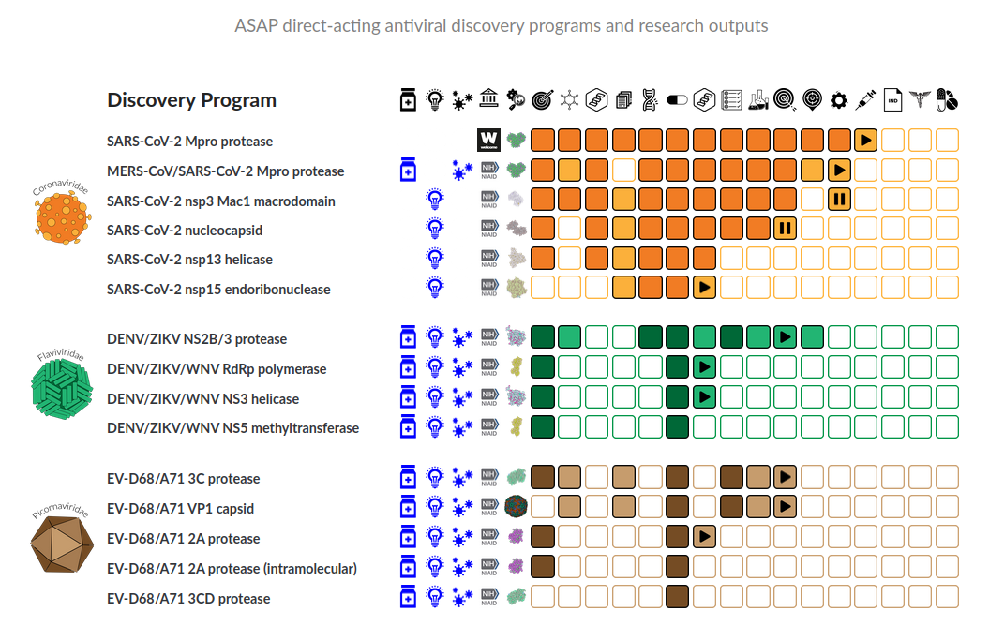
The AI-driven Structure-Enabled Antiviral Platform (ASAP) is a $68M NIH-Funded Open Science Drug Discovery Effort
ASAP uses AI/ML and computational chemistry to accelerate structure-based, open science antiviral drug discovery and deliver oral antivirals for pandemics with the goal of global, equitable, and affordable access.
https://asapdiscovery.org/

Slide 15
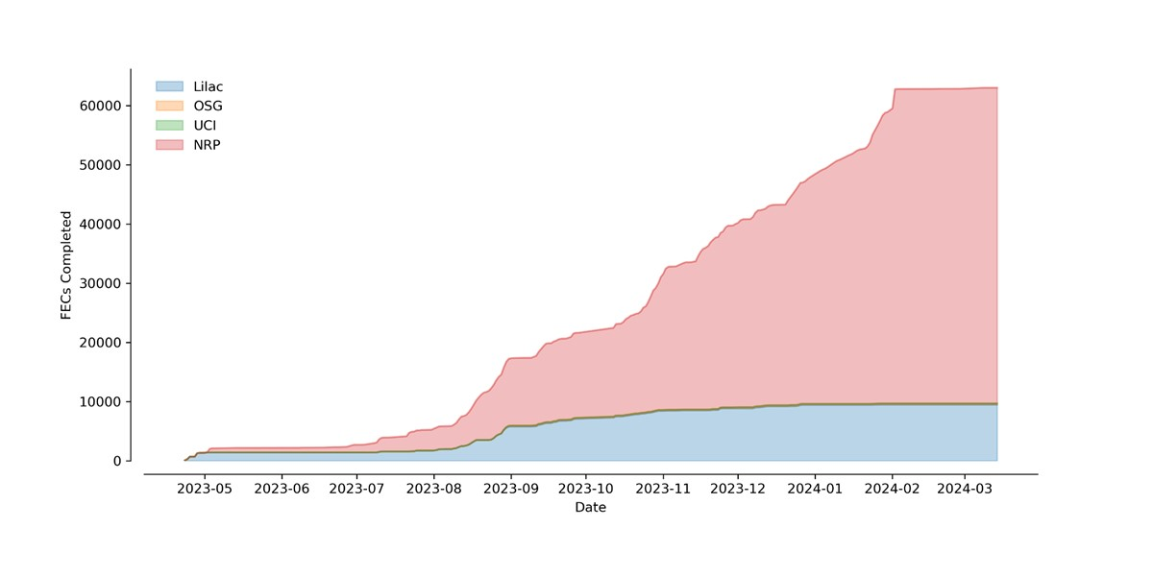
OpenFF Uses Alchemiscale On NRP To Assess Progress In Improving The Accuracy Of Biomolecular Forcefields Against Current Best-Practice Methods
NRP has completed
over 53k free energy calculations for the openforcefield namespace, 5x more than all other compute resources
http://openforcefield.org
https://docs.alchemiscale.org/

Slide 16
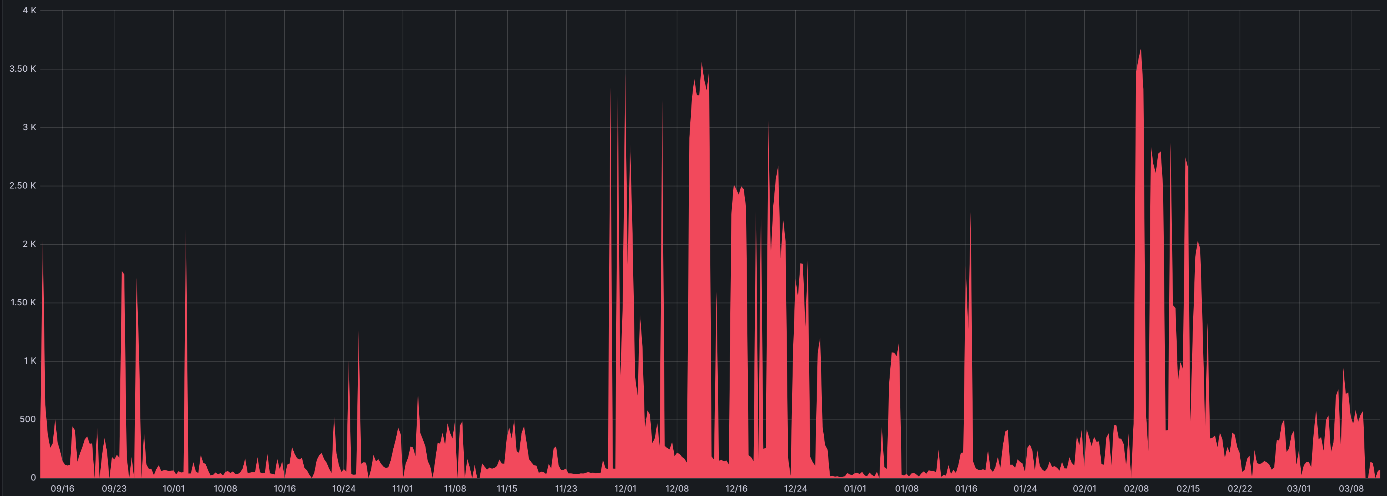
Hao Su, UC San Diego GPU/CPU Usage Per Day, Last 6 Months
Peaking at 219 GPUs
245,000 GPU-hrs
NRP
GPUs
#2 NRP GPU
Peaking at 3,680 CPUs
5,288,000 CPU-hrs
NRP
CPUs
Namespace ucsd-haosulab

Slide 17
A Major Project in UCSD’s Hao Su Lab is Large-Scale Robot Learning
We Build A Digital Twin of The Real World in Virtual Reality (VR) For Object Manipulation
Agents Evolve In VR
Specialists (Neural Nets) Learn Specific Skills by Trial and Error
Generalists (Neural Nets) Distill Knowledge to Solve Arbitrary Tasks
NRP
On Nautilus:
Hundreds of specialists have been trained
Each specialist is trained in millions of environment variants
~10,000 GPU hours per run
Source: Prof. Hao Su, UCSD

Slide 18
Frank Wuerthwein & Javier Duarte, UC San Diego GPU/CPU Usage Per Day, Last 6 Months
NRP
GPUs
Peaking at 54GPUs
53,000 GPU-hrs
NRP
CPUs
Peaking at 260 CPUs
280,000 CPU Core-hrs
Namespace cms-ml

Slide 19
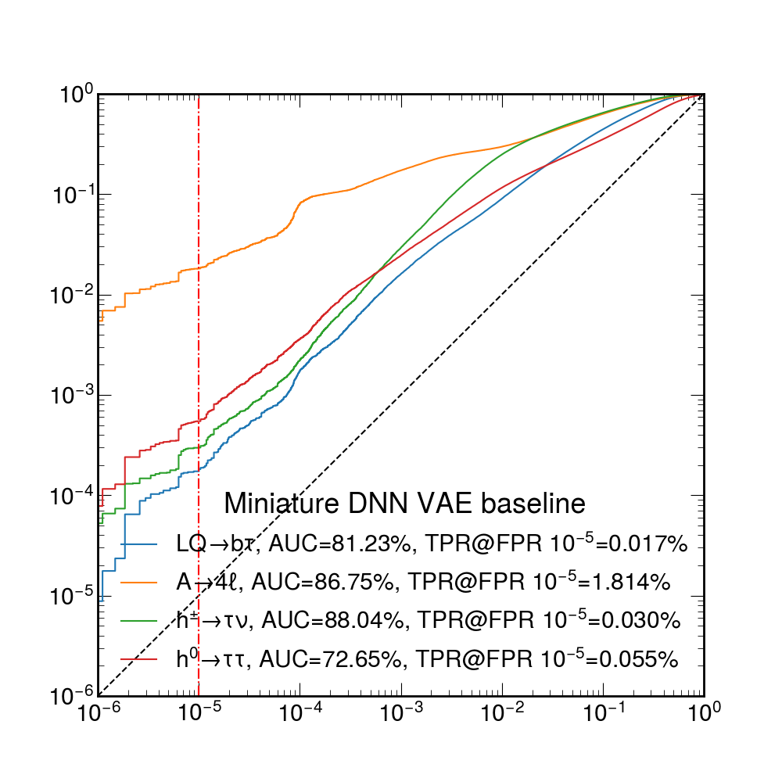
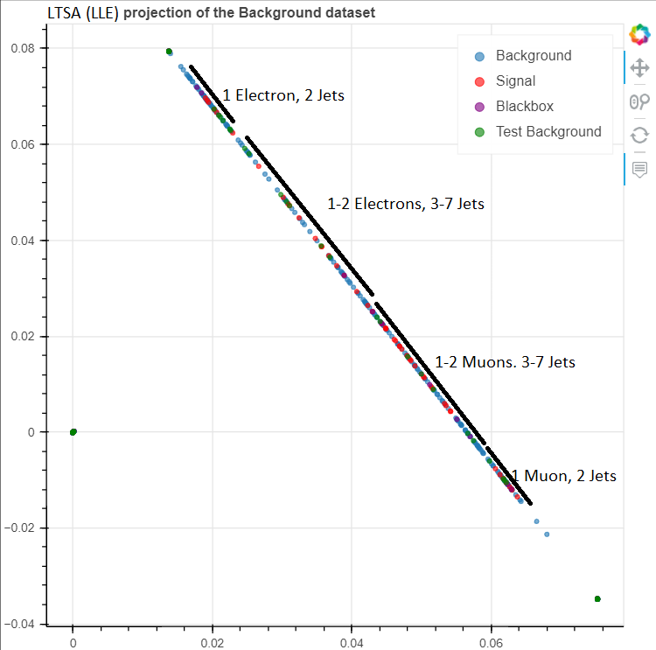
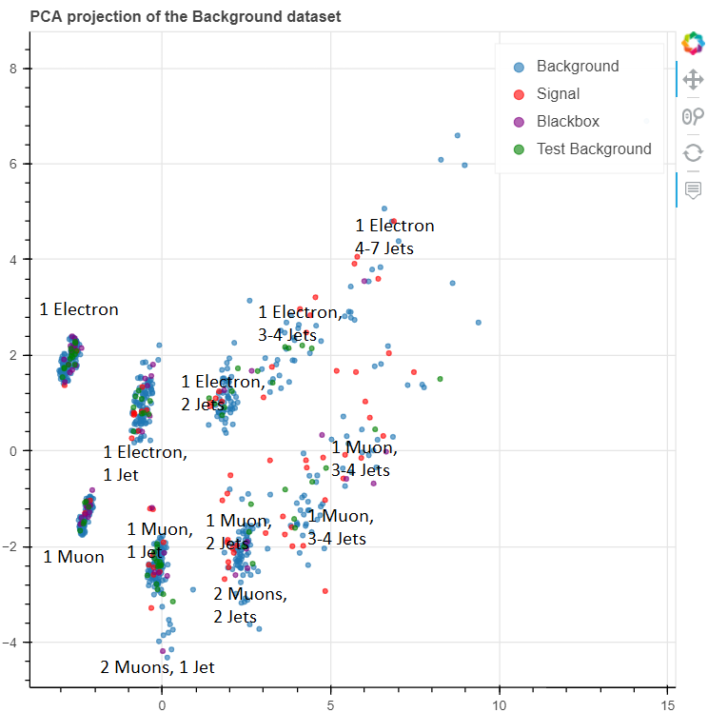
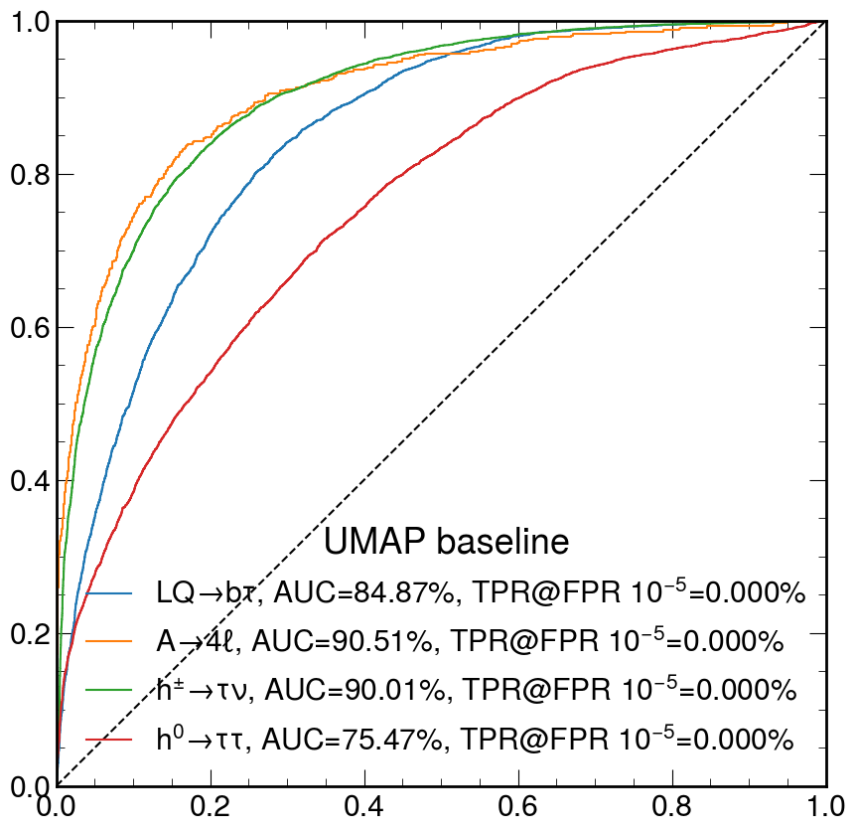
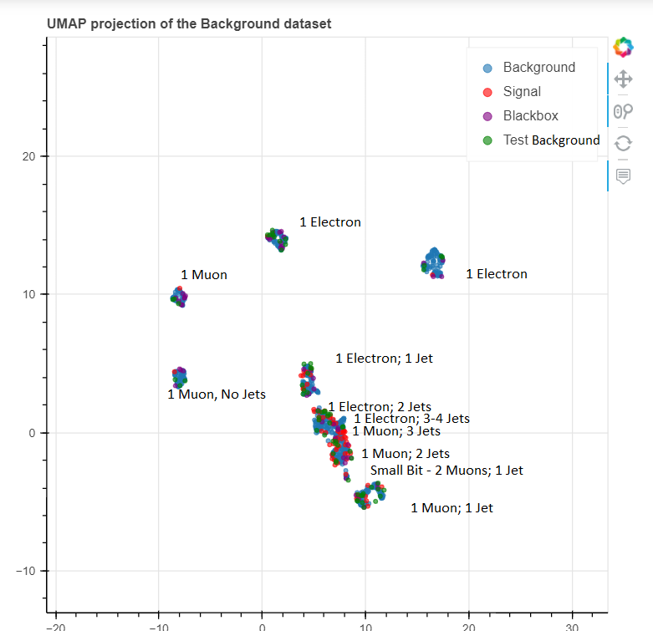
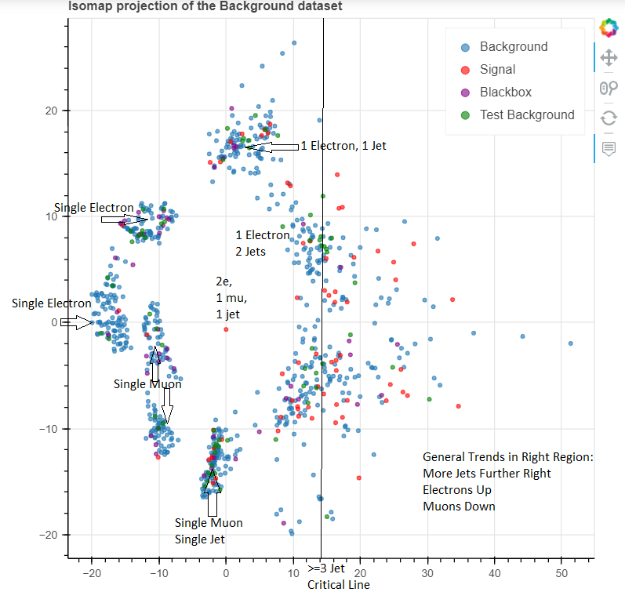
Self-Supervised Learning (SSL) for Jet Tagging
Exploring alternative dimension reduction based ML architectures & algorithms for unsupervised anomaly detection using public CMS dataset as a benchmark
Benchmark variational autoencoder vs. UMAP, LDLE, t-SNE …
Rohan Sachdeva, Melissa Quinnan

Slide 20
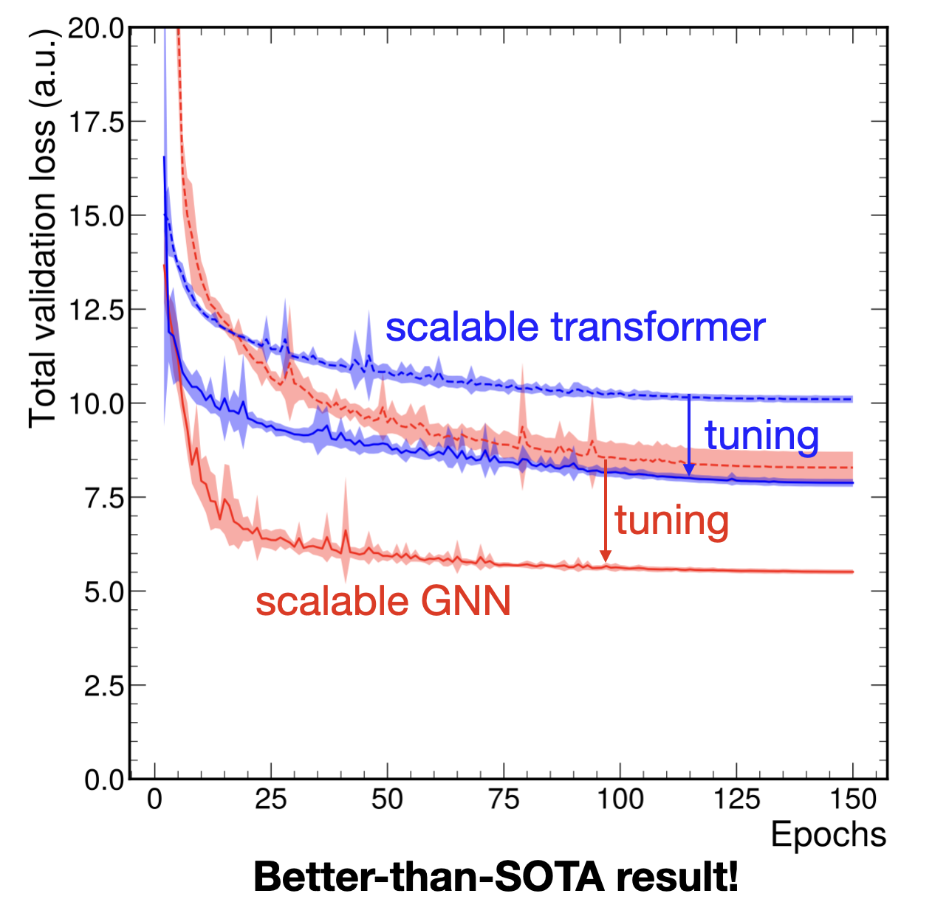
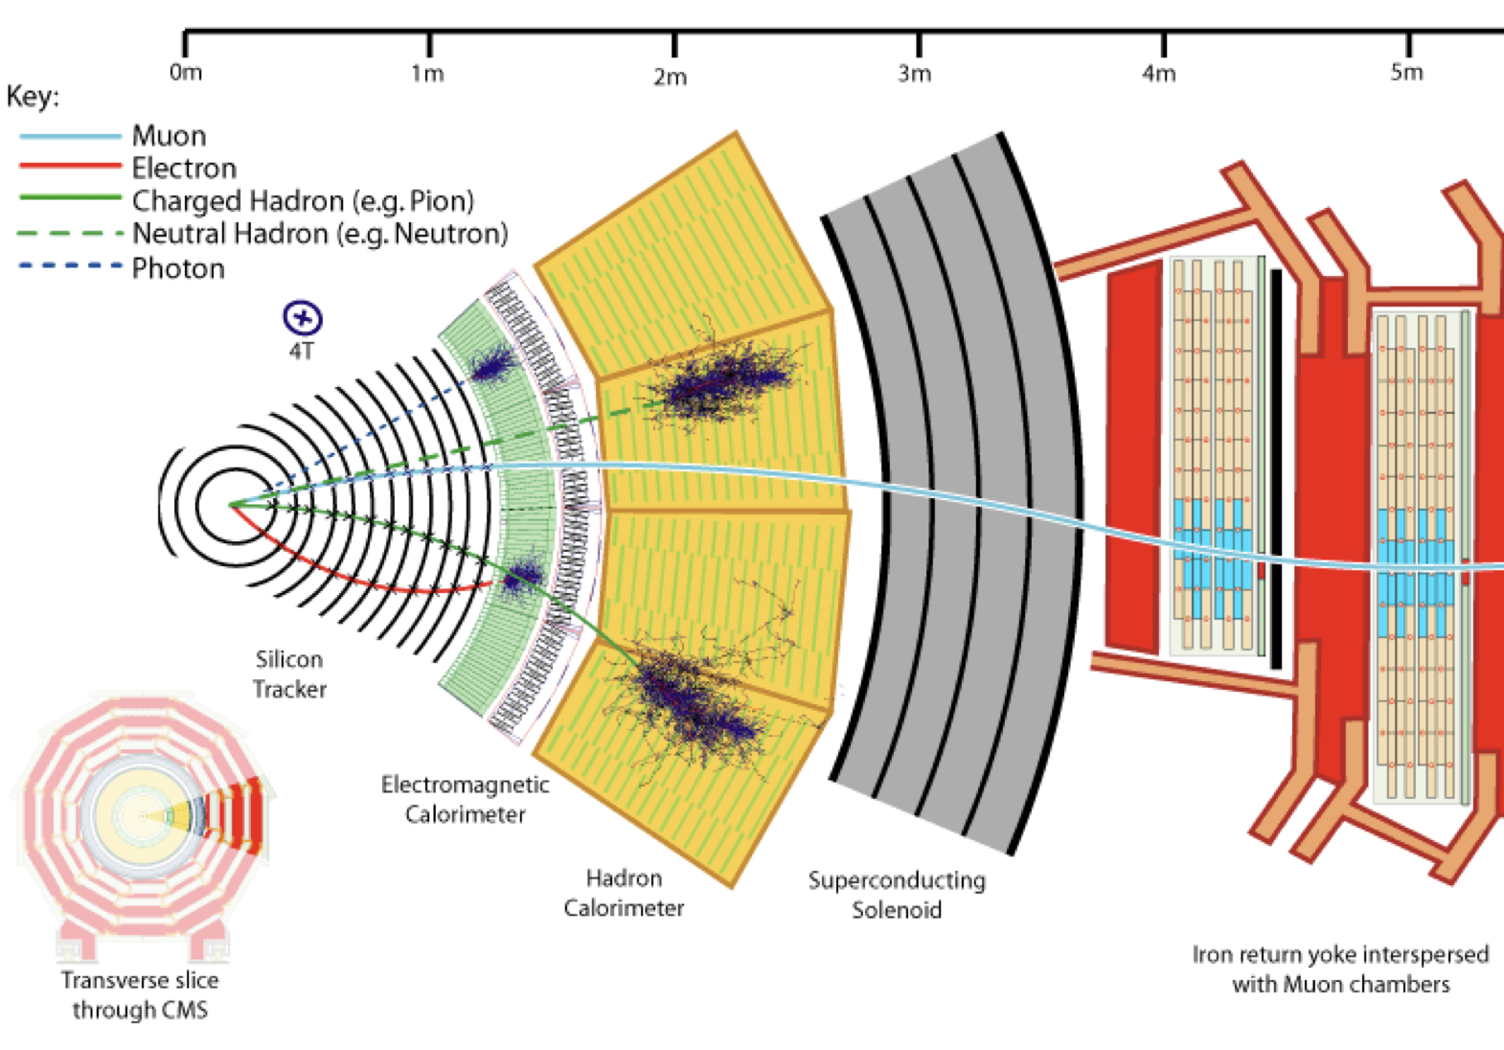
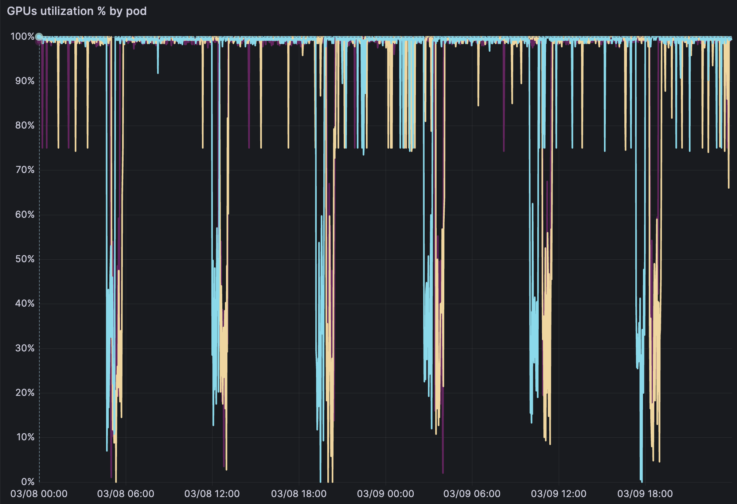
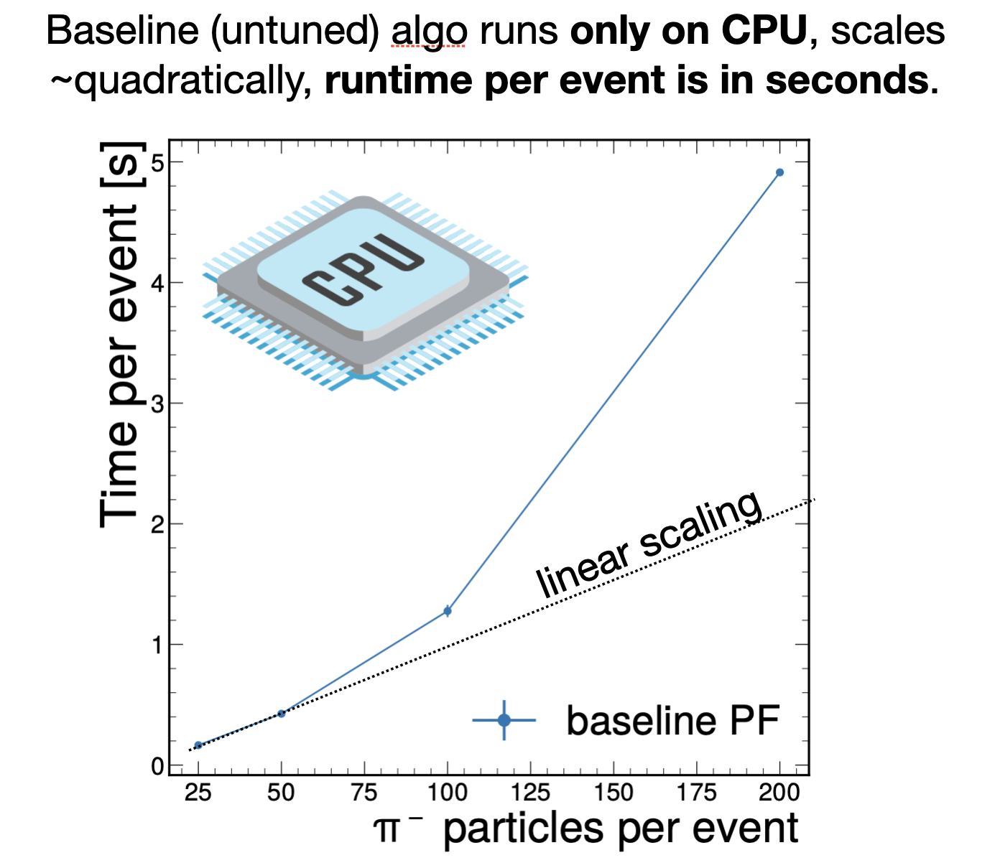
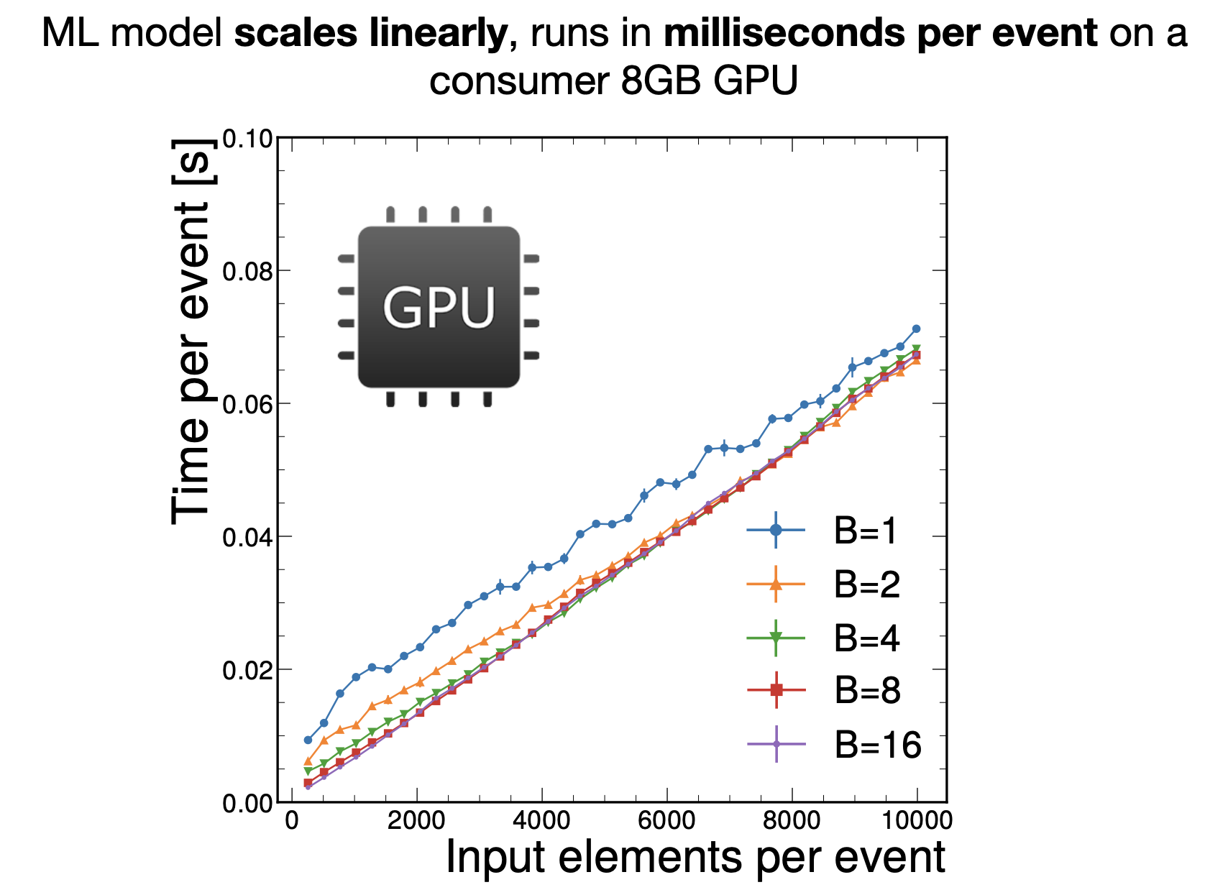
Machine-Learned Particle-Flow Reconstruction
We study Scalable neural networks for event reconstruction at current and future colliders.
Current and future multilayered detectors need complex data reconstruction → particle flow algorithm
Model hypertuning achieves better than SOTA performance!
Farouk Mokhtar

Slide 21
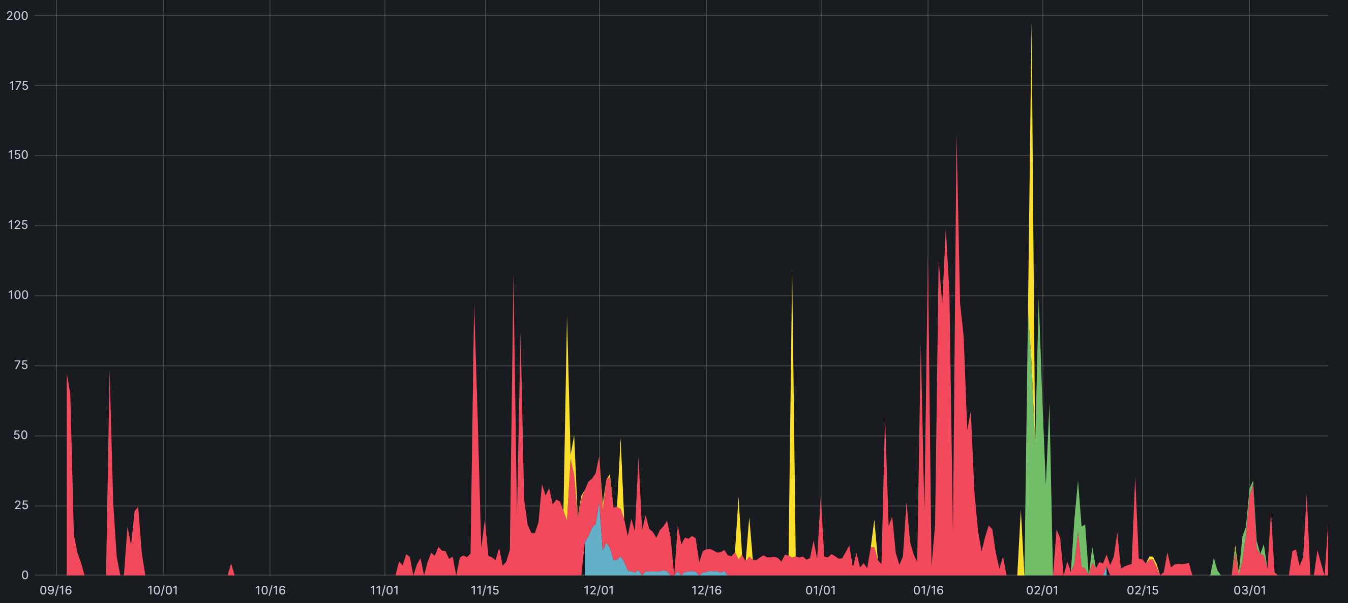
Rose Yu, UC San Diego GPU/CPU Usage Per Day, Last 6 Months
19,000 GPU-hrs, Peaking at 20 GPUs
Peaking at 130GPUs
47,000 GPU-hrs
NRP
GPUs
Peaking at 260 CPUs
150,000 CPU Core-hrs
285,000 CPU Core-hrs, Peaking at 122 CPU-Cores
NRP
CPUs
Namespaces deep-forecast, deep-point-process, spatiotemperal decision, climate-ml

Slide 22
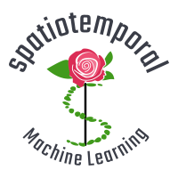
Physics-Guided AI for Large-Scale Spatiotemporal Data: Learning Spatiotemporal Dynamics
mechanical engineering
climate science
biomedical engineering
Spatiotemporal
Dynamics
transportation
sports analytics
public health
Rose Yu
UC San Diego
quantum chemistry
Notes:
The answers to these question build on our ability to learn spatiotemporal dynamics.
from … to,
progress towards real-time decision making in science and engineering

Slide 23
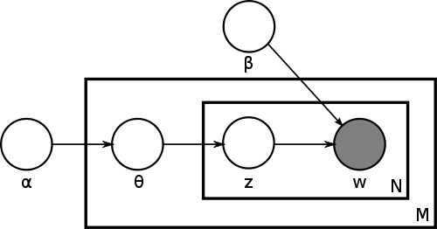
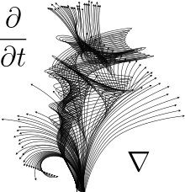
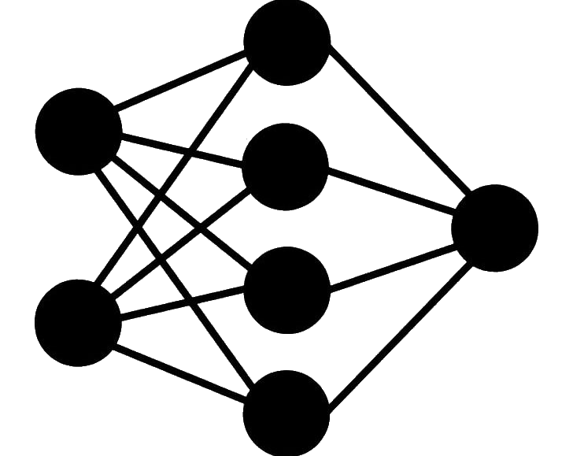
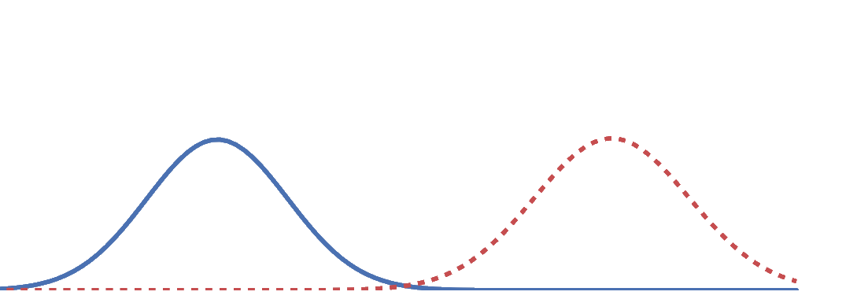
Physics-Guided AI
Physics
Learning
First Principles
Statistical Inference
Model-Based
Data-Driven
+
tensor network
graphical model
differential equations
neural networks
symmetry
variational Bayes
…
…
Encode Inductive Bias
Rose Yu
UC San Diego
Improve Generalization
Reduce Sample Complexity
Increase Trust in AI
Notes:
the overarching theme of my research is
physics: sample efficient, encode domain knowledge; but computational expensive, model misspecification
learning: efficient, realistic, but high sample complexity, black-box model, physical consistency of the predictions

Slide 24
Larry Smarr, UC San Diego GPU/CPU Usage Per Day, Last 6 Months
Peaking at 20 GPUs
19,000 GPU-hrs
NRP
GPUs
268 Registered Users
Peaking at 122 CPU-Cores
285,000 CPU Core-hrs,
NRP
CPUs
Namespace jupyterlab

Slide 25
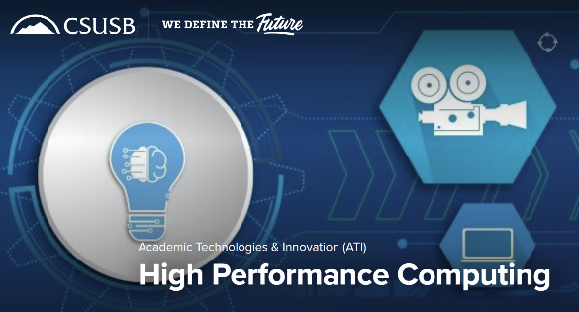
California State University San Bernardino is an Excellent Example of How to Help Your CSU Faculty and Students To Use NRP
Their Campus HPC Program
Enabled CSUSB Faculty & Students
to Use More NRP GPU-Hours
In the Last 12 Months
Than 8 of the 10 UC Campuses!
www.csusb.edu/academic-technologies-innovation/xreal-lab-and-high-performance-computing/high-performance-computing

Slide 26
A Key Reason CSUSB Has The Largest CSU Nautilus Usage: They Installed and Publicized the JupyterHub “Easy Button”
https://csusb-jupyter.nrp-nautilus.io/hub/login
Slide Adapted from
Prof. Youngsu Kim
Over 450 Total Users!

Slide 27
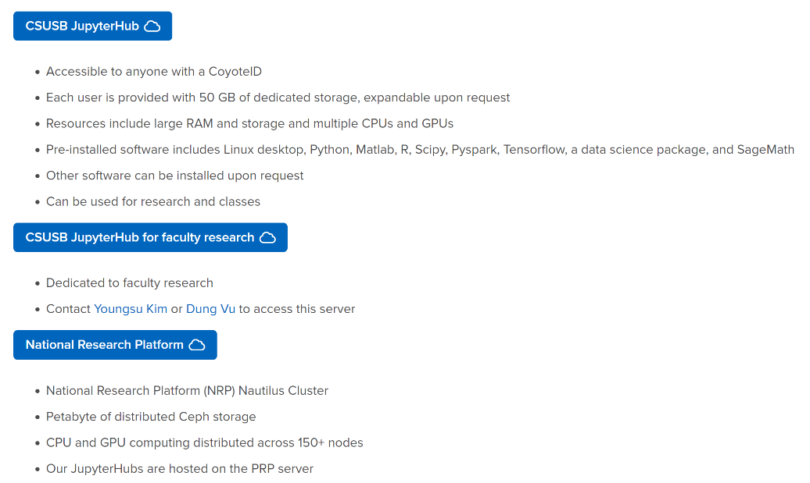
CSUSB Provides Human and On-Line Support For Faculty, Students, and Staff to Easily Use JupyterHub to Access NRP
www.csusb.edu/faculty-center-for-excellence/idat/high-performance-computing/jupyterhub-nrp

Slide 28
We are Entering a New Reality of Ambient AI/ML
3 Weeks Ago Outside Atkinson Hall

