Slide 1
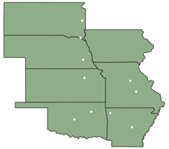
Great Plains Network & GP-ENGINE
Alex Hurt and Derek Weitzel
March 22, 2024
5NRP
gp-engine.org
ARE-ON

Slide 2
Great Plains Network
A collaboration of Midwest universities for cyberinfrastructure
It started as a collaborative for network access, but it grew significantly
Some of the successes of GPN's cyberinfrastructure: Cyberteams – Education of cyberinfrastructure experts throughout the GPN states.
Notes:
Derek

Slide 3
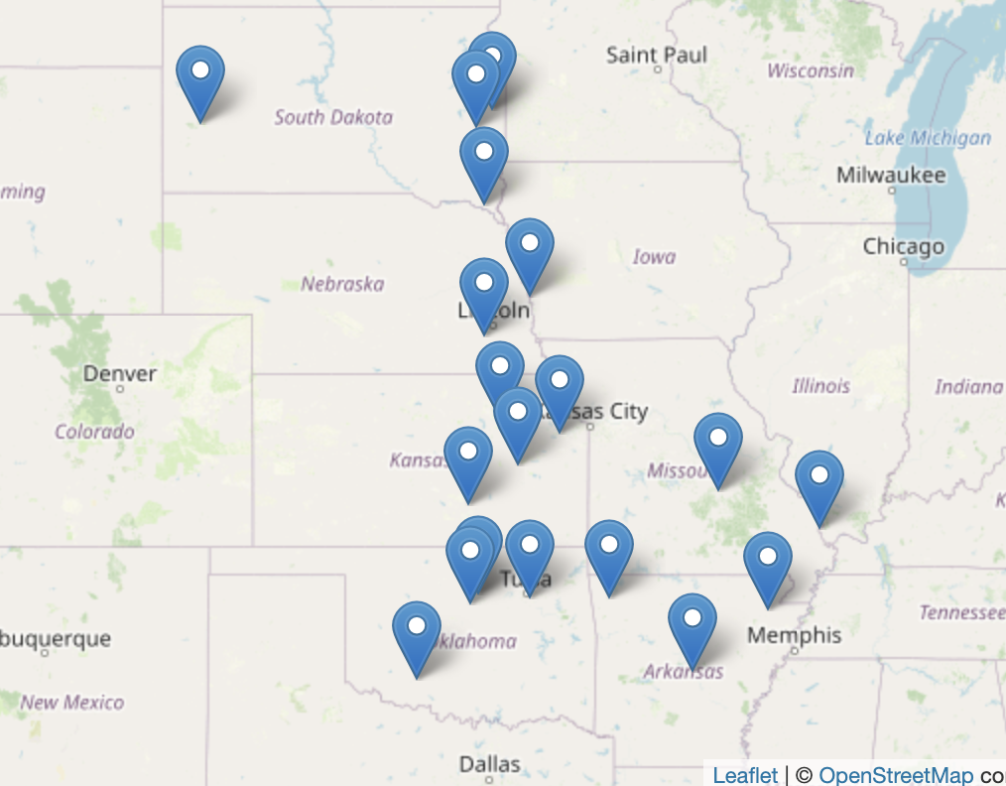
GPN – Cyberinfrastructure – GP-ARGO
The collaborations built from Cyberteams lead to the GP-ARGO project.
Originally designed to provide a gateway for OSG jobs to access local resources in the GPN.
gp-argo.greatplains.net
Contributions to the OSG resource groups:
Notes:
Derek

Slide 4
Great Plains Collaborators
6 States
8 Universities
2 Regional Network Organizations
NSF CC* Regional Computing
OAC #2322218
PI - Grant Scott
Co-PIs: Derek Weitzel, Brian Burkhart, Paul Kern
ARE-ON
Notes:
Derek

Slide 5
Computational and AI-enabled Science
Large-scale data analysis, or data science
AI development
Scaled automation of experiments?
Who needs more horsepower for AI or Simulation
?
ARE-ON
Notes:
Derek

Slide 6
Research Problem / Challenge
Supporting computational and data-intensive research at under-resourced institutions in rural states is challenging.​
Transition researchers’ nascent ideas and workbench codes into GPU-accelerated code, which can become high-throughput computing modules for national resources such as the National Research Platform.
ARE-ON
Notes:
Derek

Slide 7
GP-ENGINE Project Objectives
Increasing campus high-throughput computing cyberinfrastructure within GPN
Expanding the National Research Platform with 44 latest generation GPUs, over 300,000 cores
Improving STEM research and education through adoption of GPU-enabled interactive learning and development environments
ARE-ON
Notes:
Derek

Slide 8
Nautilus
Data
Storage
details
courtesy
Larry Smarr
2022
Now ~1PB
Notes:
Derek

Slide 9
Nautilus
GPU
Compute
details
courtesy
Larry Smarr
2022
Mizzou Hosting
24x A100
As of Jan 2024
Hosting NRP’s first GraceHopper AI Superchip (GH200)
Notes:
Derek

Slide 10
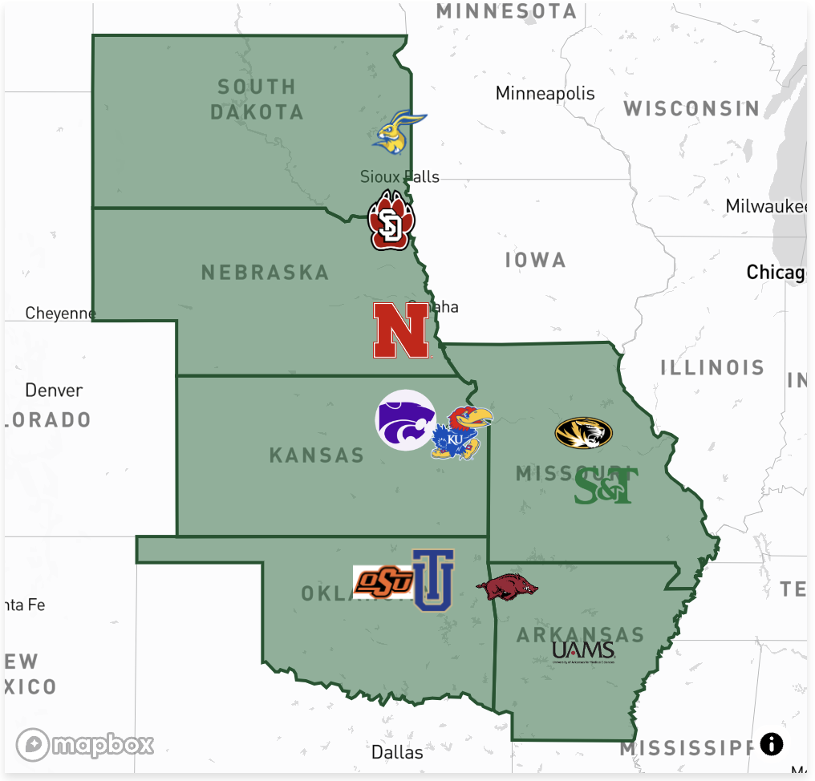
GPN – Cyberinfrastructure – GP-ARGO
Statistics for GP-ENGINE
Already making an impact in the NRP community
Available at gp-engine.org
Notes:
Derek

Slide 11
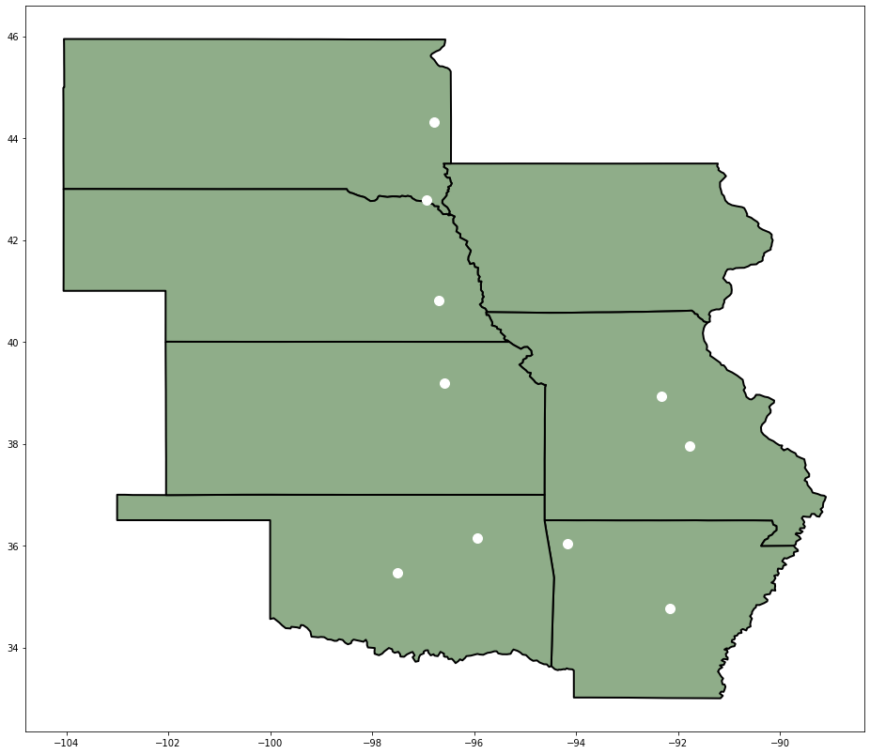
GP-ENGINE Hardware
GPU Workbench
AI/ML Compute Nodes
4x Nvidia A100
320GB GPU RAM
27,648 CUDA cores
2x AMD 7713
128 Cores / 256 Threads
1 TB RAM
2x - 25Gbe NIC
Jupyter Containers for AI/ML, Data Science, and STEM w/ GUI as needed
Training researchers to use GP-ENGINE
Workbench to HTC
Support for HTC in NRP
Containers and Training to help researchers scale their science
Notes:
Alex

Slide 12
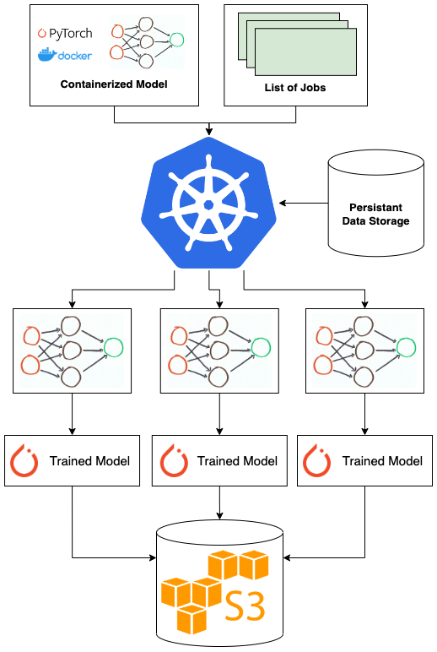
GP-ENGINE - HTC
HTC Example
Training DNN
27 DNN
8100 epochs
30M iterations
3 hours setup
77 Days
wall-clock
240M images
1.73B param
Researchers can develop interactively on same containers as used for HTC
Convert to Kubernetes Job/Pod
Link in GPU Hardware
Link in Storage (Persistent Volumes)
Ideal for Machine Learning and AI
Deep Neural Networks (DNN)
Vision Models
Language Models
Graph Models
Kubernetes Tutorials Offered in-person and Github
https://github.com/orgs/MU-HPDI/repositories
By Alex Hurt
Research Assistant Professor, EECS, MU
Notes:
Alex

Slide 13
GP-ENGINE Outreach
Teaching researchers to utilize NRP with in-person, hands-on tutorials
Notes:
Alex

Slide 14
GP-ENGINE Workshops
GP-ENGINE team delivers 4xA100 nodes to GPN member institutions to be initialized and added to NRP
While on each institution’s campus, GP-ENGINE team hosts a workshop on utilizing NRP for researchers
Introduction to Containers & Kubernetes
Introduction to NRP: Mission and Background
Starting Pods and Jobs
Creating Persistent Storage
Running Computer Vision on NRP
Training Deep Networks on NRP
Scaling Research on NRP with Automation
All resources used are published on GitHub to allow researchers to refer back later
Resources are continuously refined with feedback from attendees
ARE-ON
Notes:
Alex

Slide 15
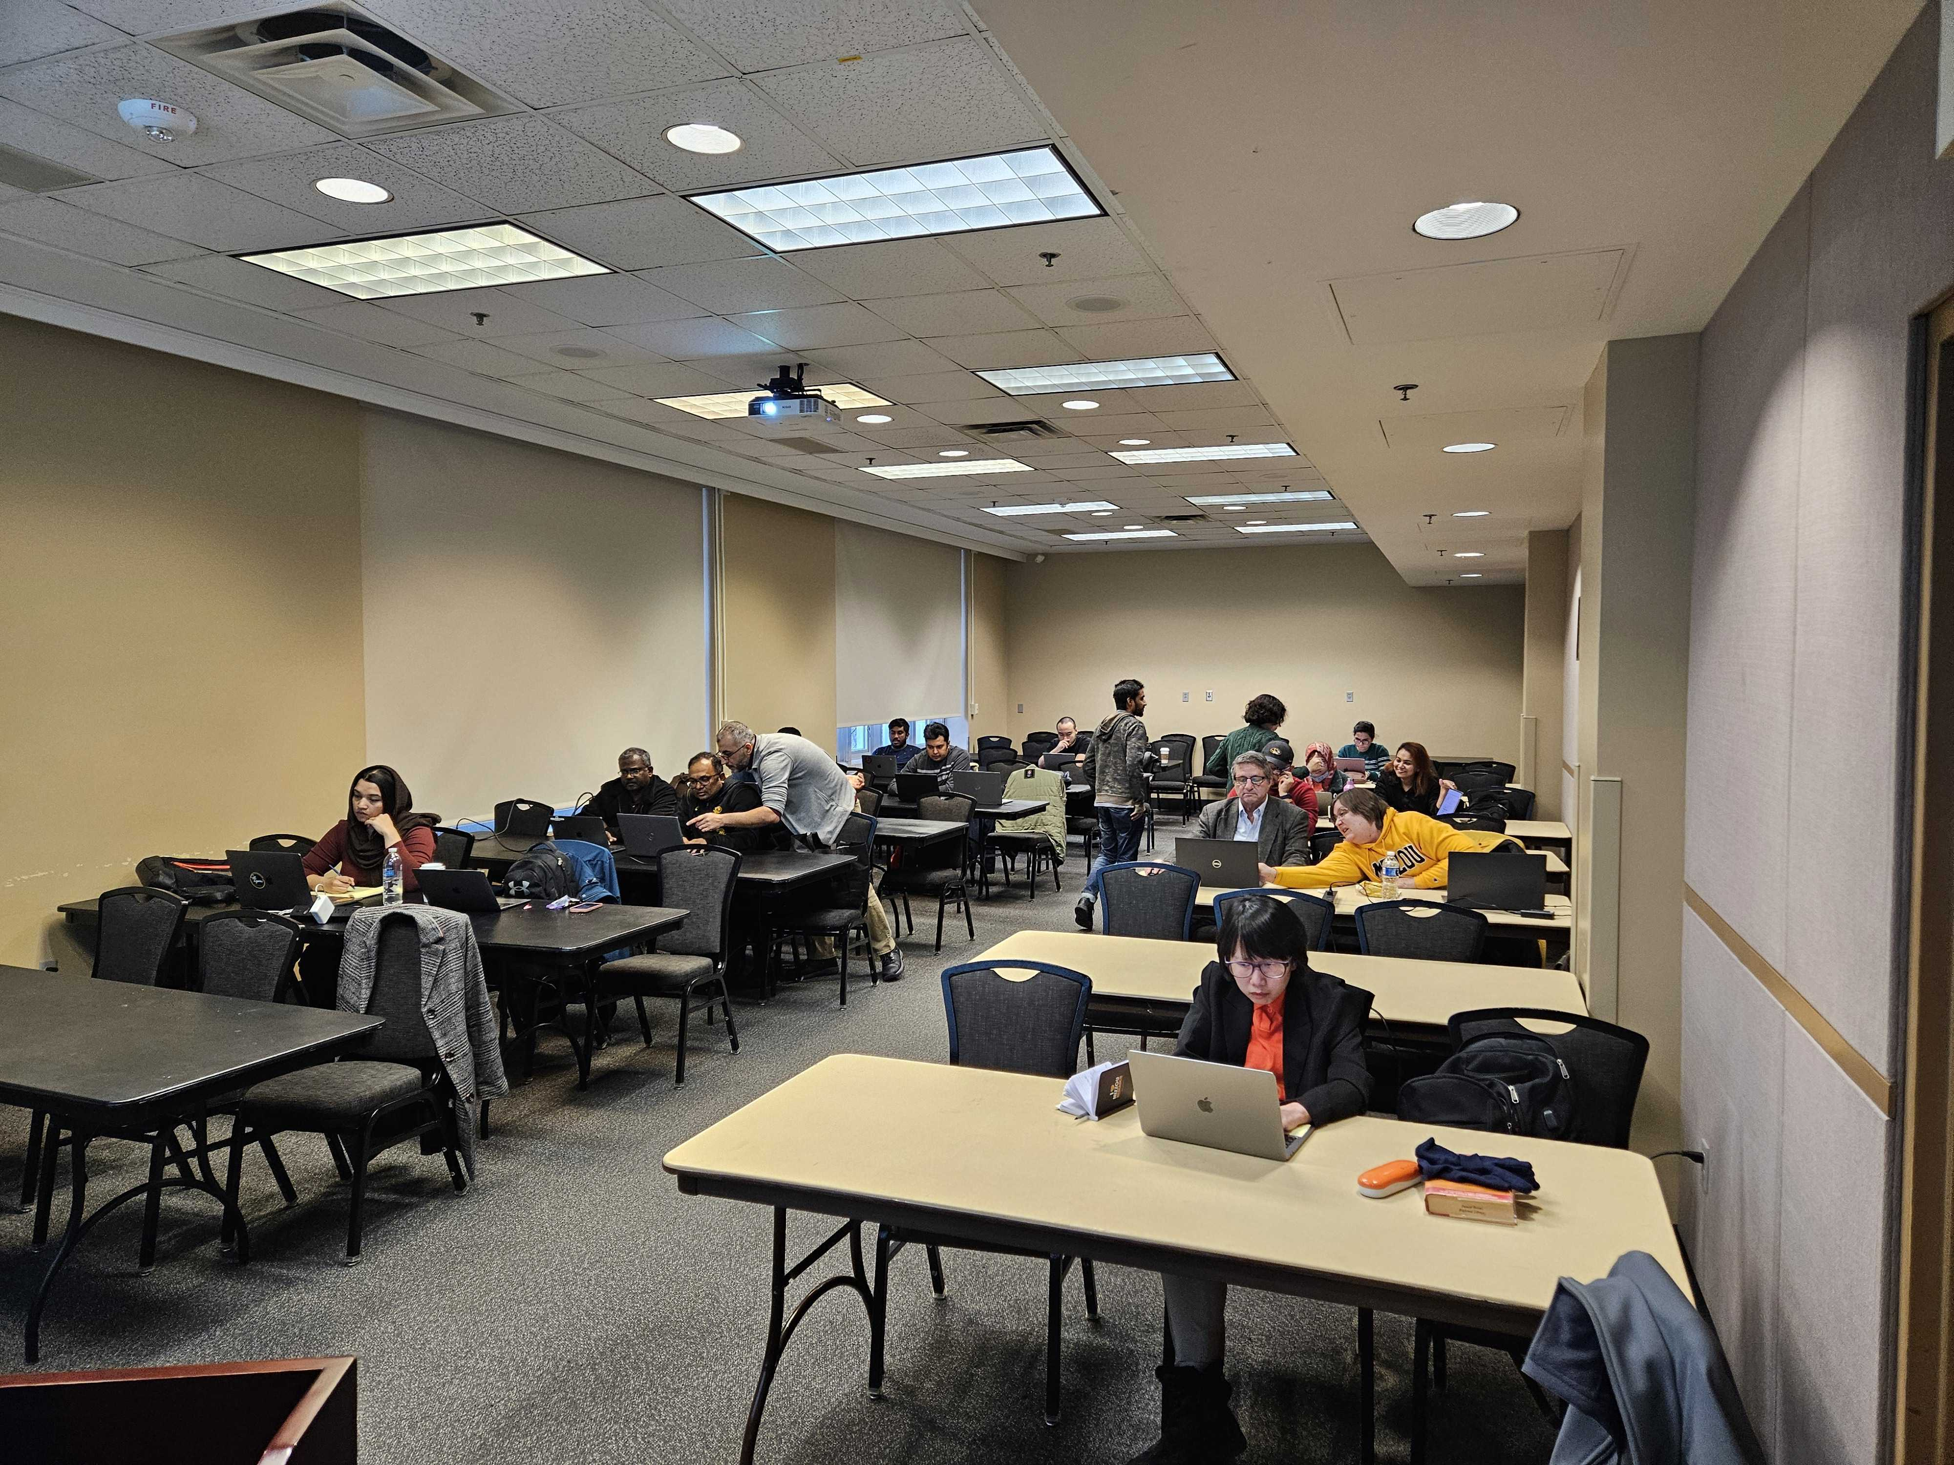
GP-ENGINE Workshops / Trainings
University of Missouri
University of Nebraska
Notes:
Alex

Slide 16
GP-ENGINE Outreach: Creating a PVC
Notes:
Alex

Slide 17
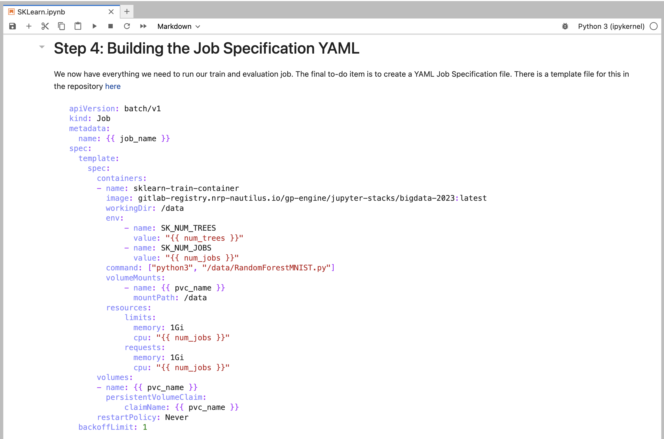
GP-ENGINE Outreach: Running SKLearn in a Job
Notes:
Alex

Slide 18
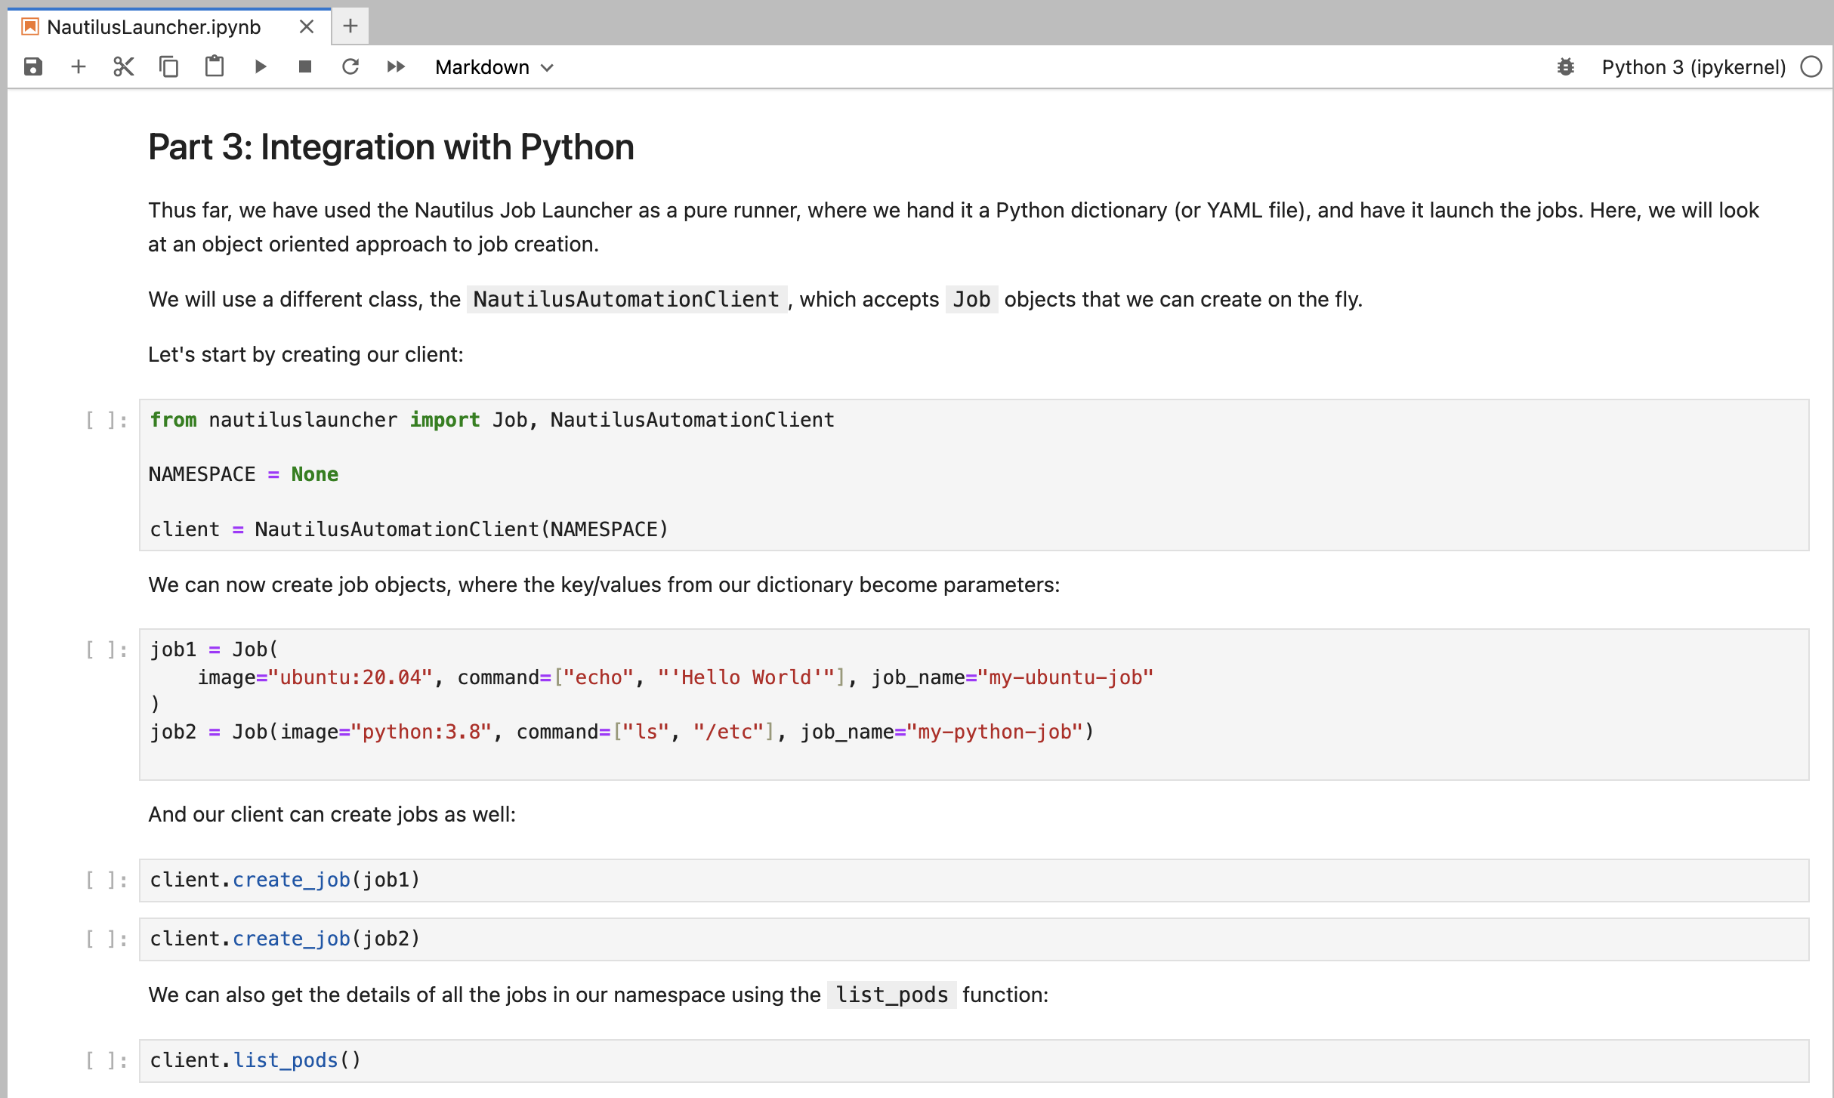
GP-ENGINE Outreach: Automating Job Creation
Notes:
Alex

Slide 19
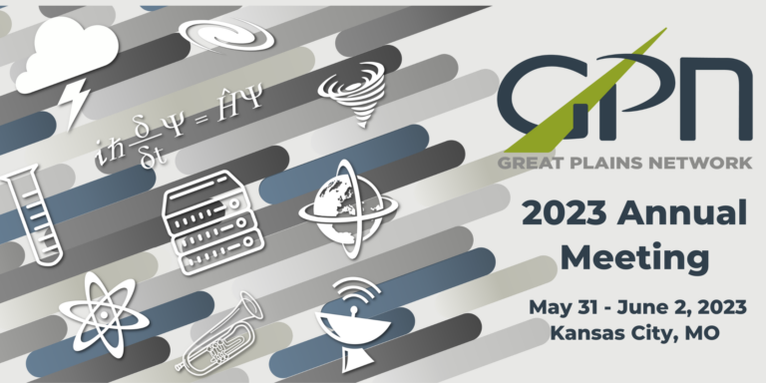
GPN Presentations on the NRP
GPN Annual Meeting 2023
Two separate 3-hour tutorials given:
Introduction to Docker and Kubernetes
Scaling Deep Learning Research in Kubernetes Using the National Research Platform
2023 IEEE International Conference on Big Data
2-hour tutorial
With Big Data Comes Big Compute: Scaling Research Compute on the National Research Platform
Notes:
Alex

Slide 20
Using NRP for CS & AI Education
Notes:
Alex

Slide 21
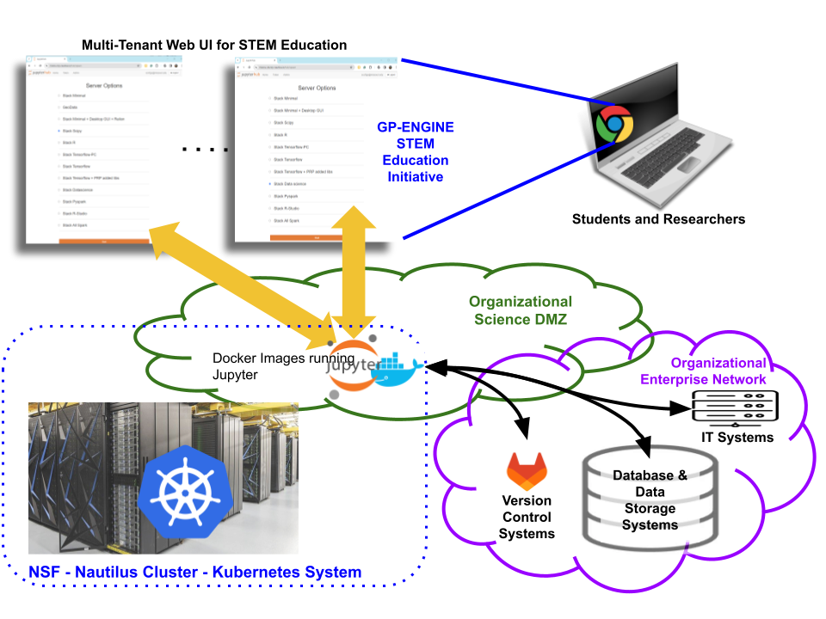
Using NRP for Teaching
Students access JupyterHub instance through browser
NRP, K8s, etc is opaque to users
Professors / TAs control the containers (software) available to students
Science DMZ allows access to organizational enterprise network for VCS, Storage, and more
Notes:
Alex

Slide 22
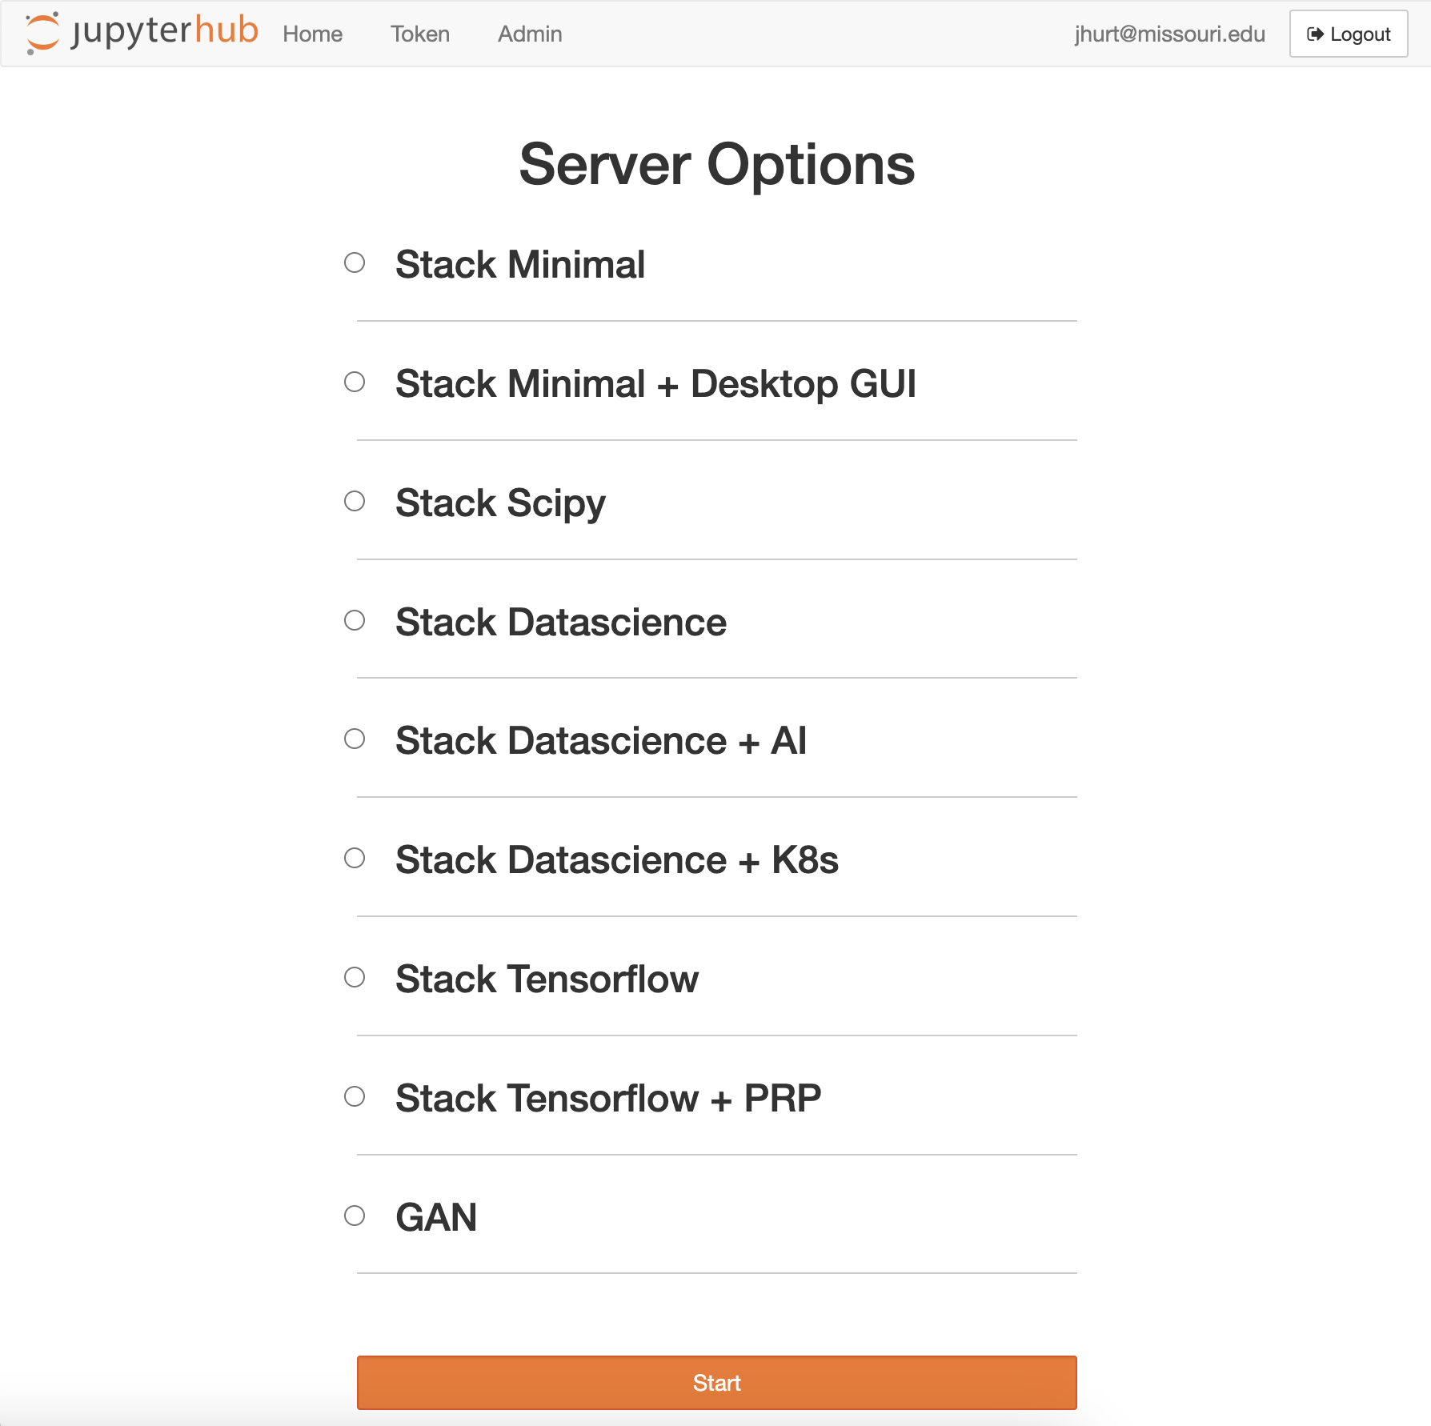
Courses Taught at MU with NRP
DATA SCI 8420: Cloud Computing for Data Analytics
Graduate cloud computing course
Distributed cluster computing and Kubernetes modules taught on NRP
Students learn containerization, K8s concepts, KubeCTL, and hands-on job and pod creation
CMP SCI 7750: Artificial Intelligence
Graduate CS and CE class
Historical AI through modern generative AI
Varied containers for Generative AI, classical AI, and computational intelligence
Notes:
Alex

Slide 23
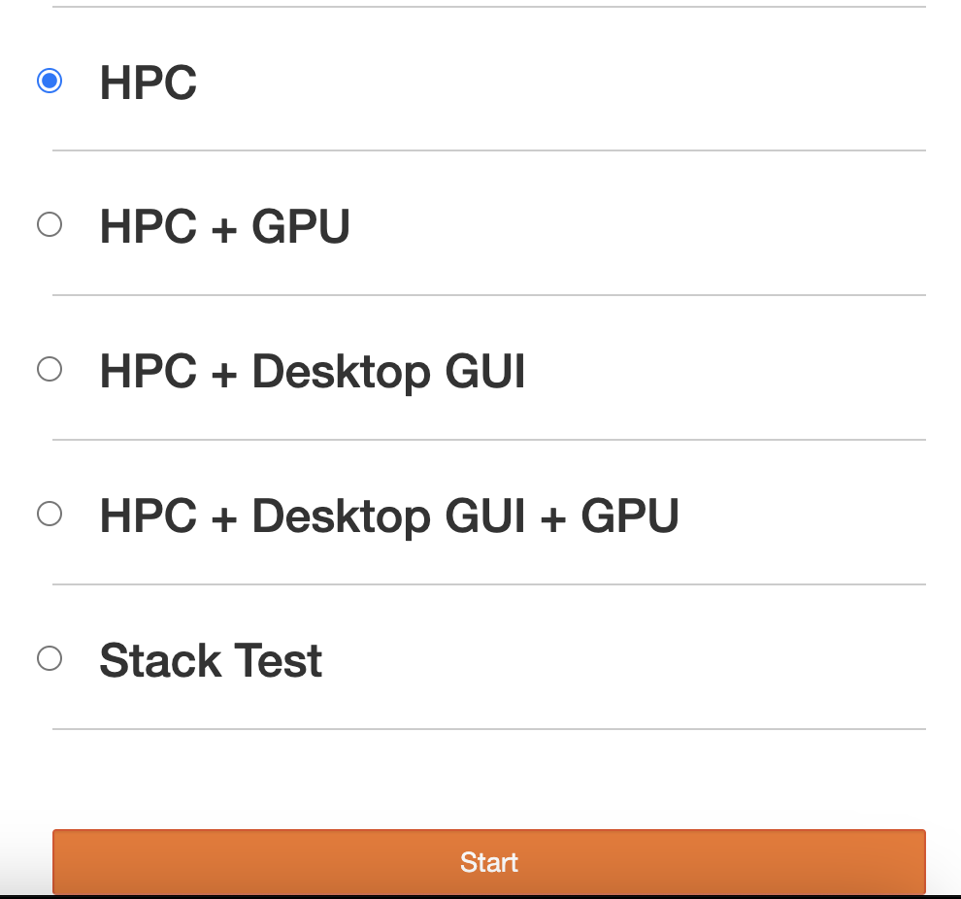
Courses Taught at MU with NRP
CMP SCI 4080: Parallel Programming for High Performance Computing
Cross-listed undergraduate / graduate course focusing on parallel programming
Entire course taught on NRP using custom Jupyter Instance, including MPI and CUDA modules
C/C++ container provided for students, while K8s and containers remain opaque
CMP SCI 8275: Parallel Hardware and Distributed Processing
Graduate computer science course, covering more advanced topics from CMP SCI 4080
Hands-on and in-depth coverage of Docker, Containerization, Kubernetes, Distributed Cluster Computing, MPI, and CUDA all performed on NRP
Notes:
Alex

Slide 24
Courses Taught at UNL with NRP - Twomey
AI Filmmaking Hackathon
Using Generative AI to create film
Uses NRP to host the AI models and the inference, ie, standard diffusion
Image generated with stable diffusion instance on the NRP
Notes:
Derek

Slide 25
Courses Taught at OU with NRP
"Over 200 individuals across multiple organizations have accessed this UL pilot, which positively impacts OU research, UL Software Carpentry workshops, and multiple courses at OU."
Lead by their libraries group, multiple groups at OU use their Jupyter notebooks for education
Notes:
Derek

Slide 26
AI/ML Research in the Great Plains Network
Notes:
Alex

Slide 27
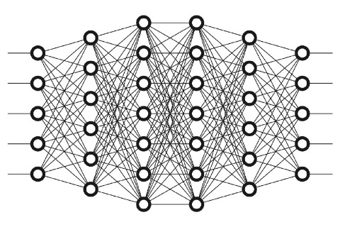
Deep Learning on Nautilus: Transformer Research
30 Trained Models
137 TB
Imagery Processed
10 Deep Neural Architectures
Load Imagery
Forward Pass
Calculate Loss
Backward Pass
9,000 Epochs
30M iterations
2.0B parameters
3 Open Source
HR-RSI Datasets
Wall Clock Time:
89 days, 6 hours
By Alex Hurt
Research Assistant Professor, EECS, MU
https://www.freecodecamp.org/news/want-to-know-how-deep-learning-works-heres-a-quick-guide-for-everyone-1aedeca88076/
https://commons.wikimedia.org/wiki/File:PyTorch_logo_icon.svg
https://www.clipartmax.com/download/m2K9A0m2b1m2i8i8_4-o-clock-clip-art-clock-face-clip-art/
Notes:
Alex

Slide 28
Maasai Boma Mapping using DCNN & Remote Sensing Data
We evaluated the very-high-resolution (VHR) Google Maps imagery on the Boma mapping task. Different architectures were experimented with, and the most efficient ProxylessNAS model was selected for broad-area scanning.
Google Maps Satellite images covering a 76.620 km² AOI across 4◦ 18.176’ S - 4◦ 24.0813’ S latitude and 36◦ 18.8062’ E - 36◦ 22.5862’ E degree longitude were acquired and scanned.
A total of 127,008,768 chips were inferred using the ProxylessNAS models.
The processing time for each 8192 × 8192 px tile is about 5 seconds using an NVIDIA GeForce GTX 1080 GPU.
It took approximately 689 hours to process the entire AOI
This can further be accelerated with parallel computing techniques at the host-level.
By Keli Cheng
PhD Candidate, EECS, MU
Read More: Mizzou Engineering Geospatial AI
Notes:
Alex

Slide 29
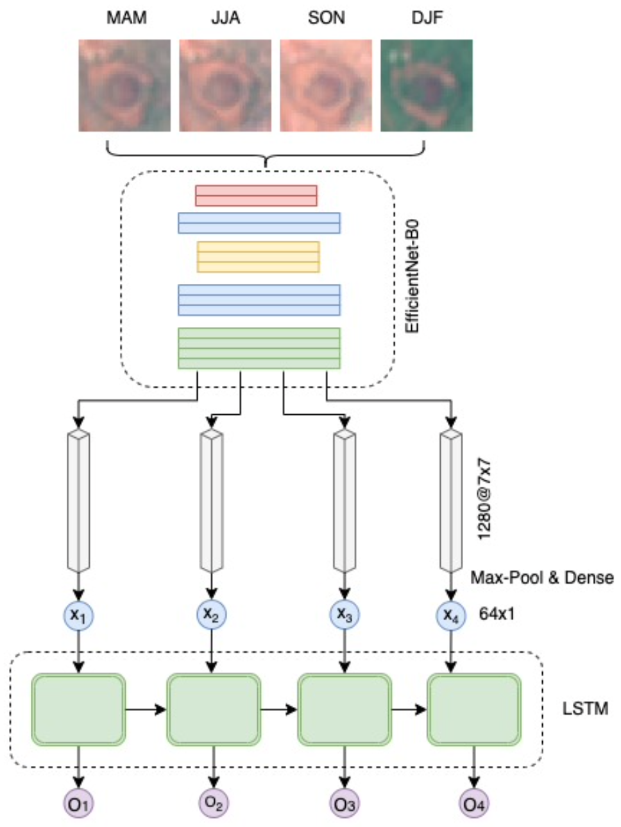
Deep Seasonal Network for Multi-temporal Data Fusion
Data source: 64x64 px chips generated from mid-res Sentinel-2 data
Training time of the EfficientNet: about 45 minutes with a Tesla T4 GPU.
It takes about 45 minutes to extract features from the four seasonal datasets (including the I/O operation time and model inference time)
With the frozen feature extractor and saved feature vectors, the actual training time of DeepSN with a 2-layer LSTM is about 21 minutes using an NVIDIA GeForce GTX 1080 GPU.
By Keli Cheng
PhD Candidate, EECS, MU
Notes:
Alex

Slide 30
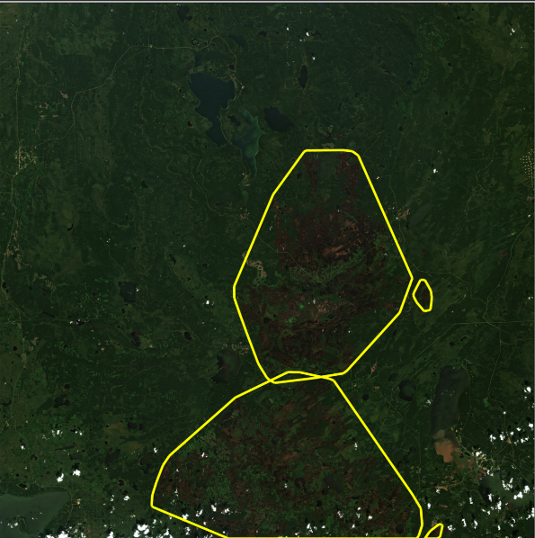
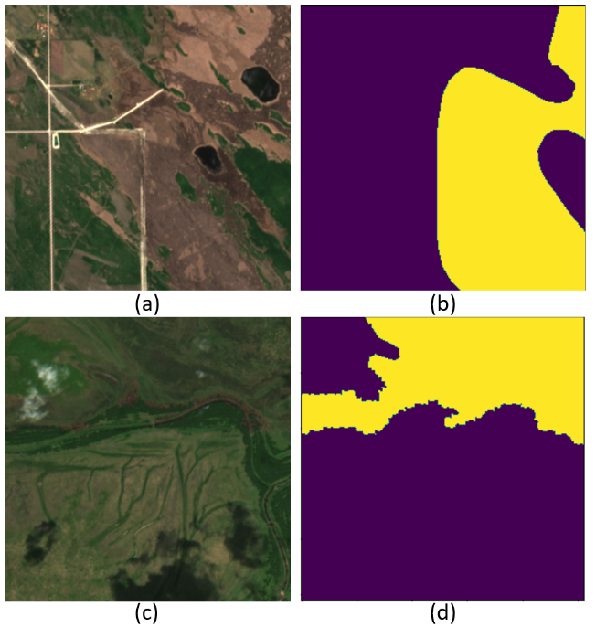
Space-borne Computer Vision: Wildfire Burned Area Mapping
Multi-Modal Data Sets
Hyperspectral satellite imagery (raster)
Visible range (R,G,B)
NIR
SWIR
Burn Area Polygons (vector data)
All data Geotagged
Variable coordinate reference systems
Pixels and Polygon vertices are all coordinates on the Earth
Images
Labels
Data Preparation
By Anes Ouadou
PhD Student, EECS, MU
Notes:
Alex

Slide 31
Space-borne Computer Vision: Wildfire Burned Area Mapping
Config options
Architecture
Learning rate
Batch size
Optimizer
Weight initialization
Programmatically Generated Experiment YAMLs
U-Net
$${10}^{−3}$$
8
Adam
Random
Each combination of these parameters provides us with a unique conditions for an experiment to run
$Number of experiments=2 ×3 ×3×2×2$
$Number of experiments=72$
For each experiments we save two models:
The last model
The best model
We end up with 144 models
Deeplab
$${10}^{−4}$$
16
LAMB
ImageNet
$${10}^{−5}$$
32
Iterations of Training Completed: 515,550
Number of images Processed: 7,070,400
Trainable Parameters Optimized: 23 million per model
The time it took to prepare the experimental set up and to run all the training sessions in parallel is 12 hours
The actual time it would have take to train is 21 days 12 hours 45 minutes
By Anes Ouadou
PhD Student, EECS, MU
Notes:
Alex

Slide 32
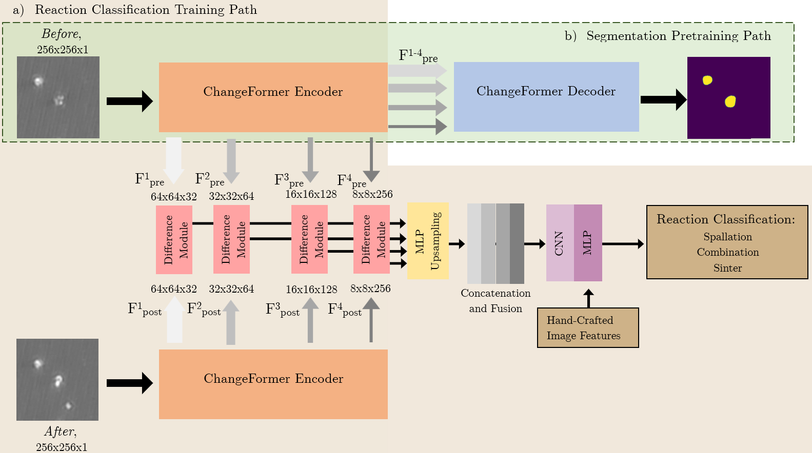
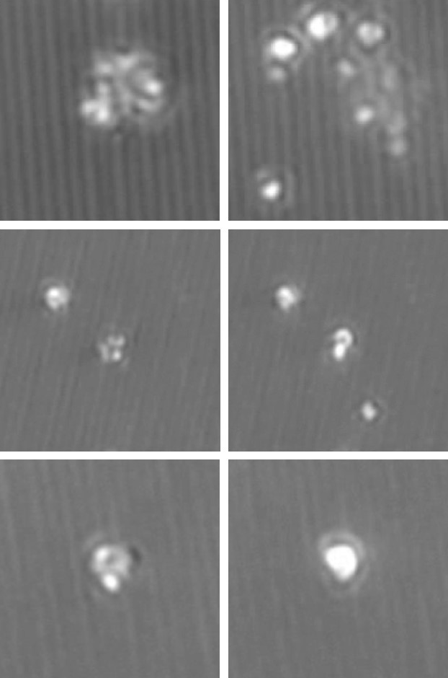
Nano-Energetic Material Reaction Classification
Before
After
Spallation
Combination
Sintering
Parallel Experimentation
Several different model architectures
Hyperparameter sweeps
Cross Validation training folds
By Tim Gaines
MS Student, EECS, MU
Notes:
Alex

Slide 33
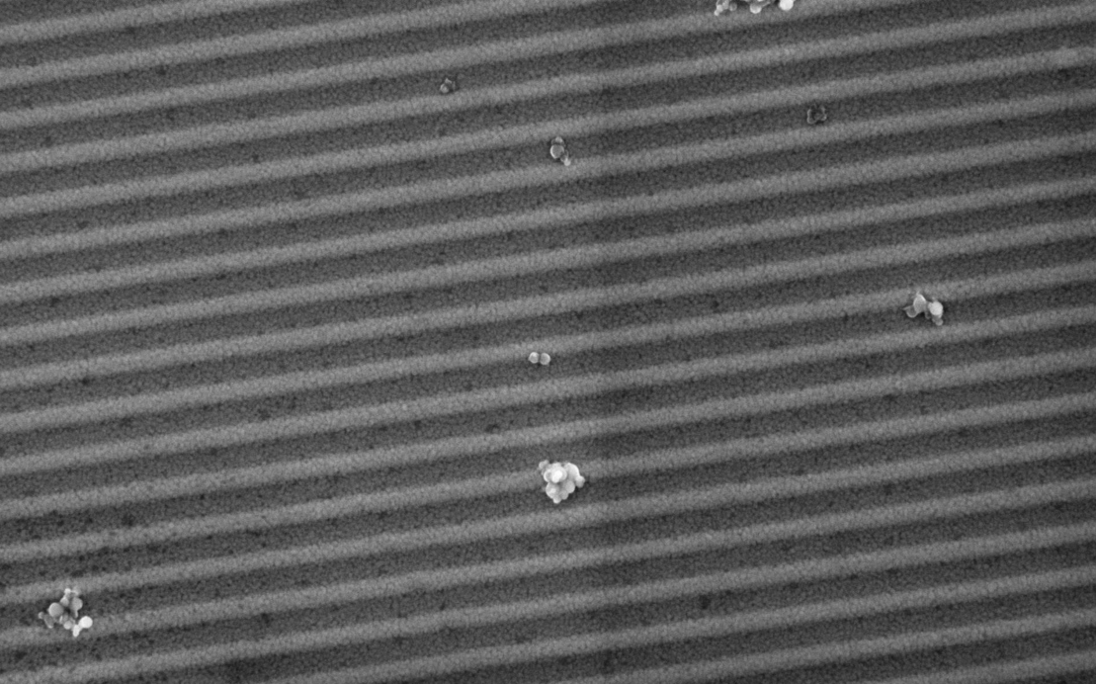
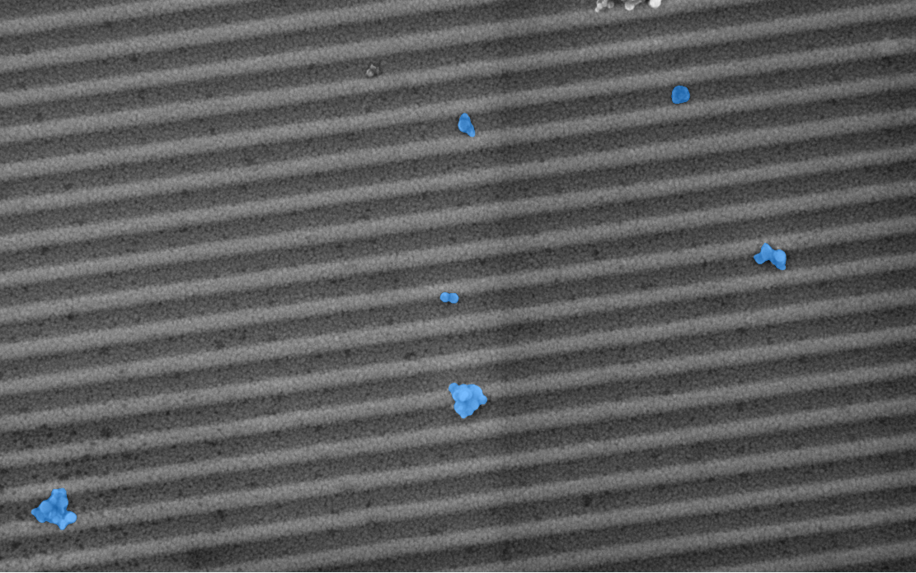
Not just for large scale batch experiments
GPU Accelerated Jupyter Environment
kubectl port-forward gpu-pod 8888:8888
Segment Anything Container
localhost:8888
Enable research on Meta’s Segment Anything
Model With GPU acceleration large image
inference times change from 8 minutes down to 11 seconds!
By Tim Gaines
MS Student, EECS, MU
Notes:
Alex
https://ucsd-prp.gitlab.io/userdocs/jupyter/jupyter-pod/
https://github.com/facebookresearch/segment-anything

Slide 34
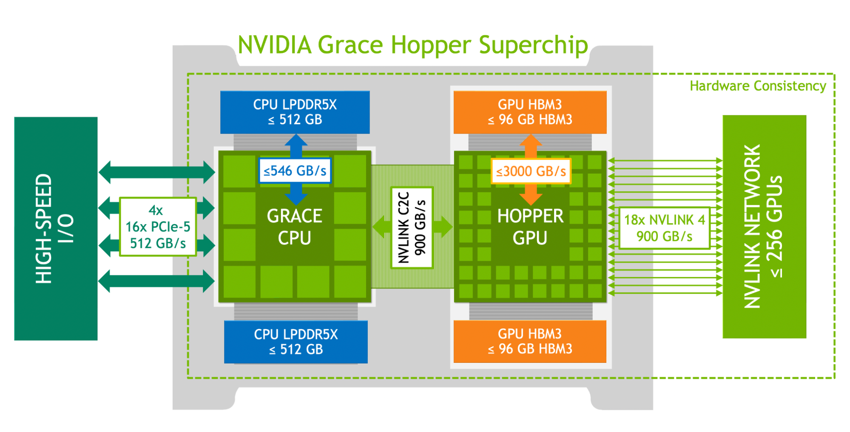
Grace Hopper Superchip: GH200
GP-ENGINE has facilitated the addition of the first publicly available NVIDIA Grace Hopper Superchip (GH200) via the National Research Platform
NVIDIA GH200 Key Features:
72 ARM CPU Cores
480 GB CPU LPDDR5X Memory
500GB/s CPU LPDDR5X Bandwidth
H100 GPU
96 GB HBM3 VRAM
3 TB/s GPU HBM3 Bandwidth
Image: https://resources.nvidia.com/en-us-grace-cpu/nvidia-grace-hopper-2
Notes:
Alex

Slide 35
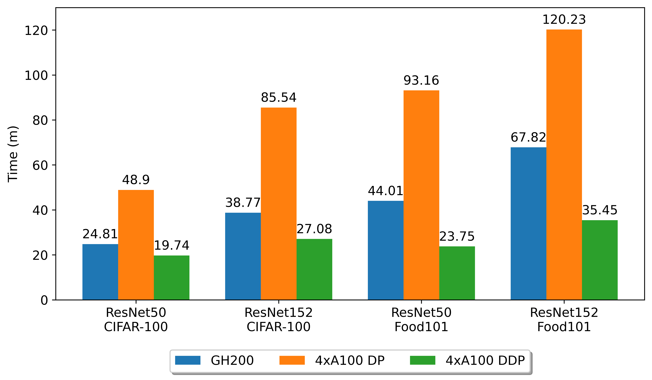
GH200 Benchmarking: Training ResNet
4xA100 DP refers to Data Parallel training, in which each batch is simply split between the GPUs
Closer to single GPU Training in IPC design
All parameters for 4x100 DP & GH200 were kept consistent
4xA100 DDP refers to full distributed training, in which each GPU processes its own batch and is responsible for its own data loading
Takes best advantage of additional resources on 4x100 nodes
Uses maximum batch size, workers, RAM, etc
Notes:
Alex

Slide 36
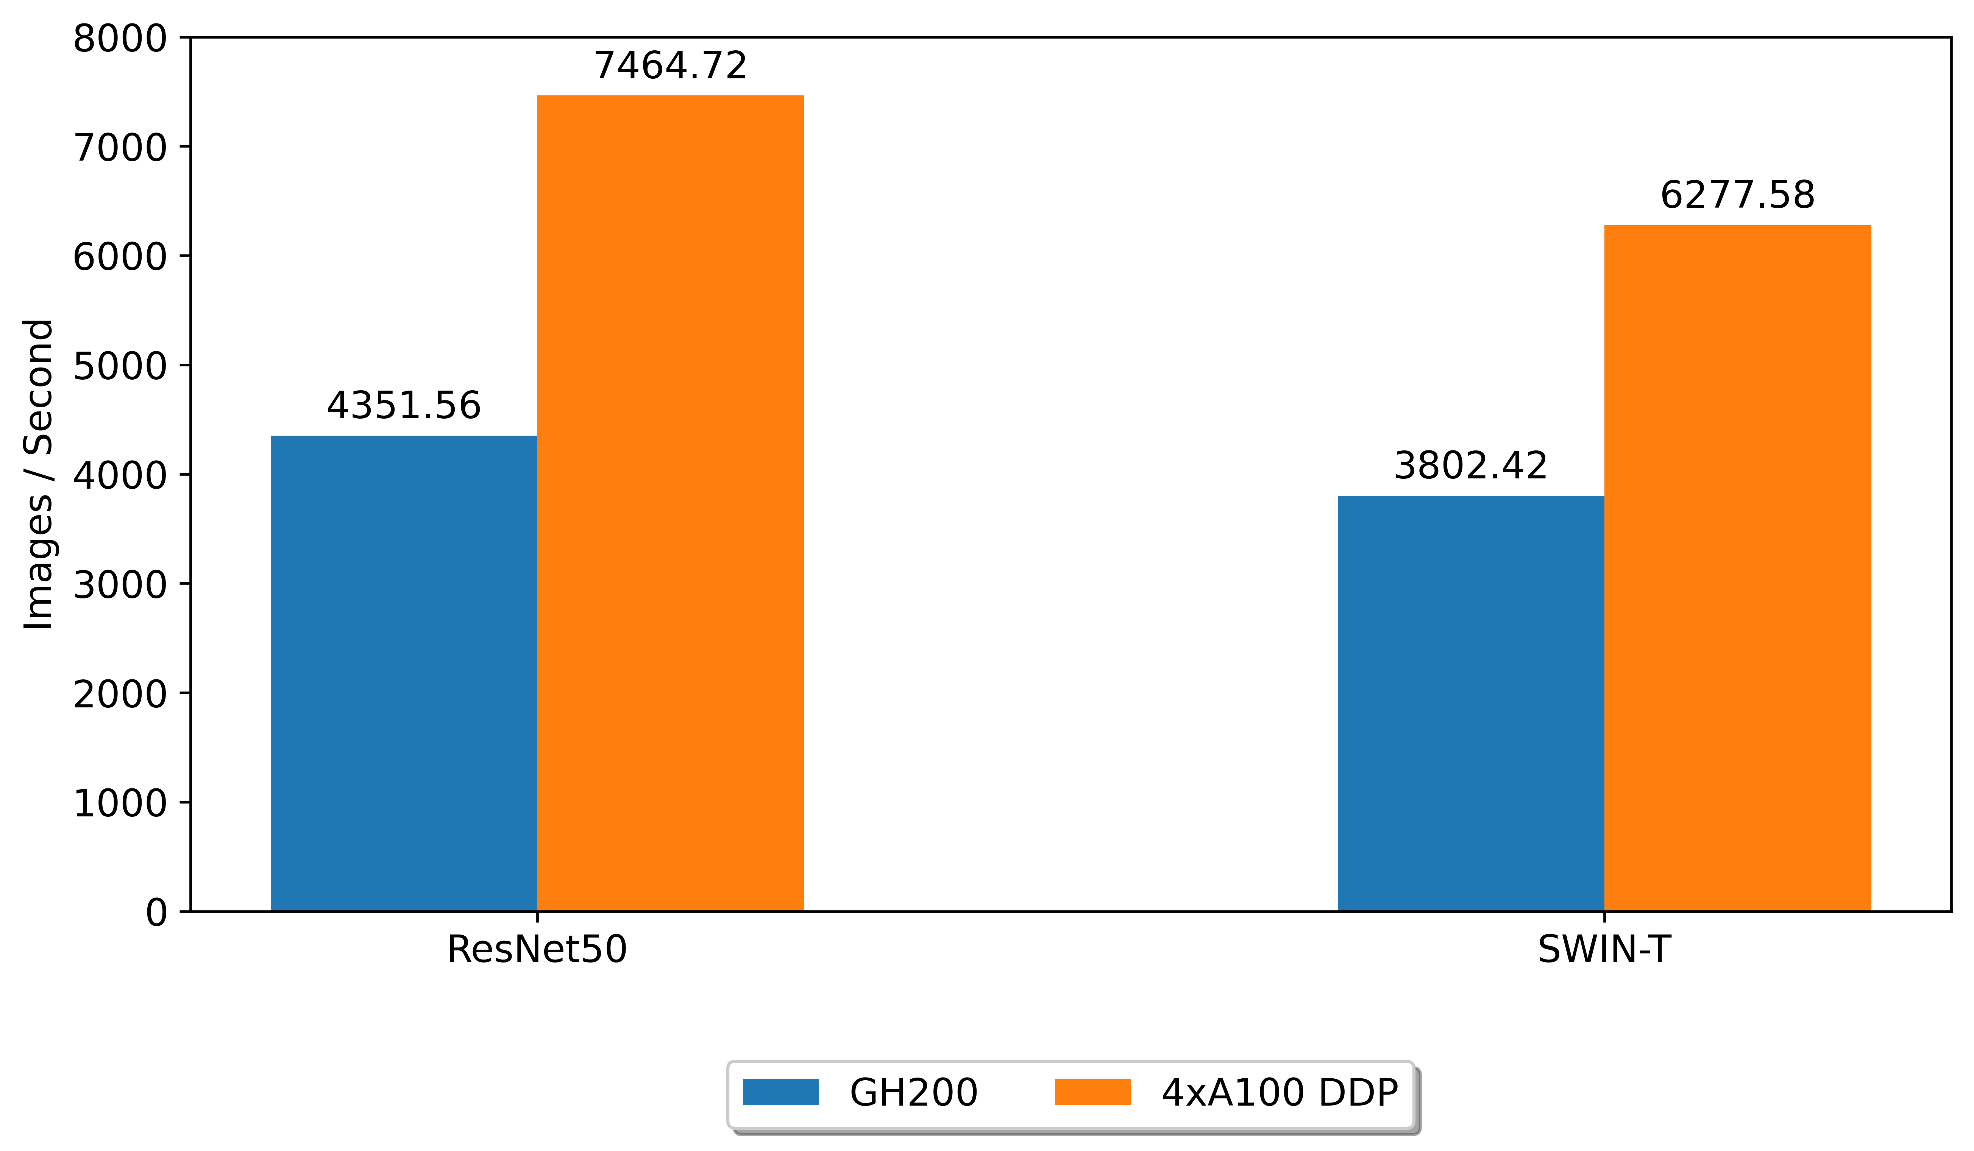
GH200 Benchmarking: Inference
Inference
Previous slides benchmarked training performance, but what about pure inference speeds?
2 networks tested: ResNet50 and SWIN-T
Use published TorchVision ImageNet model against the ImageNet validation dataset (50,000 images)
Notes:
Alex

Slide 37
Thank you!
gp-engine.org

