Slide 1
In Search of a Networking Unicorn Realizing Closed-Loop ML Pipeline for Networking
Arpit Gupta
Assistant Professor, UC Santa Barbara
Faculty Affiliate, Lawrence Berkeley Lab

Slide 2






Our Lives in the Post-Pandemic Era
Education
E-Gov
Healthcare
Work
Finance
Access to secure and performant “Internet for All”
is critical

Slide 3





Key Stakeholders---Service Providers
Service Providers
Cloud/content service providers (AWS, Google, MS, …)
Internet/Mobile service providers (AT&T, Comcast, …)
Enterprise networks (e.g., UCSB, …)
Community networks (e.g., Chattanooga MUNI, …)
Goal: Offer secure and performant Internet services with limited infrastructure and operational resources
Users

Slide 4
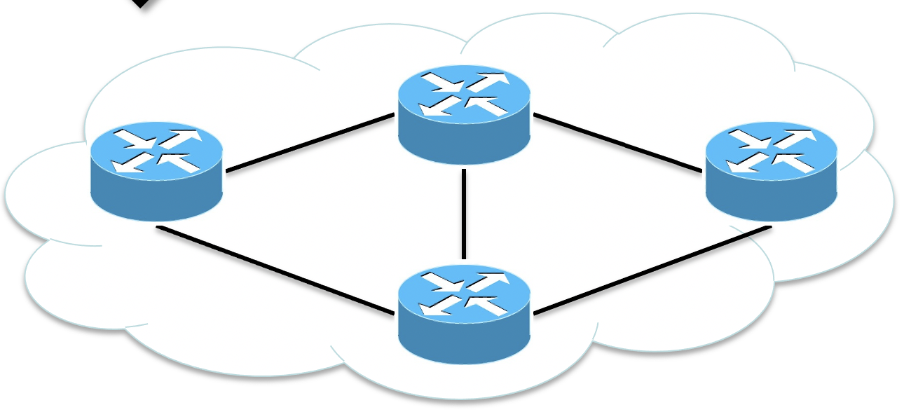
Progress in Last Decade---Software-Defined Networks
Network Automation
Infer
disruptive network events and threats
Monitor
Control
Sense
with fine-grained telemetry data
React
with precise control actions
Enables secure and performant connectivity with limited resources
Programmable Dataplane

Slide 5
Still…
Monitor
Control

Slide 6
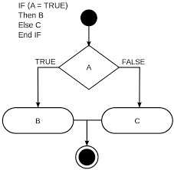
Still…SDN’s Network Automation is Human-Centric
…
Pre-defined rules
Monitor
Control
  Ineffective against dynamic, coordinated, & multi-vector threats (e.g., APTs)

Slide 7

Changing Requirements---Network Security
National Security Commission on Artificial Intelligence, 2021
AI is a quintessential dual-use technology
AI-enabled tools will be the first resort in a new era of conflict
Countering AI-capable adversaries with human intelligence alone invites disaster
Motivates complimenting Human Intelligence with AI

Slide 8
What do we “Really” Need?
Machine Learning
…
Pre-defined rules
Monitor
Control
Self-Driving Networks
secure & performant connectivity with minimal human interventions

Slide 9
Key Requirement
…
Production-ready ML Model(s)
Generalizable, robust, trustworthy, ...
Monitor
Control
Production-ready ML model(s) to handle various
dynamic, coordinated, multi-vector threats

Slide 10
Production-Ready ML Model(s) for Networks
Efforts in Past Decades
  1000+ research publications, multiple products/startups, billions of dollars invested
Expectations
  Easy to develop ML models for any given problem and target environment
  Abundance of production-ready ML models---ready for high-stake decision-making
Reality
  Availability of public datasets dictates choice of learning problem and environment
  Abundance of ML artifacts with high performance in controlled “lab” settings
  Reluctance among network operators to deploy existing ML-based solutions
Getting even a single ML model deployed in production settings is a struggle!
Notes:
High-stake decision making needs to bring up

Slide 11
Fundamental Roadblocks
Places the responsibility on users to find the right data,
i.e., data that enables developing generalizable ML model
Data
Preprocessing +
Model selection
Training
Evaluation
Deployment
Model
Standard ML Pipeline
For any given learning problem and target environment
what is the “right” data
Notes:
High-stake decision making needs to bring up

Slide 12
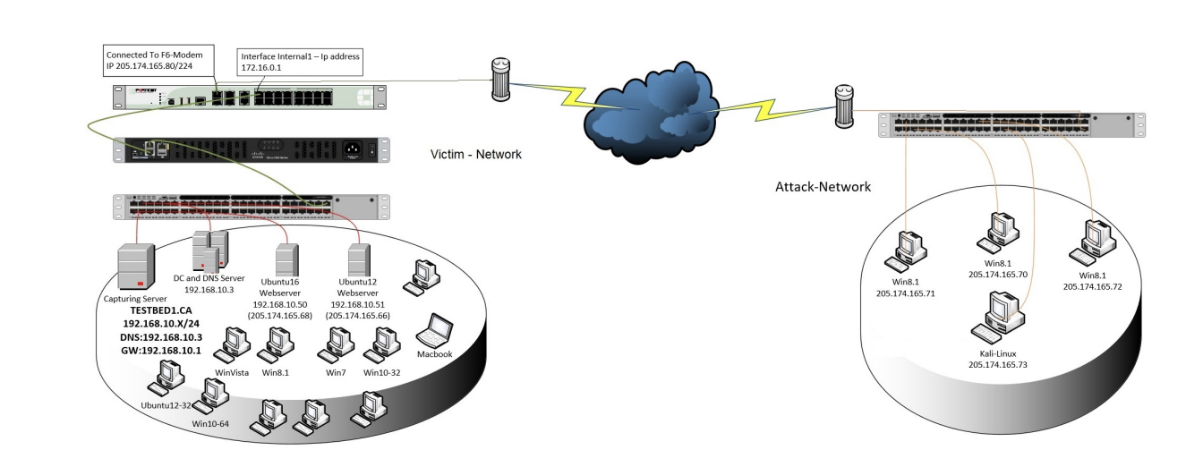
Fundamental Roadblocks
Networking problems necessitate endogenous data collection
Data Collection
Data
Preprocessing +
Model selection
Training
Evaluation
Deployment
Model
Standard ML Pipeline
For any given learning problem and target environment
how to collect the “right” data
Notes:
High-stake decision making needs to bring up

Slide 13
Data Collection Challenges
Bruteforce
Attack
Video
Fingerprinting
QoE
Inference
Learning Problems
HTTP
SSH
Fragmented
data collection
Effort 1
Effort 2
…
Effort N
Network environments
Overspecialized efforts with limited extensibility;
public datasets dictate choice of problems & models
Physical/virtual Network infrastructures
AWS
Netrics
UCSB
13

Slide 14
Fundamental Roadblocks
Outputs the most performant model, with little to no insights into model’s decision-making (black-box)
Black-box
Data
Preprocessing +
Model selection
Training
Evaluation
Deployment
Model
Standard ML Pipeline
How to assess if resulting models are generalizable, i.e., not underspecificied?

Slide 15
Underspecification Issues
Not enough information to determine the best model
Shortcut Learning
  Model takes shortcuts to classify data (cheating)
OOD Issues
  Model does not generalize to out-of-distribution samples (rot learning)
Spurious Correlations
  Model picks up wrong relations in the data (lucky guesses)

Slide 16
Example: HTTP Brute Force Attack Detection Problem
Learning shortcut
How to collect better data
at scale?
Is this model underspecified?
F1-score: 0.99
CIC-IDS
Preprocessing +
Model selection
Training
Evaluation
Is this the right data?
Standard ML Pipeline
Answering these questions critical for developing
production-ready ML artifacts for networking
Notes:
High-stake decision making needs to bring up

Slide 17

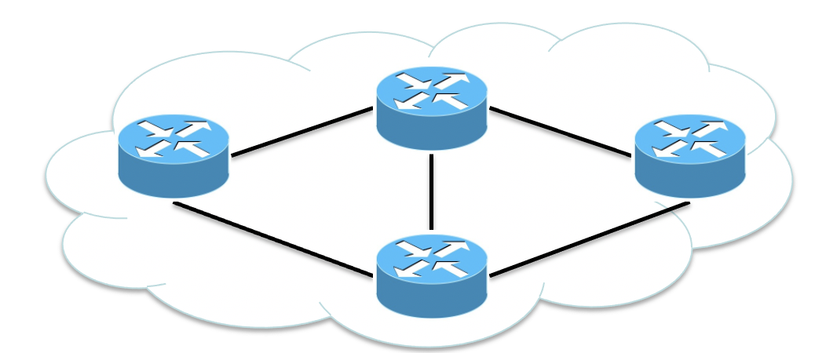
Our Approach: Closed-Loop ML Pipeline
Data-collection intents
Analysis results
Data Collection
Domain Expert
Explain
Analyze
“Some” Data
“Better” Data
Preprocessing +
Model selection
Training
Evaluation
Deployment
For any given learning problem and environment,
iteratively fix underspecification issues to collect “better” data

Slide 18

Building Blocks for Closed-loop ML Pipeline
Data-collection intents
Analysis results
netUnicorn
Domain Expert
Trustee
Data
Preprocessing +
Model selection
Training
Evaluation
Deployment
netUnicorn [CCS’23]
  Iteratively collect data for any problem and environment
Trustee [CCS’22]
  Explain and analyze ML model’s decision making
PINOT [HotNets’19, NSDI’22, VLDB’23, ANRW’23]
  Transform your production network for data collection
PINOT

Slide 19

Trustee Overview
A post-hoc global model explainability framework
Explanations
(decision trees)
Model-agnostic, high-fidelity, low-complexity, and stable explanations to model’s decision-making
Notes:
High-stake decision making needs to bring up

Slide 20
Trustee in Action: Detecting HTTP Bruteforce Attacks
Trustee’s
Decision Tree
Data: CIC-IDS-2017 Dataset
Model: Multi-layer perceptron (MLP)
F1-score: 0.99
Observations
All nodes sending benign traffic have the same TTL
Model learns a shortcut---underspecification issue
20

Slide 21
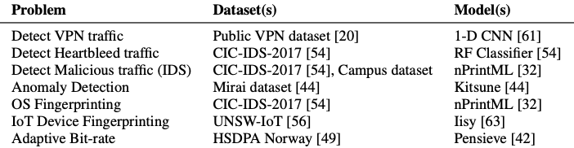
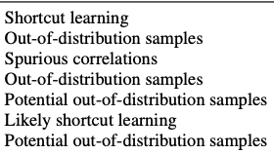
Trustee in Action
Underspecification
Issues
Demonstrated prevalence of underspecification issues in existing ML artifacts for network security

Slide 22
Trustee in Action
IETF/IRTF Applied Networking Research Prize, 2023
ACM CCS Best Paper Honorable Mention, 2022
Public Datasets
Attributed most underspecification issues to publicly available datasets

Slide 23
How to Fix Underspecification Issues?
Existing Approaches
  New data representations
  New model selection, training and evaluation algorithms
  New training dataset (using passive data augmentation)
Missed Opportunities
  Leverage newly-developed explainable ML techniques
  Ensure realism in collected training dataset
    exogenous vs. endogenous data generation

Slide 24
Our Approach: Closed-Loop ML Pipeline
Iteratively update
data-collection intents
Analysis results
Data Collection
Domain Expert
Trustee
Data
Preprocessing +
Model selection
Deployment
Training
Evaluation
Use insights from Trustee’s explanations to iteratively collect “better” data

Slide 25
Recall: Even One-Time Data Collection is Hard
Bruteforce
Attack
Video
Fingerprinting
QoE
Inference
Learning Problems
HTTP
SSH
Fragmented
data collection
Effort 1
Effort 2
…
Effort N
Network environments
Physical/virtual Network infrastructures
AWS
Netrics
UCSB
25

Slide 26
How to Simplify Data Collection?
Learning Problems
Thin Waist
Network environments
Physical/virtual Network infrastructures
26

Slide 27
Our Approach---Disaggregation
Disaggregate Intents from Mechanisms
  Let users express what and from where to collect data without worrying about “how”
Disaggregate Intents
  Decomposes intents into independent, reusable pipelines and tasks
    (simplifies extensions to different learning problems)
  Decouples data-collection pipelines from network nodes
    (simplifies extensions to disparate network environments)
Disaggregate Mechanisms
  Decompose deployment and execution tasks into modular microservices
27

Slide 28



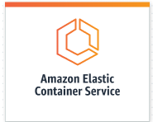
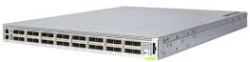

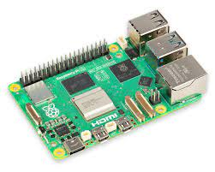
netUnicorn---A Data Collection Platform
netUnicorn
Programmable User Interface
Intents
Core Services
Mechanisms
Mediation Service
Deployment Services
Execution Services
Processor
Gateway
Datastore
Instructions
Results
Deployment Systems
Instructions
Nodes
28
Notes:
Experimenter: express data-collection intents
Developers: translate intents to mechanisms

Slide 29
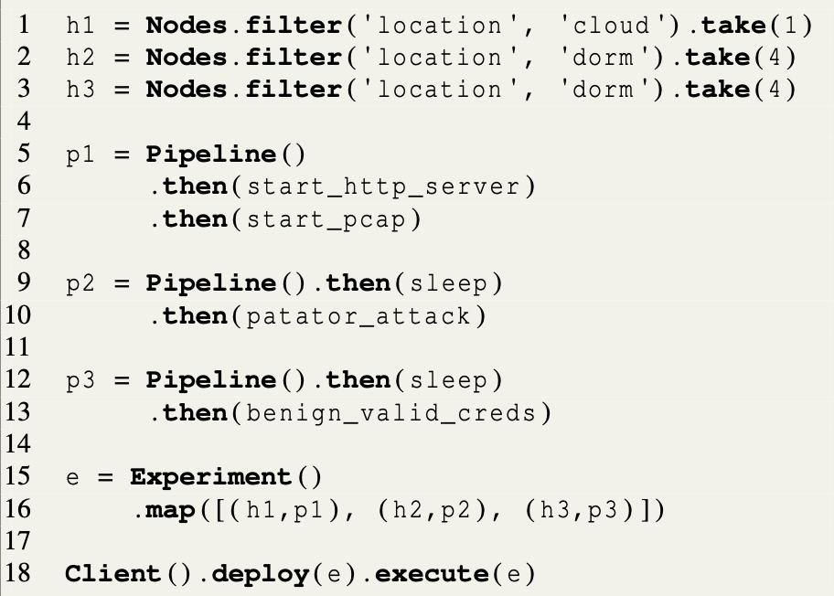
Expressing Data Collection Intent
HTTP Bruteforce Detection Problem
Selects three abstract node types from two different infrastructures
Specify different data-collection pipelines, each composed of one or more tasks
For any given learning problem and environment,
netUnicorn simplifies expressing data-collection intents
Map pipelines to nodes to express the data collection experiment

Slide 30
Data Collection
Before
After
Learning Problems
Data Collection
netUnicorn
Network environments
For any given learning problem and environment,
netUnicorn simplifies expressing data-collection intents
Physical/virtual network infrastructures
30

Slide 31
Closed-loop ML Pipeline
Data-collection intents
Analysis results
netUnicorn
Domain Expert
Trustee
Data
Preprocessing +
Model selection
Training
Evaluation
Deployment
netUnicorn + Trustee help realize closed-loop ML pipeline

Slide 32
Closed-loop ML Pipeline
Data-collection intents
Analysis results
netUnicorn
Domain Expert
Trustee
Data
Preprocessing +
Model selection
Training
Evaluation
Deployment
Does it really help iteratively collect “better” data
for any given learning problem and target environment?

Slide 33
Iterative Data Collection---Iteration 0
  Collect data from local infrastructure (campus) to train ML model for target settings (cloud)
 | Campus (validation) | Cloud (test)
Multi-layer Perceptron | 1.00
Grad. Boosting Machines | 1.00
Random Forest | 1.00
TabNet | 1.00
  Followed CIC-IDS
  data-collection methodology
  (80 lines of code)

Slide 34
Iterative Data Collection---Iteration 0
  Collect data from local infrastructure (campus) to train ML model for target settings (cloud)
 | Campus (validation) | Cloud (test)
Multi-layer Perceptron | 1.00 | 0.56
Grad. Boosting Machines | 1.00 | 0.61
Random Forest | 1.00 | 0.58
TabNet | 1.00 | 0.66
All models use same shortcut as in the CIC-IDS dataset

Slide 35
Iterative Data Collection---Iteration 1
  Refined intent to use more diverse set of malicious/benign nodes (+10 lines of code)
 | Campus (validation) | Cloud (test)
Multi-layer Perceptron | 0.97
Grad. Boosting Machines | 1.00
Random Forest | 1.00
TabNet | 0.97

Slide 36
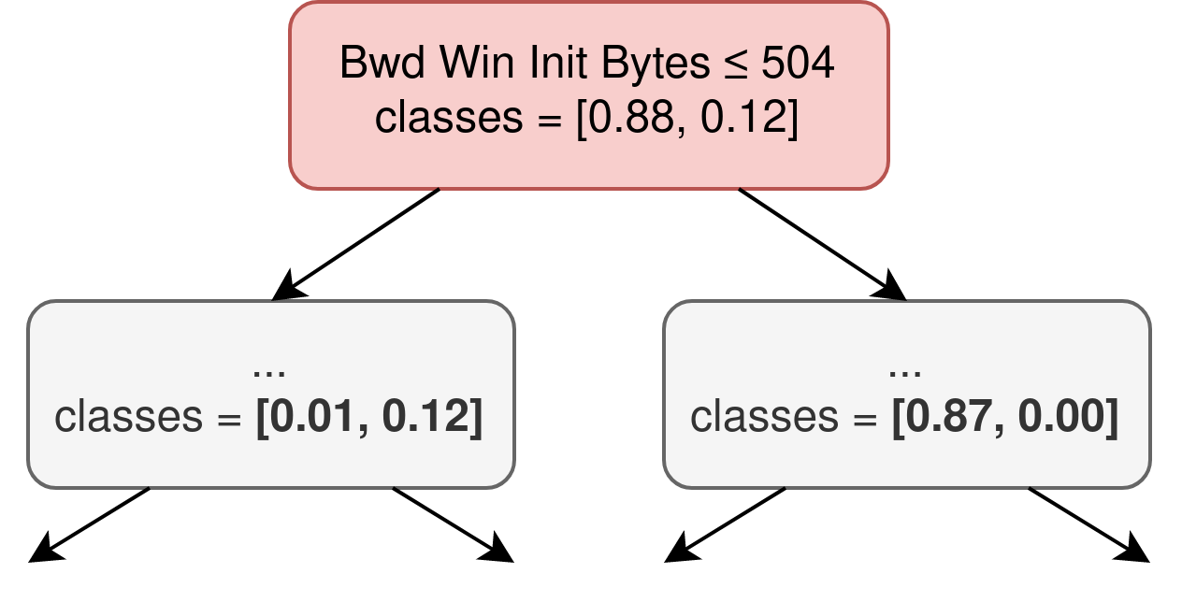
Iterative Data Collection---Iteration 1
  Refined intent to use more diverse set of malicious/benign nodes (+10 lines of code)
 | Campus (validation) | Cloud (test)
Multi-layer Perceptron | 0.97 | 0.62
Grad. Boosting Machines | 1.00 | 0.61
Random Forest | 1.00 | 0.69
TabNet | 0.97 | 0.78
Models learn a new shortcut

Slide 37
Iterative Data Collection---Iteration 2
  Refined intent to use separate TCP connection for each attempt (+20 lines of code)
 | Campus (validation) | Cloud (test)
Multi-layer Perceptron | 0.88
Grad. Boosting Machines | 0.92
Random Forest | 0.97
TabNet | 0.92

Slide 38
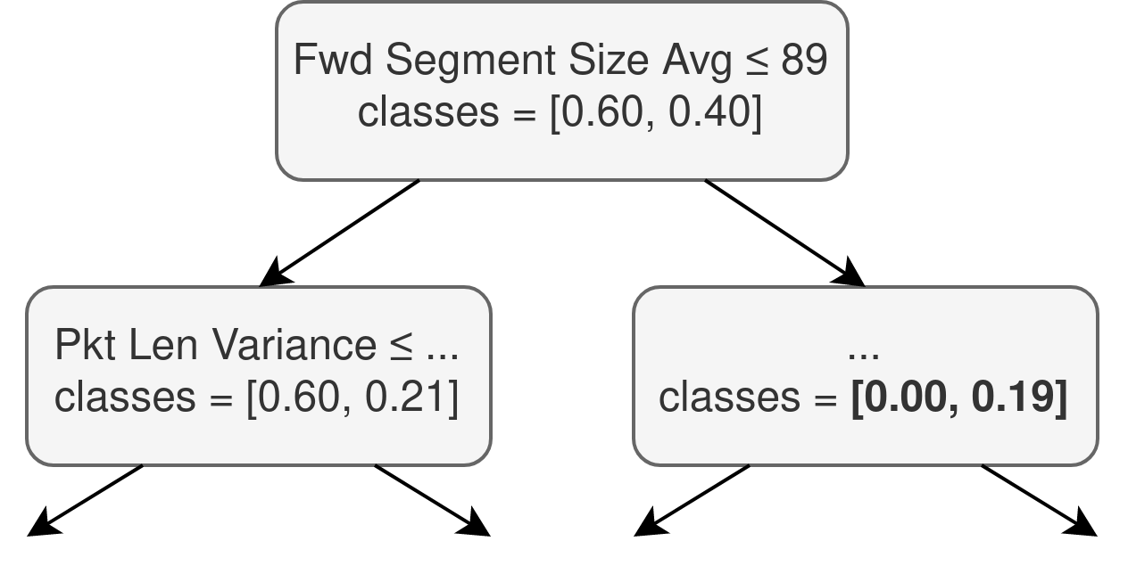
Iterative Data Collection---Iteration 2
  Refined intent to use separate TCP connection for each attempt (+20 lines of code)
 | Campus (validation) | Cloud (test)
Multi-layer Perceptron | 0.88 | 0.94
Grad. Boosting Machines | 0.92 | 0.92
Random Forest | 0.97 | 0.93
TabNet | 0.92 | 0.95
No obvious shortcut → likely to generalize

Slide 39
Closed-loop ML Pipeline
Data-collection intents
Analysis results
netUnicorn
Domain Expert
Trustee
Data
Preprocessing +
Model selection
Training
Evaluation
Deployment
Address underspecification issues with “better data” to
develop generalizable ML models

Slide 40
Self-Driving Networks
…
Production-ready ML Model(s)
Generalizable, robust, trustworthy, ...
Monitor
Control
Generalizable models are better prepared for production deployments,
critical for self-driving networks

Slide 41
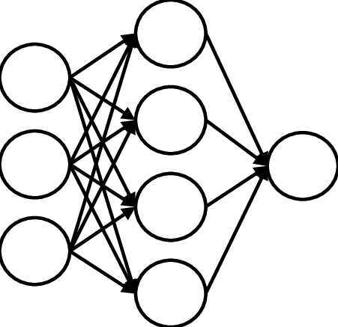
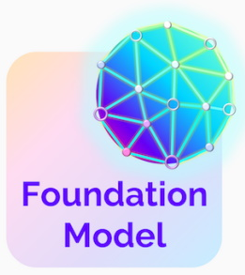
The Next Frontier: Network Foundation Model
Task Specific
supervised learning
Labelled
Network Data
Fine-Tuning
Task Agnostic
self-supervised learning
. . .
Unlabeled
Telemetry Data
Pre-Training
Labelled
Network Data
Fine-Tuning
Ability to leverage abundant telemetry data,
catalyze development of production-ready ML for networks
Abundant!
Thanks to SDN-powered telemetry infrastructure
Can be sparse and noisy!
Almost always the case, even with closed-loop ML pipeline

Slide 42
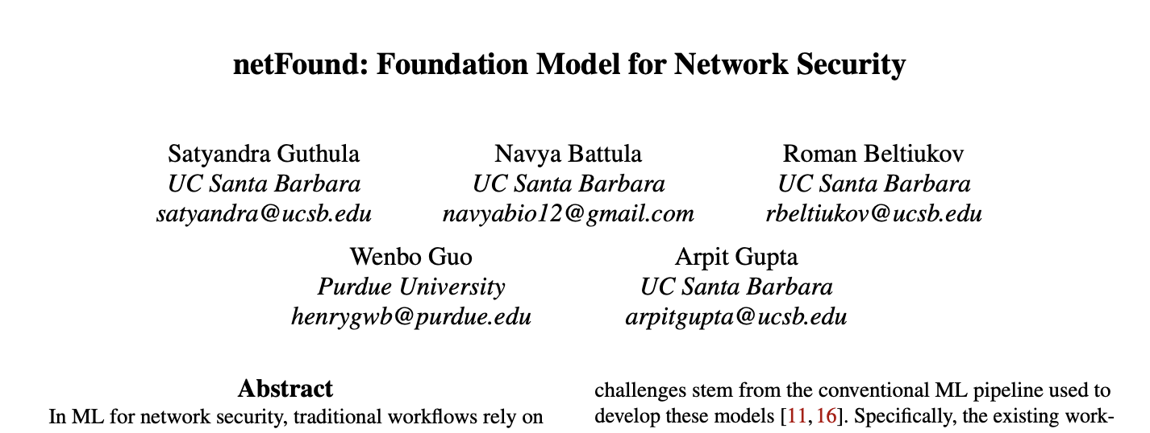



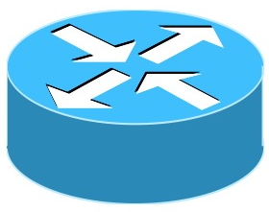


Foundation Models are Promising…but Challenging!
System
Calls
MIBs
Packet
Traces
IDS
Alerts
App.
Logs
Demonstrates the potential of foundation model for cybersecurity
2M+ flows, 200M+ params
Notes:
one day --> 108 TB

Slide 43
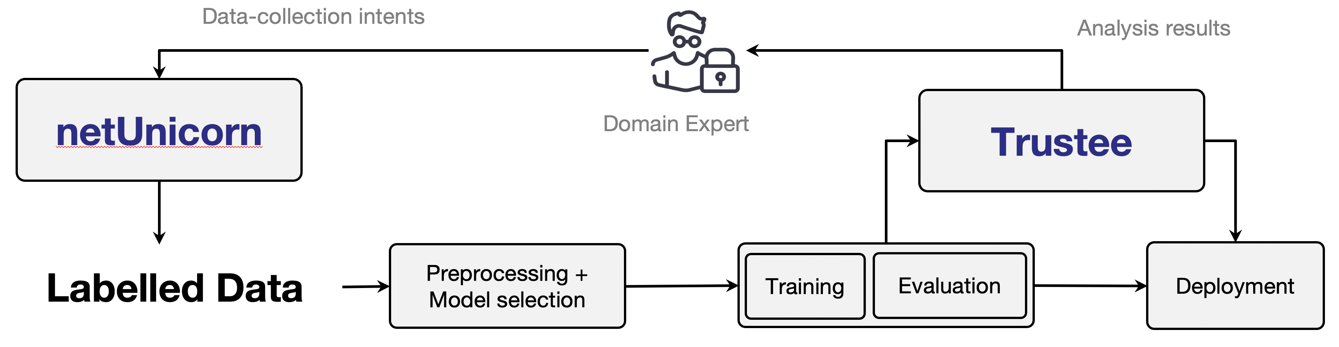
Peering into the Future
Goal
Offer trillion+ parameters network foundation model as a service
Local fine-tuning
Cloud/Content Service Providers
(AWS, Google, ESnet, etc.)
Internet Service Providers
(AWS, Google, MS, etc.)
Small-medium Enterprises
(UCSB, GT, Princeton, etc.)
Notes:
one day --> 108 TB

Slide 44



Peering into the Future
Goal
Offer trillion+ parameters network foundation model as a service
Fundamental Research Questions
Embed multi-modal multi-dimensional telemetry data from hosts & network devices
Explain decision-making for both pre-trained and fine-tuned models
Determine how much and what data to use
Scale pre-training to trillions of params
Leading the multi-year effort at DoE to develop
production-ready network foundation model for ESnet
Cloud/Content Service Providers
(AWS, Google, ESnet, etc.)
Internet Service Providers
(AWS, Google, MS, etc.)
Small-medium Enterprises
(UCSB, GT, Princeton, etc.)
Notes:
one day --> 108 TB

Slide 45
Self-Driving Networks
…
Production-ready ML Model(s)
Generalizable, robust, trustworthy, ...
Monitor
Control
Closed-loop ML pipeline + network foundation model accelerate production-ready ML---critical for self-driving networks

Slide 46
Summary
Goal
  Develop networks that can run themselves---Self-driving Networks
Closed-loop ML for production-ready models for networking
    Trustee https://trusteeml.github.io
    A model explanaibility framework: Explain and analyze model’s decision-making
    IRTF Applied Networking Research Prize (2023) , Best paper (HM) ACM CCS’22
    netUnicorn https://netunicorn.cs.ucsb.edu
    A data-collection platform: Explain and analyze ML model’s decision making
    PINOT https://pinot.cs.ucsb.edu
    Programmable data-collection: Enable transforming production networks for data collection
The Next Frontier

