Slide 1
Benjamin Smarr, UC San Diego Namespace TemPredict
Machine Learning on Secure Human Time Series
COI: Dr. Smarr receives compensation from Oura Ring as a Scientific Advisor

Slide 2
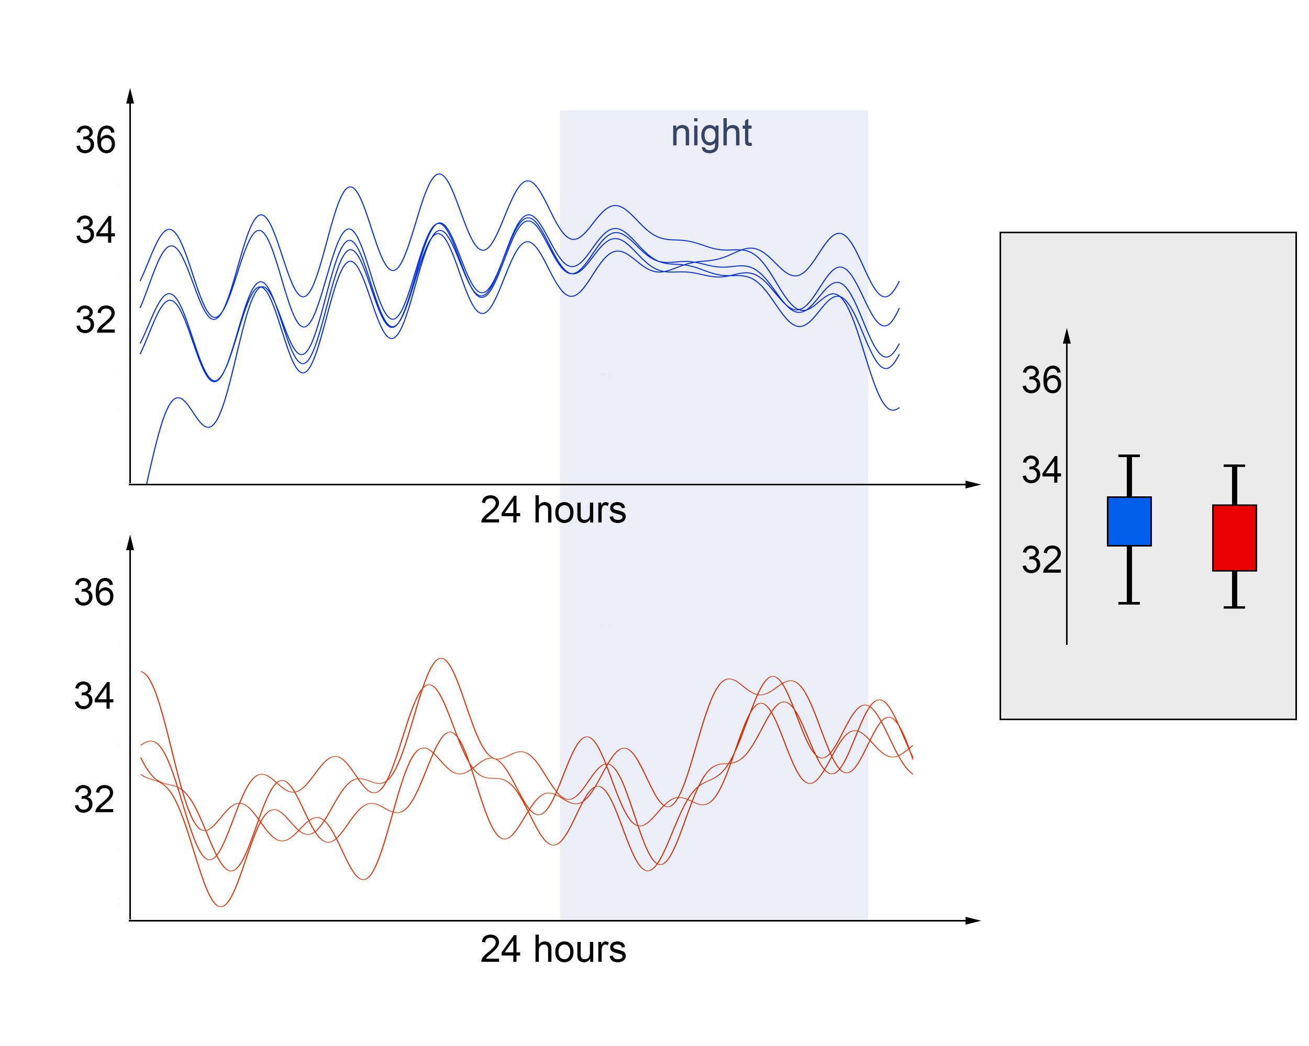
People generate more data than hospitals. That’s a big deal.
We know distributions do not reflect
the patterns of change.
We knew this from wearables with temperature 10 years+ ago.
If we can train ML/AI on pattern features, they can be (much) more precise!
Smarr and Burnett et al, IEEE Trans Aff Comp, 2016

Slide 3
Acute illness detection
COVID-19
Daily rhythms
Recovery monitoring
Time from DX (days)
Accurate detection
Physiology changes over time
Some change is expected;
Some is acute illness.
What is “normal” or “baseline”?
Time from DX (days)
Mason et al, Scientific Reports, 2022

Slide 4
Digital twinning in complex physiological space and time
Cyclic
Acyclic
People are similar based on patterns, not just averages
We are defining “physiological diversity”
Bruce et al, Biology of Sex Differences, 2023

Slide 5
Digital twinning in complex physiological space and time
Systematic classification of individuals based on patterns
Identify cyclic women
Remove false positives from ovulation
Systematic debiasing to promote equity in precision
Bruce et al, Biology of Sex Differences, 2023

Slide 6
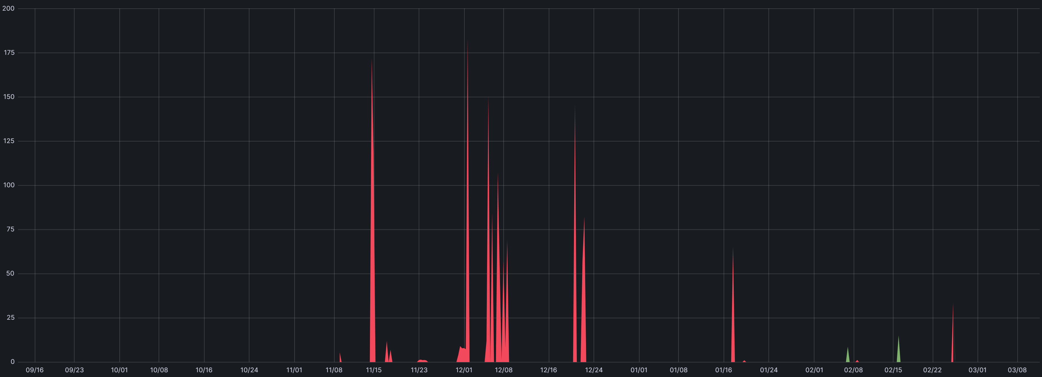
Benjamin Smarr, UC San Diego GPU/CPU Usage Per Day, Last 6 Months
NRP
GPUs
Peaking at 2 GPUs
190 GPU-hrs
NRP
CPUs
Peaking at 183 CPU-Cores
178,000 CPU Core-hrs,
Namespaces tempredict, ucsd-hdsi-collab

Slide 7
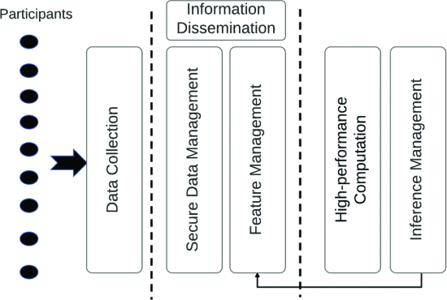
AI/ML Analysis of Human Generated Data using NRP
Donated server ($8K well spent!)
Supervised approaches:
forests
autoencoders
Long short-term memory (LSTM) NNs
Unsupervised exploration
signal processing
high-dimensional graphs
Dimension reduction
Iterate to discover and pursue hypotheses
Purawat et al, IEEE Big Data, 2021

Slide 8
Architecture Solutions for health in NRP
Full IRB / security compliance for health data is a major challenge!
Live, daily alerts to 2,500 clinicians during 2021 COVID surge
Segregating identity ➔ largescale NRP processing while supporting clinical interventions
Purawat et al, IEEE Big Data, 2021

Slide 9
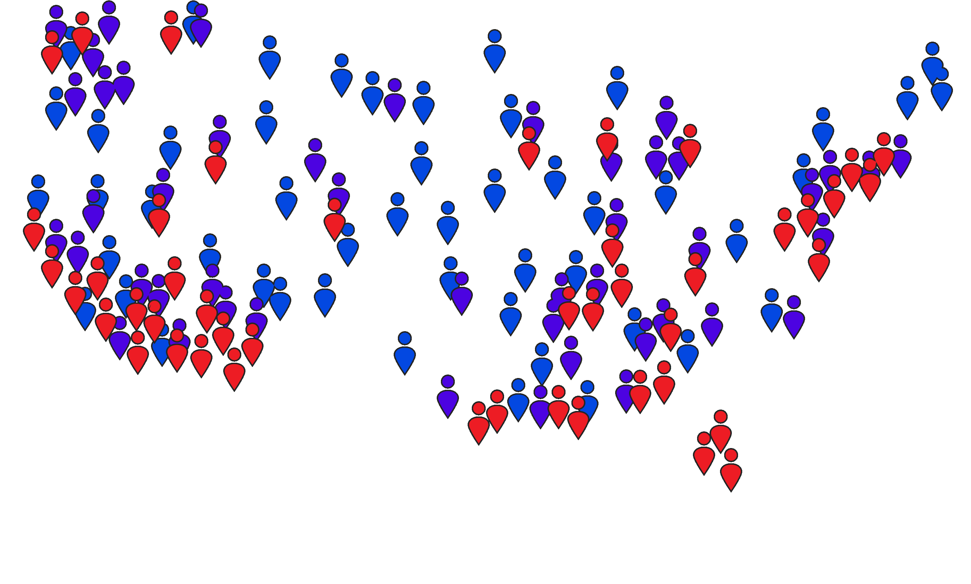
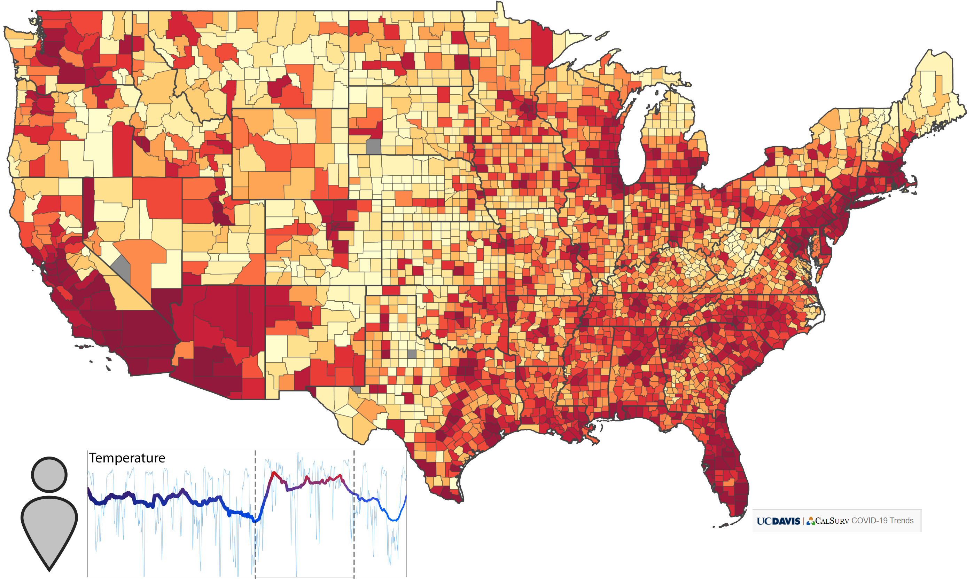
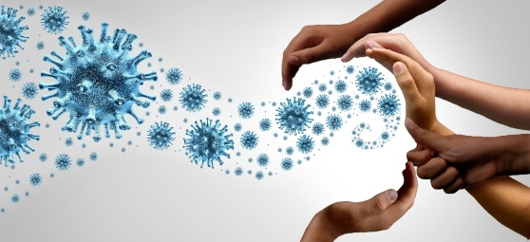
Bringing data insights broadly, equitably, safely, quickly
PREPARE Institute
Challenges:
Find info sources
More diversity
Be un-creepy
“Weather radar”
Support actions

Slide 10
Thank you!
Sandeep Chandra, Anthony Boyd, Danielle Whitehair
Ilkay Altintas, Amarnath Gupta, Subhasis Dasgupta, Shweta Purawat,
Tom Defanti, Larry Smarr, Rajesh Gupta

